Slide 1
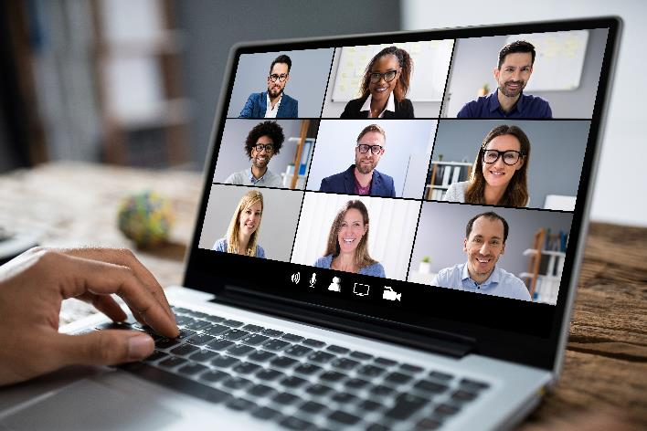
POLY Workshops
Beth Elacqua: Workshop Chair
Committee: Gobet Advincula, Mike Hickner, Helen Tran, Jena McCollum, Rakesh Nambiar, and Yongping Zha

Slide 2


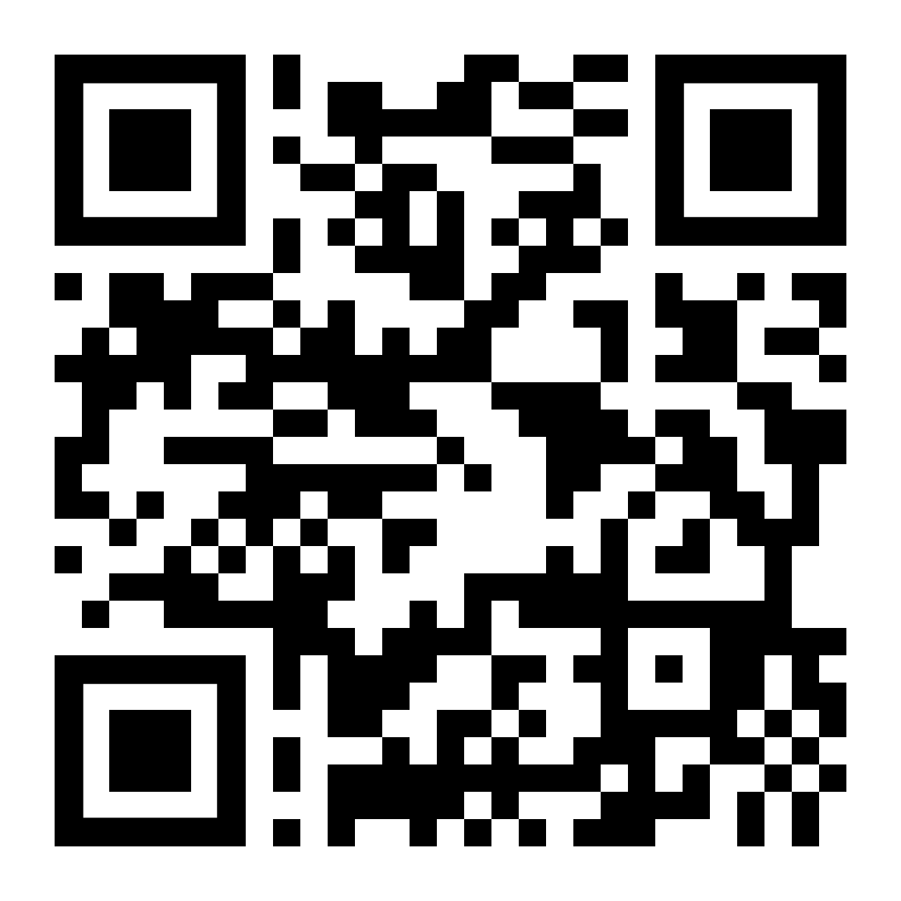
2024 POLY Workshops
99 Total Attendees 40 Speakers 25 Posters 8 Sponsors | Budget Overview: $101,534 Income $78,881.32 Expenses (including 20k Admin Fee) $22,653.28 Meeting Gains Donated to POLY
Fire & Polymers
May 12-15, 2024 - New Orleans LA
Jaime Grunlan
Texas A&M University
Alexander Morgan
Univ. of Dayton Research Institute
REGISTRATION/LODGING
DEADLINE:
AUGUST 28th
Organizers:
Dr. Jerzy Klosin
The Dow Chemical Company​
Prof. Rick Register
Princeton University
Prof. Kim Ragaert
Maastricht University
Prof. Kenneth B. Wagener
University of Florida
Prof. João B. P. Soares
University of Alberta

Slide 3

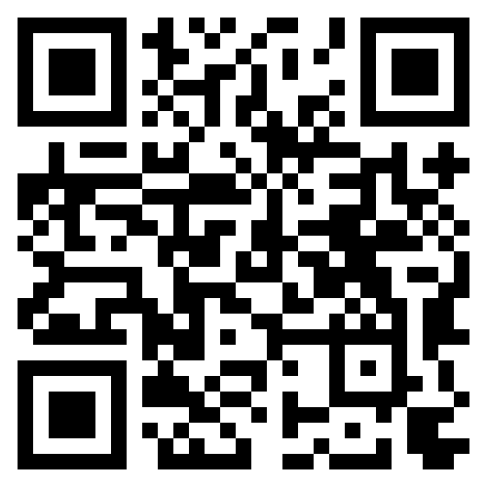


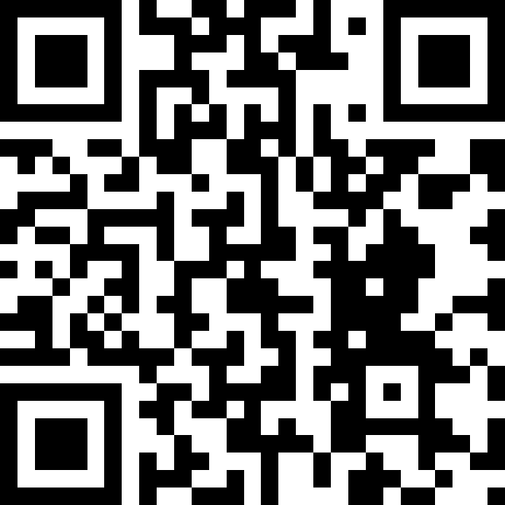

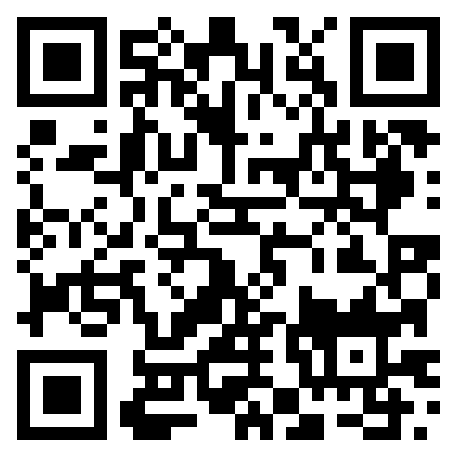
2025 POLY Workshops
ASU Organizers:
S. Eileen Seo
Timothy E. Long
March 18-21, 2025
Organizers:
Prof. Jena McCollum
University of Colorado
Dr. Bruno Ameduri
National Center for Scientific Research
Dr. Cameron Parish
The Chemours Company
Prof. Frank Leibfarth
University of North Carolina, Chapel Hill
Organizers:
Brian C. Benicewicz, Ph.D.
University of South Carolina
Michael Hickner, Ph.D.
Michigan State University
Tom Zawodzinski, Ph.D.
University of Tennessee, Knoxville
Safety Harbor, FL – November 2-5, 2026

Slide 4

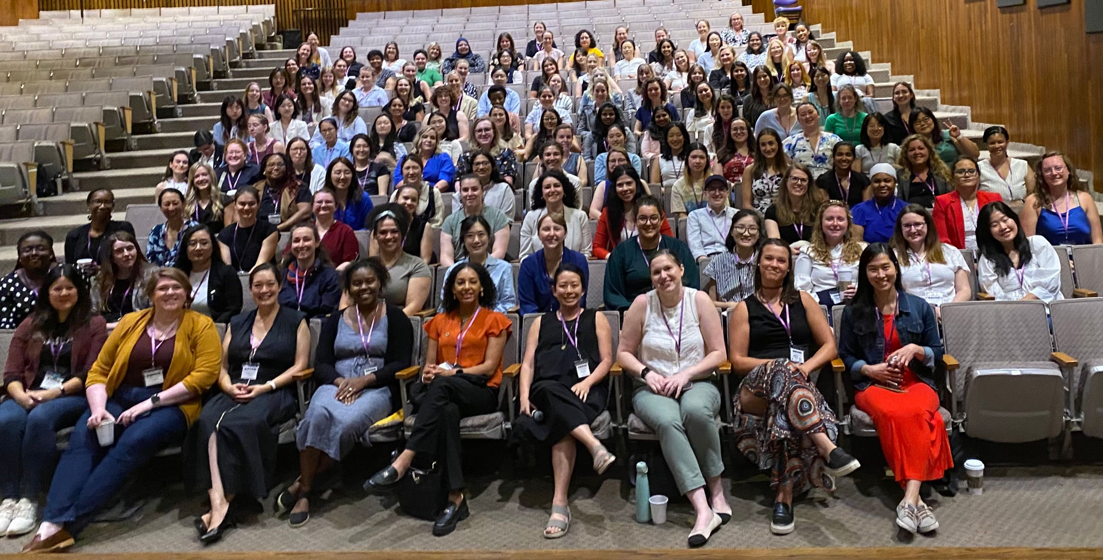
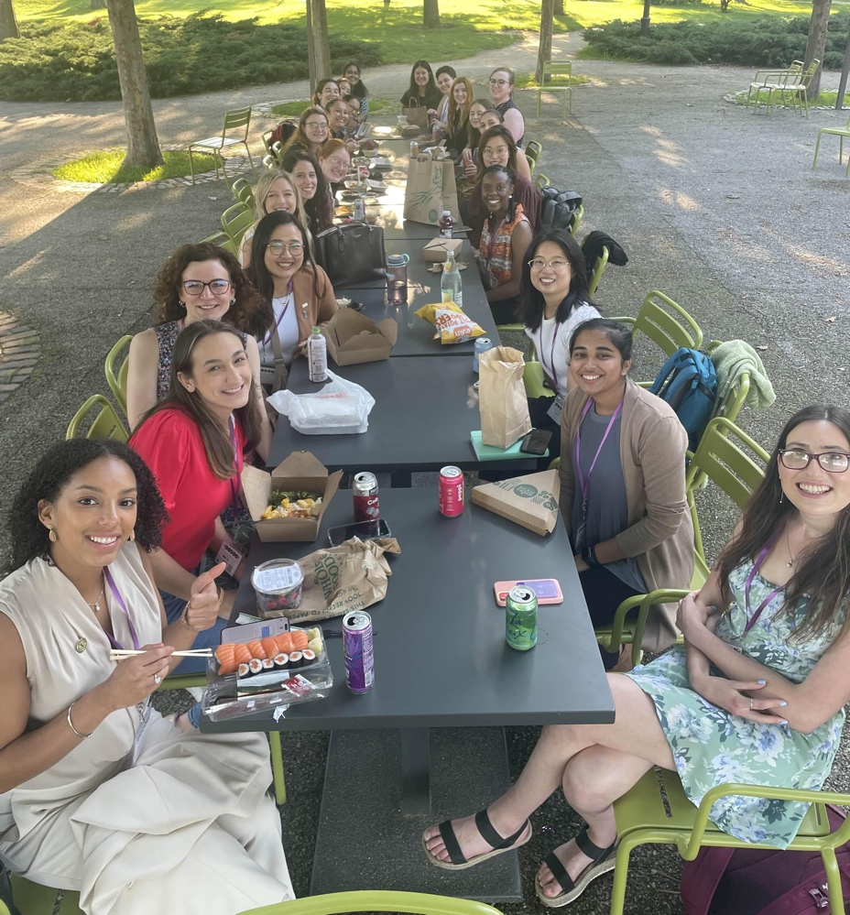
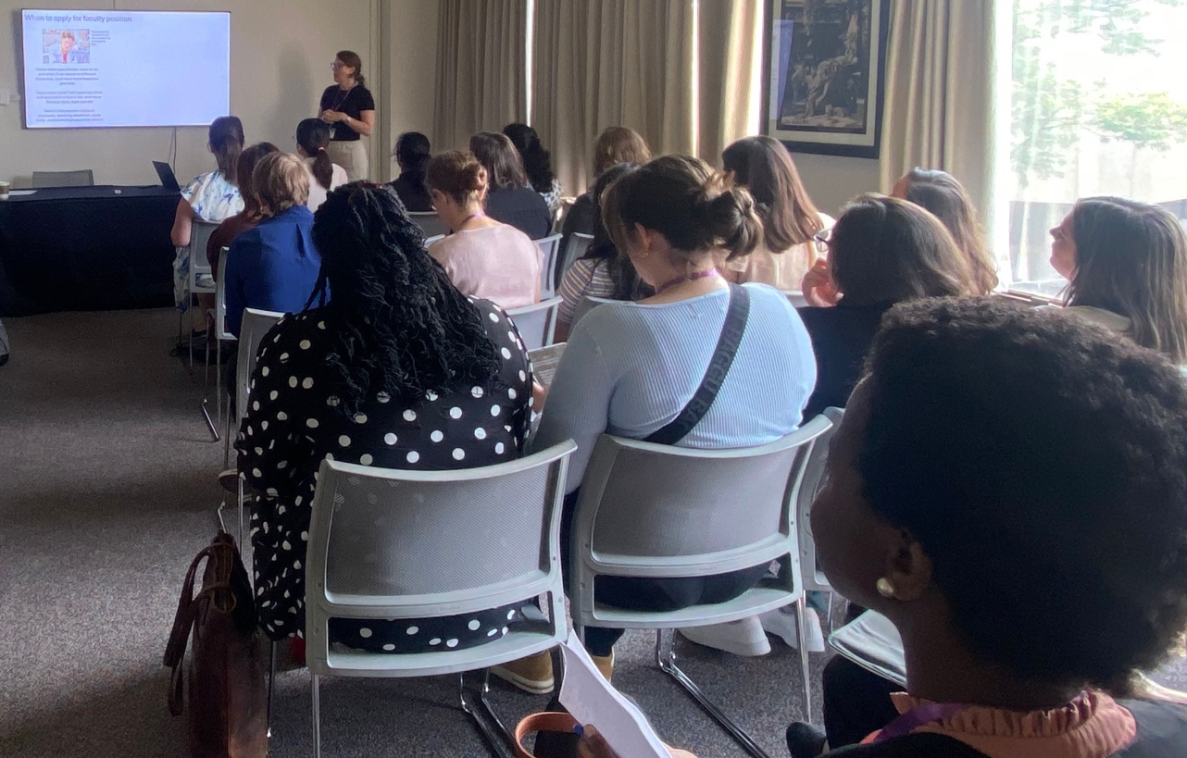
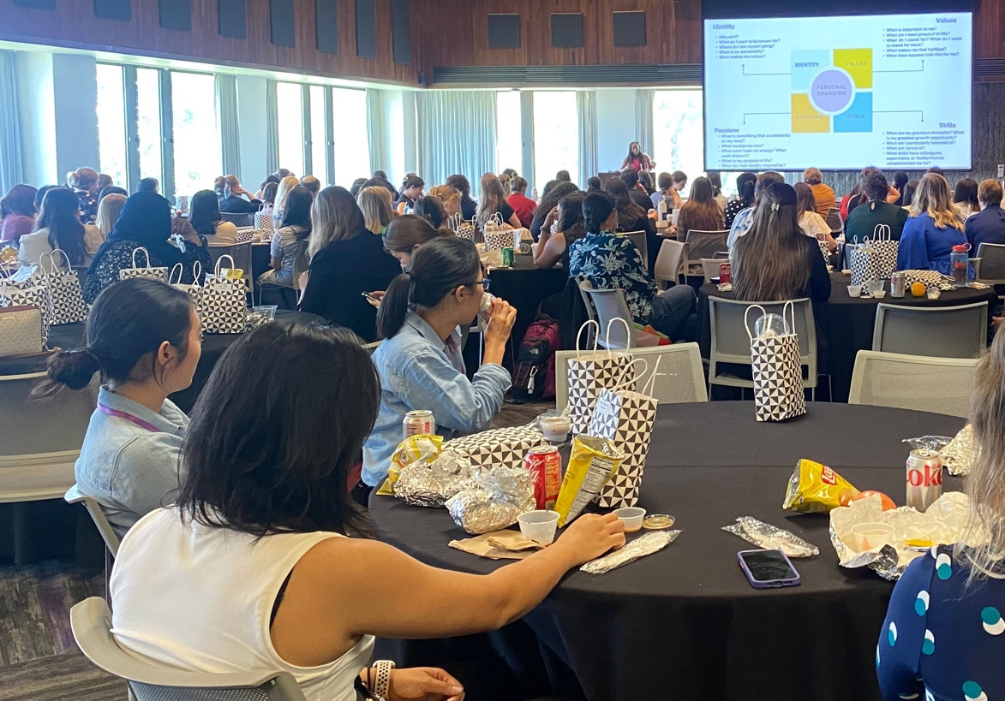








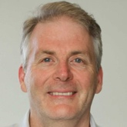
Building Community and Outreach
Organizers: Prof. Julia Kalow, Dr. Jill Alty, Prof. Helen Tran, Prof. Symone Alexander, Dr. Sara Orski, and Dr. Katie Houston
>80 contributed posters
58 institutions across the US and Canada
>180 attendees, organizers, speakers
Technical sessions from academics, government leaders, industry leaders
$44k in sponsor support and $8k in registration income
Gold Sponsors ($5k+)
Silver Sponsors ($2k)
Lunch and Learn:
B.R.A.G. Different with Dr. Jeanita Pritchett Clay
Career Panel, Time Management, and When to Take the Leap Workshops
Themed Networking Dinners
Notes:
Recap (from Kathy): Julia and her team led an effort to apply for an ACS IPG Grant to run a "Women in Polymers (POWERS)" meeting, to be held at Northwestern University. ACS awarded the IPG support, and the meeting was held in July 2024 (grant funds came in 2023). Julia/Team requested POLY Admin support (collecting registrations/sponsors, advertising, and fund distribution). ExComm approved with some regulations. This isn't quite a workshop, but it does fall under a POLY meeting (similar to the Graduate meeting). As such, it's reportable under "Workshops" at the board meeting
Looking Ahead: Julia has expressed a possible interest in holding a future POWERS meeting.

