Slide 1

POLY Workshops
Beth Elacqua: Workshop Chair
Committee: Gobet Advincula, Mike Hickner, Helen Tran, Jena McCollum, Rakesh Nambiar, and Yongping Zha

Slide 2
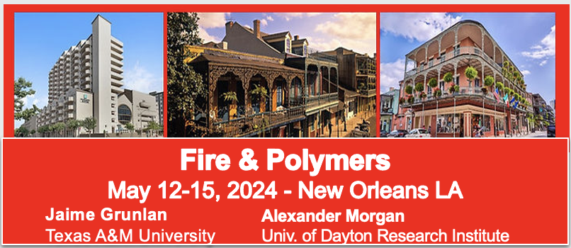
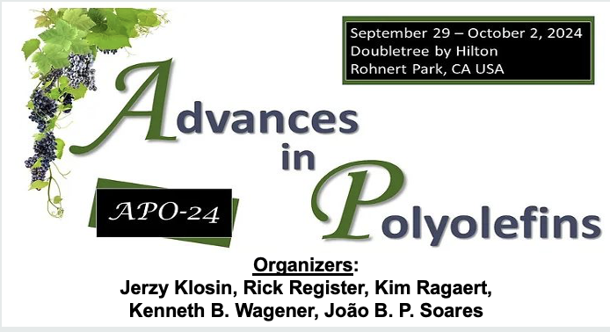

2024 POLY Workshops
99 Attendees 40 Speakers 25 Posters 8 Sponsors | Budget Overview: $101,534 Income $78,881.32 Expenses (including 20k Admin Fee) $22,653.28 Meeting Gains Donated to POLY
106 Attendees 30 Speakers 21 Posters 19 Sponsors | Budget Overview: $137,216 Income $133,921.77 Expenses (including 20k Admin Fee) $3,294 Meeting Gains Donated to POLY
Notes:
Kathy, do we have the info for POWER here? Maybe it is not needed but it was in last spring’s set of workshops to be held soon.

Slide 3

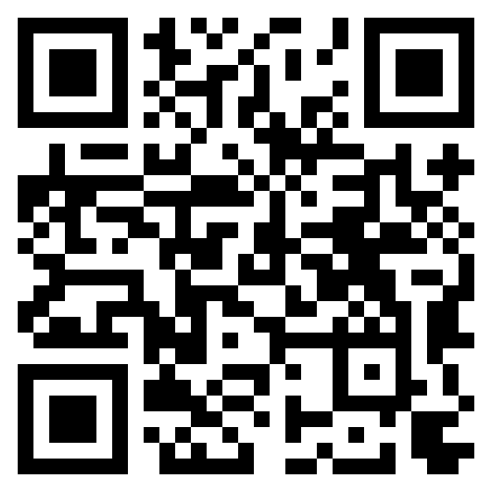

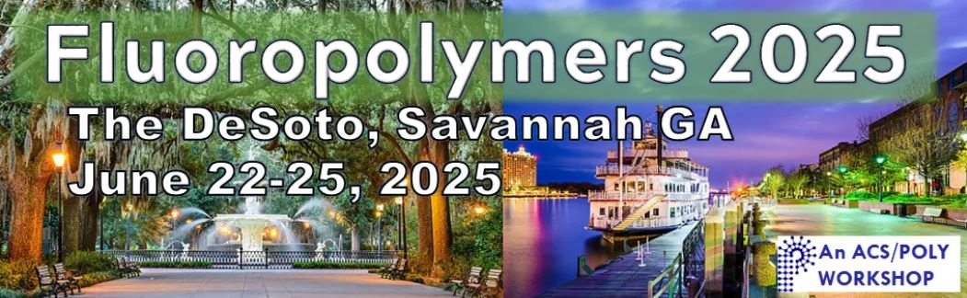
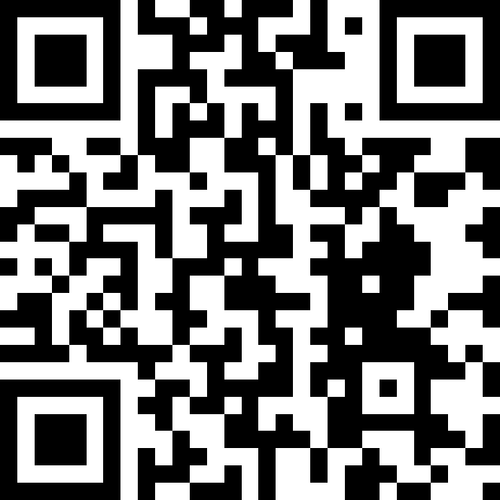
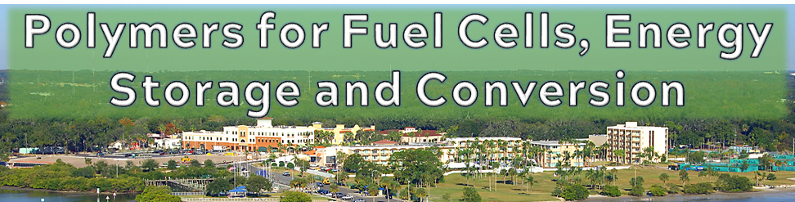
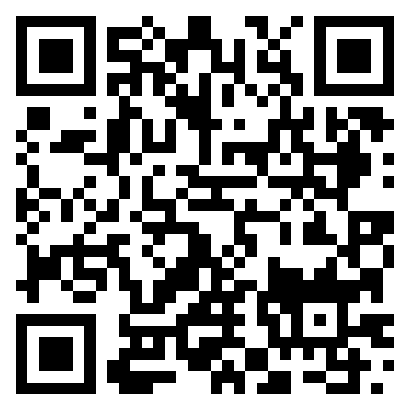
2025 POLY Workshops
ASU Organizers:
S. Eileen Seo
Timothy E. Long
March 18-21, 2025
Organizers:
Jena McCollum
Bruno Ameduri
Cameron Parish
Frank Leibfarth
Organizers:
Brian C. Benicewicz
Michael Hickner
Tom Zawodzinski
Safety Harbor, FL – November 2-5, 2026
Notes:
Kathy: are there updates on this?

Slide 4


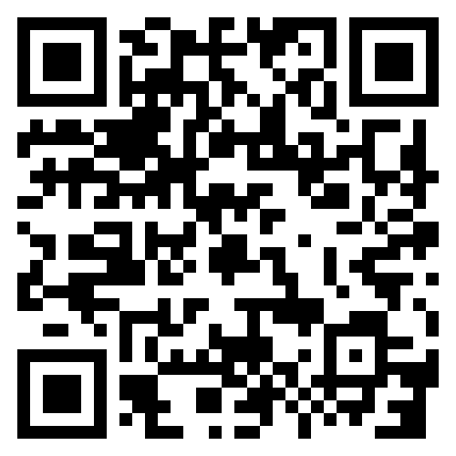


2026 POLY Workshops
Organizers:
Jaime Grunlan
Alex Morgan
Organizing Team:
Brett Helms
LaShanda Korley
Megan Robertson
Katrina Knauer
Web Coming Soon
polyacs.org/ poly-workshops/
POLY holds . . .
2 Topical Workshops Annually scheduled SPRING (May/June) and FALL (Oct/Nov)
Plus ONE Graduate Student Focused Meeting Odd-Years

Slide 5
FOR EXCOMM MEETING
Hayley to Present

Slide 6
2027 POLY Workshops
Advances in Polyolefins (APO) Organizers: Klosin, Wagener, Register, Soares, and Ragaert June 6-9, 2027, Napa Valley | Conditional Approval from ExComm
National Graduate Research Polymer Conference (NGRPC) University of Florida Organizers: Ariana Tamura, Austin Evans, and Brent Sumerlin | Proposal Ready for ExComm Review/Approval
Controlled Radical Polymerization (CRP) Organizers: Sumerlin/Matyjaszewski | Anticipated 4 Year Return Proposal Anticipated
2 Workshops Annually
SPRING (May/June) or FALL (Oct/Nov) to avoid other meeting/workload
Planned solicitation for open workshop spot in time for discussion at Winter 2026 ExComm meeting
Notes:
NGRPC: Beth and Kathy separately pinged past competitive applications from Florida and Georgia; only Florida returned an application although both were interested. Beth separately pinged younger PIs in academia and solicited applications; got interest from junior faculty at Minnesota but they were trying to get the organic grad conference there for 2027.
Beth: us getting only one is my fault for the late solicitation, HOWEVER, I do think this is one way to get younger polymer folks involved
Remaining 2027 workshop: Beth to chat with Brent in early Fall and suggest CRP to submit another application if they are interested, while stressing the need to come through on sponsor support and make sure the workshop can be more successful than the past iteration.

Slide 7
Thank you for your support and advice moving forward!

Slide 8
FOR WORKSHOP COMMITTEE
Workshops For Further Consideration
Silicon-Containing Polymers and Composites (December 1-4, 2021)
(Had a loss in 2021, but 2021 was rough Covid timing.)
Org: Furgal & Hartmann-Thompson, 2025 would be 3 Yr Rotation
They sent in a proposal last year, Workshop Comm. approved it, and Ex-Comm asked for a reduction due to staff shortage. Joe is waiting for a reply as to “when” there’s an opening.
Polymers for Fuel Cells, Energy Storage, and Conversion (May 15 – 18, 2022)
  Brian Benicewicz (Univ. SC), Tom Zawodzinski (UTK), Mike Hickner (Penn St.)
  I think Brian Retired. He was the key organizer.
Polymers in Medicine and Biology (November 28 – December 1,2022)
  Theresa Reineke (UMN), Buddy Ratner (Univ. Washington) - NEED NEW ORGANIZER!!
Sustainable Polymer (October 15 – 18, 2023) PROJECTED REPEAT 2026
Merged with Polymer Upcycling and Circularity
  M. Hillmyer, T. Epps, M. Robertson
  May merge with Upcycling – I think 2026
Controlled Radical Polymerization (November 12–15, 2023) – PROJECTED REPEAT 2027
  B. Sumerlin, K. Matyjaszewski, N. Tsarevsky, H. Gao

