Slide 1

External Meeting Support - Regional and Other
Regional Meeting – Mark Dadmun
Other Meeting Support – Current Chair
Annual Budget
Regional = $2,000 Other - $1,500
2020
Regional Meetings
All meetings Canceled*
Other Meeting
$ 1,000 Polymer GRC (Scheduled 6/6/21)
2021
Regional Meetings
$500 Rocky Mountain Regional meeting
$1,000 POLY Graduate Meeting - VT (Virtual)
Other Meeting Support
TBD
2022
Regional Meetings - Anticipated
NERM (Paid in 2019)
Other Meeting Support
TBD

Slide 2
External Meeting Support
- Regional
Summary
Regional Meetings
by Mark Dadmun
$500 NERM 2020 (Paid in 2019) - Focusing on Future of Chemistry
NERM - paid and will cover support for rescheduled 2022 NERM
CERM 2020 – meeting cancelled
NORM 2020 – meeting cancelled
Planned
Regional Meetings
by Mark Dadmun
Requests
$500 2021 Rocky Mountain Regional Meeting

Slide 3
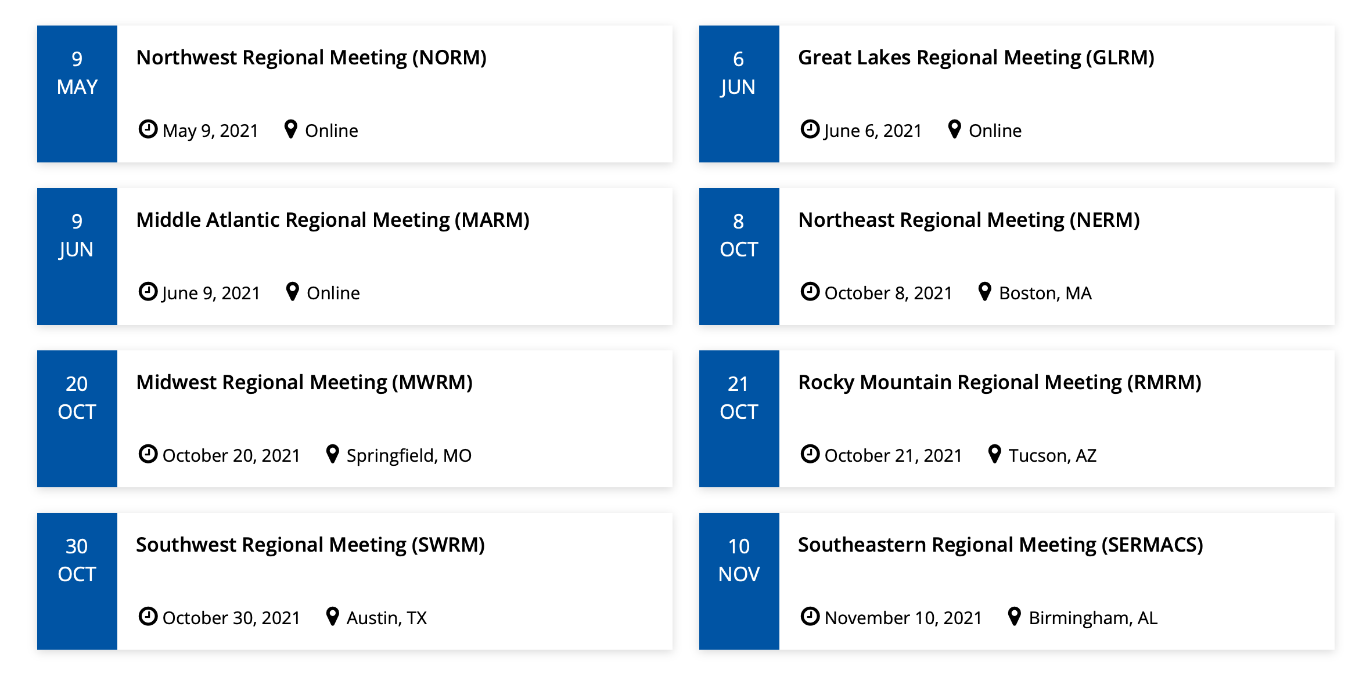
External Meeting Support - Regional
2021 Regional Meetings

Slide 4
External Meeting Support - Regional
Committee Activity
Regional Meetings Committee
    Brittany deRonde (ProAmpac)
    Kenny Mineart (Bucknell)
    Dawanne Poree (ARO)
    Piril Ertem (Surmodics)
  Charge: For POLY to develop a more pro-active approach to interacting with the regional ACS meetings to expand benefits for our members and continue to improve our outreach beyond the national meetings.

Slide 5
External Meeting Support - Regional
Committee Activity
Regional Meetings Committee
    Met twice by Zoom (May 12 & May 24)
  Define target audience of activities those POLY members who are more likely to attend Regional meetings rather than the National meeting
  Our best estimate is that the following communities fit this profile:
    Industrial scientists at small to mid-size companies
    Students and early career scientists
    Faculty at primarily undergraduate institutions.

Slide 6
External Meeting Support - Regional
Committee Activity
Regional Meetings Committee
    Met twice by Zoom (May 12 & May 24)
  In the process of arranging Zoom calls with current and future Regional meeting chairs. The goals of these meetings will be two fold:
    To alert them to POLY support of Regional meeting symposia with details and limitations
    To request their perspective/input/feedback of how POLY may better serve these communities at Regional meetings.
  POLY/PMSE student chapters have been correlated to their ACS Region. Next step is to begin conversations with Student chapters to engage at Regional meetings. Potential activities include lunch and learn, Science Café, or networking activities.

Slide 7
External Meeting Support - Regional
Committee Activity
Regional Meetings Committee
    I will begin discussions with:
      POLY Industrial Advisory board to discuss opportunities for industrial members to network with students/post-docs at Regional meetings
      Workshops Committee to discuss possibility of co-locating Workshops at Regional meetings.
      POLY Meeting Chairs to discuss opportunities to steer proposed symposia to Regional meetings.

