Slide 1

Secretary’s Report
Sub-Agenda
Information: Upcoming National Meeting in New Orleans
Discussion/Information about Reservations/Ai system at ACS Meetings
2023 ACS Meeting Spending: What went right / wrong
Reminder about Minutes and online Committee Reports
Newsletter Updates
Website/Social Media (Tayler & Jeff – separate slides)
American Chemical Society Division of Polymer Chemistry
ExComm Winter Meeting, Orlando, FL 01/27/2024

Slide 2
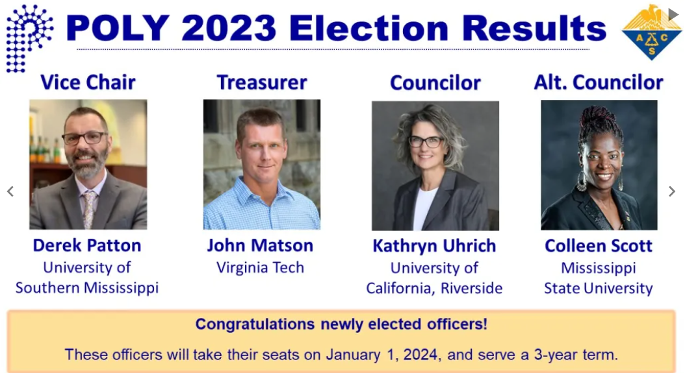
Elections
The total election participation:
582 votes = 22.9% voting body (last year it was 23.3%)
American Chemical Society Division of Polymer Chemistry
ExComm Winter Meeting, Orlando, FL 01/27/2024

Slide 3
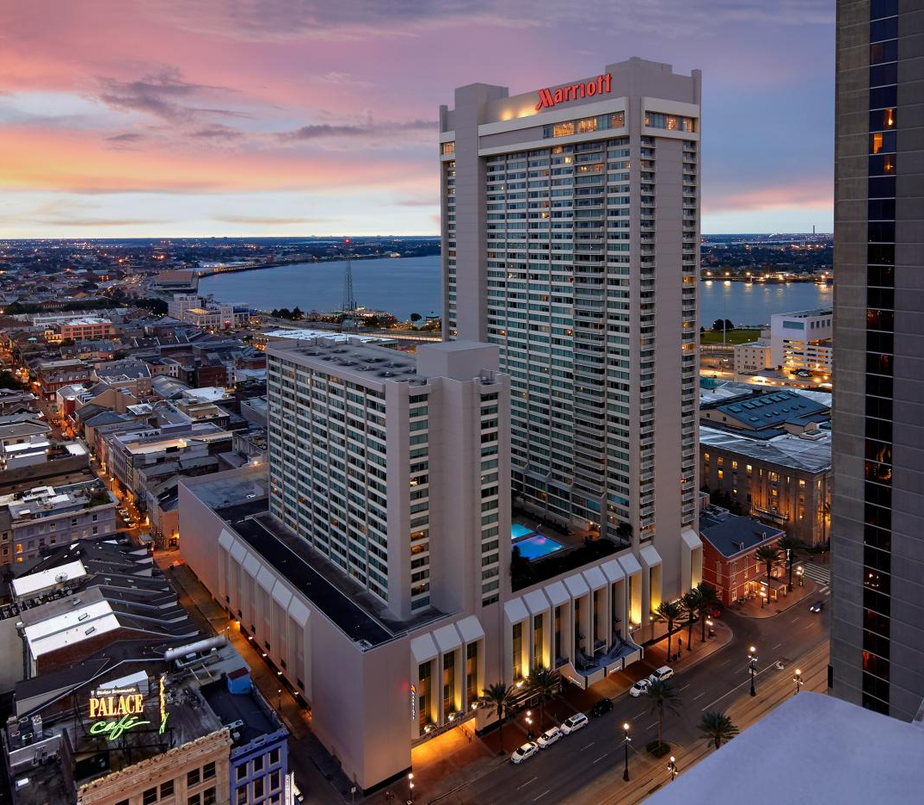
Information: Upcoming National Meeting in New Orleans
POLY/PMSE will be in the New Orleans Marriott on Canal Street
(Sun–Wed, March 17–20) Poly Membership Desk Open at 8 am
Sunday, March 17
12:00 pm Business Meeting-Lunch
7:00 pm ExComm Dinner
Monday, March 27
3:00 pm POLY ExComm Meeting
6:00 pm Student Social?
6:00pm IAB Social?
Tuesday, March 19
7:30 am IAB Breakfast Meeting
12:00 pm Programming Lunch
1:00 pm POLY/PMSE Coord. Meeting
4:00 pm Membership Meeting
(55 Fahrenheit in hotel)
Wednesday, March 20
5:30 pm POLY/PMSEPlenary Awards/Reception
OTHER NOTABLE:
POLY/PMSE Poster Sessions will be held in the Marriott (not in the Convention Center)
  POLY Sessions are Tues & Wed at 10:30 – 12:30pm (3 PMSE Sessions in PM: Mon, Tues, Wed)
  This is experimental and supports ACS’ plan for inventive ideas, however they are not helping with $$
  ~$5K for poster setups (split with PMSE), ~$2K to cater some assorted snacks/muffins at session.
American Chemical Society Division of Polymer Chemistry
ExComm Winter Meeting, Orlando, FL 01/27/2024

Slide 4
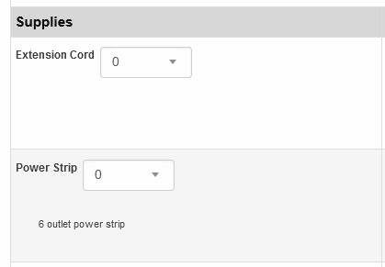
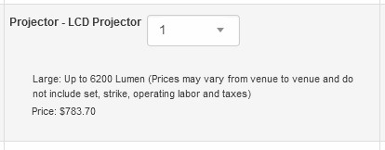
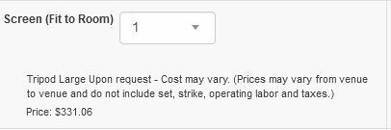
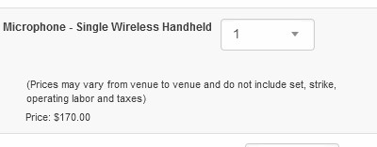
Discussion/Information about Reservations/ai system at ACS Meetings
All rooms, audio, video, and food/bev for every POLY function at ACS is reserved in the online ACS Ai system.
Example – POLY Business Meeting:
tables, chairs, layout, projector, screen, microphones, mixer, lectern, laptop, internet, additional power cables/strips, food (buffet)
The A/V cost is ambiguous at best (see screenshots).
Food is much more itemized & predictable.
For ACS San Fran, 8 power strips were requested and came at a later cost of $5,000
Note: no price listed
(screenshots taken from online Ai interface for ACS Spring NOLA)
BOTTOM LINE:
The hotels appear to be able to charge us whatever they want, without recourse from ACS.
The only guaranteed method for cost reduction is meeting reduction.
American Chemical Society Division of Polymer Chemistry
ExComm Winter Meeting, Orlando, FL 01/27/2024

Slide 5
ACS Meeting Spending: Right and Wrongs
Right
Wrong
INDY: Made very little changes (first time)
  MACRO and International Meetings → Zoom
San Fran: relocated membership meeting from site room to local establishment (cost: ~$500, saved ?? (due to ambuiguity)
San Fran: removed decaff coffee throughout and reduced Thurs coffee ($182/gal. , ~$1K saved)
Both POLY Business Meetings were very well attended. (50+)
ExComm meeting and ExComm Dinner footprint reduced (Allan)
Those darn power strips ($5K)
Didn’t shake enough bushes when realized that POLY/PMSE Event was setup as residual after the ChemLuminary Event. (Kathy tried)
Personal View
With sponsors on decline, we need to express our concern to ACS with regards to the untenable and unregulated hotel prices at these meetings. (I’m pretty sure PMSE will join our expression of concern)
American Chemical Society Division of Polymer Chemistry
ExComm Winter Meeting, Orlando, FL 01/27/2024

Slide 6
Newsletter – Other Outreach
Reminder that all POLY Minutes, Committee Reports, and Newsletter Updates are found on the Winter Executive Meeting Website https://www.polyacs.net/polywinterexec
American Chemical Society Division of Polymer Chemistry
ExComm Winter Meeting, Orlando, FL 01/27/2024

Slide 7
Newsletter/E-News Advertisers
General Info.
Drafting process begins a week post ACS mtgs.
Posted before July & November 1 per POLY bylaws
Posted online (interactive newsletter) at https://www.polyacs.net/newsletter
Article suggestions/improvements?
Estimated 2024 Expense
Expense: $1,500
​Estimated 2024 Advertising
Tosoh Bioscience $3,000
Cancelled Advertisers
2022 American Polymer Stand. Corp. $480
2022 Polyhedron Laboratories, Inc. $480
2021 HMJ $1,000
2019 Specific Polymers $800
2019 Malvern Instruments $4,200
2019 Specific Polymers $800
2018 Polymaterials $480
2017 Scientific Polymer Prod., Inc $480
2017 Polymer Char $1,920
2016 Wyatt Technology Corp. $3,600
DTCS $1,600
Sigma-Aldrich $3,700
Taylor & Francis $960
Article Deadlines are Important
American Chemical Society Division of Polymer Chemistry

Slide 8
WEBSITE
Separate slides created for website.
Special thanks to Coralie, Jeff and welcome to Tayler for their efforts!
American Chemical Society Division of Polymer Chemistry
ExComm Winter Meeting, Orlando, FL 01/27/2024

