Slide 1
POLY Publicity/Communications Committee
Current team: Chair - Tayler Hebner (Purdue University) Coralie Backlund (Novo Nordisk) Jeff Ting (Nanite) Kaden Stevens (University of Florida)
Recent/Ongoing Projects:
Website migration to polyacs.org is complete
no more .net site aside from some archival pdf reports that we are still figuring out what to do with
Communications strategy & website revamp (see next slide)
New linkedIn page – please go follow!
We will be posting in this page moving forward, not in the old “group”
Continuing to pilot national meeting events calendars via google cal – feedback on this is welcome
Calendar for this meeting linked on subsequent slide
Reminder: volunteer interest forms now linked on website – please share and encourage others to fill it out!
We are actively looking for new members of our team – please reach out if you have anyone in mind that may be interested in getting more involved in POLY!

Slide 2
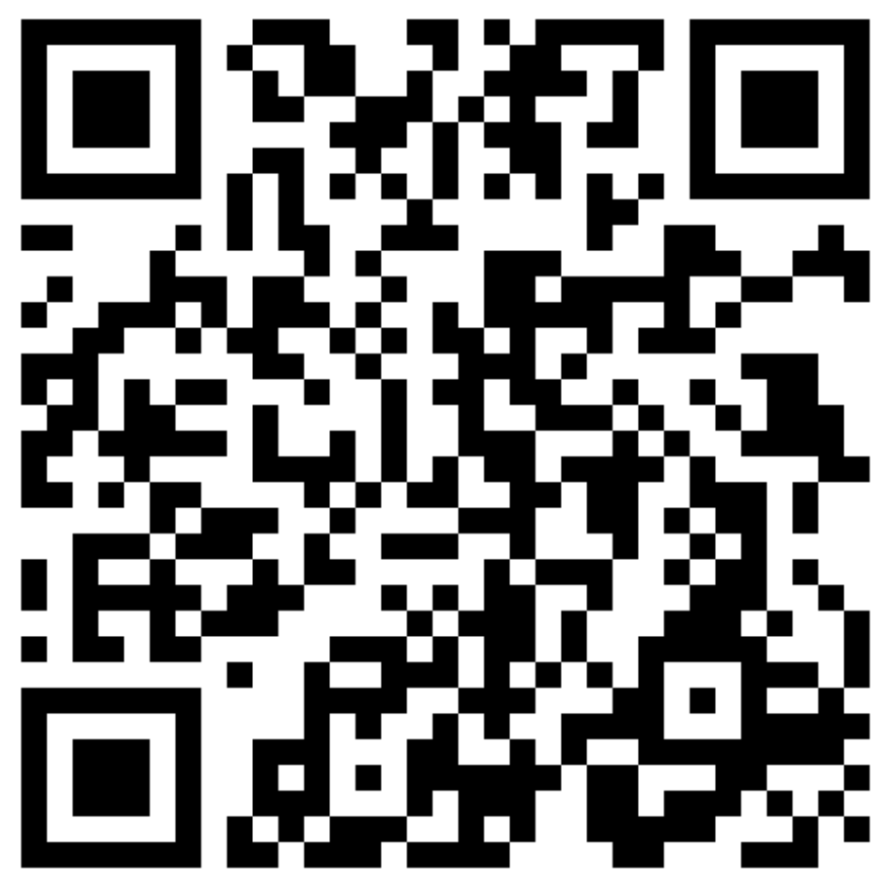
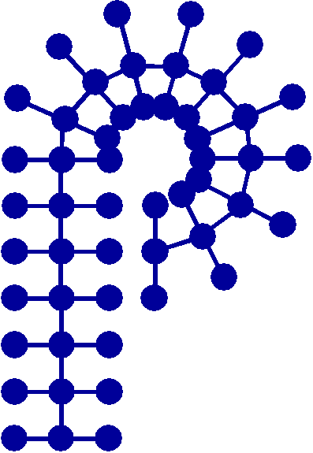
Website/Communications Strategy Update
Current project: communications strategy analysis/revamp
TPG grant used to hire web design/communications specialist (Joann Young)
Goals:
Create a communications strategy that will allow for effective communication of POLY’s value proposition on the website, Facebook, LinkedIn, X/Twitter, and YouTube pages
Develop more active interactions between POLY members on social media platforms
Create an online community of engaged members, nationally and internationally
Develop a template strategy for when and what to post on which platform to spur the highest level of interactions between members
Demonstrate the value of ACS and POLY membership
Provide updated curated POLY content for the best user experience
Retain and increase membership
Timeline (goal of completion within ~ 12 months):
Phase I: Research & Discovery (includes surveying current membership, and data gathering and analysis)
Phase II: Creating a Communications Strategy Based on Data (includes report and presentation)
Phase III: Implementation
Phase IV: Final Assessment and Adjustment
Scan QR code for membership survey; your feedback is critical for this project!
American Chemical Society Division of Polymer Chemistry

Slide 3
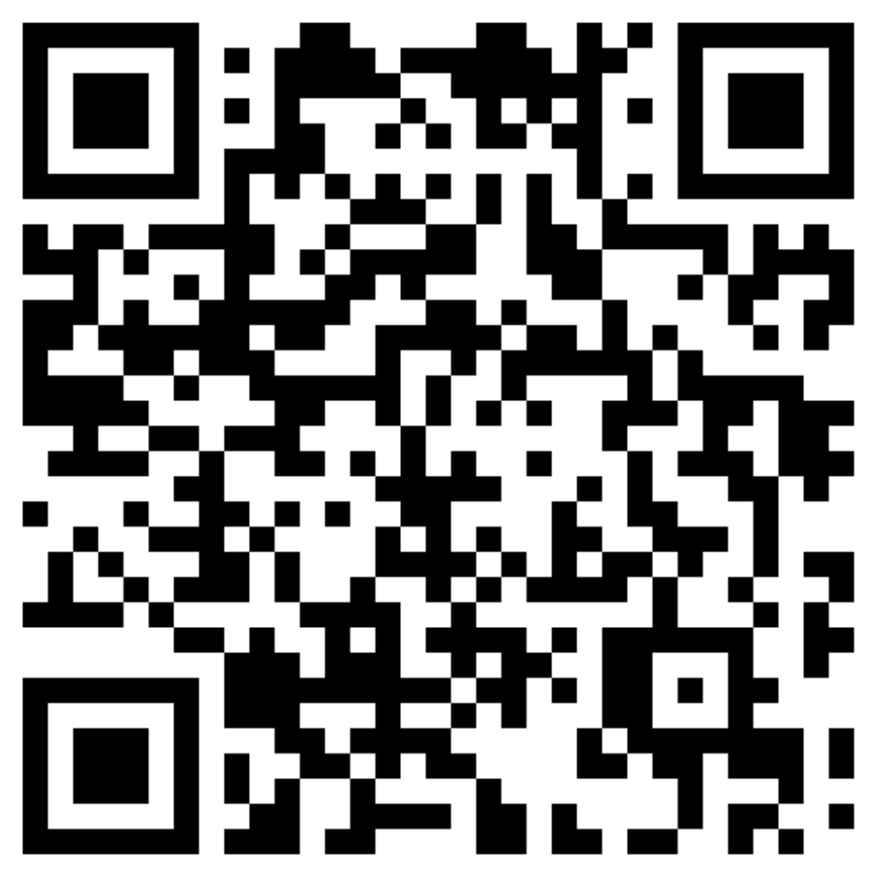
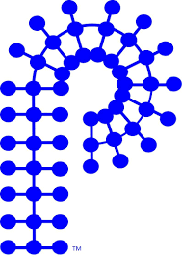
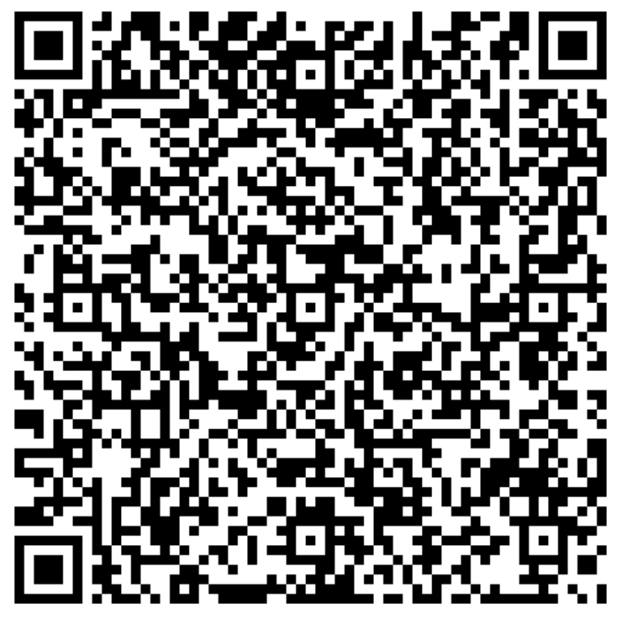




Find us on the web and social media!
Scan here for a calendar of POLY-related events at the ACS Spring 2025 Meeting

