Slide 1

ACS
DIVISION OF POLYMER CHEMISTRY
POLY Annual Business Meeting
BUDGET Report for FALL 2021 by Treasurer
Presented by Christine Coltrain (Treasurer)
Support from Kathy Mitchem, Lesia Pristas, and Carlee Black
August 2021

Slide 2
Outline
Staff appreciation
2021 Budget & Actual To-Date Activity
Income and Sponsor opportunities
Discussion items

Slide 3
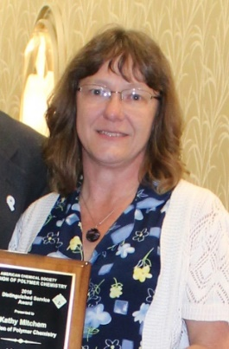
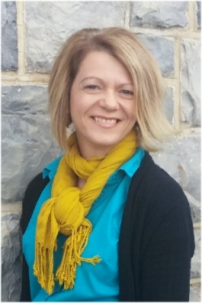
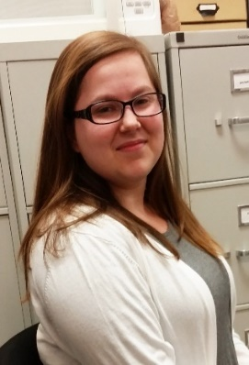
POLY Business Office
THANK YOU!!!
  Oversite: *POLY Supervisor– Christine Coltrain
  *VT Representative-Bob Moore
  Location: ICTAS II, 1075 Life Science Circle, Virginia Tech, Blacksburg, VA
Kathy Mitchem
  Budgeting/Bookkeeping
  ExComm Officer Support
  ACS Meetings Support
  Publications/Circulation
  VT/Staff Oversite
Lesia Pristas
  Workshops
  Event Planning
  Industrial Advisory Board
  Office Web Site
  Bookkeeping Audit
  Virtual Meeting Management
  Carlee Black
  Awards
  Memberships
  Publicity
  Workshop Assistant
  Graphical Abs./Preprint
  Facebook/Enews/Listserve Posts
  Websites Updates
  Supplies/Orders

Slide 4
2021 Budget / Actuals

Slide 5
2021 Budget (reality check)
by Treasurer, Christine Coltrain, 8/2021
2021 budget is within historical range
*Values do not include transfers

Slide 6
2021 POLY APPROVED BUDGET AND ACTIVITY TO DATE (SUMMARY)
by Treasurer, Christine Coltrain, 8/2021
ACS POLY Membership: Trending lower year after year.
Allocations: ONE TIME Extra “COVID Allocation” for the 2020 year. Essentially double of normal Allocation. Helpful!!
Investment: Partial cash-out early in the year to cover expenses.
Reminder
Approved $182k cash-in from investment account to balance the budget.
Investment cash-in for POLY sponsored awards ($10k/year) was postponed from 2020 to 2021 ($6k was expensed in 2020 for these but not cashed in from investments in 2020).
Increase in value in investment accounts was:
$169k in 2019
$139k in 2020
– and $78k YTD in 2021 (with cash-ins)

Slide 7
Trends / Major Sources of Income
by Treasurer, Christine Coltrain, 8/2021
Membership Dues
ACS Division Allocation
Workshops
Sponsors
2021SP $36,810 +$60
- this was for July-December 2020
- will receive payment in September for Jan-June 2021 membership.
2021 – $56,424 x 2 = $112,848
Extra “COVID Allocation” for the 2020 year.

Slide 8
2021 APPROVED BUDGET AND ACTIVITY (continued)
by Treasurer, Christine Coltrain, 8/2021
ACS Meeting Expenses and Support: Expenses lower due to virtual and hybrid meetings. POLY will support some symposia at the Fall 2021 meeting.
Symposia sponsorship income in 2020 will be expensed in 2021, 2022.
2021 MACRO(Spring) CELEBRATION: – expenses will occur in 2021.
PACIFICHEM 2021 (Hybrid)– $20k POLY support for symposia ($12k) and staff travel ($8k) if needed. Funds will come from the Vanguard International Investment account.

Slide 9
2021 APPROVED BUDGET AND ACTIVITY (continued)
by Treasurer, Christine Coltrain, 8/2021
Workshops: May hold 2 of the 5 proposed for 2021.
  Controlled Radical Polymerization (Nov)
  Silicon-Containing Polymers (Dec)
POLY Workshop Income will not come in as anticipated.
Administrative: On target. Lower staff travel expenses.

Slide 10
2021 APPROVED BUDGET AND ACTIVITY (continued)
by Treasurer, Christine Coltrain, 8/2021
GA/Library: A few Library’s have dropped their subscription to the Graphical Abstract this year
Membership: Received $7k IPG Grant “Three Minute Pitch Competition” in 2020– in progress to use this in 2021.
Awards: Additional award expenses due to postponed (from 2020) awards. Most expenses occur in the Fall.
Education: POLYED checking account was closed.

Slide 11
Non-Profit Status Maintained
10 Year (YE) Snap-Shot
by Treasurer, Christine Coltrain, 8/2021
UP 81k
Investments cashed: 272k
2021 June Checking Balance: $256k
2021 July Investment Balance: $1,310k
  These remain healthy

Slide 12
by Treasurer, Christine Coltrain, 8/2021
2021 Overview
2021 Budget YTD
  Continued decline in revenues from ACS dues.
  ACS helped the Divisions significantly by providing a “bonus Allocation”.
  In-person meeting cancellations significantly lowered expenses.
  Workshops were mostly cancelled and will provided only modest revenue.
  Income received in 2020 from Sponsors is being expensed in 2021/2022.
  Both the checking and investment accounts remain healthy.
The ACS Report for 2021 has been filed
The 2021 Tax forms 990 have been filed with the IRS
Other / questions?
  The significant dedication of Kathy, Lesia, Carlee was invaluable in POLY’s success during this year of constant changes

Slide 13
Some 2021 POLY Initiatives
  Significant efforts in student-oriented activities and active Membership Committee
    Redirecting use of the IPG grant for “3 Minute Pitch” to National Graduate Research Polymer Conference (NGRPC) – Thanks Katrina!
    Educational incentives - MACRO Initiative, symposium, and website
    Undergraduate and Graduate student symposia at National Meetings
    Student Chapters
    Awards for young professionals (YIPS, Travel, POSTER awards)
  Industrial members representation through IAB, symposia, networking, and Awards (IPS, YIPS)
  POLY Awards continue to be sponsored and highlighted
  Organizational involvement in International meetings: MACRO2020 (Apr), Macromex (Nov), PACIFICHEM (Dec)

Slide 14
Some 2021 POLY Initiatives - continued
  “Webshops”, Workshops, Webinars
    Webshop rebroadcast planned (October): “Stimulus-Responsive Polymers and Liquid Crystal Elastomers” (Boul, Konkolewicz)
    2 Workshops for Fall 2021: Controlled Radical Polymerization (Nov); Silicon-Containing Polymers (Dec) and many (6) in 2022.
  IAB has been supportive of webshops and webinars this year by covering speaker honoraria – Thank you!!
  POLY completed a spring needs assessment and member survey for identifying ways to bolster and improve membership. Much of the information will be reported at this ACS Meeting. Thanks to Lesia, Semra, and the team for initiating this….

Slide 15
Major Sources of Income for POLY
by Treasurer, Christine Coltrain, 8/2021
Membership Dues –$69k received in 2020; annually see 5-7% decrease
ACS Division Allocation – expect ~ $50k (received in 2020)
Workshops Delta – should expect ~ $45k to $60k (per year) (larger fluctuations)
Sponsors – expect ~ 20-30k
    10-15k ACS National Meeting
    4-5k Newsletter Advertisers
    15-20k Awards [Henkel, DSM, BioMacro, etc ]
    Other opportunities – NEED for growth
IPG (Innovative Project Grants / ACS): The maximum funding per project is $7,500; the maximum funding per calendar year is $12,500.

Slide 16

by Treasurer, Christine Coltrain, 8/2021
Sponsors
Open Sponsor Opportunities
Newsletter Advertising | $500-$5,000 | Annually
E-news with Web Link | $500 | Annually
Webinars | $1,000-$2,500 | Each
Mark Scholar Awards | 4,500 | Bi-Annually
Plenary Speaker | $1,500 | Bi-Annually
Poster Session | $2,500 | Per Mtg
Major Awards Mavel/Flory/Mark/IPS | 5,000 each | Bi-Annually
Tentative Sponsor In Place
Student Social | $1,000-$2,000 | Annually
Coffee Break Sponsor | $600-$3,000 | Pre Mtg
Poster Awards | $2,000 | Annually
POLY/PMSE Award Reception | $5,000 | Per Mtg
Current Sponsors - THANKS
    ACS National Meeting (ACS Pubs/TOSOH)
    Award Support (Henkel, DSM, ACS Pubs, Springer Nature )
    IAB Sponsored Awards
    Newsletter Advertisers (Tosoh, American Standards, HMJ, Polyhedron)
Consider Advertising with POLY

Slide 17
Major decision from EXCOM meeting in January 26, 2020
POLY support for National Meeting symposia requires that at least one member of the organizer team be a POLY member. This NEW requirement must be communicated to organizers via Program Chairs and POLY website. This is to be applied to the PACIFICHEM 2021 meeting and all ACS National and Regional meetings starting in 2021.

