Slide 1
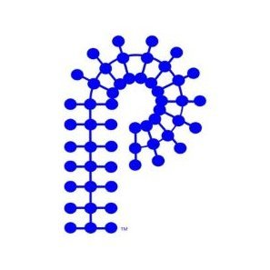
Polymer Chemistry Division, ACS.
International Committee Updates:
PPC 19 in Kyushu University in Fukuoka, Japan underway July 6-10 2025 organized by Prof. Kato and Prof. Tanaka, PPF Councilors (R. Advincula, K.Matyjaszewski, T. Lodge)
https://main.spsj.or.jp/ppc19/
IUPAC Macro 2024 (50th WCC) at Warrick University, UK recently concluded
Japan Society of Polymer Science (JSPS) Sendai, Japan, July 2024, concluded
Macromex 2026 in Mexico (SPM, ACS Poly Division) – planning
PAT Conference 2025 – Planning with Avi Domb (Israel) - planning
Others upcoming for 2024-2025:
1) RSC: 5th International Conference on Advanced Polymer Science and Engineering, Athens, Greece (Oct. 2024)
2) EPF European Polymer Congress (June 2025)
.
- Will schedule a virtual meeting after the ACS.

