Slide 1


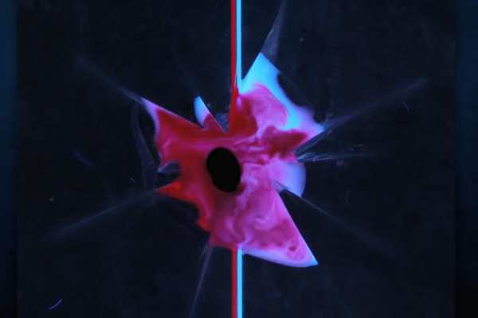
POLY Webinars: 2023
Designing Polyelectrolyte Coatings: Coacervates, Assemblies, and Complex Materials, 1/26/2023
Polymers at the Interface of Biology: Engineering Polymers that Prevent Rejection of Gene Therapy and 3-D Printed Implants 4/13/2023
Unbreakable Design: The Polymer Mechanochemistry of Self-healing Materials 11/16/2023
Jaime Grunlan Leland T. Jordan ’29 Chair Professor
Department of Mechanical Engineering, Texas A&M University
Sarah Perry Associate Professor
Department of Chemical Engineering, University of Massachusetts Amherst
Rong Yang (moderator) Assistant Professor
Chemical and Biomolecular Engineering, Cornell University
Ke Zhang Professor Department of Chemistry and Chemical Biology Northeastern University
Matthew Becker
Hugo L. Blomquist Distinguished Professor
Department of Chemistry
Duke University
C. Adrian Figg (Moderator)
Assistant Professor
Department of Chemistry
Virginia Tech
Jeffrey Moore Stanley O. Ikenberry Research Professor, Howard Hughes Medical Institute Professor
Department of Chemistry
University of Illinois Urbana-Champaign
Stephen Craig
William T. Miller Distinguished Professor
Department of Chemistry
Duke University
Junpeng Wang (moderator)
Assistant Professor
School of Polymer Science and Polymer Engineering
The University of Akron

Slide 2
First POLY/ACS Webinar in 2023
Speakers
Jaime Grunlan Leland T. Jordan ’29 Chair Professor
Department of Mechanical Engineering, Texas A&M University
Sarah Perry Associate Professor
Department of Chemical Engineering, University of Massachusetts Amherst
Moderator
Rong Yang
Assistant Professor
Chemical and Biomolecular Engineering, Cornell University
POLY Leads
249

Slide 3
Second POLY/ACS Webinar in 2023
Speakers
Ke Zhang Professor, Department of Chemistry and Chemical Biology
Northeastern University
Matthew Becker
Hugo L. Blomquist Distinguished Professor
Department of Chemistry
Duke University
Moderator
C. Adrian Figg (Moderator)
Assistant Professor
Department of Chemistry
Virginia Tech
POLY Leads
174

Slide 4
Third POLY/ACS Webinar in 2023
Speakers
Jeffrey Moore Stanley O. Ikenberry Research Professor, Howard Hughes Medical Institute Professor
Department of Chemistry
University of Illinois Urbana-Champaign
Stephen Craig
William T. Miller Distinguished Professor of Chemistry
Department of Chemistry
Duke University
Moderator
Junpeng Wang
Assistant Professor
School of Polymer Science and Polymer Engineering
The University of Akron
POLY Leads
307

Slide 5
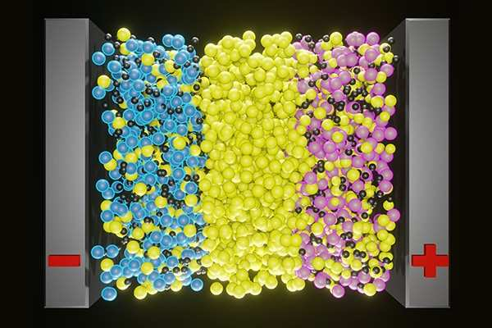
POLY Webinars: 2024
Better Ion Transport Through Polymer Chemistry 2/8/2024
Alternative Approaches to ROP
5/2/2024
TBD
9/19/2024
Alexei Sokolov ORNL/UT Governor's Chair, Professor
Chemical Sciences Division
Oak Ridge National Laboratory
Department of Chemistry
University of Tennessee, Knoxville
Michael Hickner
Craig A. Rogerson Endowed Professor
Department of Chemical Engineering and Materials Science
Michigan State University
X. Chelsea Chen (moderator)
R&D Staff - Polymer Scientist
Chemical Sciences Division
Oak Ridge National Laboratory
Jia Niu
Associate Professor of Chemistry
Department of Chemistry
Boston College
Julien Nicolas
CNRS Research Director
Institut Galien Paris-Saclay, CNRS UMR 8612
Faculté de Pharmacie, Université Paris-Saclay
Josh Worch (moderator)
Assistant Professor of Chemistry
Department of Chemistry
Virginia Tech

Slide 6
First POLY/ACS Webinar in 2024
Speakers
Alexei Sokolov ORNL/UT Governor's Chair, Professor
Chemical Sciences Division
Oak Ridge National Laboratory
Department of Chemistry
University of Tennessee, Knoxville
Michael Hickner
Craig A. Rogerson Endowed Professor
Department of Chemical Engineering and Materials Science
Michigan State University
Moderator
X. Chelsea Chen
R&D Staff - Polymer Scientist
Chemical Sciences Division
Oak Ridge National Laboratory
POLY Leads
335

Slide 7
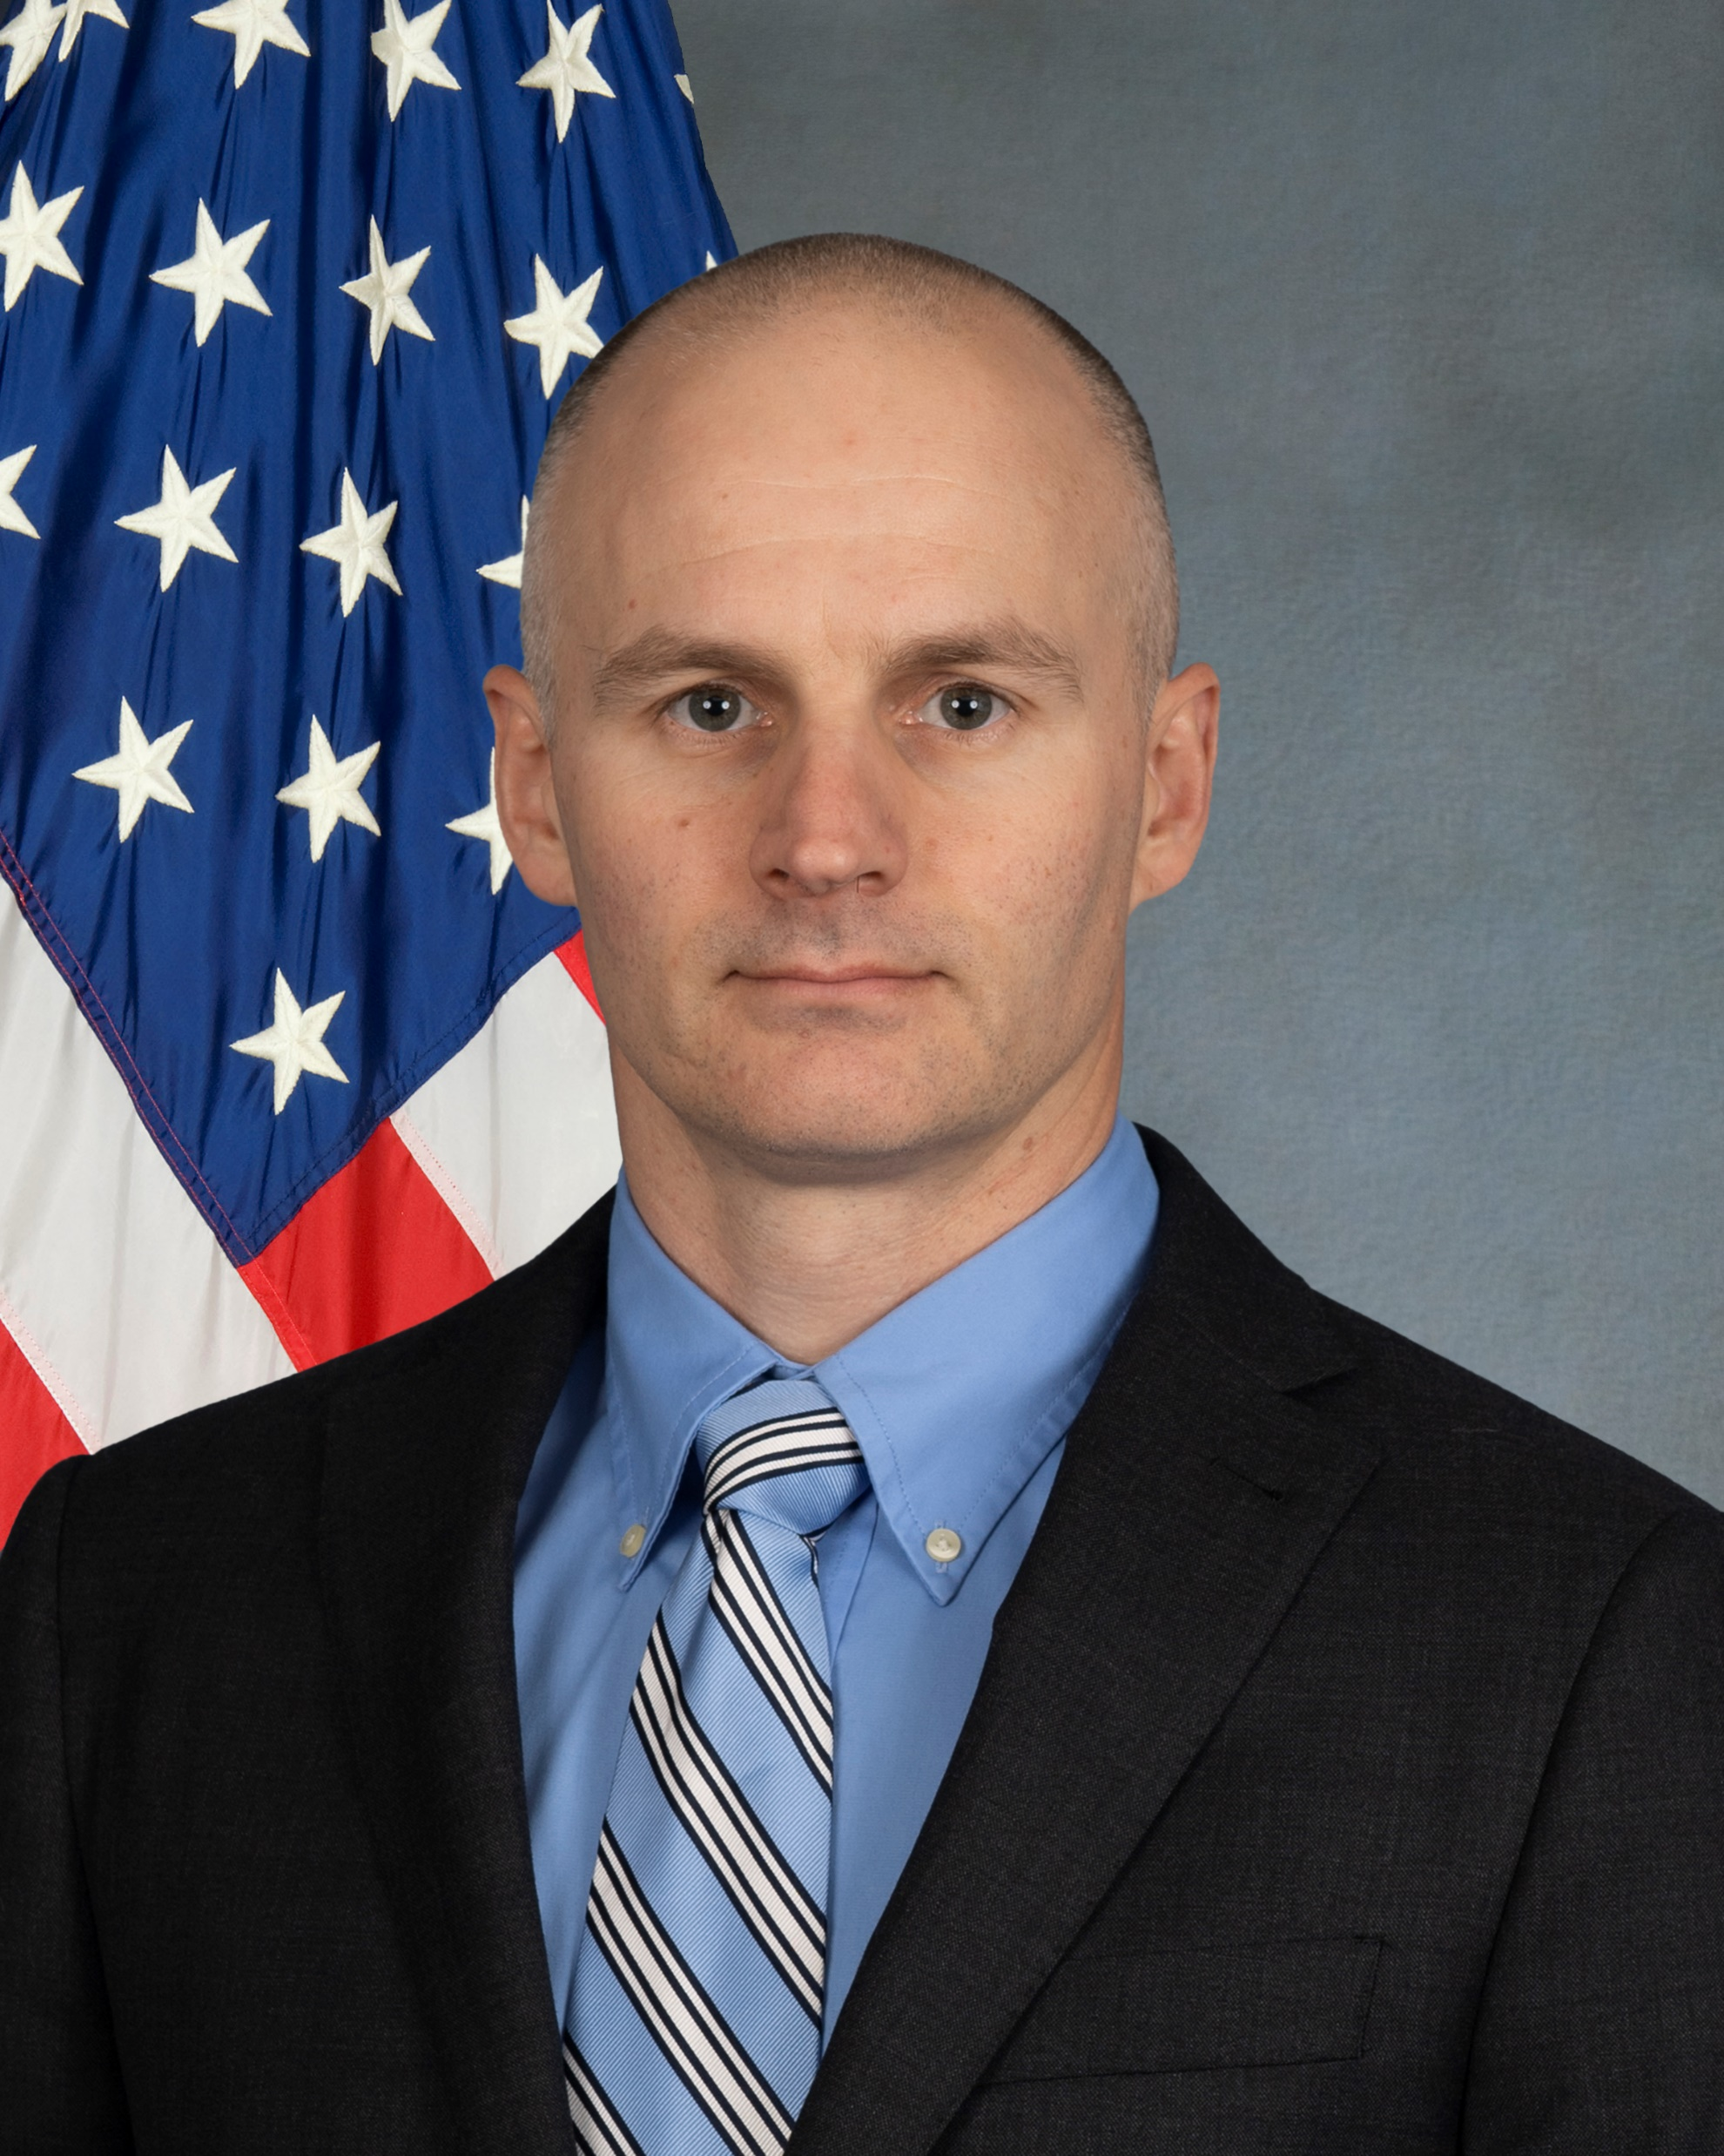
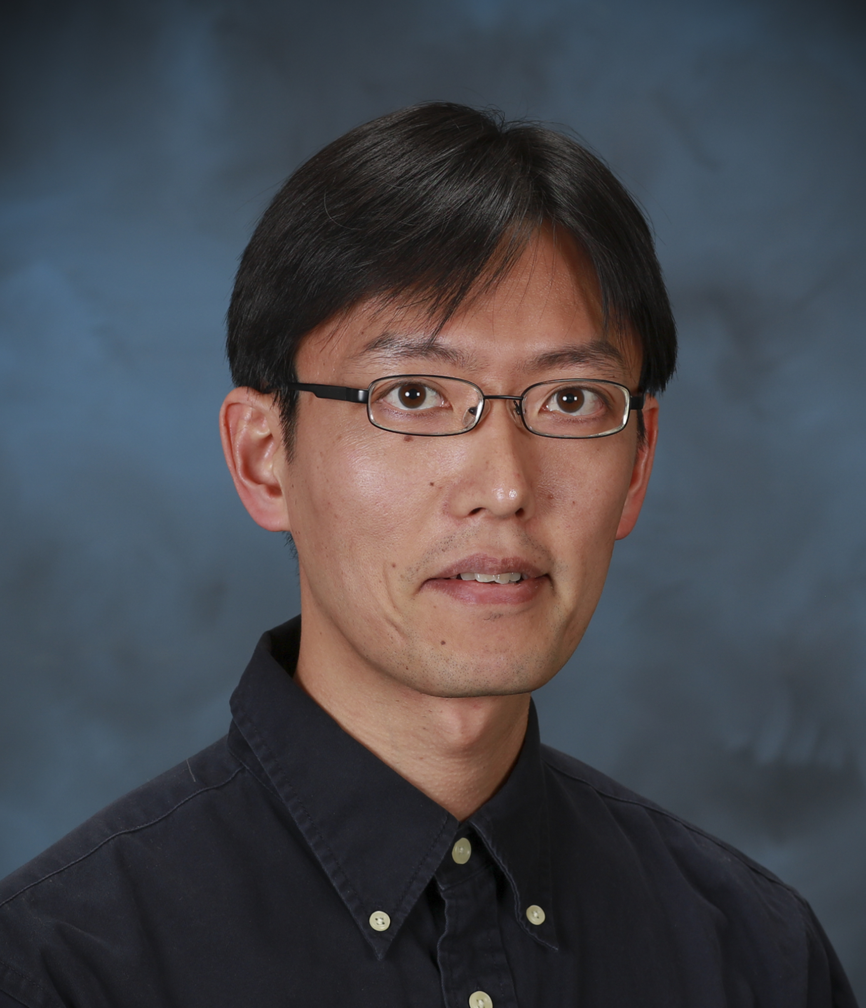

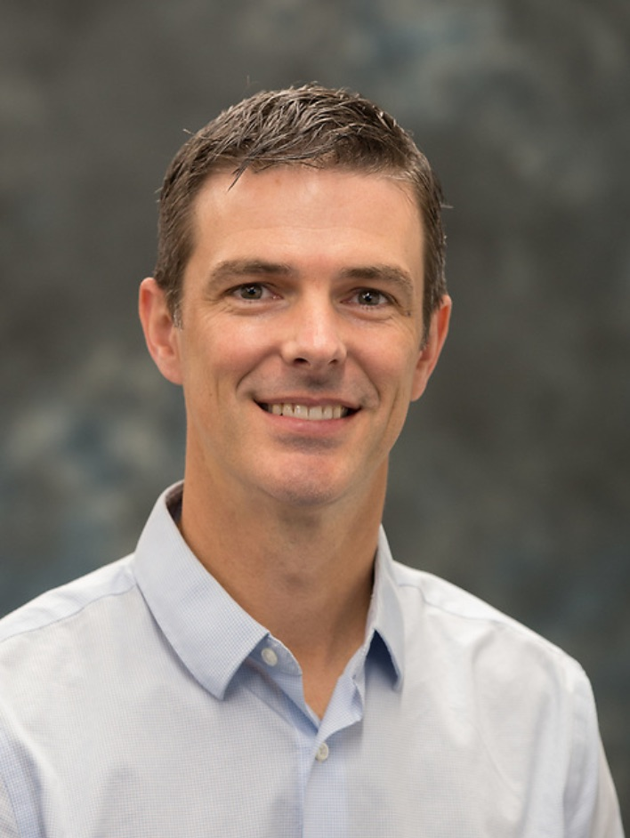
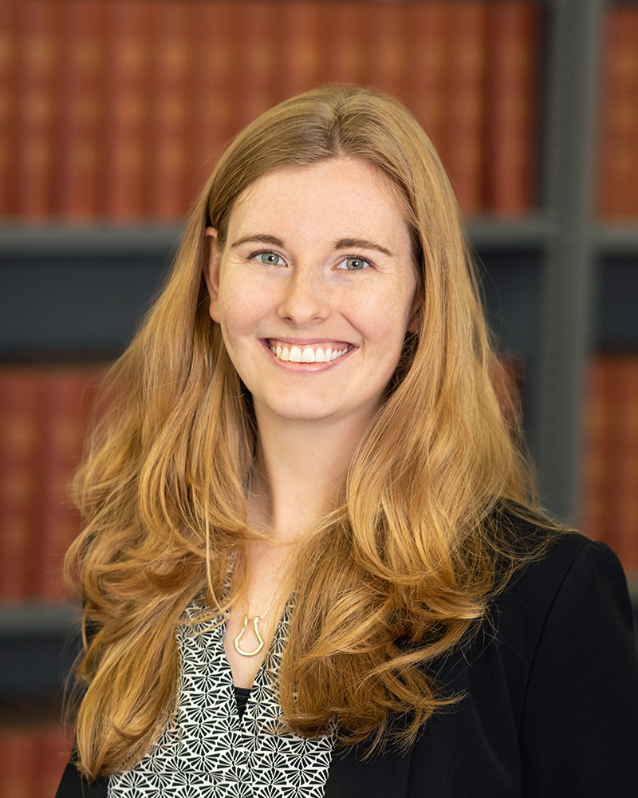
POLY Webinar Committee
Future Webinar
Please send your ideas and feedback to any of us.
The committee welcomes a new committee member, Bob Lambeth, Amy Research Laboratory robert.h.lambeth2.civ@army.mil
Tomonori Saito (chair), Oak Ridge National Laboratory saitot@ornl.gov
Brent Sumerlin, University of Florida sumerlin@chem.ufl.edu
Rebecca Olson Short, PPG RAShort@PPG.com

