Slide 1

POLY Workshops
Beth Elacqua: Workshop Chair
Committee: Gobet Advincula, Mike Hickner, Helen Tran, Jena McCollum, Rakesh Nambiar, and Yongping Zha

Slide 2
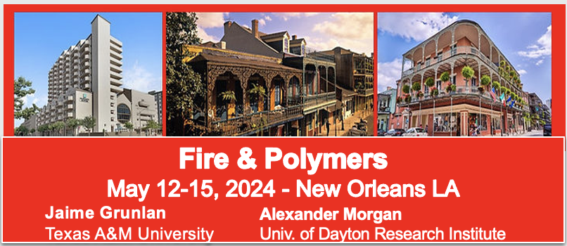
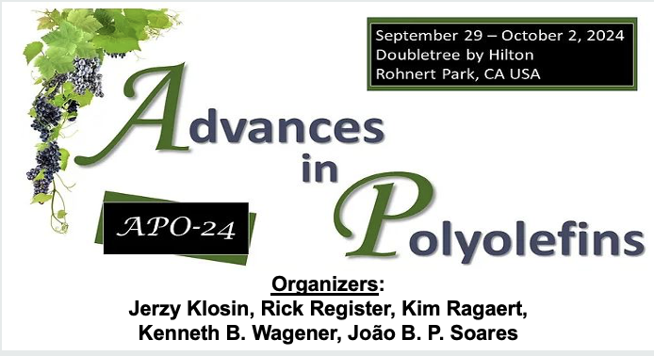

2024 POLY Workshops
99 Attendees 40 Speakers 25 Posters 8 Sponsors | Budget Overview: $101,534 Income $78,881 Expenses (including 20k Admin Fee) $22,653 Meeting Gains Donated to POLY
106 Attendees 30 Speakers 21 Posters 19 Sponsors | Budget Overview: $137,216 Income $133,921.77 Expenses (including 20k Admin Fee) $3,294 Meeting Gains Donated to POLY
Up for a ChemLuminary

Slide 3


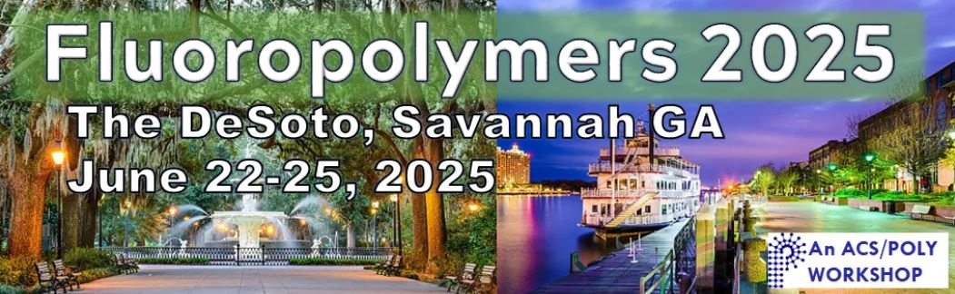
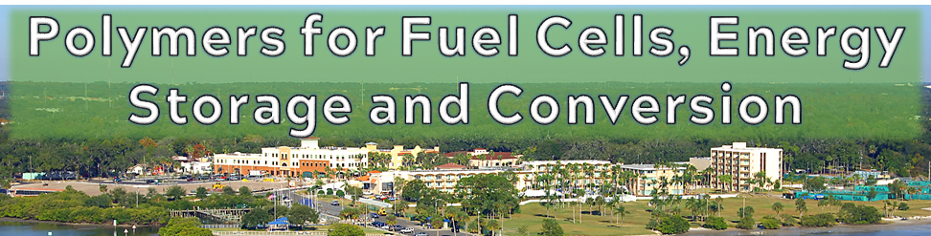
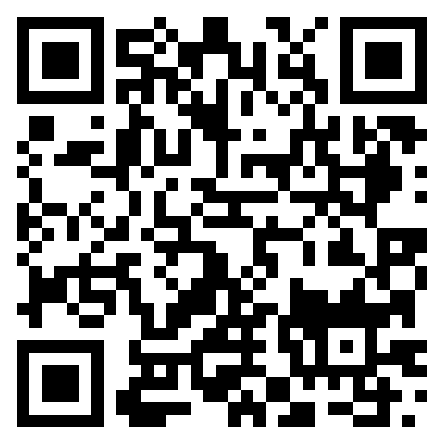
2025 POLY Workshops
145 Attendees
46 Speakers
58 Posters
17 Sponsors
Organizers:
S. Eileen Seo
Timothy E. Long
March 18-21, 2025
61 Attendees 27 Speakers 10 Posters 8 Sponsors | Budget Overview: $60,394 Income $56,204 Expenses (including 20k Admin Fee) $4,190 Meeting Gains Donated to POLY
Organizers:
Brian C. Benicewicz Michael Hickner Tom Zawodzinski
Safety Harbor, FL – November 2-5, 2025

Slide 4


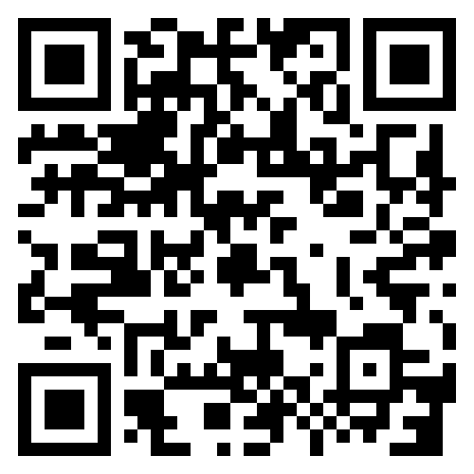


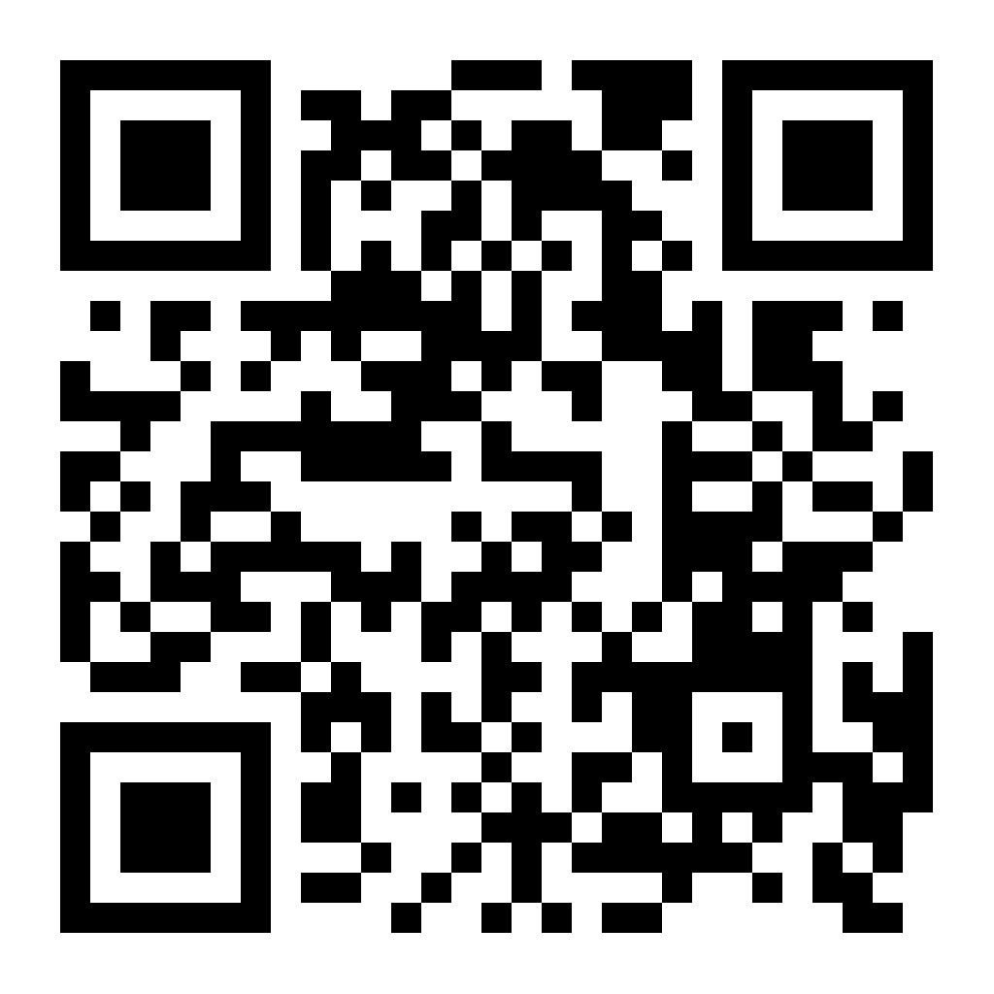
2026 POLY Workshops
Organizers:
Jaime Grunlan
Alex Morgan
Organizing Team:
Brett Helms
LaShanda Korley
Megan Robertson
Katrina Knauer

Slide 5
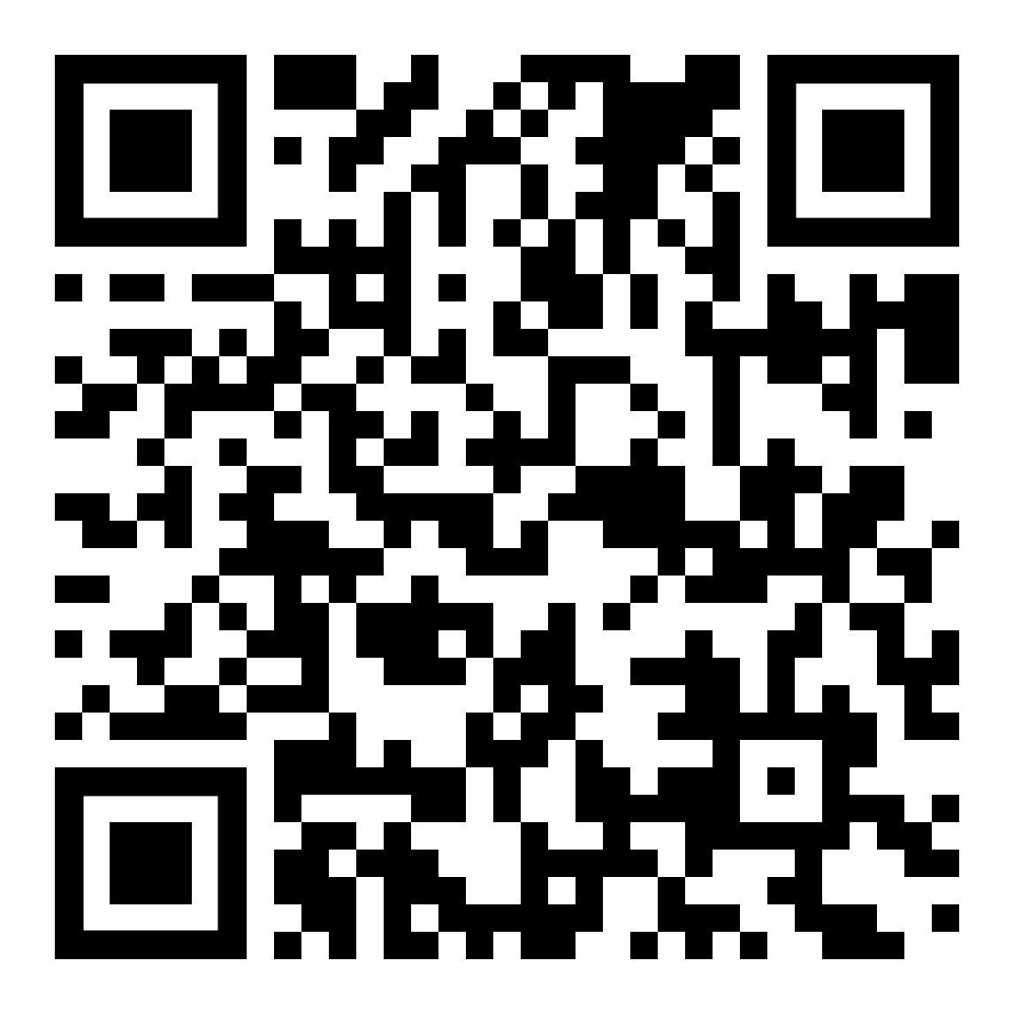
POLY NGRPC National Graduate Research Polymer Conference
Applications were collected Early 2025:
CONGRATULATIONS:
POLY 2027 NGRPC Winner
Previous Graduate Conferences
Penn State, 1994
Virginia Tech, 1996
University of Akron, 1998
Southern Mississippi Univ., 2000
Lehigh University, 2003
UMass Amherst, 2005
UT Knoxville, 2007
Univ. of NC at Chapel Hill, 2010
Case Western Reserve Univ., 2012
Louisiana State Univ., 2014
University of Akron, 2016
University of Minnesota, 2018
Virginia Tech (virtual), 2021
University of Michigan, 2023
Arizona State University, 2025
University of Florida
Organizers: Austin Evans, Ariana Tamura, and Brent Sumerlin (faculty); Annabelle Palmer, Pouriya Nayebpashaei, Madeline Howell, Eva Vasquez, and Andrei Potapenko (student team)
Target Date: April/May 2027
https://sites.google.com/view/ngrpc2027/home
Notes:
Hayley, you can skip this slide if you’d like since NGRPC is on the next one as well, but I thought it would be good to list the student team and show the QR code (and past locations) too.

Slide 6

2027 POLY Workshops
June 6-9, 2027
Doubletree by Hilton
Rohnert Park, CA, USA
Advances
POLY holds 2 Topical Workshops Annually
SPRING (May/June)
FALL (Oct/Nov)
Plus ONE Graduate Student Focused Meeting Odd-Years (application due fall even-years)
If interested in proposing a future workshop, email POLY Workshop Chair:
Beth Elacqua eze31@psu.edu
in Polyolefins
Organizers:
J. Klosin, R. Register, K. Ragaert, K. B. Wagener, J. B. P Soars
National Graduate Research Polymer Conference (NGRPC)
University of Florida
April/May 2027
Organizers: Ariana Tamura, Austin Evans,
and Brent Sumerlin
Fall 2027
To be determined

Slide 7
FOR EXCOMM MEETING
Hayley to Present

Slide 8
Workshop Progress
NEW WORKSHOPS: 2024 Fire and Polymers (very successful-repeating 2026) and 2026 Upcycling & Sustainable Polymers
ORGANIZER ROTATION: strongly encouraged & long-time workshops have new organizers
8 RETIRED WORKSHOP OVER 10 YEARS: (Polymer in Med, Polymer Colloids, Next Generation Smart Materials, Layered Polymeric Systems, Poly and Nanotechnology, Silicone-Containing Polymers Composites, Advanced Polymer Materials, & Advances in Water Purifications)
HISTORICAL WORKSHOPS ARE IMPORTANT: APO, Fluoropolymers, & Fuel Cells remain active. Others have only repeated 2-3 times.
SCHEDULE ADJUSTMENTS: repeats are going to 2.5 – 4 years (verses 2 yrs.) Example: CRP to 4 year and APO 2 ½ years, other changes to follow
FUTURE TOPICS: a “Call for Potential Workshops” will be circulated later this year.
CHANGE TAKES TIME: Workshop change take 2-3 years to implement
SUMMARY:
New workshops ARE included; things ARE continuously changing, & new organizers ARE engaged (all accomplished while reducing from 4 workshops to 2 per year)

Slide 9
2027 POLY Workshops
Advances in Polyolefins (APO) Organizers: Klosin, Wagener, Register, Soares (lead), and Ragaert June 6-9, 2027, Napa Valley | Approved
National Graduate Research Polymer Conference (NGRPC) University of Florida Organizers: Ariana Tamura, Austin Evans, and Brent Sumerlin | Approved
(Open slot)
Notes:
Remaining 2027 workshop: Beth has reached out to Brent to get a sense of what he is thinking while noting the repeating might be closer to a ~3 year period given the move to only 2 annual workshops and the desires to both award successful workshops and encourage new ones.
**Can we get thoughts regarding open solicitation and specific review dates vs. planned solicitations**

Slide 10
Potential POLY Workshops
Controlled Radical Polymerization (CRP) Organizers: Brent Sumerlin, Kris Matyjaszewski | (International iteration, November 2025) Proposal Anticipated for 4-year repeat
Fluoropolymers Organizers: Jena McCollum, and Dr. Bruno Ameduri, Cameron Parrish, Frank Leibfarth | Proposal Anticipated
2 Workshops Annually
SPRING (May/June) or FALL (Oct/Nov) to avoid other meetings (i.e., ACS) and manage workload
Planned solicitation for open workshop spot (along with 2028-2029?) in time for discussion at Winter 2027 ExComm meeting
Notes:
Remaining 2027 workshop: Beth has reached out to Brent to get a sense of what he is thinking while noting the repeating might be closer to a ~3 year period given the move to only 2 annual workshops and the desires to both award successful workshops and encourage new ones.
**Can we get thoughts regarding open solicitation and specific review dates vs. planned solicitations**

Slide 11
Thank you for your support and advice moving forward!

