Slide 1

POLY Workshops
Marc Hillmyer: Workshop Chair
Committee: Gobet Advincula, Elizabeth Elacqua, Mike Hickner, Joe Mabry, Jena McCollum, Rakesh Nambiar, and Yongping Zha

Slide 2
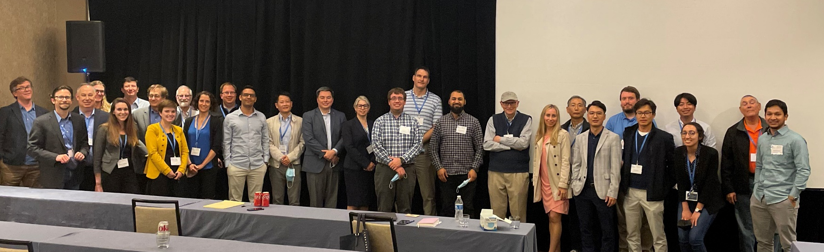
In-Person workshops

Slide 3

2022 approved
Hybrid experience
28 on site attendees
23 virtual
Polymer Colloids (19 – 22 Feb 2022)
  Wei Gao (Dow), John Tsavalas (UMH)
Polymers for Fuel Cells, Energy Storage, and Conversation (15 – 18 May 2022)
  Brian Benicewicz (Univ. SC), Tom Zawodzinski (UTK), Mike Hickner (Penn St.)
Fire and Polymers (5-8 June 2022)
  Jaime Grunlan (Texas A&M), Alexander Morgan (U. Dayton Res. Inst.)
Advances in Polyolefins (18 – 21 Sept 2022)
  Jerzy Klosin (Dow), Rick Register (Princeton), Ken Wagener (U. FL), Pal Arjunan (Eureka-GlobalChem), Joao Soares (U. Alberta)
Polymers and Nanotechnology (16 – 19 Oct 2022)
  Rick Laine (UM), Jaime Grunlan (Texas A&M)
Polymers in Medicine and Biology (23 – 26 Oct 2022)
  Theresa Reineke (UMN), Buddy Ratner (Univ. Washington)
82 on site attendees
88 on site attendees
75 to date on site attendees
Notes:
This slide represents the slate of 2022 POLY workshops that are approved. For complete information, visit:
https://www.polyacs.net/workshops
One thing to discuss during the workshop committee is how smaller topical workshops struggle with the financial aspects of a hybrid event. Adding something like this to a 60 person workshop simply does not fit within a reasonable budget i.e. makes registration fees unreasonable. Consider a virtual piece post-meeting if needed.
As mentioned previously, we are on-point regarding registrations/budget/topics. We hope for the same in the fall; however, the new variant may impact numbers.

Slide 4
2023 approved/rescheduled
Fluoropolymer (17 – 22 June 2023)
  Scott Iacono (USAF Academy), Bruno Amaduri (CNRS), Jena McCullum (U Colorado, Colorado Springs)
Sustainable Polymers (15 – 18 October 2023)
  Marc Hillmyer (UMN), Thomas Epps (U. Delaware), Megan Robertson (U. Houston)
2023 Polymers in Data Science ( TBD)
  Kate Beers (NIST), Brad Olsen (MIT), Debra Audus (NIST)
2023 Controlled Radical Polymerization (November 12 – 15, 2023)
Kris Matyjaszewski (Carnegie Mellon University), ​Nick Tsarevsky (Southern Methodist University), ​Haifeng Gao (University of Notre Dame), Brent Sumerlin (University of Florida)
Notes:
This slide represents the slate of 2023 POLY workshops that are approved i.e. rescheduled from previous years due to Covid-19. For complete information, visit:
https://www.polyacs.net/workshops

Slide 5
2024 Workshops, cont’d
Workshop Topics | Organizers
2024 Advancing Protection Through Materials Design | Aaron Forster (NIST), Joseph M. Dennis (Army Research Laboratory), Amanda L. Forster (NIST) Plan to recruit for organization: Vicky Nguyen (Johns Hopkins University), Leslie Lamberson (Colorado School of Mines)
2024 Polymer Upcycling and Circularity | Brett Helms (LBL) Plan to recruit for organization: LaShanda Korley, (University of Delaware), Kat Knauer (NREL)
Notes:
In 2021, the POLY workshop committee reached out to 10 potential workshop groups (both previous and new) based on topics of interest in the field. Of those, 4 submitted a workshop proposal for this cycle. The committee approved all submissions and ask that POLY Exec review and approve them. They are ___ (above)
Following is a complete list of organizers the committee reached out to:
Polymer Peptoids, Laura Stratton (PCI) and Richard Hoogenboom
The Defense Applications/Structure-Property Measurements, Aaron Forster (NIST)
Polymers in Data Science, Kate Beers (NIST), Brad Olsen (MIT)
Entrepreneurship…, Craig Hawker (UCSB), Geoff Coates
Polymer Composites and High Performance/ combine possibly with Manufacturing
Polymers/Additives/Machine learning, Sarah Morgan (Uiv So. Miss), Jena McCullum (Univ Colorado, Colorado Springs)
AI/ML driven Continuous Flow Chemistry Polymerizations, Gobet Advincula
Next Generation/Smart Materials, Johan Foster and Erik Berda
Microplastics, Kate Beers (NIST), Rob Mathers (PSU), Kensington (sp),
Membranes i.e. Water Purification, Abhishek Roy (NREL), Mike Hickner (PSU)
Cir. Economy in Polymers, Brett Helms
The late 2021 and early 22 workshops have all expressed an interest in repeating so collecting of submission will start soon.

Slide 6

Virtual workshops (POLY Webshops)

Slide 7
Webshops in 2021
Live
On-demand
Catalysts in Polymers
2020
77 attendees*
24 paid
2021
22 paid
97 views
Net income
+875.99
Stimulus-Responsive Polymers and Liquid Crystal Elastomers
2021
116 attendees*
23 paid
2021
19 paid
93 views
POLY IAB sponsored speaker honoraria
Net income
+3,128.00
* 10 access links were given per each 1 registration purchased
Future?
  Is there a special advantage for POLY to continue amid the free webinars by ACS? Using virtual pieces from hybrid workshops? TBD
Notes:
In 2021, POLY rebroadcast the Catalysts in Polymers webshop and offered a live and rebroadcast of Stimulus-Responsive Polymers.
Catalyst:
October 2020 - Live
- 77 attendees for live session
Of those 24 paid (REMEMBER: offered 10 per registration for access)
February 2021 – On-Demand
22 paid on-demand attendees
97 on-demand views
Stimulus
April 2021 - Live
- 116 attendees for live session
Of those 23 paid (offered 10 per registration for access)
October 2021 – On-Demand
- 19 paid on-demand attendees
- 93 on-demand views

Slide 8

National Graduate Research Polymer Conference

Slide 9
National Graduate Research Polymer Conference (NGRPC)
POLY’s role
Workshop Committee reviews proposals biennially to select a hosting university. POLY Exec approves committee recommendations.
Sponsorship
Penn State, 1994
VA Tech, 1996
University of Akron, 1998
Southern Mississippi Univ., 2000
Lehigh, 2003
UMASS, 2005
UT Knoxville, 2007
University of North Carolina at Chapel Hill, 2010.
Case Western Reserve University, 2012.
Louisiana State Univ., 2014
University of Akron, 2016
University of Minnesota, 2018
Virginia Tech (virtual), 2021
Location selected for 2023
  University of Michigan
Previously
Notes:
The workshop committee reviews proposals biennially to select a hosting university for the National Graduate Research Polymer Conference (NGRPC) . Since the 2020 installment was postponed until 2021, the cycle is now shifted to 2023. For more information regarding Virginia Tech virtual conference, visit the fall POLY newsletter. They did a great job incorporating an avatar-based platform called gather-town.
POLY selects the hosting university, and sponsors the event through regional meeting funds and IAB.
POLY Exec approves committee recommendations.
We had 2 proposals submissions and the committee is recommending ____
FYI: The committee invited previous submitters: Georgia Tech, Michigan, NC State and send general notices to the POLY Membership.

Slide 10
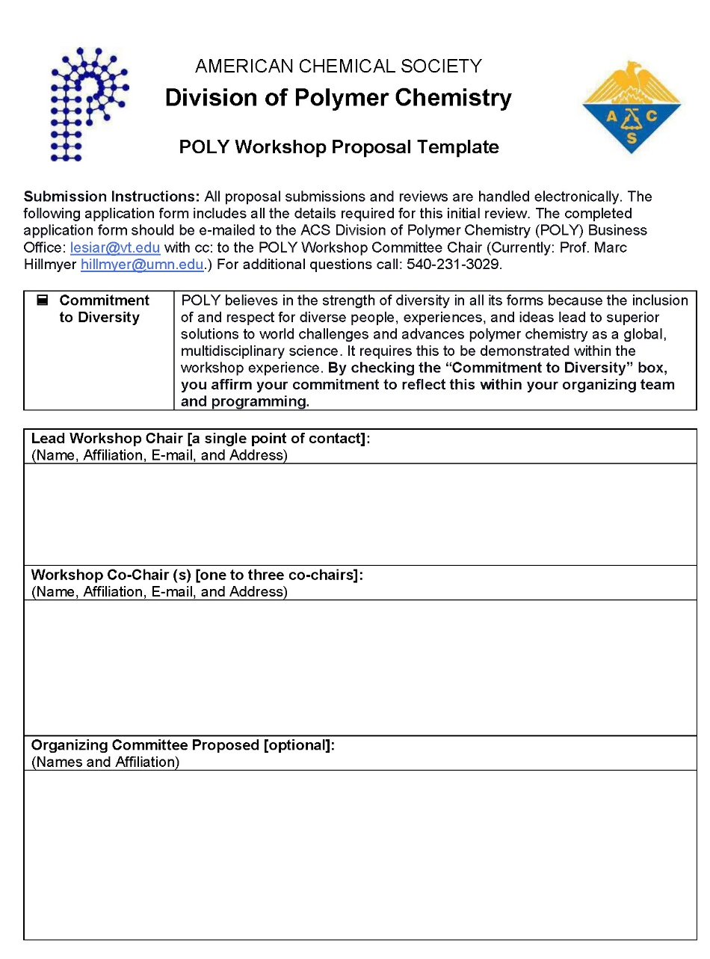
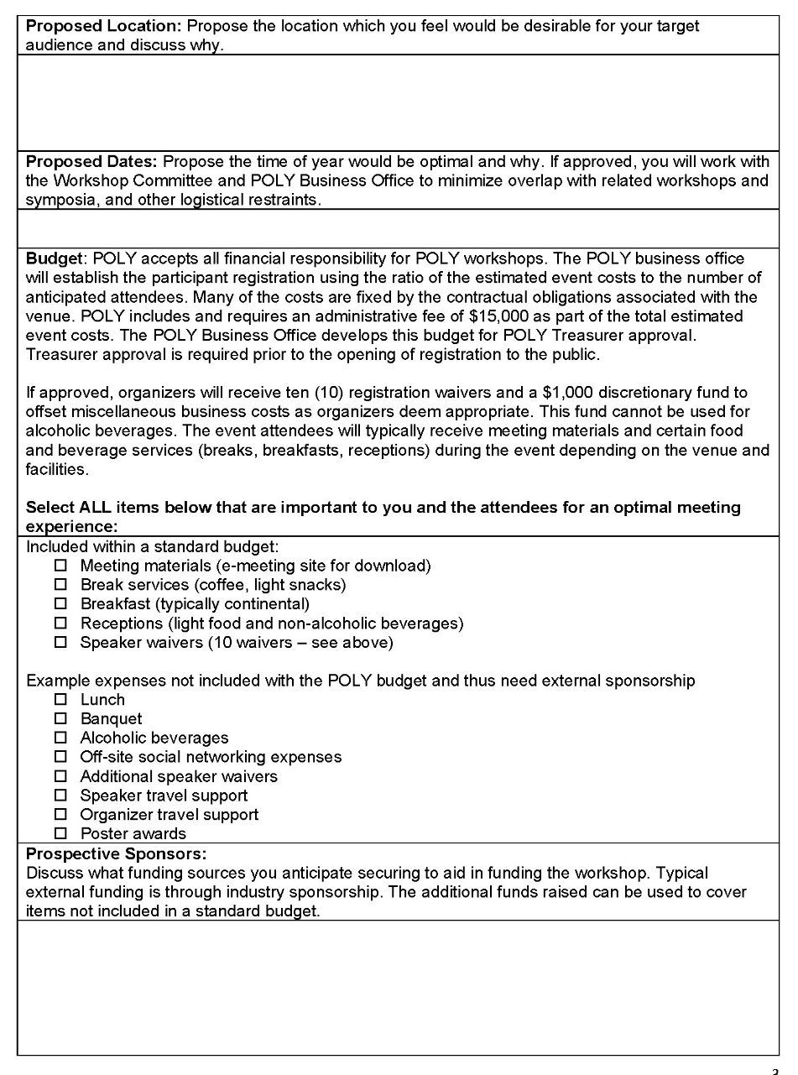
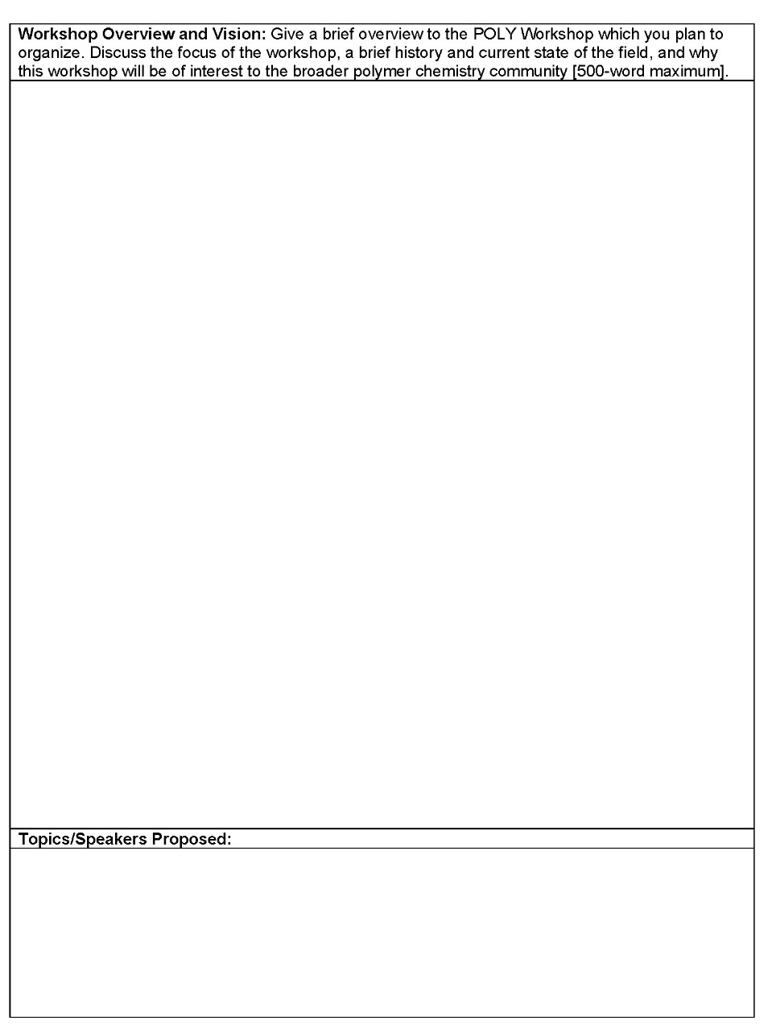
FYI: New proposal forms created by committee in 2021
Notes:
To simplify the proposal process for the organizers and to ensure that requests honor POLY desire for equity, diversity and include, a fillable application form was developed in 2021. The applications you are reviewing are using this new form.

Slide 11
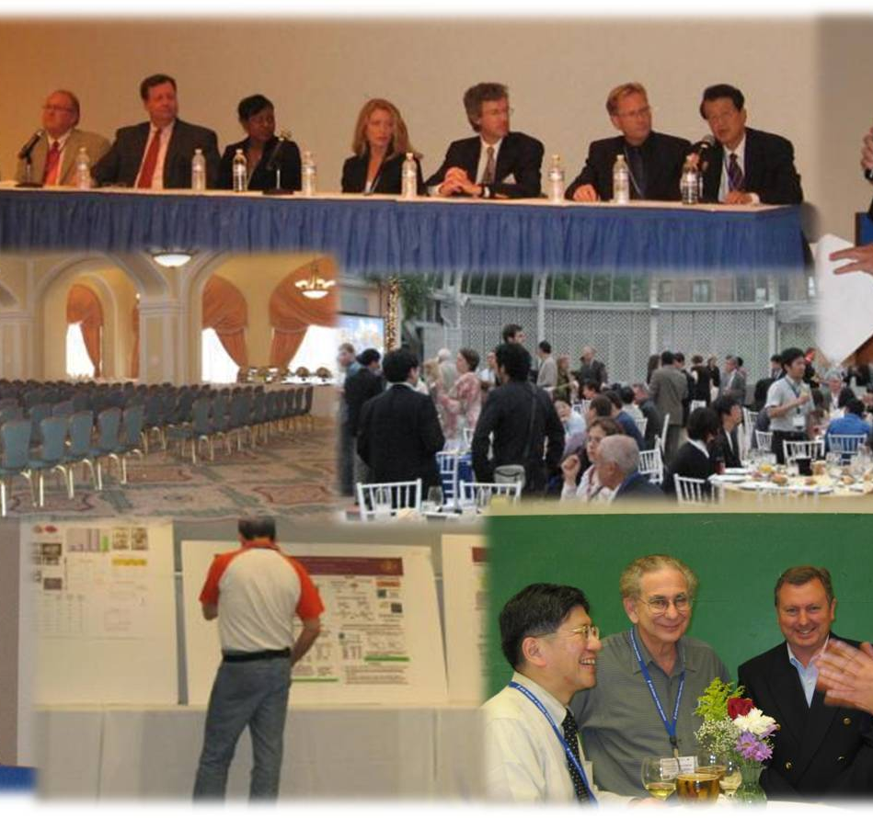
Thank you

