Slide 1

POLY Workshops
Marc Hillmyer: Workshop Chair
Committee: Gobet Advincula, Elizabeth Elacqua, Mike Hickner, Joe Mabry, Jena McCollum, Rakesh Nambiar, and Yongping Zha

Slide 2
2021 Budget
Original Budget
Actual (year-end)
 | in | out |  |  | in | out
21 Sustainable | 55,000 | 40,000 | 15,000 |  | 0 | 375 | -375
21 Fluoropolymer | 65,000 | 50,000 | 15,000 |  | 0 | 0 | 0
21 CRP | 75,000 | 60,000 | 15,000 |  | 31,643 | 33,717 | -2,074
21 Silicon | 65,000 | 50,000 | 15,000 |  | 35,555 | 48,951 | -13,396
21 Macromex |  |  |  |  | 1,454 | 91 | 1,363
22 Fuel Cells | 5,000 | 3,000 | 2,000 |  |  | 250 | -250
22 Future events |  | 8,000 | -8,000 |  | 43,294 | 31,801 | 11,493
Credit card charges |  | 5,500 | -5,500 |  |  | 1,365 | -1,365
2020 Webshop |  |  |  |  | 855 | 189 | 666
2021 Webshop |  |  |  |  | 3,164 | 36 | 3,128
Totals | 273,000 | 220,500 | 52,500 |  | 115,963 | 116,775 | -810
Notes:
Here is the 2021 Workshop Budget approved and final for 2021. Amid the pandemic, Sustainable and Fluoropolymer were re-contracted to 2023, and POLY negotiated with hotel and organizers to move forward with Silicon and Controlled Radical. Though the financials were turbulent this year, POLY was able to minimize losses.
Notes:
2021 workshop details are on the next few slides.
For 22 future events: Fire and Polymers… and Polyolefins have been working hard on their fundraising and are already active. We have pre-paid some deposits but still ended up with some delta that will need to be spent next year.
Webshops: An add-on to POLY Member offerings and the budget; however, we question whether POLY membership has significant interest in paying for virtual offerings when ACS offers webinars for free. More information on upcoming slides.

Slide 3
2022 Budget
Proposed
 | in | out
22 Colloids | 25,000 | 40,000 | (15,000)
22 Fuel cells | 65,000 | 50,000 | 15,000
22 Fire & polymers | 75,000 | 60,000 | 15,000
22 Polyolefins | 75,000 | 50,000 | 25,000
22 Nanotechnology | 65,000 | 50,000 | 15,000
22 Biomed | 65,000 | 50,000 | 15,000
23 Future events |  | 8,000 | (8,000)
Credit card charges |  | 5,500 | (5,500)
2022 Virtual re-broadcasts from workshops | 1,100 | 100 | 1,000
Increased wages |  | 10,000 | (10,000)
Totals | 371,100 | 323,600 | 47,500
Notes:
Here is the 2022 proposed budget for workshops. POLY believes that Colloids and their attendees will get caught up in some restrictions as the last few workshops and will likely have limited attendance. We expect a loss similar to the Silicon-Containing workshop.
All other events, we hope, are promising as we get back to some type of normal.
The virtual income is projected from proceeds of re-broadcasting virtual pieces from Silicon and Colloids (more information is in the slides coming up)
POLY Business Office is proposing an increase in wages due to the increase of workshops from 4 to 6. This would allow for a temp student or wage for a few months during its most busy time.

Slide 4
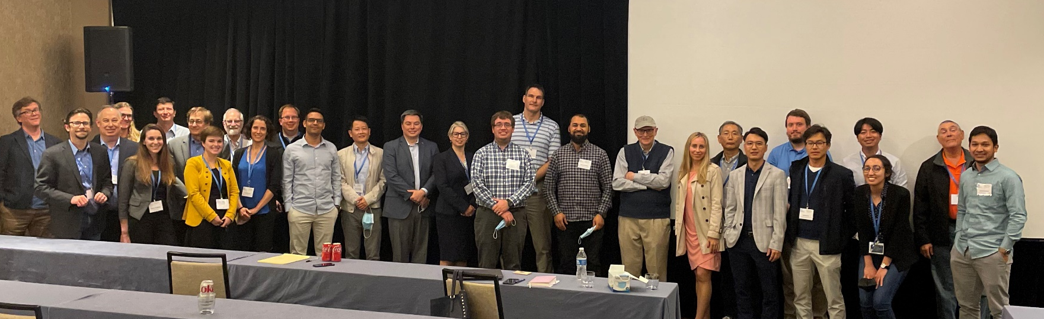
In-Person workshops

Slide 5
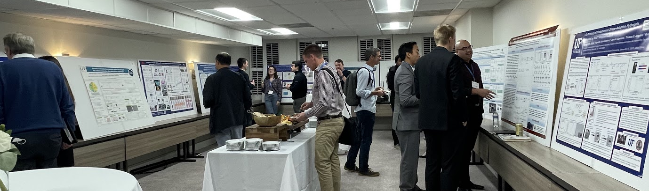
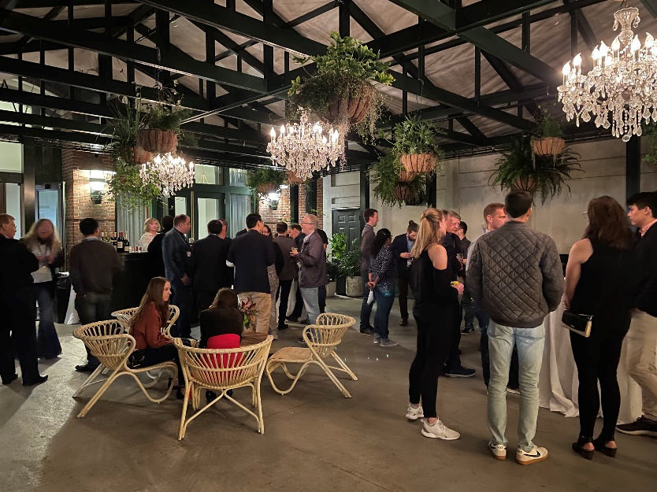
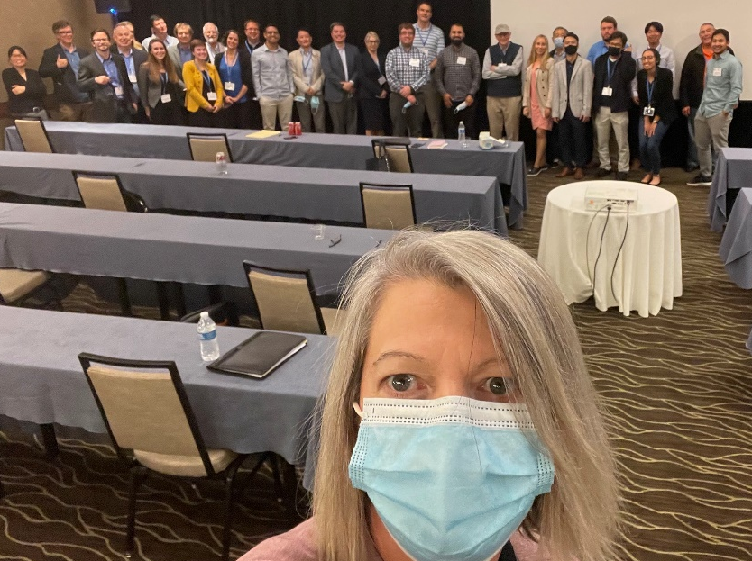
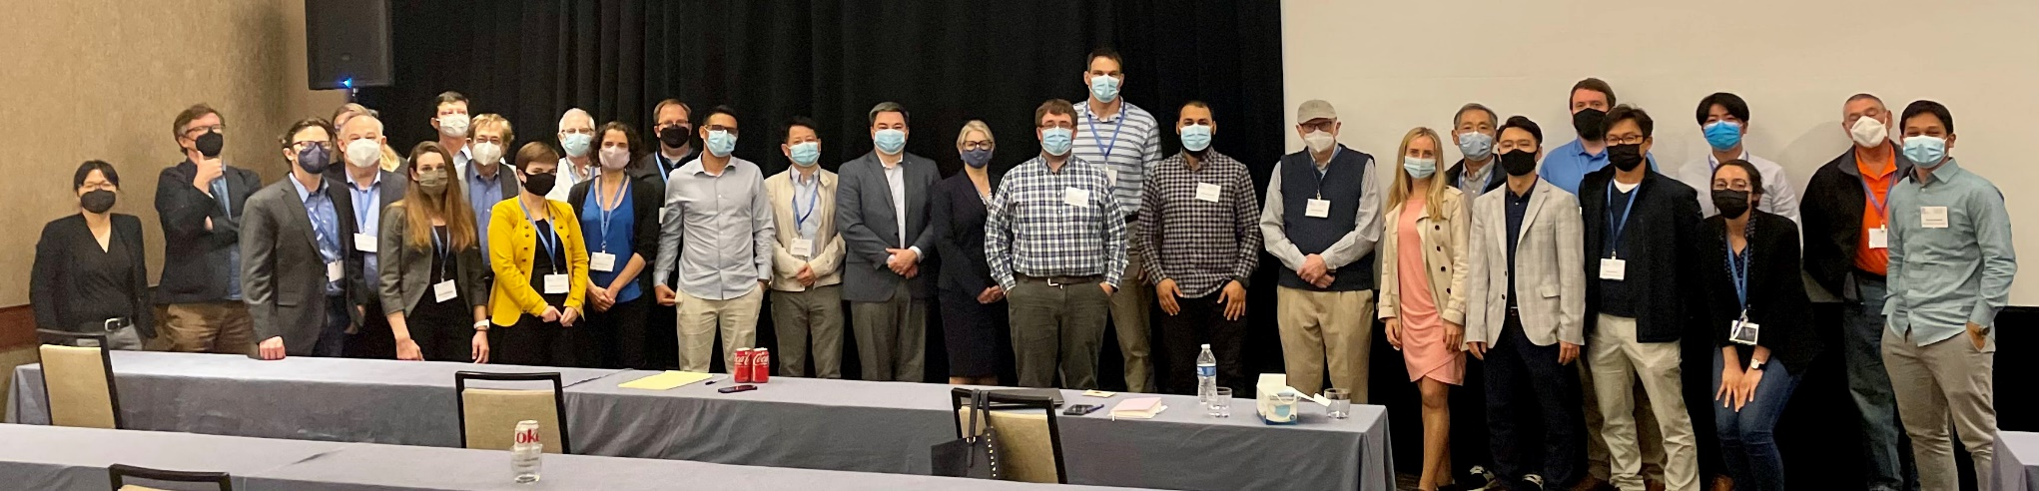
2021
Controlled Radical Polymerization(14 - 17 Nov 2021)
  Kris Matyjaszewski (Carnegie Mellon U), Nick Tsarevsky (Southern Methodist U), Haifeng Gao (Univ of Notre Dame), Brent Sumerlin (Univ of Florida)
51 Attendees
Silicon-Containing Polymers and Composites (1-4 Dec 2021)
  Joseph Furgal (Bowling Green State Univ), Claire Hartmann-Thompson (3M)
  43 Attendees
Macromex (1-4 Nov 2021)
POLY provided general advertising and registration support
Notes:
POLY held 2 in-person workshops during 2021. The consensus, as typical, was that there is significant value in an in-person experience.
POLY Business Office thanks organizers for pushing forward and bringing attendees together.
Silicon-Containing offered a virtual piece post-meeting (2 days, 7 speakers). These sessions were recorded and organizers/speakers agree to allow POLY to rebroadcast as desire.
Macromex, POLY signed a letter of agreement to provide advertising and general registration collection of US participants. Their event was virtual.
November 1 - 4, 2021
Riviera Maya
Organizers: Lepe, Cruz, Advincula, and Cunningham

Slide 6
2022 approved
Polymer Colloids (19 – 22 Feb 2022)
  Wei Gao (Dow), John Tsavalas (UMH)
Polymers for Fuel Cells, Energy Storage, and Conversation (15 – 18 May 2022)
  Brian Benicewicz (Univ. SC), Tom Zawodzinski (UTK), Mike Hickner (Penn St.)
Fire and Polymers (5-8 June 2022)
  Jaime Grunlan (Texas A&M), Alexander Morgan (U. Dayton Res. Inst.)
Advances in Polyolefins (18 – 21 Sept 2022)
  Jerzy Klosin (Dow), Rick Register (Princeton), Ken Wagener (U. FL), Pal Arjunan (Eureka-GlobalChem), Joao Soares (U. Alberta)
Polymers and Nanotechnology (16 – 19 Oct 2022)
  Rick Laine (UM), Jaime Grunlan (Texas A&M)
Polymers in Medicine and Biology (23 – 26 Oct 2022)
  Theresa Reineke (UMN), Buddy Ratner (Univ. Washington)
Notes:
This slide represents the slate of 2022 POLY workshops that are approved. For complete information, visit:
https://www.polyacs.net/workshops

Slide 7
2023 approved/rescheduled
Fluoropolymer (17 – 22 June 2023)
  Scott Iacono (USAF Academy), Bruno Amaduri (CNRS), Jena McCullum (U Colorado, Colorado Springs)
Sustainable Polymers (15 – 18 October 2023)
  Marc Hillmyer (UMN), Thomas Epps (U. Delaware), Megan Robertson (U. Houston)
Notes:
This slide represents the slate of 2023 POLY workshops that are approved i.e. rescheduled from previous years due to Covid-19. For complete information, visit:
https://www.polyacs.net/workshops

Slide 8
2023-24 Workshop proposals for this meeting
Workshop Topics | Potential Organizers
2023 Polymers in Data Science | Kate Beers (NIST), Brad Olsen (MIT), Debra Audus (NIST)
2023 Controlled Radical Polymerization | Kris Matyjaszewski (Carnegie Mellon University), ​ Nick Tsarevsky (Southern Methodist University), ​ Haifeng Gao (University of Notre Dame), Brent Sumerlin (University of Florida)
2024 Advancing Protection Through Materials Design | Aaron Forster (NIST), Joseph M. Dennis (Army Research Laboratory), Amanda L. Forster (NIST) Plan to recruit for organization: Vicky Nguyen (Johns Hopkins University), Leslie Lamberson (Colorado School of Mines)
2024 Polymer Upcycling and Circularity | Brett Helms (LBL) Plan to recruit for organization: LaShanda Korley, (University of Delaware), Kat Knauer (NREL)
For approval at this meeting
Notes:
In 2021, the POLY workshop committee reached out to 10 potential workshop groups (both previous and new) based on topics of interest in the field. Of those, 4 submitted a workshop proposal for this cycle. The committee approved all submissions and ask that POLY Exec review and approve them. They are ___ (above)
Following is a complete list of organizers the committee reached out to:
Polymer Peptoids, Laura Stratton (PCI) and Richard Hoogenboom
The Defense Applications/Structure-Property Measurements, Aaron Forster (NIST)
Polymers in Data Science, Kate Beers (NIST), Brad Olsen (MIT)
Entrepreneurship…, Craig Hawker (UCSB), Geoff Coates
Polymer Composites and High Performance/ combine possibly with Manufacturing
Polymers/Additives/Machine learning, Sarah Morgan (Uiv So. Miss), Jena McCullum (Univ Colorado, Colorado Springs)
AI/ML driven Continuous Flow Chemistry Polymerizations, Gobet Advincula
Next Generation/Smart Materials, Johan Foster and Erik Berda
Microplastics, Kate Beers (NIST), Rob Mathers (PSU), Kensington (sp),
Membranes i.e. Water Purification, Abhishek Roy (NREL), Mike Hickner (PSU)
Cir. Economy in Polymers, Brett Helms

Slide 9

Virtual workshops (POLY Webshops)

Slide 10
Webshops in 2021
Live
On-demand
Catalysts in Polymers
2020
77 attendees*
24 paid
2021
22 paid
97 views
Net income
+875.99
Stimulus-Responsive Polymers and Liquid Crystal Elastomers
2021
116 attendees*
23 paid
2021
19 paid
93 views
POLY IAB sponsored speaker honoraria
Net income
+3,128.00
Is it advantageous to continue? * Topics? * Schedule? * Opportunities?
* 10 access links were given per each 1 registration purchased
Notes:
In 2021, POLY rebroadcast the Catalysts in Polymers webshop and offered a live and rebroadcast of Stimulus-Responsive Polymers.
Catalyst:
October 2020 - Live
- 77 attendees for live session
Of those 24 paid (REMEMBER: offered 10 per registration for access)
February 2021 – On-Demand
22 paid on-demand attendees
97 on-demand views
Stimulus
April 2021 - Live
- 116 attendees for live session
Of those 23 paid (offered 10 per registration for access)
October 2021 – On-Demand
- 19 paid on-demand attendees
- 93 on-demand views

Slide 11
Webshops in 2022 and beyond
Opportunities
Live workshops, virtual piece
Silicon-Containing Polymers and Composites (1-4 Dec 2021)
    2 virtual follow-up sessions in Decembers, Organizers and speakers agree to use of recordings.
    Operate as a re-broadcast at regular fee (49.00)
Polymer Colloids (19 – 22 Feb 2022)
    Hybrid/virtual sessions during workshop, Organizers and speakers agree to use of recordings.
    Operate as a re-broadcast at regular fee (49.00)
Future?
  Is there a special advantage for POLY to continue amid the free webinars by ACS?
Notes:
Both the Silicon-containing and Colloid workshops will or did offer a virtual piece as part of their in-person experience. The POLY Business Office proposes operating those virtual pieces as we have done for the webshop re-broadcast throughout 2022.
FYI:
Silicon complete their virtual piece post-meeting via zoom
Colloids plans to offer a hybrid experience during their meeting.

Slide 12

National Graduate Research Polymer Conference

Slide 13
National Graduate Research Polymer Conference (NGRPC)
POLY’s role
Workshop Committee reviews proposals biennially to select a hosting university. POLY Exec approves committee recommendations.
Sponsorship
Call for proposals for 2023
Submissions for 2023
  University of Michigan
  Arizona State University
Previously
Penn State, 1994
VA Tech, 1996
University of Akron, 1998
Southern Mississippi Univ., 2000
Lehigh, 2003
UMASS, 2005
UT Knoxville, 2007
University of North Carolina at Chapel Hill, 2010.
Case Western Reserve University, 2012.
Louisiana State Univ., 2014
University of Akron, 2016
University of Minnesota, 2018
Virginia Tech (virtual), 2021
Recommendation:
________________
For approval at this meeting
Notes:
The workshop committee reviews proposals biennially to select a hosting university for the National Graduate Research Polymer Conference (NGRPC) . Since the 2020 installment was postponed until 2021, the cycle is now shifted to 2023. For more information regarding Virginia Tech virtual conference, visit the fall POLY newsletter. They did a great job incorporating an avatar-based platform called gather-town.
POLY selects the hosting university, and sponsors the event through regional meeting funds and IAB.
POLY Exec approves committee recommendations.
We had 2 proposals submissions and the committee is recommending ____
FYI: The committee invited previous submitters: Georgia Tech, Michigan, NC State and send general notices to the POLY Membership.

Slide 14
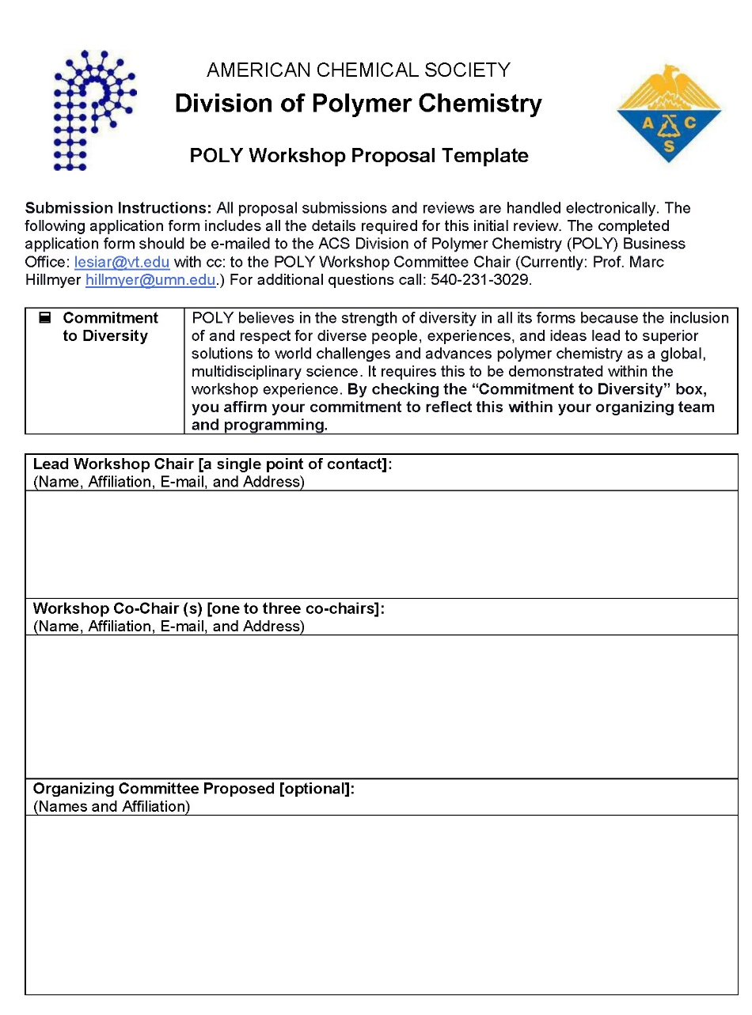
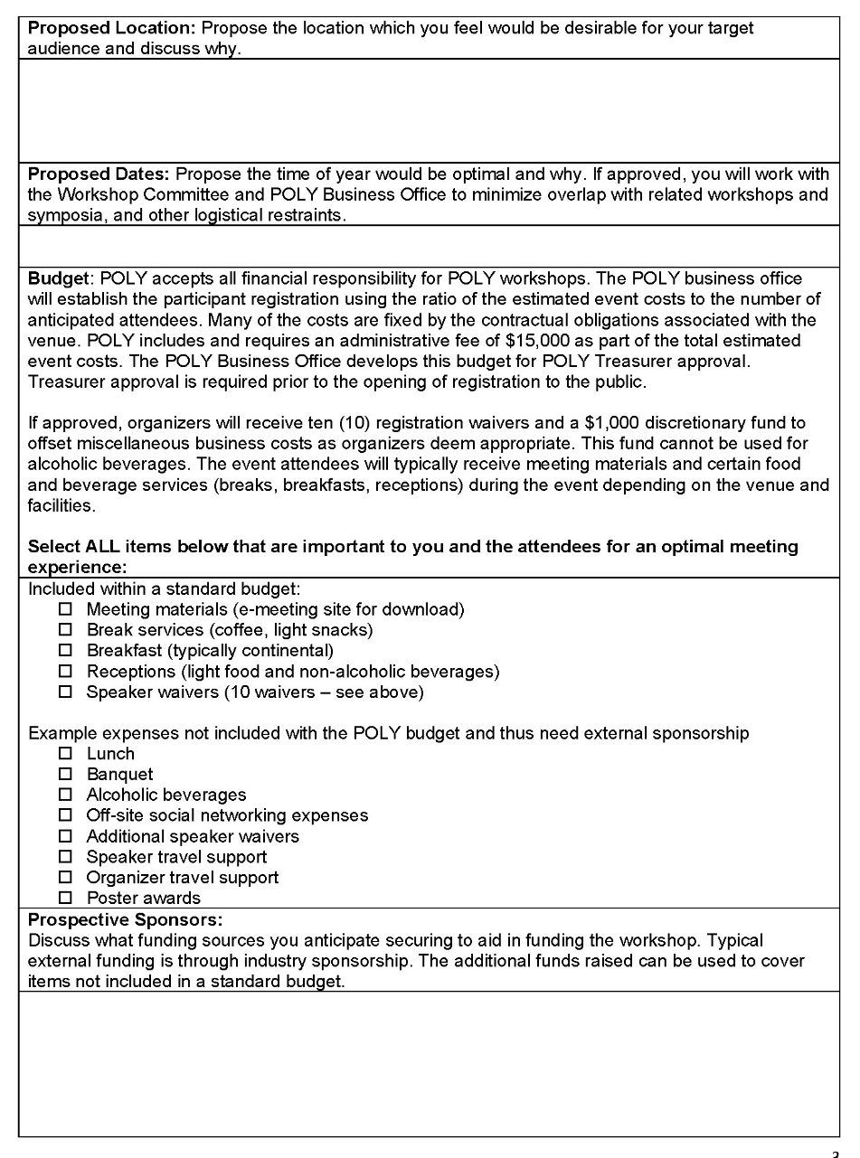
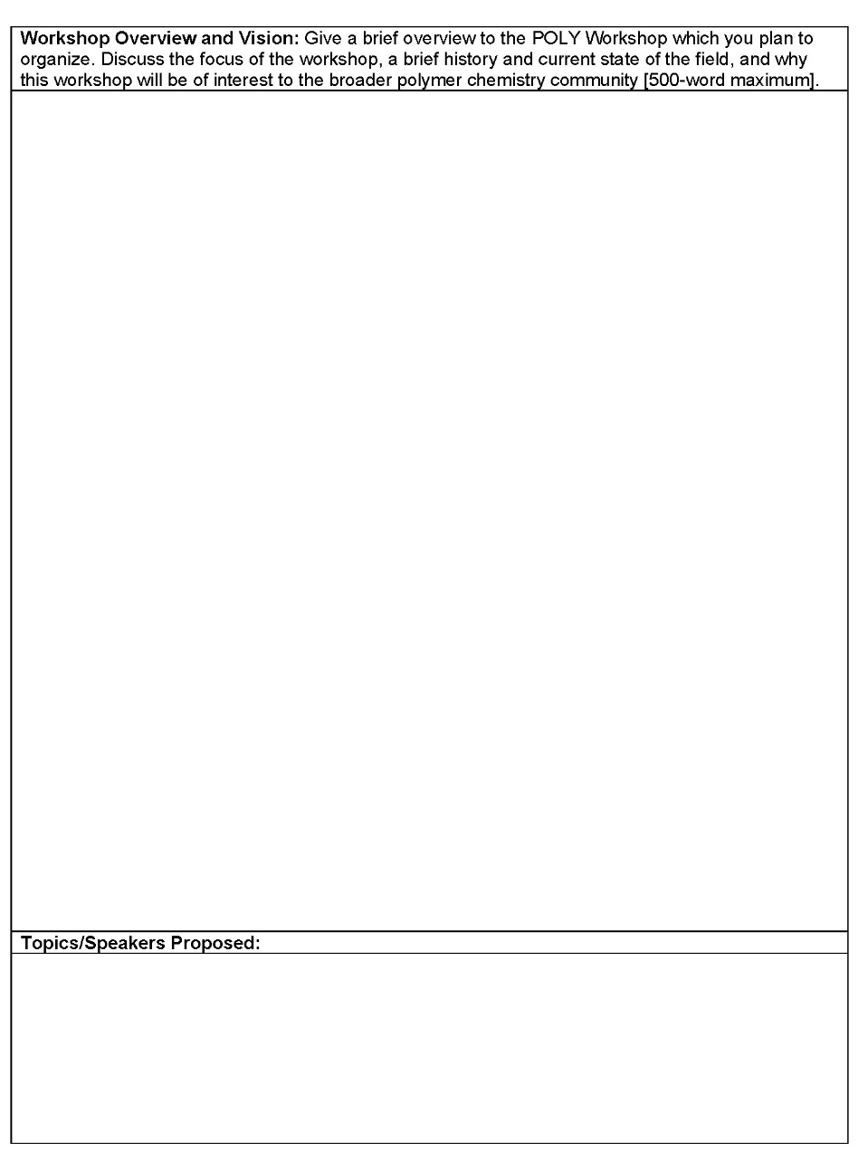
FYI: New proposal forms created by committee in 2021
Notes:
To simplify the proposal process for the organizers and to ensure that requests honor POLY desire for equity, diversity and include, a fillable application form was developed in 2021. The applications you are reviewing are using this new form.

Slide 15
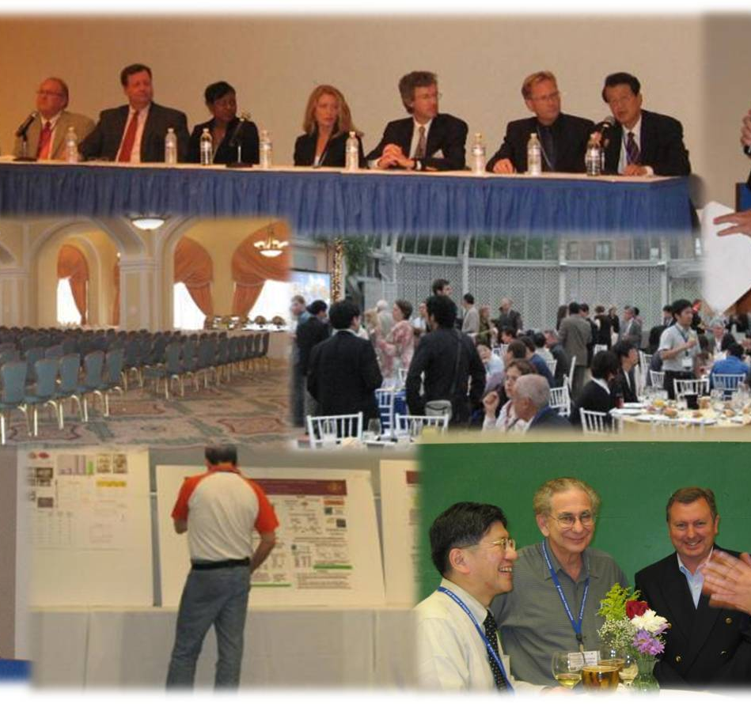
Thank you
Request for Winter Business Meeting:
Approve/incorporate new 2022 budget
Approve future POLY Workshops
Approve selection for 2023 NGRPC

Slide 16
Notes and previous docs:

Slide 17
POLY workshops FUTURE PLANNING summary | 2020 | 2021 | 2022 | 2023 | 2024 | 2025 | 2026
Fuel Cell |  |  | X |  |  | X
Layered Polym Sys | X
Sustainable |  |  |  | x | X
Fluoropolymer |  |  |  | x |  | X
Composites |  |  |  |  |  | X | X
Polyolefins |  |  | X |  | X
Med & Biol |  |  | X |  |  | X
Silicon |  | X |  |  | X
Nanotech |  |  | X |  |  | X
Smart Polym |  |  |  |  | X |  | X
Controlled Polym |  | X |  | X
Polym Colloids |  |  | X |  |  | X
Polym Additives |  |  |  |  | X | X
Peptoids |  |  |  |  | X
Defense Apps/Advancing Protection Through Materials Design |  |  |  |  | X
Fire and Polymers |  |  | X
Polymers in Data Science |  |  |  | x
Polymer Upcycling and Circularity |  |  |  |  | x
Polycondensation |  |  |  |  | X
PPF/PPC Hawaii |  |  |  |  |  | X
Macromex (Admin Only) |  | X |  | X
X: Completed
X: Proposed X: Approved
X: Future for consideration
4 Per year at current staff levels
Notes:
Here is the workshop committee grid. Your key take away is that the Workshop Committee is always looking 1 to two years in advance. They seek out potential topics of interest but also welcomes anyone wishing to propose an idea. As mentioned previously, Fluoropolymer is currently be shifted again.. This time to 2023. Contracts are currently being negotiated.

Slide 18
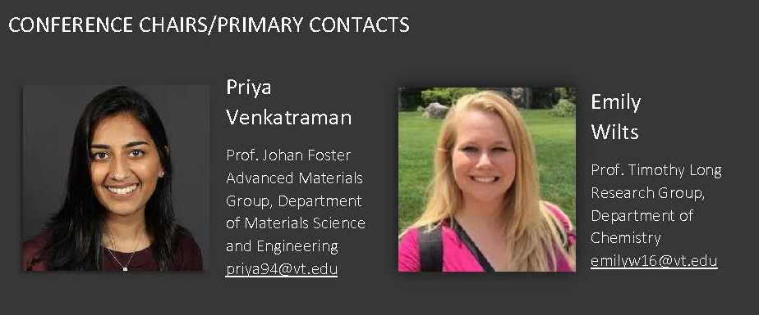


2021
National Graduate Research Polymer Conference (NGRPC)
VIRTUAL EVENT
July 26 – 28, 2021
(originally set for 2020)
Report will be posted in the Fall Newsletter
POLY’s role
Workshop Committee reviews proposals biennially to select a hosting university (next review will start in 2021 for a tentative 2023 event
Sponsorship
Call for proposals
Fall 2021
Notes:
The NGPRC finished up last month and we congratulate these organizers for navigating through uncharted territory. They are working on a reporting and hope to offer POLY an article for the Fall Newsletter.
We will start a Call for Proposals this Fall and decisions will be made in January.

Slide 19
Notes from Fall 2021 - Workshop Committee Meeting
(1) Review the current workshop list and status
(2) Get feedback on the new workshop and graduate conference proposal form (send this in advance of the committee meeting)
(3) Talk about possible new workshops for 2023 and get a list of folks to contact (e.g., the groups you listed below). We can wait until after the workshop committee meeting to solicit new proposals.
(4) Create a plan for the Grad Conference procedure for review
  Hillmyer/group to review previous procedures per H. N. Cheng
  Proposal deadline October 30
  Review Nov and Dec
  Recommendations to Exec by January

Slide 20
2020 Budget
Original Budget
Actual
 | in | out |  |  | in | out
20 Layered Poly. Sys. | 42,565 | 33,264 | 9,301 |  | 26,333 | 26,821 | -488
20 Sustainable | 50,775 | 36,775 | 14,000 |  | 11,050 | 5,567 | 5,483
20 Fluoropolymer | 66,925 | 49,426 | 17,499 |  | 821 | 1,685 | -864
20 Controlled | 66,000 | 50,000 | 16,000 |  | 2,500 | 2,270 | 230
20 Webshop | 11,000 | 9,000 | 2,000 |  | 2,489 | 2,300 | 189
21 Future events | 6,000 | 8,000 | -2,000 |  | 0 | 161 | -161
Increased wages |  | 3,000 | -3,000 |  |  | 0 | 0
Credit card charges |  | 5,000 | -5,000 |  |  | 2,568 | -2,568
2019 Workshops |  |  |  |  | 1,646 | 1,646 | 0
Totals | 243,265 | 194,465 | 48,800 |  | 44,839 | 43,018 | 1,821
Notes:
Here is an overview of the 2020 POLY budget (original and then actual). The POLY Executive Committee has already seen this and the key takeaway is that due to pandemic cancellations, there was a direct impact on the POLY budget. The POLY Treasurer can speak more on this topic as needed.

Slide 21
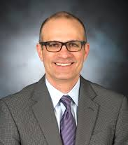
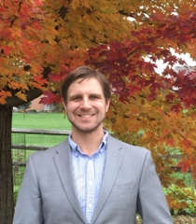
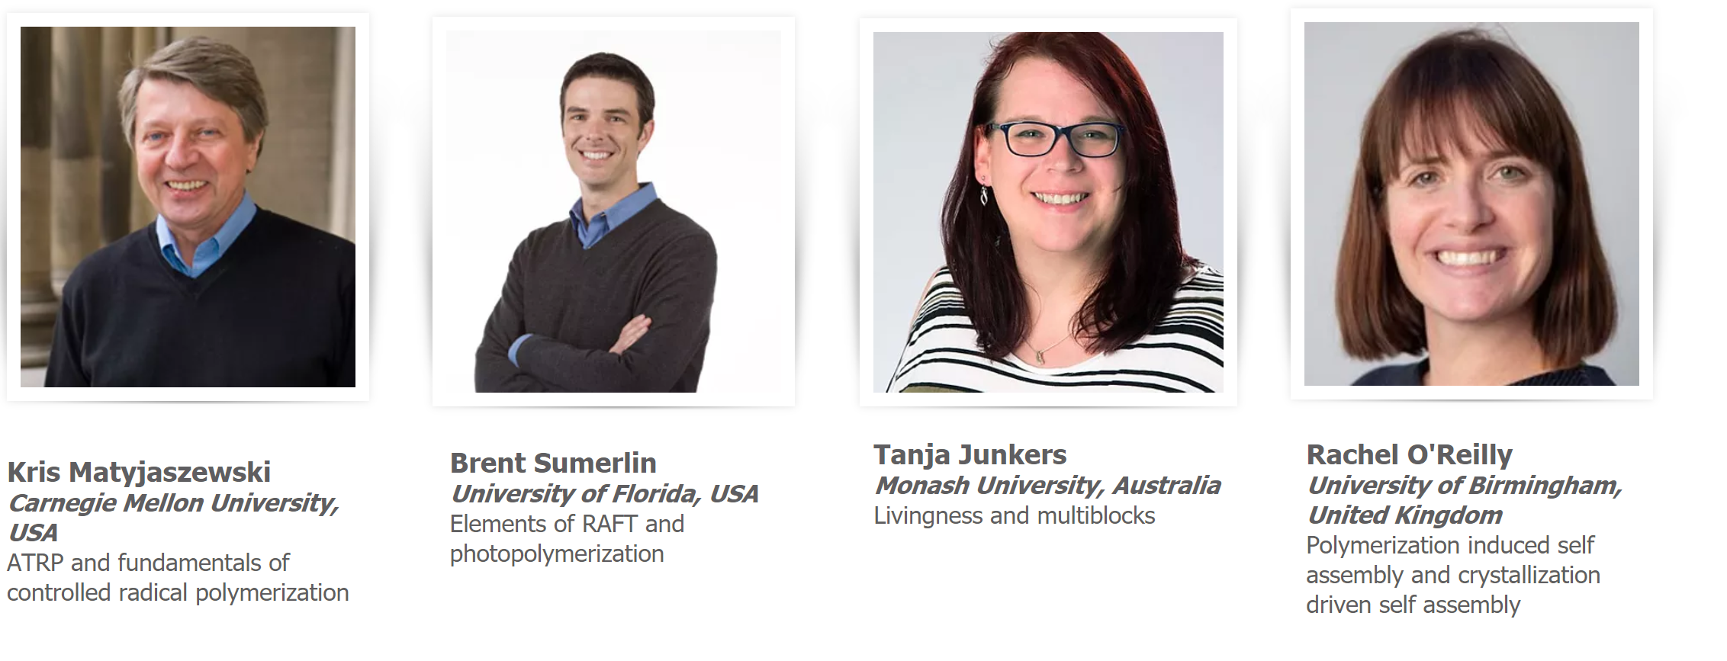
2019 Webshop
Exec. Producer
M. Hillmyer
(UMN)
Host
D. Konkolewicz
(U. Miami Ohio)
Controlled Polymerization
Cost
$99 live
$49 rebroadcast
Attendees
Live, June | 84
Rebroadcast, October | 9
On demand, November | 21
Total | 114
Income |  |  | Expenses
Registrations | 10,965 |  | Honoraria and/other details | 8,567
IPG | 4,154
Totals | +15,119 |  |  | -8,567 | 6,552
Bal w/o IPG |  |  |  |  | 2,398
5
Notes:
During POLY’s 2018 strategic planning, a strategy was proposed to “Organize a virtual workshop/tutorial on a contemporary topic for launching in 2019.” As such, In collaboration with ACS Webinars, POLY organized a workshop-like online experience of modern polymer chemistry content for POLY members which attendees accessed from home or work at a relatively small cost. Dominik K. organized this with the mentorship of Marc Hillmyer of Minnesota. The inaugural Web-Shop on Controlled Polymerization was successfully broadcast on June 24 with 2 re-broadcasts later in the year.
We will need to identify if ACS is willing to host this again and if POLY sees a benefit for repeating.
The Key point is: without IPG, the event netted 2,398. ACS plans to charge more for continuing the event… from 3K to 5K…and the event plans for 1 less speaker.. -4K to -3K. What adjustments will we need to make on the event budget to accommodate this.
Dominik has already identified the next Host/Organizer Brian Long.

Slide 22
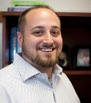
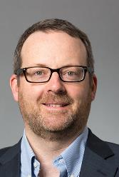
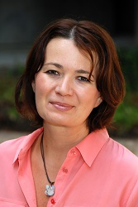
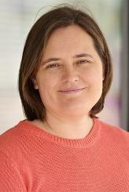
2020 Webshop
Catalysts in Polymers
Executive Producer
D. Konkolewicz
(U. Miami Ohio)
Host
B. Long
(Univ. Tenn. Knoxville)
October 2020 - Live
- 77 attendees for live session
Of those 24 paid (offered 10 per registration for access)
February 2021 – On-Demand
22 paid on-demand attendees
  97 on-demand views
Geoffrey Coates
Cornell University
Paula Diaconescu
UCLA
Charlotte Williams
University of Oxford
Notes:
We have just completed our re-broadcast of the second webshop on Catalysts in Polymers. There was continued interest for the re-broadcast.
22 individuals paid for the on-demand and POLY did not restrict how many views or users within departments had access. The video itself was viewed 97 times during the re-broadcast period.

Slide 23
Jan |  |  | Winter Exec
Feb | Polymers and Nano (Feb 21 – 24)
Mar |  | ACS Mtg (Mar 21 – 25)
….. June |  |  | Webshop (April)
July
Aug |  | ACS Mtg (August 22 – 26)
Sept | Fluoropolymer (Sept 19 – 22)
Oct | Sustainable Polymers (Oct 17 – 20) |  | Webshop Rebroadcast
Nov | Controlled Radical Polymerization (Nov 14 -17)
Dec | Silicon-Containing (Dec 1 - 4) | PACIFICHEM
POSTPONTED DUE TO COVID-19

