Slide 1

POLY Workshops
Beth Elacqua: Workshop Chair
Committee: Gobet Advincula, Mike Hickner, Helen Tran, Jena McCollum, Rakesh Nambiar, and Yongping Zha

Slide 2


2024 POLY Workshops Success
99 Attendees 40 Speakers 25 Posters 8 Sponsors | Budget Overview: $101,534 Income $78,881.32 Expenses (including 20k Admin Fee) $22,653.28 Meeting Gains Donated to POLY
Fire & Polymers
May 12-15, 2024 - New Orleans LA
Jaime Grunlan Texas A&M University
Alexander Morgan
Univ. of Dayton Research Institute
106 Attendees 30 Speakers 21 Posters 19 Sponsors | Budget Overview: $137,216 Income $133,921.77 Expenses (including 20k Admin Fee) $3,294 Meeting Gains Donated to POLY
Organizers:
Jerzy Klosin, Rick Register, Kim Ragaert,
Kenneth B. Wagener, João B. P. Soares

Slide 3

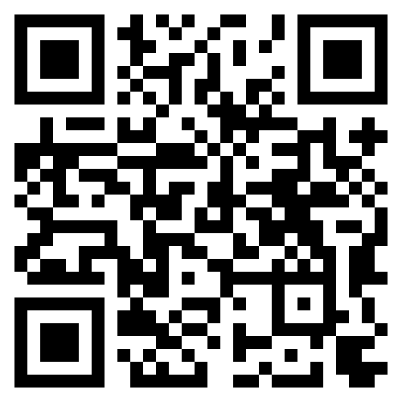


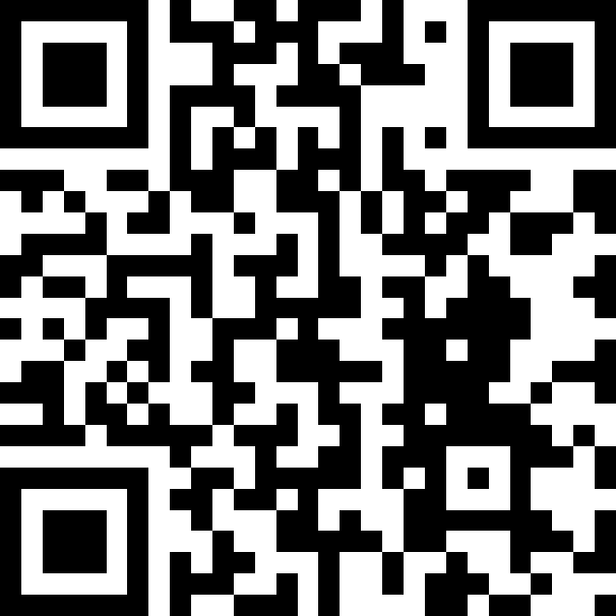

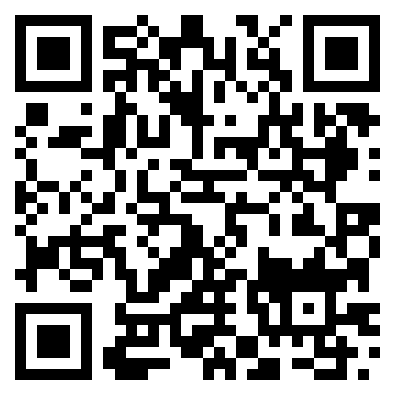
2025 POLY Workshops
ASU Organizers:
S. Eileen Seo
Timothy E. Long
March 18-21, 2025
Organizers:
Jena McCollum Bruno Ameduri Cameron Parish Frank Leibfarth
Organizers:
Brian C. Benicewicz Michael Hickner Tom Zawodzinski
Safety Harbor, FL – November 2-5, 2026

Slide 4

2026 POLY Workshops
Fire and Polymers Jaime Grunlan & Alex Morgan May 17-10, 2026 Westgate Hotel, San Diego, CA | ExComm Approved Budget Approved Hotel Contracted
Upcycling/Sustainable Polymers Brett Helms, LaShanda Korley, Megan Robertson, Katrina Knauer November 7-11, 2026 Courtyard by Marriott, Santa Rosa, CA | ExComm Approved Budget Approved Hotel Contracted
Polymer Upcycling / Sustainable Polymers ??DATE?? (Looking at Fall) Waiting for organizers to select date/location. Met with Kathy in July to begin the process | ExComm Approved Pre-Covid
FIRE AND POLYMERS POLY Workshop Committee recommendation open 2026 Jaime Grunlan & Alexander Morgan Target location: San Diego, CA | ExComm Approved Hotel Contracted

Slide 5
2027 POLY Workshops (to be proposed)
Advances in Polyolefins (APO) Organizers: Klosin, Wagener, Register, Soares, and Ragaert June 6-9, 2027, Napa Valley | Proposal Received UP FOR VOTE
Controlled Radical Polymerization (CRP) Organizers: Sumerlin/Matyjaszewski | Anticipated 4 Year Return Proposal Anticipated
National Graduate Research Polymer Conference (NGRPC) TO BE RECOMMENDED | Proposal Deadline March 2025
2 Workshops Annually
SPRING (May/June) or FALL (Oct/Nov) to avoid other meeting/workload
Both of the above typically scheduled in fall – which will take spring/fall

Slide 6
National Graduate Research Polymer Conference (NGRPC)
Workshop Committee reviews proposals to select a hosting university, recommends winner, and POLY Exec approves committee recommendations.
POLY provides $1,000 sponsorship the year of meeting (Regional Support Budget Line)
POLY staff provides minor guidance
Currently on a 2 years rotation. Should this continue on 2 yr cycle?
2027 Application Deadline: March 7, 2025
Workshop comm will review applications, submit recommendation to ExComm at Spring ACS
Previously
Penn State, 1994
VA Tech, 1996
University of Akron, 1998
Southern Mississippi Univ., 2000
Lehigh, 2003
UMASS, 2005
UT Knoxville, 2007
Univ. of North Carolina at Chapel Hill, 2010
Case Western Reserve University, 2012
Louisiana State Univ., 2014
University of Akron, 2016
University of Minnesota, 2018
Virginia Tech (virtual), 2021
University of Michigan, 2023
Arizona State University, 2025
???, 2027
6

Slide 7
Workshop Budget - Stretch over multiple years
For example this year, 4 workshops . . . .
Activity INCOME EXPENSE
2023 CRP Late Sponsor Payment $4,000 0
2023 Sustainable Commission Payment $3,372 0
2024 APO $142,525 $99,633
2024 Fire Polymers $96,028 $48,378
2025 Fluoropolymers Sponsors $5,072 $5,250
2025 Fuel Cells 0 $3,250
2026 Fire and Polymers Hotel Deposit 0 $3,500
2026 Upcycling Hotel Deposit 0 $500
7

