Slide 1

Current Membership
History
January 2021 3,638
January 2020 4,133
January 2019 4,164
January 2018 4,641
January 2017 4,560
January 2016 4,254
January 2015 4,302
January 2014 4,489
January 2013 4,886
January 2012 4,977
January 2011 5,300
January 2010 5,677
January 2009 6,193
January 2007 6,604
Total Members 3,450
Year | Affiliates | Students | Regular
2021 | 162 | 629 | 2,659
2020 | 139 | 724 | 2,775
2019 | 265 | 912 | 2,961
Notes:
ACS has only released data as far back as November 2020. If there is an update before the meeting I will adjust the numbers with the latest.

Slide 2

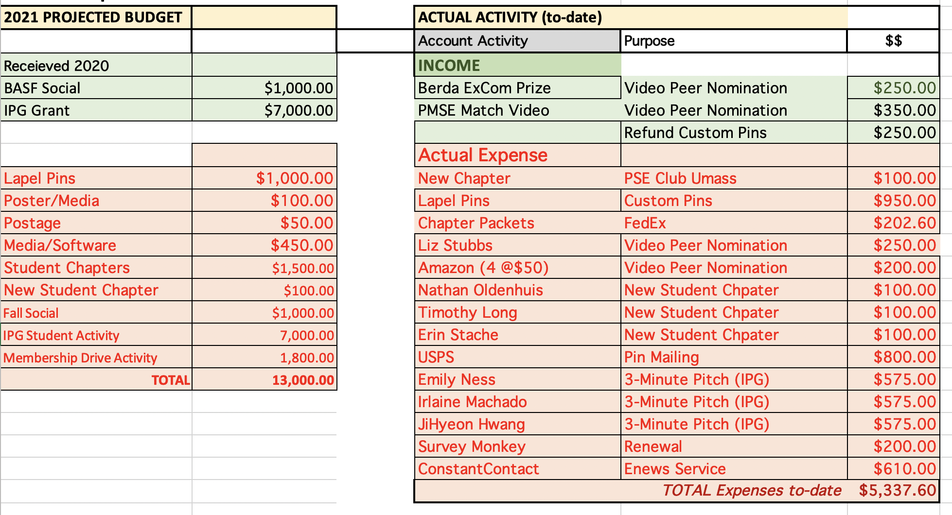
Membership Budget
Only used $1725 of IPG
$7223 under budget
Requesting to use $500 for SCs
Notes:
Check Numbers

Slide 3


POLY/PMSE Student Chapters
Chapter Location Advisor
University of Michigan Charles McCrory
University of Florida Brent Sumerlin
University of Minnesota Reineke Theresa
University of South Carolina Brian Benicewicz
Virginia Tech John Matson
Case Western Reserve Dave Schiraldi
Univ. of Southern Mississippi Derek Patton
University of Akron Kevin Cavicchi
Texas A&M Quentin Michaudel
Cornell University Erin Stache
Umass Amherst Todd Emrick
Arizona State University Tim Long
University of New Hampshire Erik Berda
Best Student Chapter:
The University of Florida, Sofia Goodrich
Outstanding New Chapter:
The University of Massachusetts-Amherst, Liz Stubbs
Pandemic Pivot:
Case Western University, Dana Klein

Slide 4
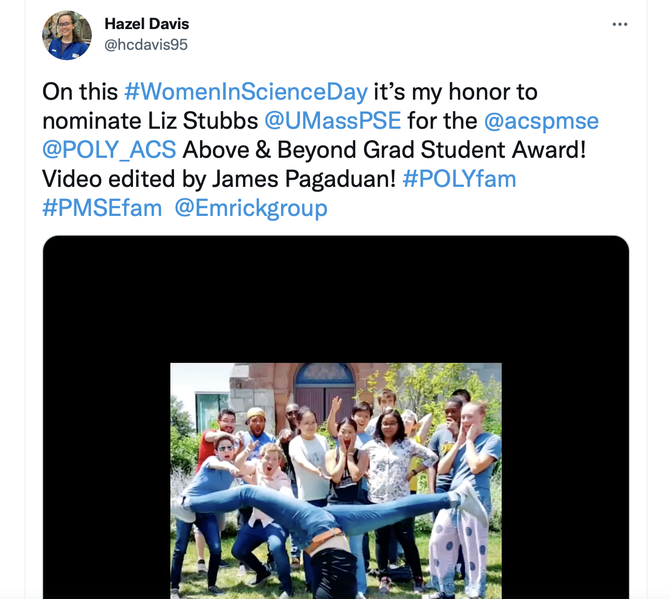
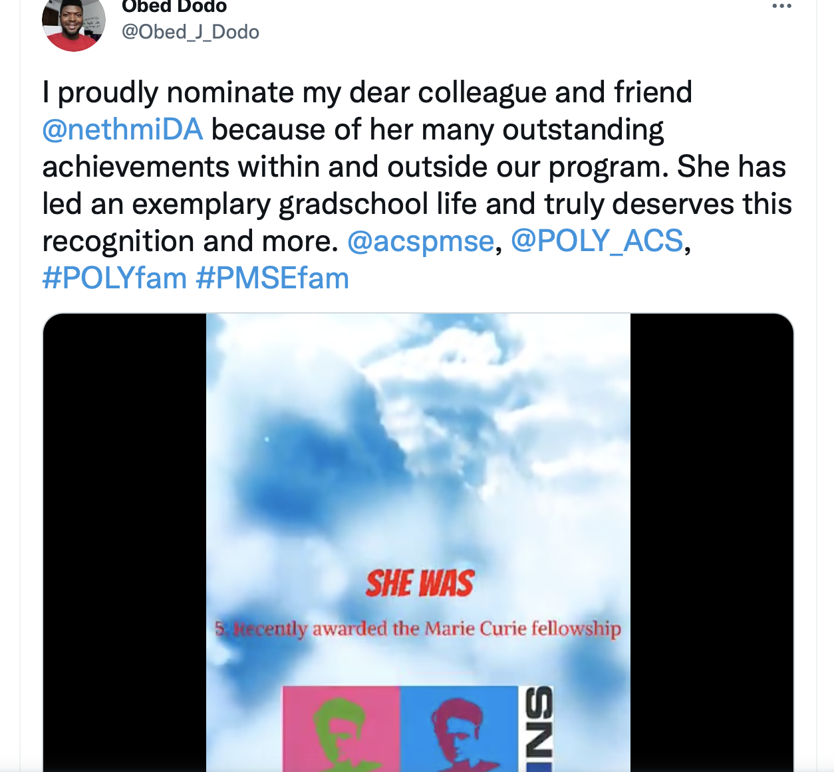
Outstanding Graduate Student Peer Nomination
Lizz Stubbs
UMass Amherst
Nethmi De Alwis
Miami University
https://twitter.com/hcdavis95/status/1359946806214283265
https://twitter.com/Obed_J_Dodo/status/1361125304266293248

Slide 5
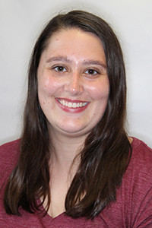
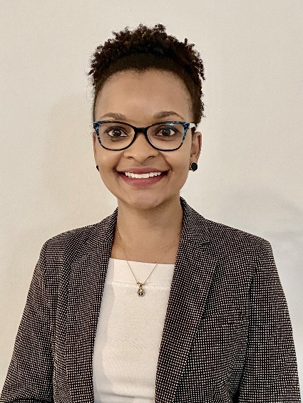
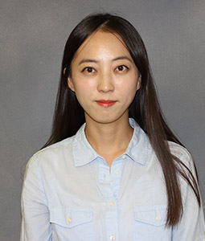
Student Chapters 3-Minute Pitch Competition
THE WINNERS!!
Emily Ness
University of Minnesota
Irlaine Machado
Case Western University
JiHyeon Hwang
University of South Carolina

Slide 6
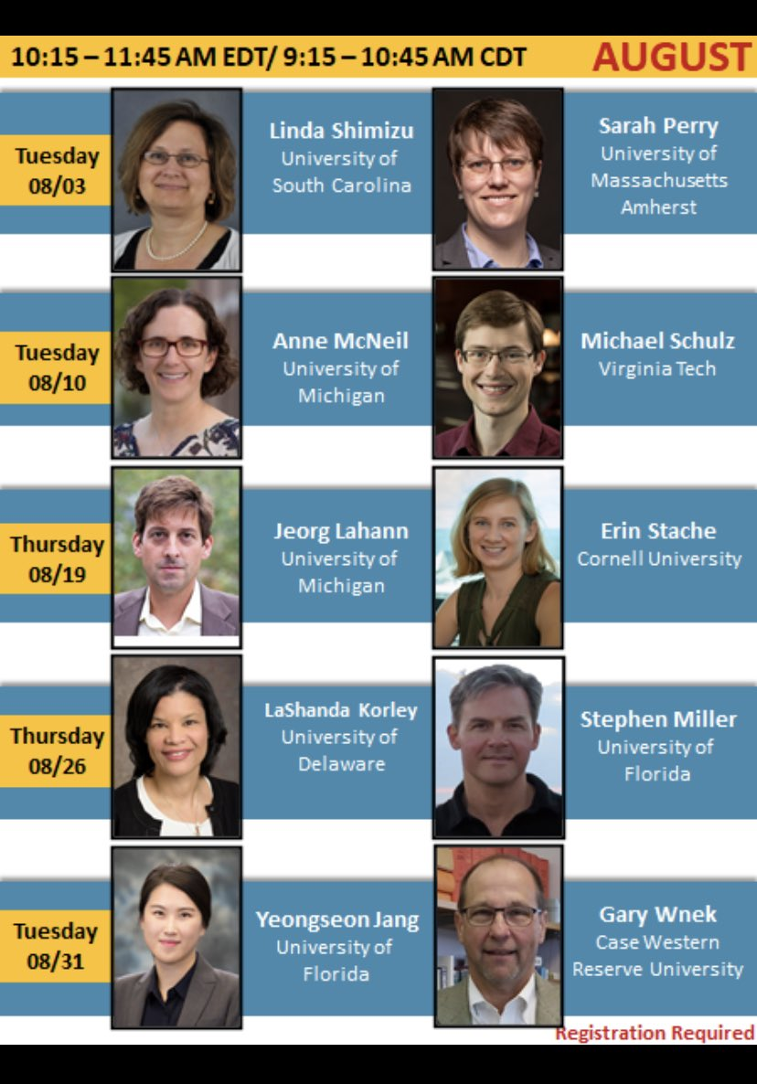
Other Student Chapter Updates
POLY/PMSE STUDENT CHAPTER MACROMOLECULAR SUMMER SEMINAR SERIES

Slide 7
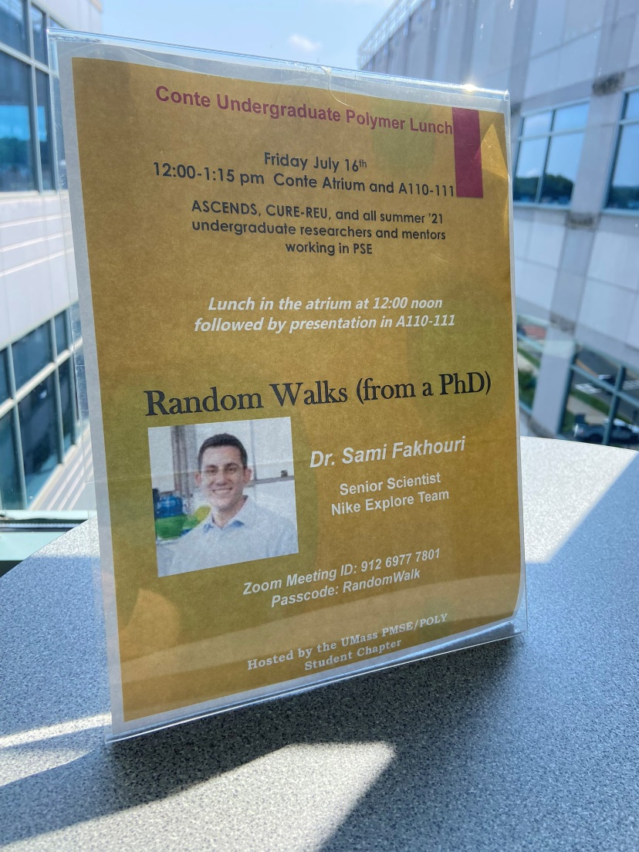
Other Student Chapter Updates
Student Chapter Executive Board
  SC presidents
  Meets biannually
New Format for Annual Chapter Reports
  Student chapters will submit a poster
  Posters will be showcased at ACS meetings
Student Chapter Symposium
  National ACS meeting
Potential New Chapters
  University of Dallas
UMass-Amherst Random Walks Seminar Series

Slide 8
Other Membership Updates
Graduate Student Social
  San Diego Spring Meeting
  Melanie Chu (Stoneybrook)
  Sponsored by BASF
Other Ideas???

