Slide 1
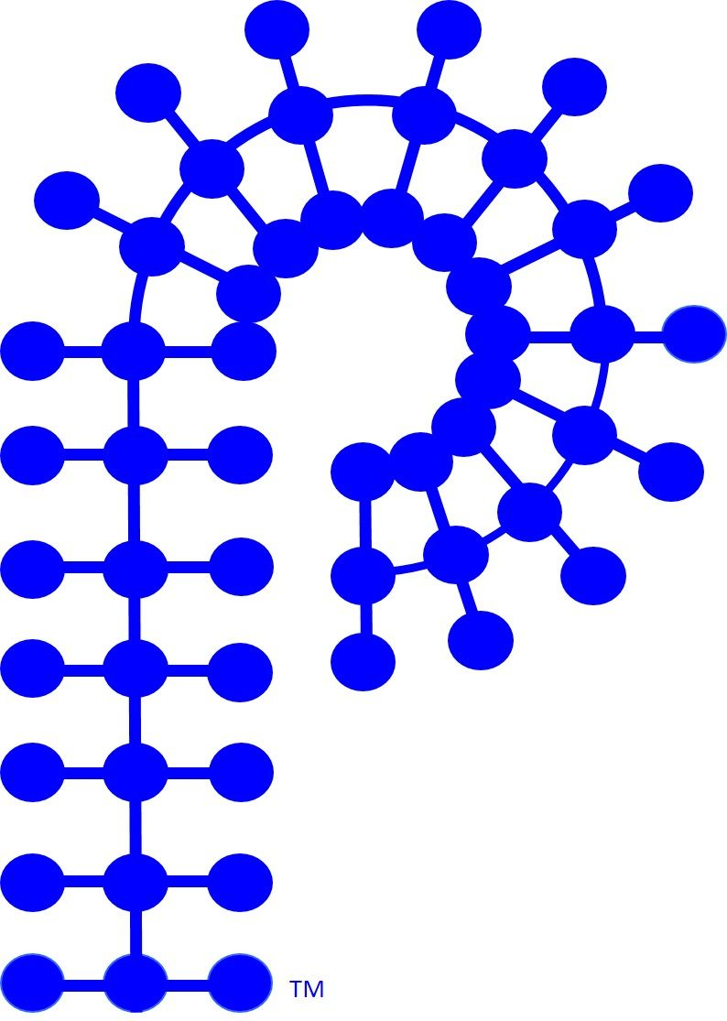
Current Membership
History
December 2021 3,226
January 2020 4,133
January 2019 4,164
January 2018 4,641
January 2017 4,560
January 2016 4,254
January 2015 4,302
January 2014 4,489
January 2013 4,886
January 2012 4,977
January 2011 5,300
January 2010 5,677
January 2009 6,193
January 2007 6,604
Total Members 3,226
Year | Affiliates | Students | Regular
2021 | 143 | 515 | 2,568
2020 | 134 | 734 | 2,840
2019 | 265 | 912 | 2,961

Slide 2
Industry/Government/Academia
Total Members 3,226
Industry makes up a huge portion of our membership with very little benefits!
Academia | Government | Industry | Other
1,315 | 132 | 1,177 | 582
Notes:
Other category includes those listed as other, no response, and N/A.

Slide 3
Membership Budget
2021 Expenses Anticipated Actual 2022
Anniversary Lapel Pins (decided to mail) $1,000 $1,500 $1,200
Fall Social (no in-person meeting) $1,000 $0 $1,000
Membership Drive Activity $1,800 $0 $1,000
Student Chapters Support & Annual Award $1,500 $2,150 $2,000
New Student Chapter $100 $400 $100
Media/Software Renewal (Constant Contact/Survey Monkey) $450 $840 $500
Poster/Media (for ACS Meeting displays) $100 $0 $100
Postage $50 $203 $100
Video Peer Competition (Berda/PMSE donated) $0 $500 $0
ExComm Gifts 0 $1,055 $0
MEMBERSHIP IPG - Student 3-Minute Pitch $7,000 $2,225 $4,775
SPONSOR
2021 Berda ExCom Prize (Video-Peer) $250
2021 PMSE Match (Video Peer) $250
2020 BASF – Student Social $1,000
2020 IPG $7,000
2022 Budget
Income: $?
Membership Expense: $6,000
IPG Expenses $4,775

Slide 4
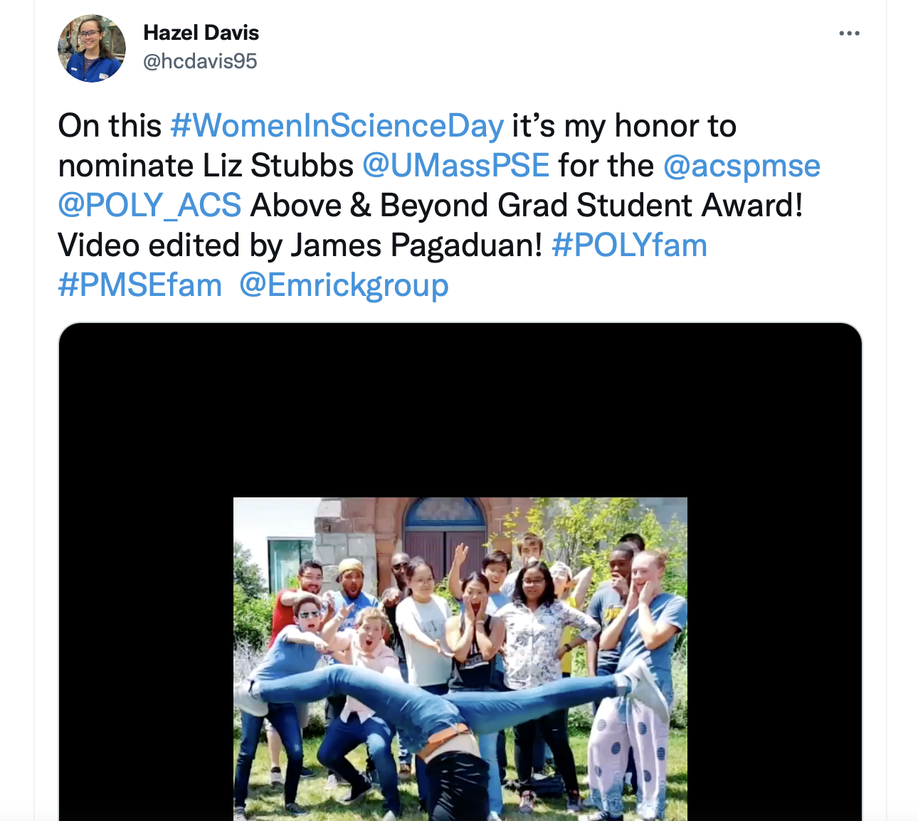
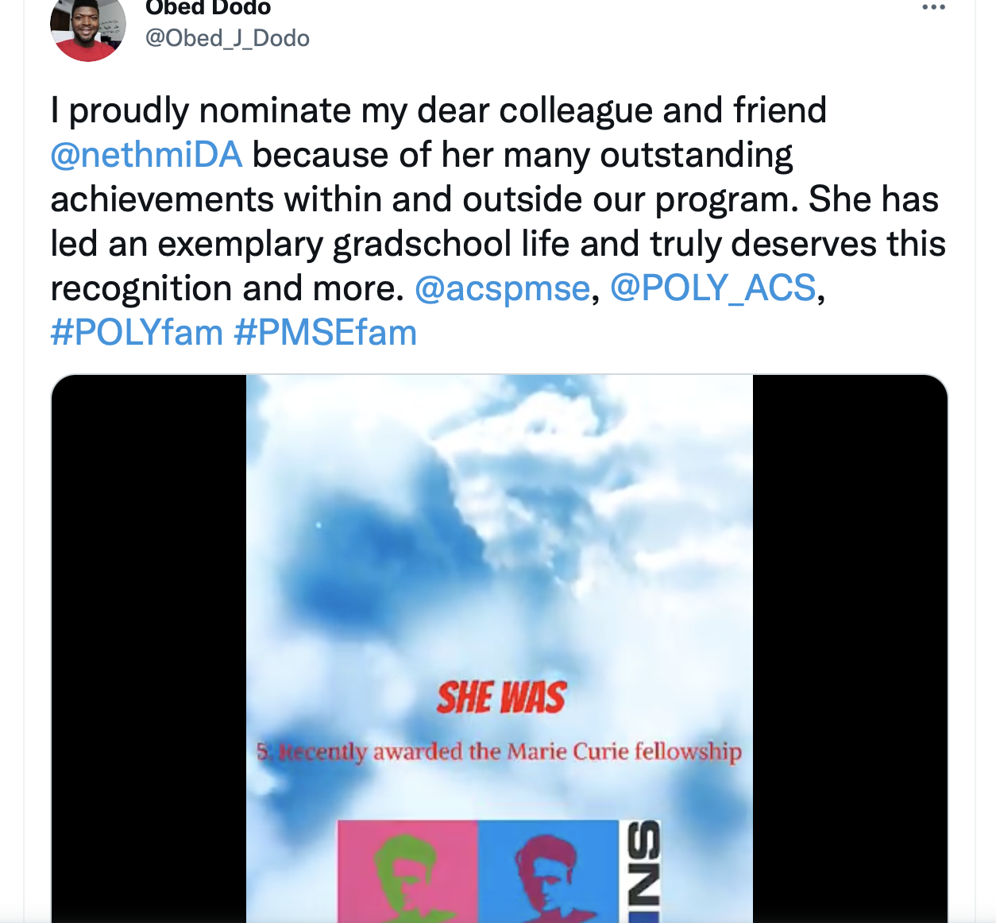
Outstanding Graduate Student Peer Nomination
Lizz Stubbs
UMass Amherst
Nethmi De Alwis
Miami University
February 2021
$250 from POLY and $250 from PMSE

Slide 5
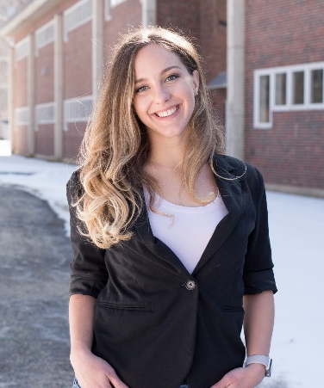
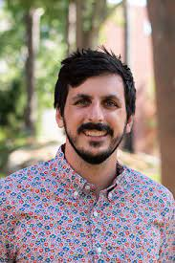
POLY/PMSE Student Chapters
Chapter Location Advisor Members
Arizona State University Tim Long 15
Case Western Reserve Dave Schiraldi 47
Cornell University Erin Stache 13
Florida A&M University J. Kennemuer 4
Southern Miss (no report) -
Texas TAMU (no report) -
Univ. of Mass.- Amherst Liz Stubbs 30
University of Florida Brent Sumerlin 34
University of New Hampshire Nathan Oldenhuis 15
University of Michigan Charles McCrory 134
University of Minnesota Theresa Reineke 89
University of South Carolina Brian Benicewicz 12
Virginia Tech John Matson 4
Student Chapter Chair
Dan Savin-PMSE
Elizabeth Bright-POLY
ebright@mmm.com
Nate Oldenhuis Nathan.Oldenhuis@unh.edu

Slide 6
POLY Student Chapters Big 3
Partnering with PMSE to Create an Inclusive, Student-led Community
Student advisory board: three meetings based on academic calendar
Better understand student needs
Connect chapters to share best practices, build student networks and communities
Help share information
Student-planned symposium in ACS Chicago Fall 2022
Build on their interest and ability to coordinate their efforts as seen in summer lecture series planned by UF last year
Annual Reports – change to poster form
Easier to share their good work within their schools, at national meetings, and with other chapters with newer programs

Slide 7

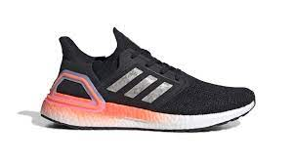
Graduate Student Social – San Diego
Graduate Student Social
San Diego Spring Meeting
Yes or No?
BASF is willing to do an in-person
Previous organizer: Melanie Chu
Action Item: Reach out to Melanie
Who plans to attend San Diego?
Raffle Prize: Adidas Boost

Slide 8
Membership Drive Brainstorming
Remaining IPG Funding
Have student chapters apply for $500 to bring in a guest speaker
Need to identify speaker and write out justification and agenda for visit
UF student chapter example
Student Chapter poster “reports” for spring meeting
Membership drive activity → Should we set this up for members to apply for?
Create more POLY exclusive events
“Clickable” join now button on POLY website
More industry recognition (significant portion of POLY membership)

