Slide 1

ACS
DIVISION OF POLYMER CHEMISTRY
Treasurer Report
POLY Winter ExComm Meeting 2026
Presented by John Matson (Treasurer)
Support from Kathy Mitchem and Carlee Black
Notes:
I have a 20-minute slot for this.

Slide 2
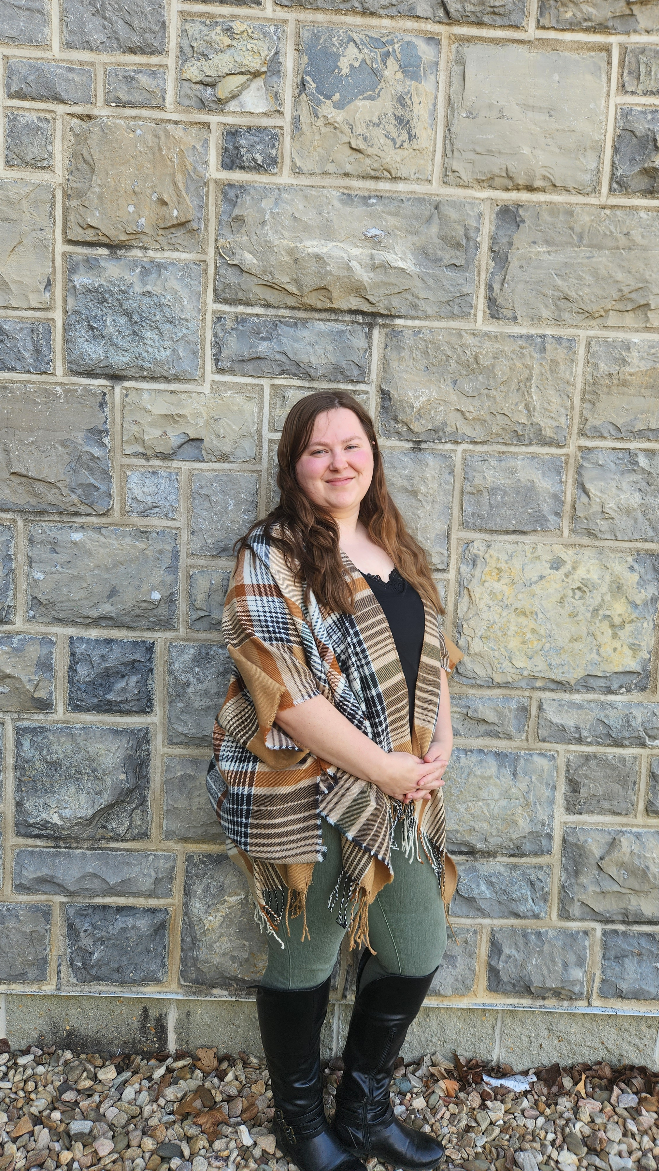
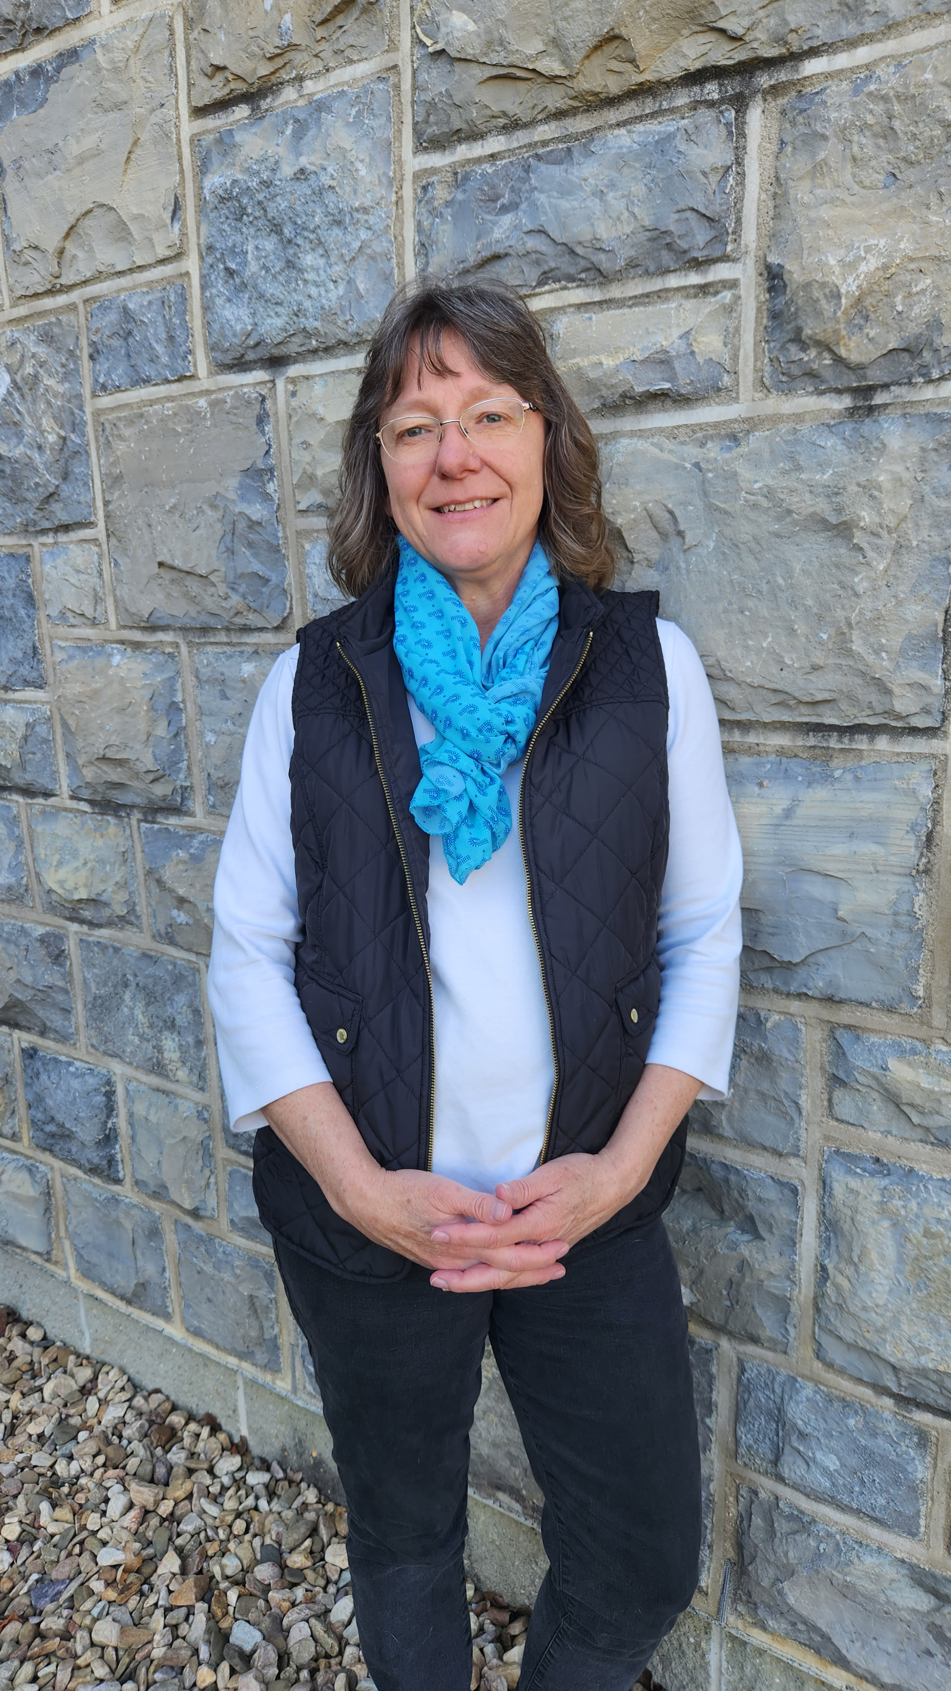
POLY Business Office
  Oversite:
  *POLY Supervisor– John Matson (Treasurer)
  *VT Representative-Bob Moore
  Location: Blacksburg, VA (new offices!)
  Carlee Black
  Administrative Assistant
  Salary 32hrs Week
  Membership Support
  Workshop/Meeting Prep, Website, etc.
  Awards Oversite
  POLY Newsletter & Publicity Posts:
  Facebook, E-news, ListServe
  General Websites Updates
  Graphical Abstracts/Preprint
  Office Supplies/Orders
Kathy Mitchem
Business Manager
  Full Time
  Budget Support-Bookkeeping
  ExComm Officer Support
  Workshops & Event Planning
  ACS Meetings Support
  Industrial Advisory Board
  - & Other Committee Assistance
  Election Oversite
  VT/Staff/Office Oversite

Slide 3
2025 Year-End Positives and Negatives
Positives
Income
Sponsor income is up, largely due to JAI ($9K versus $3K budgeted).
Investments had a good year (up 20%, $108K with $115K withdrawn; +$223K in total).
  We withdrew $115K from investments in 2025 ($151K was projected).
  Some of this apparent positive is masked—we were not actually $36K better than our budget.
No other significant income positives.
Expenses
We saved money in a few areas, notably:
  ACS Expenses $3K better than projected
  Awards $3K better than projected
Red Herrings (things that are misleading)
Natural Polymers CCC spent $11K less than budgeted; these funds will go out in 2026.
Our checking balance is lower at the end of this year than it was at the end of 2024 (keeping $ in market).
Negatives
Income
POLY membership dues generated $45K, continuing the downward trend ($5K below budget). See later slides.
ACS allocation was $50K ($58K in 2024), $8K less than budgeted.
Expenses
IAB appears to be $2K in the red but an early Jan 2026 payment for 2025 alleviates it.
Workshops
Workshop delta baseline is $40K for two workshops, but delta in 2025 was $31.7K. Fuel Cells fell well short of budget.
Summary
Overall, income is declining and expenses are increasing.
A strong market year made the budget look better than it actually was.

Slide 4
2025 Budget / YE Actuals

Slide 5
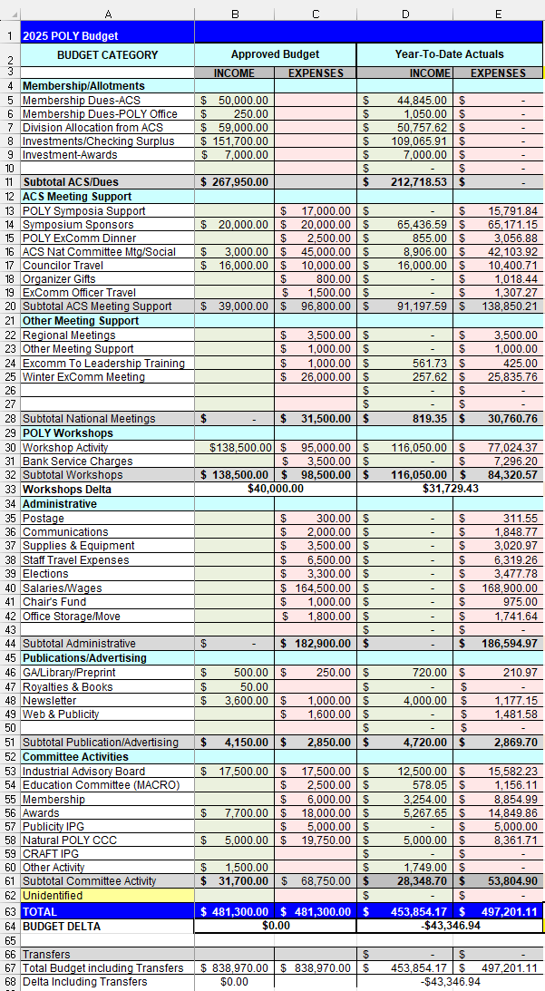
2025 Budget Report: Complete Budget
Important points
This is the complete 2025 budget and year-end actuals.
The next slides contain breakdowns.

Slide 6
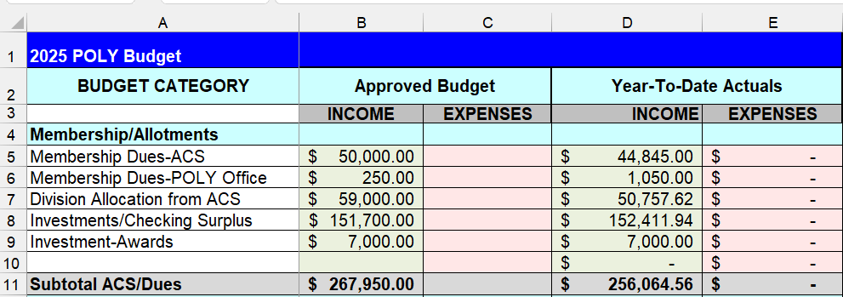
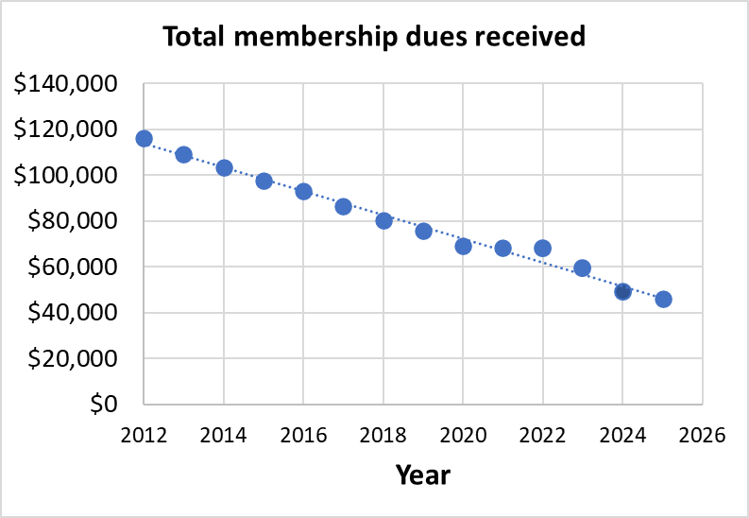
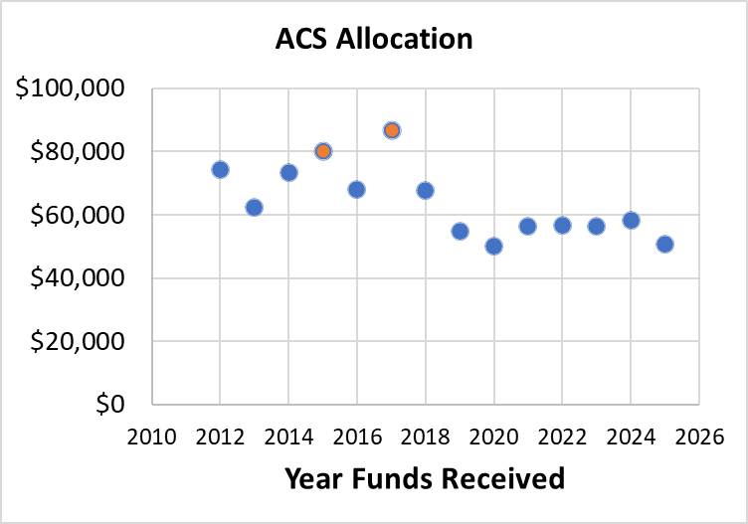
2025 Budget Report 1: Income from dues & ACS
Important points
Membership dues (5): Over 13 years, we are dropping ~$5K/year; we dropped $3.2K last year.
ACS allocation (7): ACS allocation is $8.2K less than expected.
Summary
Our budget projections were relatively conservative, and even less income has come in from these sources than we budgeted for.

Slide 7
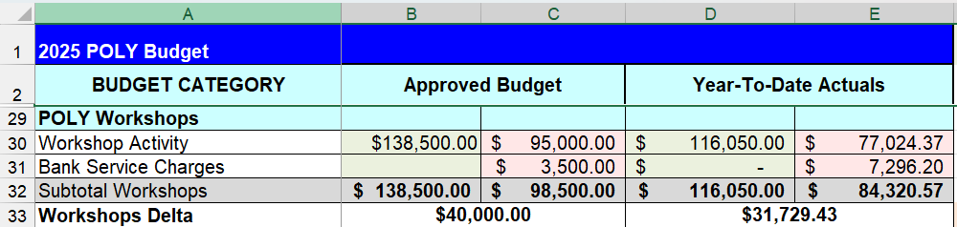
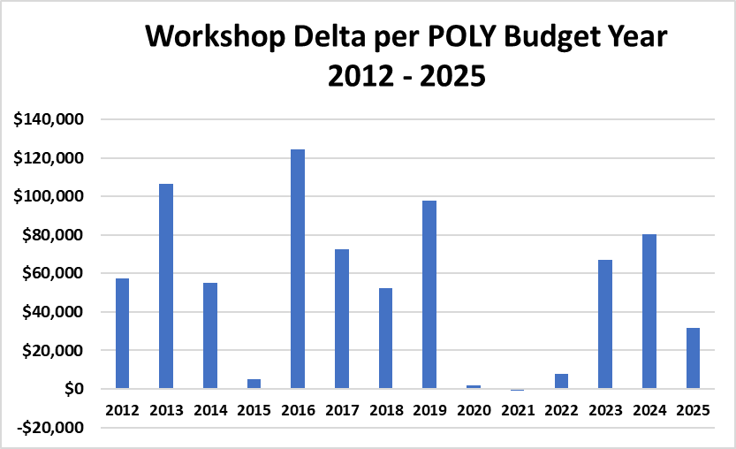
2025 Budget Report 2: Income from workshops
Important points
Fluoropolymers (June 2025) was a scientific and financial success. $4.2K donated to POLY above $20K admin fee.
Polymers for Fuel Cells, Energy Storage, Conversions (Nov 2025) fell $9.9K below the target. Low attendance and some speaker cancellations contributed.
Summary
The $20K/workshop admin fee ($40K total) covers business office time and other expenses
POLY made $8.3K less than projected.
Workshops can lose money, as we saw this year.

Slide 8
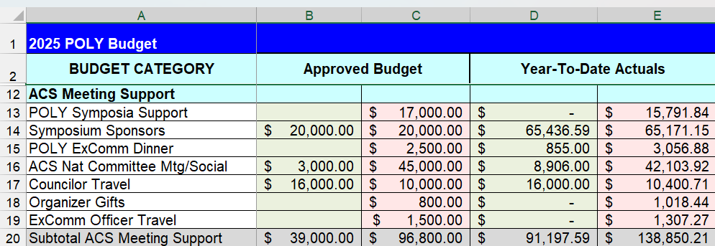
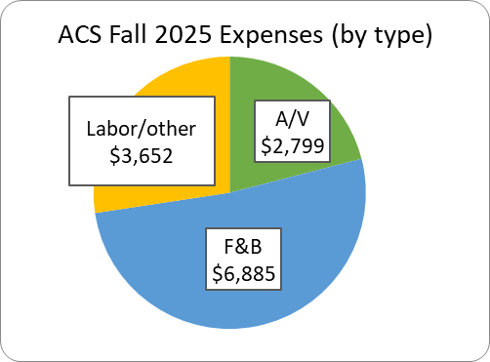
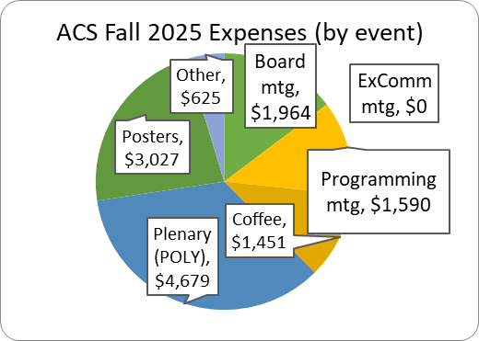
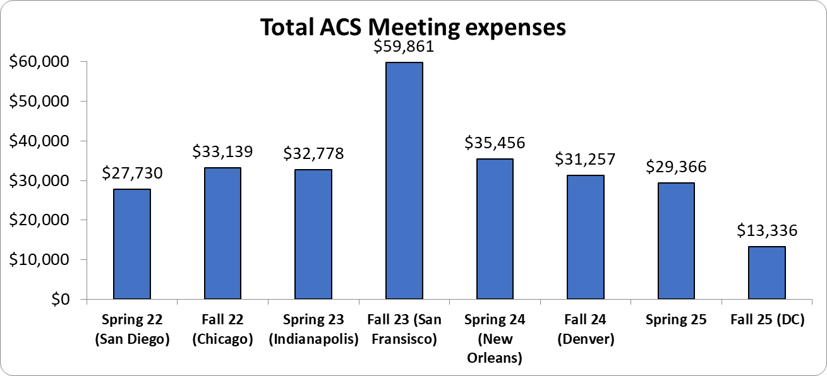
Important points
Symposia support (13): We were $1.2K under budget.
ExComm dinner (15): Going ‘dutch’ in the fall helped.
ACS meeting (16): We kept it under budget due to a very low Fall ACS and new sponsors (JAI).
Summary
F&B costs remain high, but we’re managing. Encore A/V mischarged us initially. Keeping a close eye is key.
2025 Budget Report 3:
ACS meeting-related expenses

Slide 9
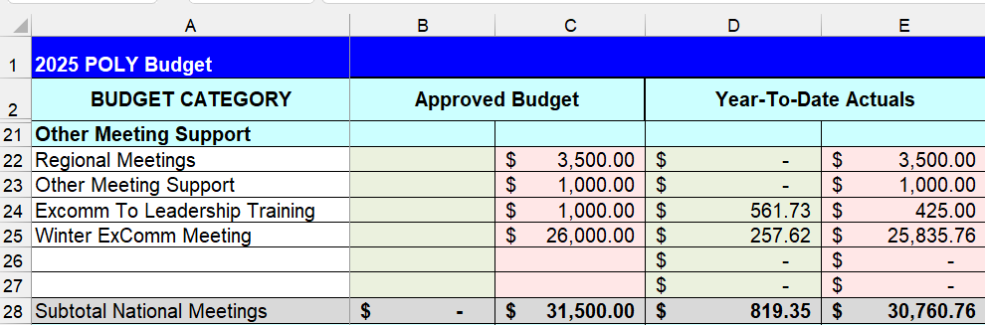
2025 Budget Report 4: Other Meetings
Important points
Winter ExComm meeting (25): We came in right on target.
Summary
No major unexpected outcomes so far here.

Slide 10
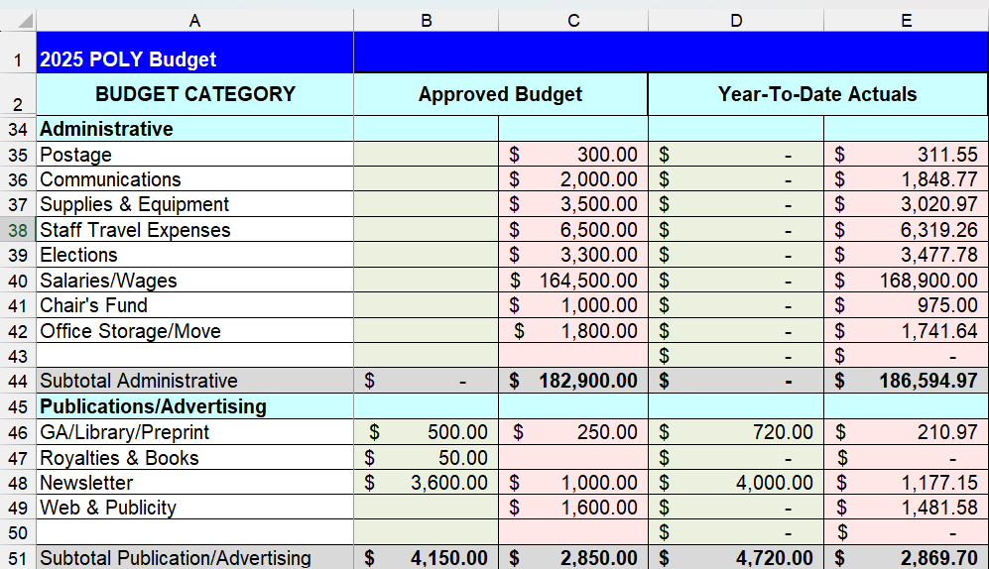
2025 Budget Report 5: Administrative
Important points
Staff travel (40): Kathy strives to keep staff travel costs low.
Summary
No major unexpected outcomes here.

Slide 11
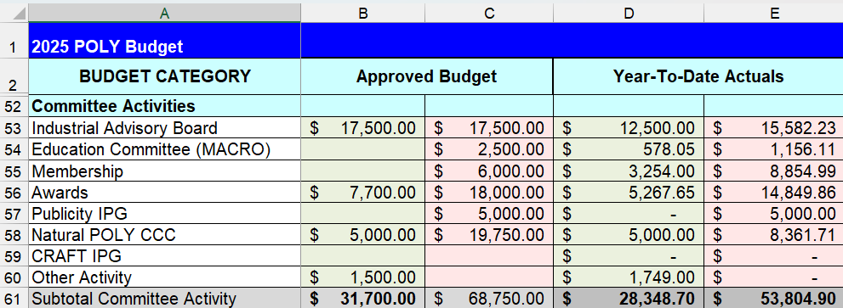
2025 Budget Report 6: Committee Activities
Important points
IAB (53): Late payment for 2025 came in Jan 2026, so IN/EX discrepancy is artificially high.
MACRO (54): Spent $1.3K less than expected.
Membership (55): Membership gained sponsorship for the social. 0.4K under budget.
Awards (56): Expenses lower than expected by $3.1K; some winners did not spent full amount.
Natural Polymers CCC (58): Planned symposium was postponed to 2026.
Summary
More award sponsors would help our bottom line

Slide 12
Sponsorship Support
Newsletter Advertising | 1/8 pg $20 up to Full pg $2,000 | Semi-Annually
E-news with Web Link | $500 | Annually
Mark Scholar Awards (3 awards) | $4,500 | Bi-Annually
Plenary Speaker | $1,500 | Annually ($600x2 annually)
Major Awards: Each: Marvel, Flory, Mark, IPS | $3,500 each (prize & travel) | Bi-Annually
Student Social | $1,000-$3,000 | Semi-Annually
Cookie/Snack Break Sponsor | $1,500 per ACS Mtg | Semi-Annually
Sponsors for 2025
Coffee Break Sponsor | $3,250 per ACS meeting (?) | TOSOH
Poster Awards | $750 per ACS meeting | Springer
General Papers | $600 per ACS meeting | Polymer Chemistry
Poster Session Food and Beverage | $3,000 per ACS meeting | JAI
Important points
General papers. Polymer Chemistry will no longer sponsor the General Papers awards in 2026. Shall we discontinue these? This could be attractive for industry sponsorship.

Slide 13
2025 Investments Activity and Future Projections

Slide 14
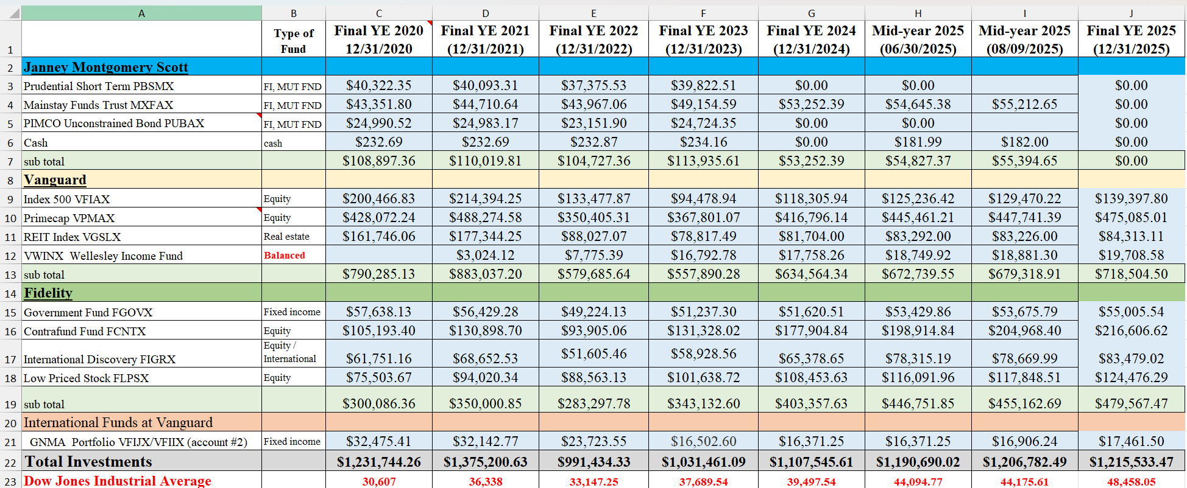
$55,717.93
POLY Investment Fund Details
Summary
As of Dec 31, 2025, after all withdrawals, POLY has $1,215,533.47 in investments.
Actions taken in 2025
Moved $30K (Aug 2025) and another $30K (Dec 2025) from Vanguard to checking.
Moved all funds from Janney ($55,717.93 + $165.93) to checking.
Closed Janney account. Now we have just two fund families to manage.

Slide 15
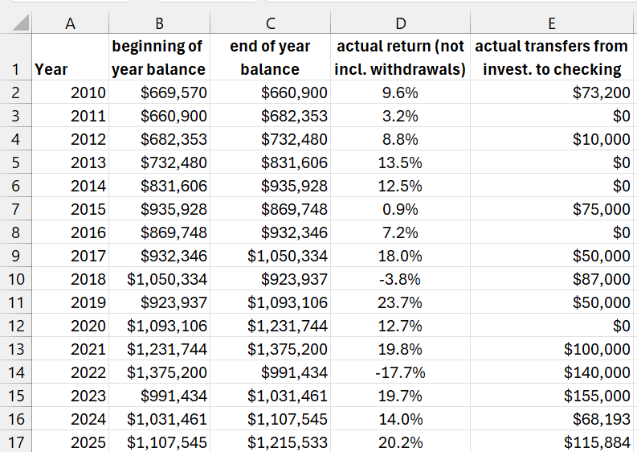
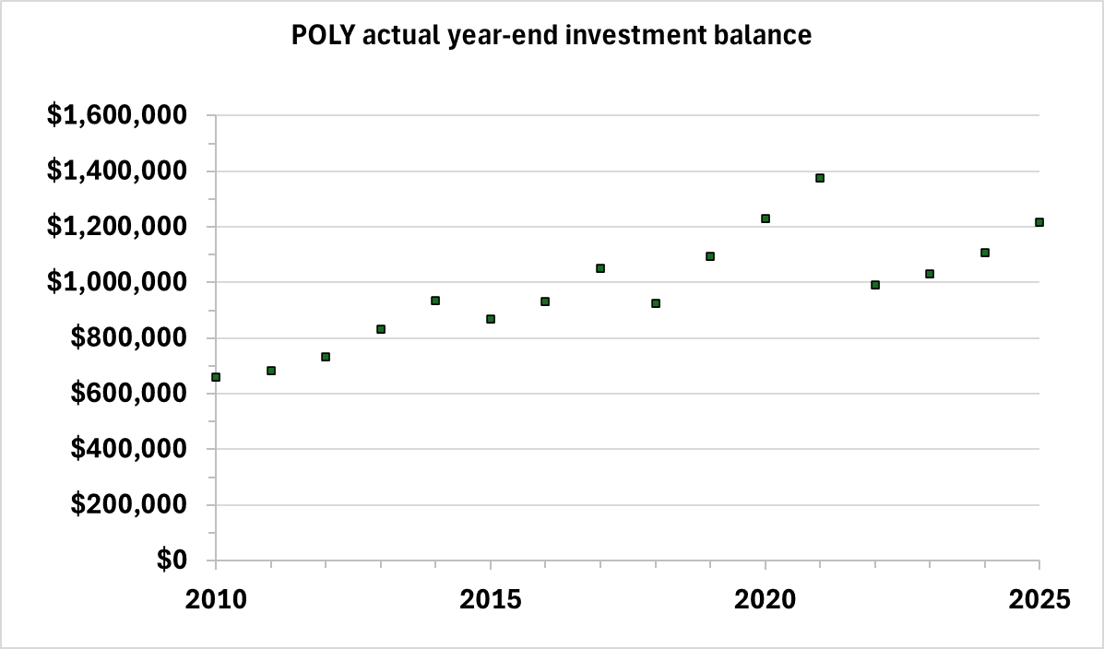
Investments 1: Historical data basis for model
Historical data
Average return since 2010: 10.2% (high = 24%, low = –18%)
Average withdrawal since 2010: $57.8K (high = $155K, low = $0K [5 times])
Projection Simulation Model and Methodology
As in 2025, based on these historical data, I set up a randomizer to project future returns, ranging from –10% to +30%, with an average of 10% (slightly rosier than historical data).
I then produced an Excel macro to run 1,000 simulations each at various annual withdrawal amounts (e.g., $100K/year up to $180K/year).

Slide 16
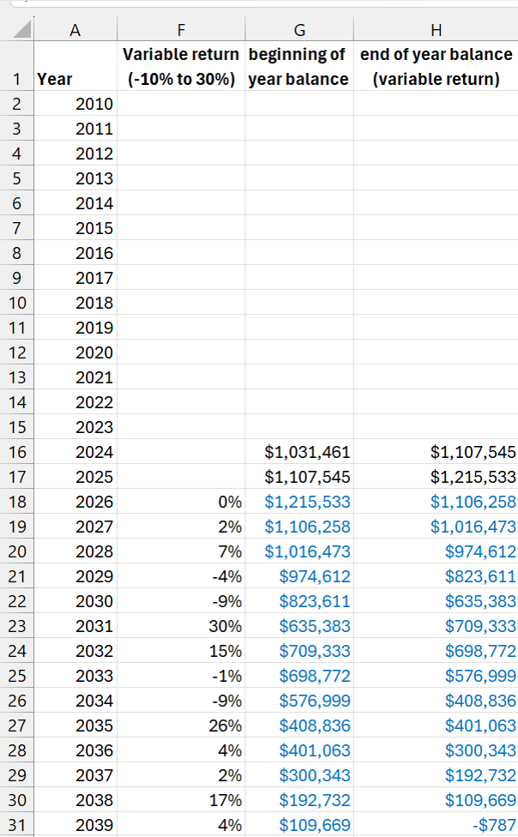
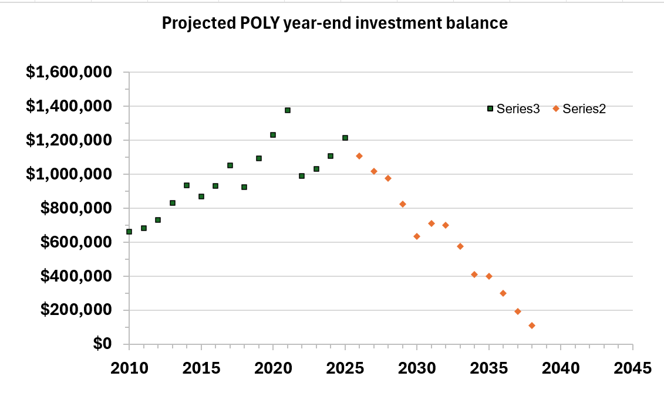
Investments 2: Example Projection Simulation
Example Projection: Annual withdrawal of $115K (our 2025 withdrawal)
This is just one simulation. Others are more positive.
The key thing is what happens in the next few years. Good market years are vital given our reliance on the investment fund for all of our operations. A bad market year will hurt.
For this particular projection:
POLY investments dropped below $0 in 2039.
Average return through 2042 was only 6%.

Slide 17
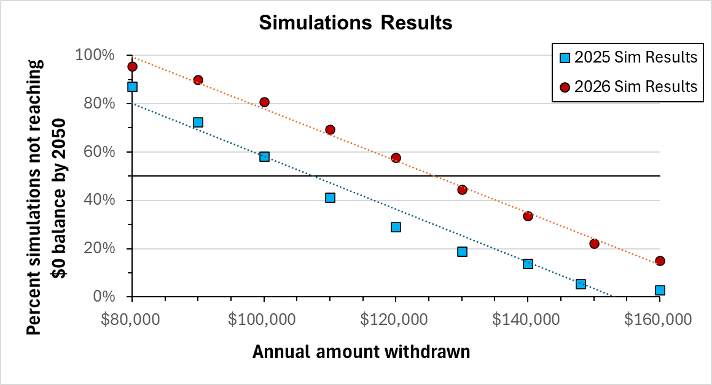
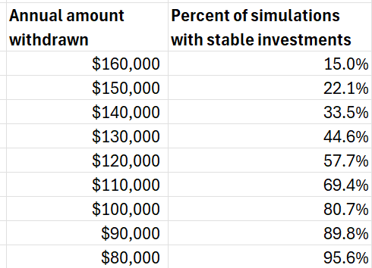
Investments 3: Projection Simulations Summary
Projection Simulation Summary: Chances of stability versus annual withdrawal amount
I ran 1,000 simulations each for a range of scenarios from $80K–160K annual withdrawal.
Based on these 10,000 simulations, I graphed “stability chance” vs. annual withdrawal amount
A target annual withdrawal amount of $125K/year gives POLY a 50% chance of retaining an investment balance past 2050 (it was $108K in Jan 2025)
An excellent market year really helped us in 2025, but a downturn can happen any time, so we need to continue to be financially responsible.

Slide 18
Discussion Points
Investments
We still rely too heavily on investments to be in a comfortable position for long-term financial stability, but the last few years have fortunately been strong market years.
We withdrew less than anticipated in 2025 largely because we are striving to have a smaller checking surplus in order to have more money in the market.
Potential ways to improve our bottom line
Reducing ACS meeting expenses has helped keep the budget under control.
  We learned after the fall ACS that we need to request projectors ala carte. Otherwise, if ACS puts us in a big room, they charge us for a big projector rental ($3K). This is an easy fix.
  Programming snacks/coffee has reduced spending, but attendance is very low. Other ideas?
  Each plenary costs ~$9K. We stopped printing plenary posters, which saves ~$0.5-2K per plenary. Now they are digital. Another easy solution that saved up to $1K.
Membership
  $6000 for membership has always seemed like a lot for me with low return on investment given that membership continues to drop. Can we reduce?
Symposium support
  In Phoenix, we changed the symposium support language, but it was not in line with PMSE, so we just ended up paying $500 per POLY half-day session. A formal update would be useful.
  Should we consider lowering symposium support to $400 per half-day session? We would be lower than PMSE.

Slide 19
2025 Budget
(see Excel file)

