Slide 1

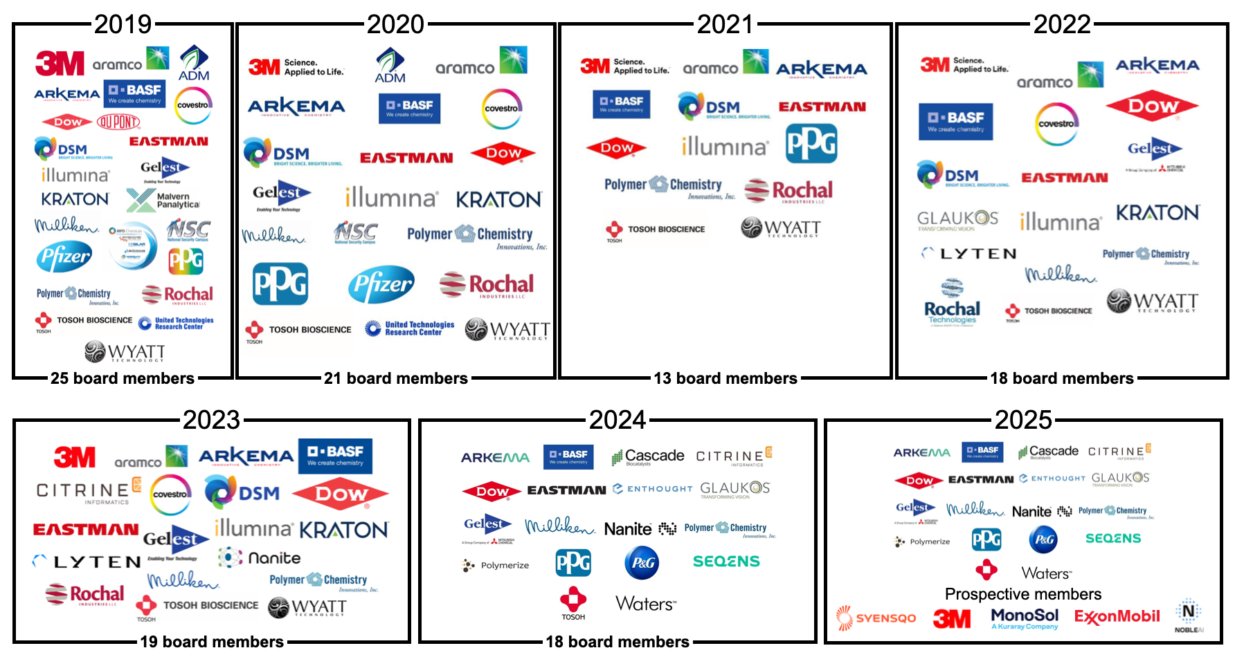
POLY Industrial Advisory Board
Annual dues: $1,500
Small company dues: $500
Chair: Mike Sims (Syensqo)
Co-Chair: Kapil Dev Sayala (SEQENS)

Slide 2

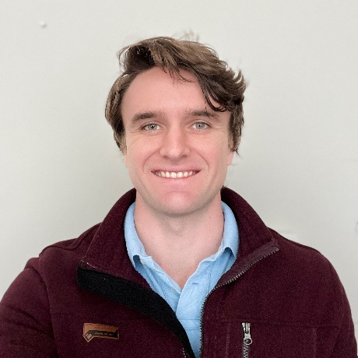
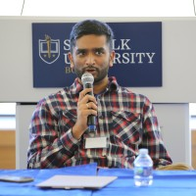
IAB Mission & Officers 2026
Chair: Mike Sims (Nanite)
Co-Chair: Kapil Dev Sayala (SEQENS)
Networking
Monday networking hour
Tuesday morning breakfast
Finance & Reporting
IAB business meetings
Bulletin
Succession Planning
Industrial Awards (IPS & YIPS) Support
POLY Awards Subcommittee Member
New Initiatives
Membership & Retainment
Programming
Industrial Innovation in Polymer Science (IIPS)
Other industrial programming
“Enhance and foster industrial engagement and support to develop programming, education, recognition & awards within the ACS Division of Polymer Chemistry.”

Slide 3
IAB Wins in 2025
New members!
Syensqo, Medtronic, Qnity
Significant IAB member involvement in ACS programming
Sponsorship & presence at academic events
ASU NGRPC
MIT Polymer Day
Future Faculty Workshop @ UC Irvine

Slide 4
IAB Focuses for 2026
Maintain programming & awards support
Deliver on member company initiatives
IAB Networking Sessions
IAB Meetings
Company flyers @ ACS
Integrate smaller company members
Streamline & standardize invoicing schedules
Support small events

Slide 5
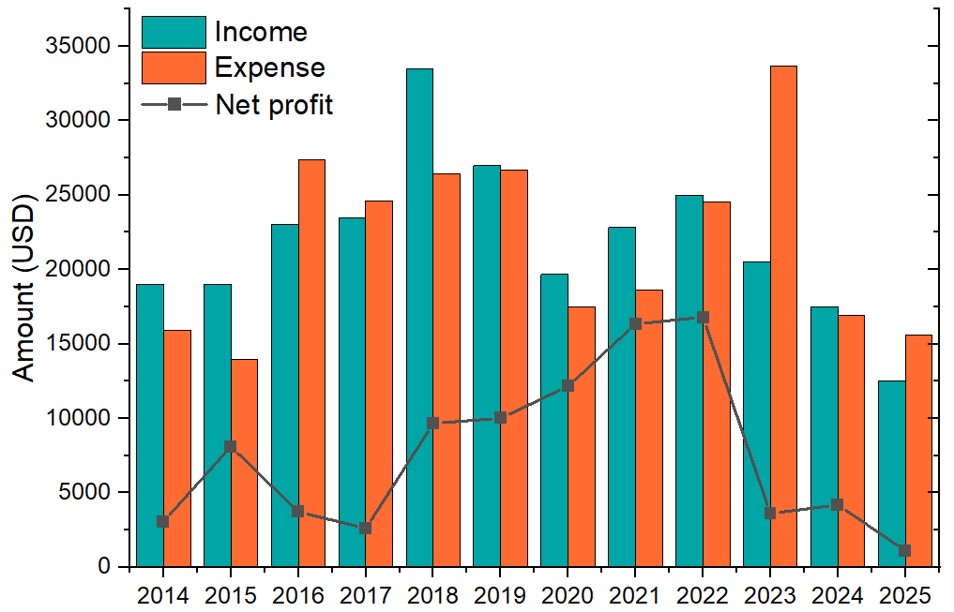
IAB Budget Overview

Slide 6
2025-2026 IAB Budget Summary
 | Final 2025 | Proposed 2026
Income | $12,500 | $23,500
Expenses
Networking | $6919.81 | $8000.00
Meetings | $1662.42 | $700.00
Awards | $3500.00 | $3000.00
Programming (no virtual) | $1500.00 | $5000.00
Other (shirts, pins) | $0 | $0
subtotal | $15,582.23 | $16,700.00
Bal | $ | $1900.00

Slide 7
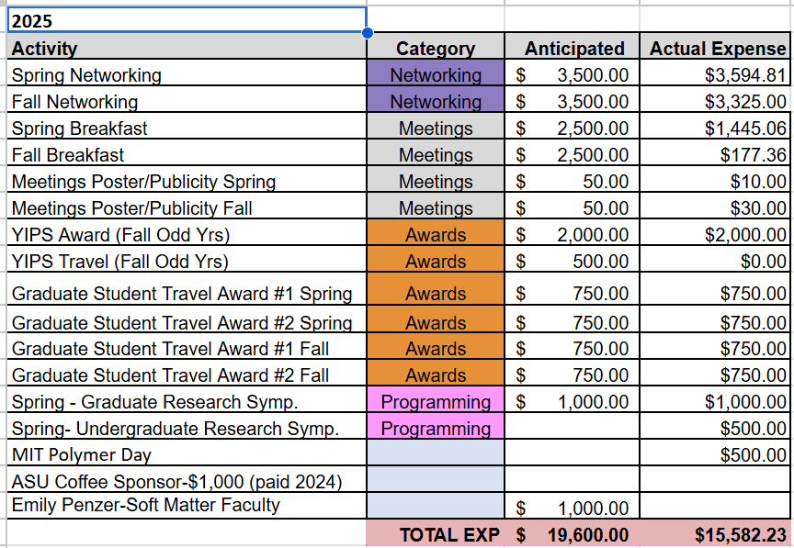
2025 Budget overview

Slide 8
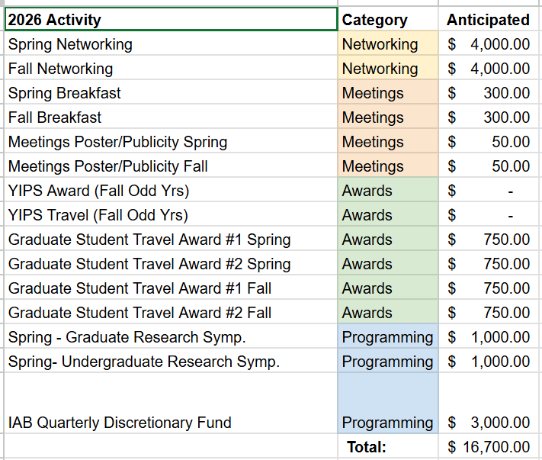
2026 Budget overview

Slide 9





Spring 2026 Programming and Networking
Industrial Innovations in Polymer Science
Organizers: Jeff Ting (Nanite), Jacob Blankenship (Syensqo), Kapil Dev Sayala (SEQENS)
Academic Entrepreneurship & Tech Transfer: Turning Research into Revenue
Organizers: Jeff Ting, Kapil Sayala (SEQENS), Chris Wirth, Caroline Szczepanski, Shuipto Dishari
IAB Networking Reception
Monday, March 23rd, 6:00-8:30 pm
White Oak Kitchen (pending)
270 Peachtree St NW, Atlanta, GA
IAB Members, POLY ExCom Officers, and potential Industrial representatives welcome
Industrial Advisory Board Meeting
Tuesday, March 24th, 7:30 am
Location TBD
IAB Member Company Representatives, POLY ExCom Officers Only

Slide 10

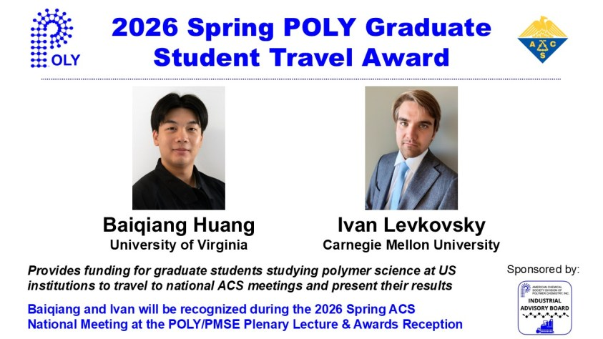
2026 POLY
Graduate Student Travel Award
Baiqiang Huang
University of Virginia
Ivan Levkovsky
Carnegie Mellon University
To provide funding for graduate students studying polymer science at
US institutions to travel to national ACS meetings and present their results

Slide 11
New activities in 2026
Virtual panel discussion
Career progression in industry
Invite speakers who have progressed up the technical ladder or transitioned to other roles (management, marketing, etc)
Ad hoc IAB sponsorships
FSU POLY/PMSE symposium
MIT Polymer Day
Others to come!

Slide 12
Future ideas
Expand virtual panel topics
How to get your first industry job
Basics of IP/patents
Workshops at ACS meetings
Resume building
Interviewing/soft skills
IAB Company Flyers
Set aside specific table next to POLY?
Consider raising dues(?)

Slide 13
Thank you
Industrial Advisory Board

