Slide 1
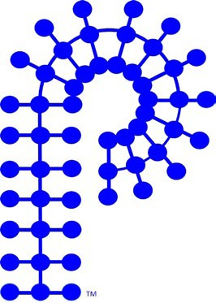
ACS POLY Membership Committee Report
Member-at-Large: S. Piril Ertem
Membership Committee
Student Chapters:
Oleg Davydovich (Sandia)
Colleen Scott (MS State)
Kaitlin Crawford (UCF)
Sofia Goodrich (UCF)
Volunteer Coordinators:
Colleen Scott (MS State)
Ezra Kone (CRWU)
Student Social Organization:
Ying Yang ( UNR)
Dillon Gagnon (CWRU)
Poster Judge Coordination:
Mayuri Powwal (Qnity), Jareett Rowlet (Ineos)

Slide 2
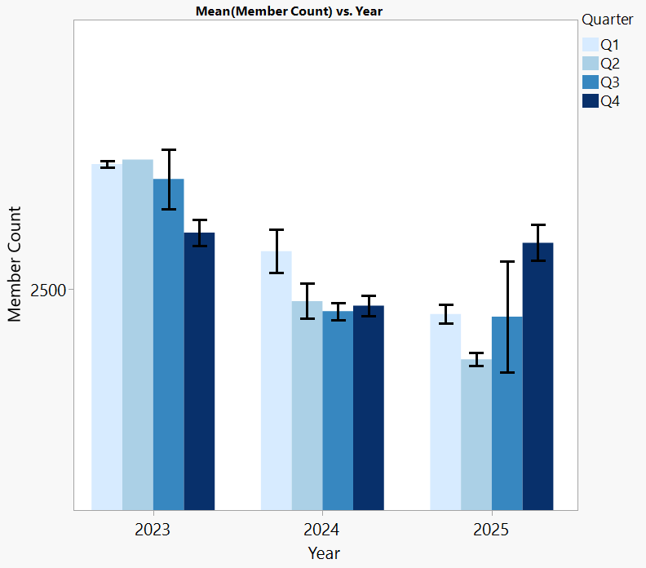

Membership count (as of Nov 2025)
History
2025 | 2,560
2024 | 2,450
2023 | 2,574
2022 | 2,766
2021 | 3,226
2020 | 4,133
2019 | 4,164
2018 | 4,641
2017 | 4,560
2016 | 4,254
2015 | 4,302
2014 | 4,489
Membership Dues
$30 ACS Regula Member
$50 Non-ACS
$10 ACS Student Member
(Regular or Non-Member)
Total membership count caught up with Q4 2023.
Membership drive- June – September 2025

Slide 3
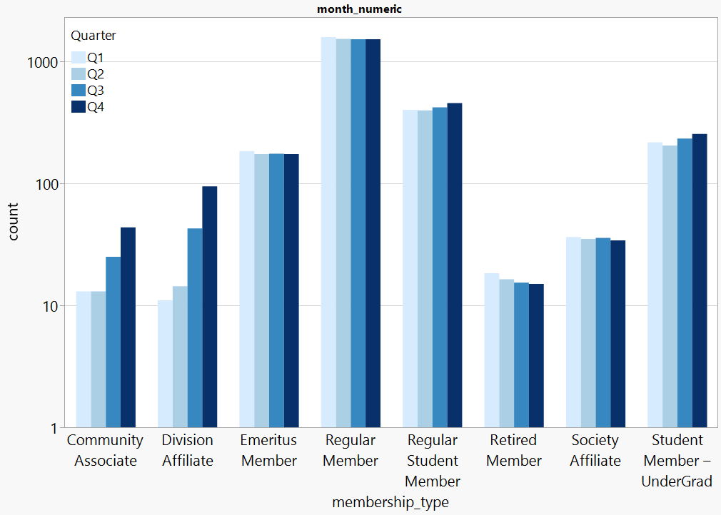
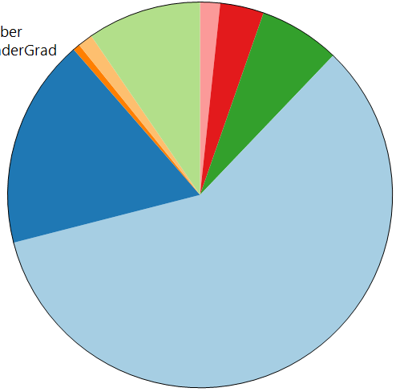
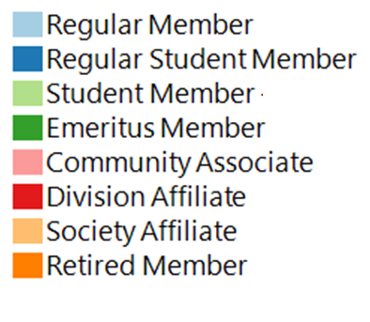
2025 Membership breakdown – by membership type
2025 breakdown
Nov 2025
9.6%
18%
59%
Since Jan 2025
Significant increase with associate and affiliate members
+50% regular student members
+30% undergraduate student members
- 80% regular members
840%
230%
-14%
-82%
59%
-4%
-5%
30%

Slide 4
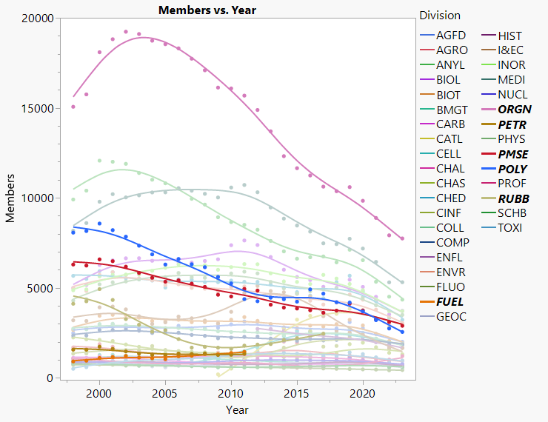
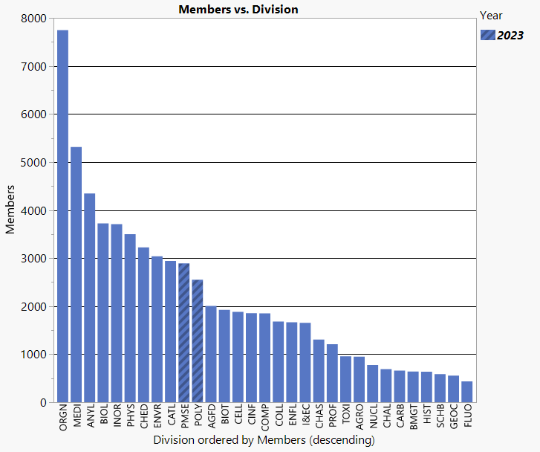
Membership is decreasing across all ACS Divisions

Slide 5
What Works? What Doesn’t?
Working Group Survey – Division Related Highlights
ACS initiated a Division Membership Working Group in June 2025
Opportunities for networking, career advancement, and publishing
Local sections and divisions’ role in community and leadership engagement
Transparency in division dues
Access to C&EN, InChemistry, technical sessions, and newsletters
Lack of clear engagement paths (especially low-effort or entry-level involvement)
Not enough support for new member onboarding
Unclear differences between Society Affiliate and Community Associate
No clear outreach to industry or support for managers encouraging ACS membership
Benefits & Value
Quarterly newsletters and technical updates help keep members informed
Transparency in division dues (with some exceptions)
Insufficient messaging around why someone should join — mission, impact, and purpose under-communicated
Few examples of impact stories, metrics, or testimonials to convey real member value
Communications

Slide 6
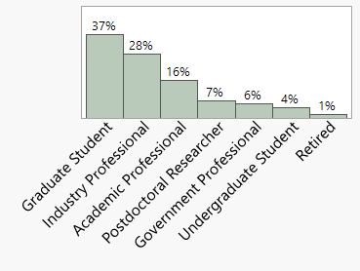
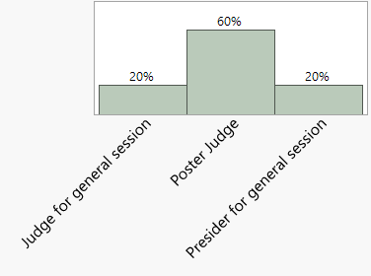
Membership Committee Highlight of 2025
Poly Volunteer Interest Form* (started in Jul 2024) Colleen Scott, Volunteer Coordinator
collaboration with
Jeff Ting, Tayler Hebner, Publicity Team
Total of 68 new volunteers in 1 year
Majority
Grad Students and Industry Professionals
Want serve as a poster judge
Volunteer coordination streamlined
9 Sci-Mix Judges
6 POLY Desk volunteers
*Membership not mandatory to volunteer

Slide 7
2026 Focus
Create opportunities for volunteering, networking, and career advancement
Continued volunteer engagement Colleen Scott, Ezra Kone
Engage with individual committees and align on volunteer needs
Revisit volunteer form based on committee feedback
Circulate volunteer coordination form 1-month ahead of national meetings
POLY/PMSE Mentoring Program Kickoff Piril Ertem, Rafael Verduzco
Survey circulated Q4 2025. 30 mentors, 80 mentees
Mentor-mentee pairing to start in Q1 2026
6-month pulse check and start a new cohort based on feedback
This is a great initiative to strengthen the polymer community. I’m excited to participate and help bridge academia–industry gaps
Thank you for taking the time to kickstart this initiative, and I sincerely hope it will effective for all parties involved.

Slide 8
2026 Focus
Create opportunities for volunteering, networking, and career advancement
Continued volunteer engagement Colleen Scott, Ezra Kone
Engage with individual committees and align on volunteer needs
Revisit volunteer form based on committee feedback
Circulate volunteer coordination form 1-month ahead of national meetings
POLY/PMSE Mentoring Program Kickoff Piril Ertem, Rafael Verduzco
Survey circulated Q4 2025. 30 mentors, 80 mentees
Mentor-mentee pairing to start in Q1 2026
6-month pulse check and start a new cohort based on feedback
This is a great initiative to strengthen the polymer community. I’m excited to participate and help bridge academia–industry gaps
Thank you for taking the time to kickstart this initiative, and I sincerely hope it will effective for all parties involved.

Slide 10
Membership Budget
Largest expenses:
Student Chapter Funding *
$2250
Student Social at ACS * $4510.93 (Spring/Fall)
* PMSE & POLY joint support
Sponsor support: $3500
 | Attendance | Cost
Fall Student Social | 45+ | $2869
Fall Membership Social | 7 | $260

Slide 11
Budget Increase Request
Ask: $7500
Estimated cost for one student social
Item | Cost Calculation | Cost
Drinks | 1 drink × $8 × 50 | $400
Snacks | $15 × 50 | $750
Subtotal | - | $1,150
Tips + Tax (30%) | 30% of subtotal | $345
Total Estimated Cost | - | $1,495
Facts:
Sponsorship is not guaranteed
Overall food/beverage cost increase
Alternative approach:
Limit social to student members only
Cap attendance at 40

Slide 12

19 Student Chapters
Chapter Location | Advisor
Arizona State University | Jeffrey Self
Case Western Reserve | Gary Wnek
Colorado State University | Megan Hill
Cornell University | Erin Stache
Florida State/FAMU combined | Daniel Hallinan
SW Ohio University | Neil Ayres & Dominik Konkolewicz
Texas A&M University | Quentin Michaudel
Virginia Tech | John Matson
University of Akron | Kevin Cavicchi
University of Florida | Brent Sumerlin
University of Massachusetts, Amherst | Todd Emrick
University of Michigan | Charles McCrory
University of Minnesota | Jessica Lamb
University of South Carolina | Chuanbing Tang
University of Southern Mississippi | Derek Patton
University of Tennessee | Mark Dadmun
University of Utah | Doug Tree & Chen Wang
Univ. Illinois Urbana-Champaign | Damien Guironnet
New Hampshire | Nathan Oldenhuis
Inactive Chapters
Cornell University
New Chapter:
UIUC U. New Hampshire
Student Chapter Co-Chairs
Kaitlin Crawford
University of Central Florida
kcrawford@ucf.edu
Sofia Goodrich sofia.goodrich@gmail.com

Slide 13

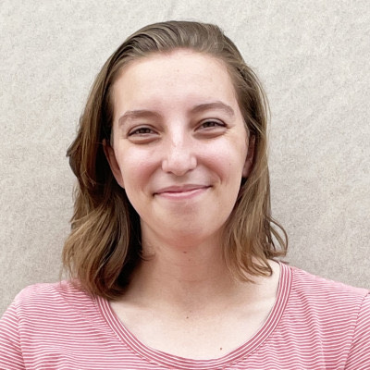
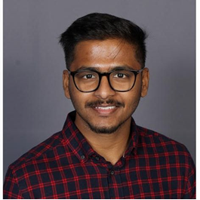
STUDENT CHAPTER HAPPENINGS – Fall 2025 Kaitlyn Crawford, UCF; Sofia Goodrich, BD; POLY: Piril Ertem 3M
1 new student chapter starting in May 2025: University of Illinois, Urbana-Champaign (18 total)
UC Irvine expressed interest in starting a chapter (August 2025)
24-25AY student reports: 10 on time; 2 late; 6 missing (following up with faculty advisors)
New volunteer from Pakistan to help with connecting chapters online
Collaborating with POLY member-at-large, Piril Ertem, to enhance overall student involvement
Fall 2025 travel awardees
Basic Stats (based on 12 reports)
Members: 486 grad, 55 ug, 2 postdocs
Seminars: 30+ (some weekly)
Networking: 30+
Outreach: ~24
Full symposium: 1
Events like: lunch-&-learn, art show, professional development, K-12
Mary Jutze
UMASS Amherst
PI: Reika Katsumata
Dhanush Patil
UC Berkeley
PI: Grace Gu
Notes:
6 missing (FSU, UNH, USC, Uakron, USM, UT)
New for 25-26AY: scheduling, submission formats, online connectivity, strategic planning (Megan and Rob)

Slide 14


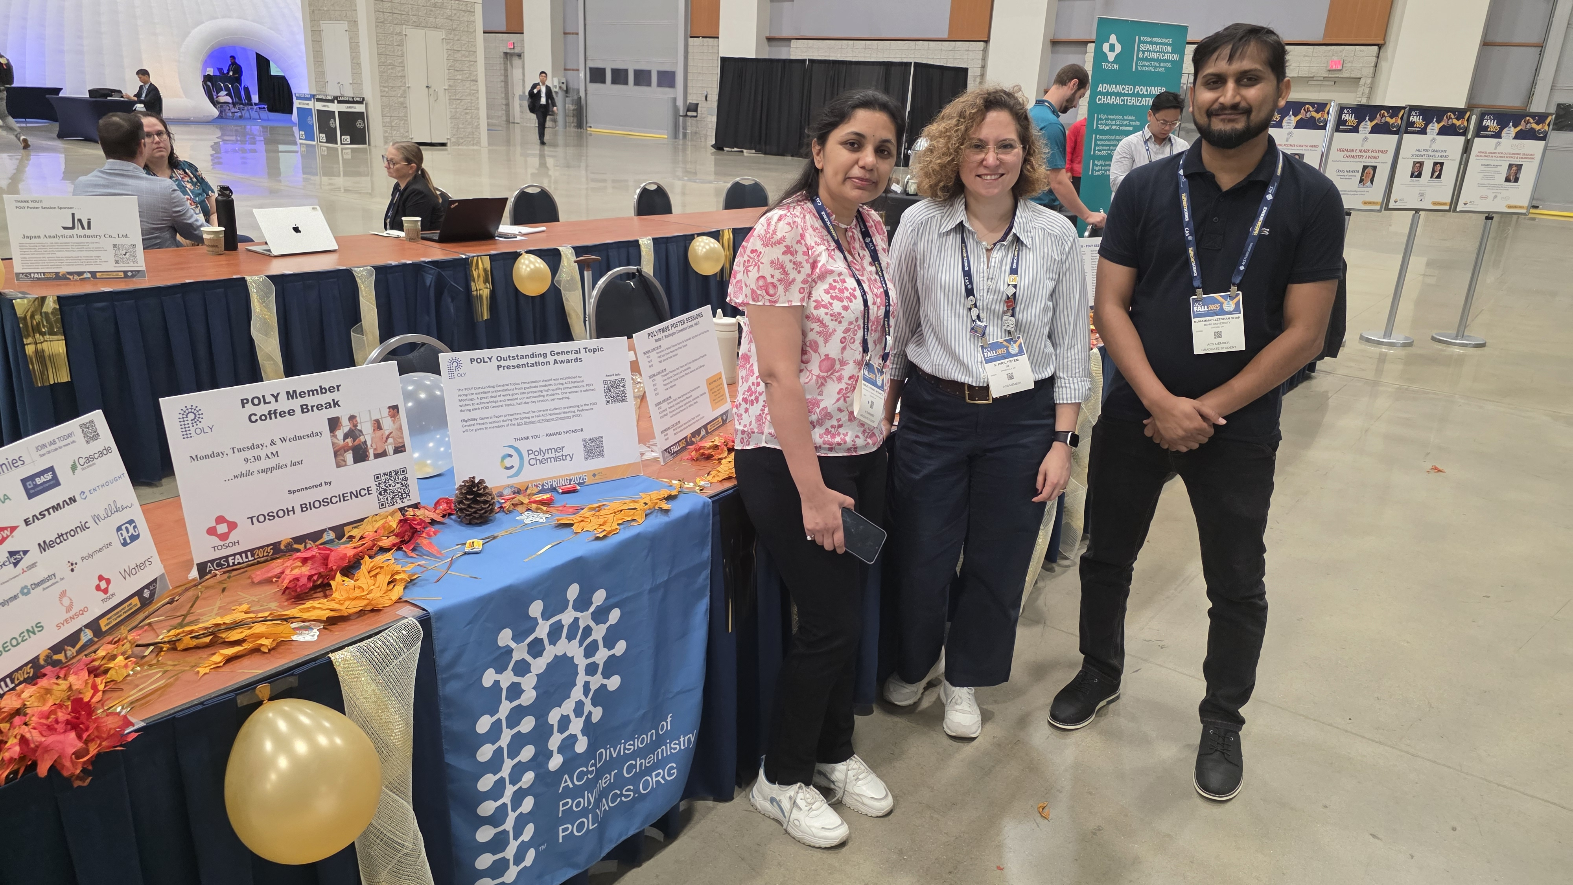
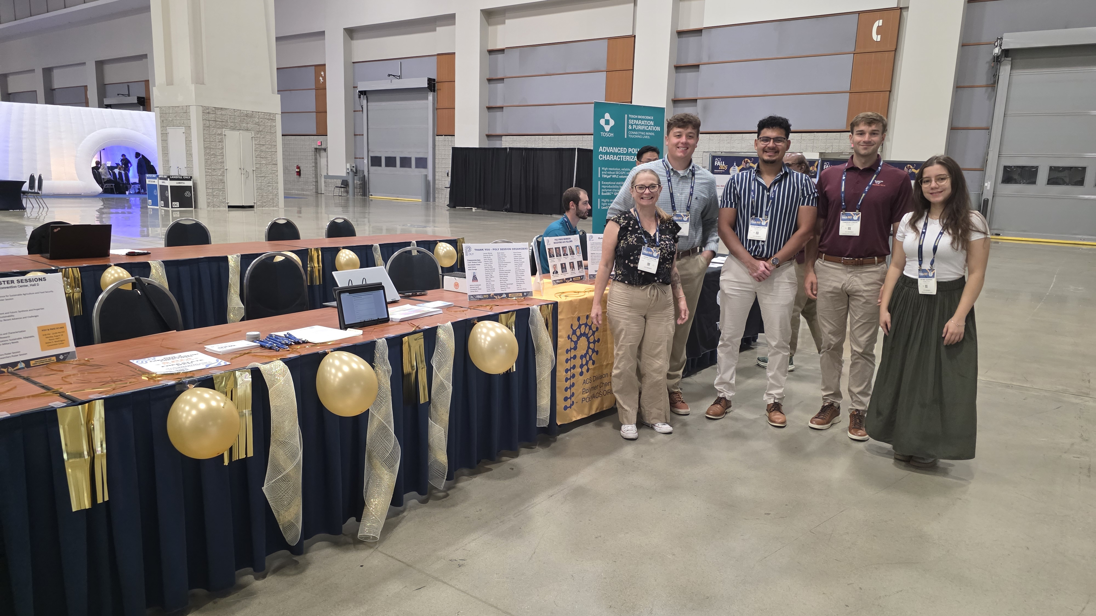
2025 Fall Meeting Highlights
Miami University
Virginia Tech

