Slide 1

POLY Workshops
Beth Elacqua: Workshop Chair
Committee: Gobet Advincula, Mike Hickner, Helen Tran, Jena McCollum, Rakesh Nambiar, and Yongping Zha

Slide 2
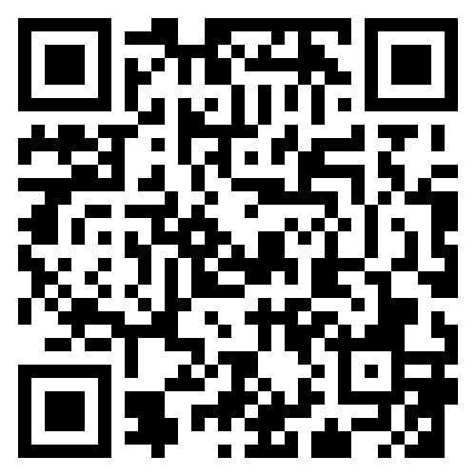
Workshops - Goal
POLY Mission: Advance the broader polymer enterprise and its practitioners to meet the global challenges of today and the future.
POLY Goal: Grow a robust, diverse, and engaged global organization that encompasses the broader polymer enterprise.
Workshop gains support the division budget which support other programs
Provide opportunities for members. Leaders, Speakers, Poster Presenters, and Sponsors
REMINDER:
POLY holds 2 Topical Workshops Annually SPRING (May/June) and FALL (Oct/Nov)
+Plus ONE National Graduate Focused Meeting (Odd-Years)
Workshops application should be submitted 2 yrs pre-event date, reviewed by workshop committee and approved by ExComm 18 months out.
Submit Application Online

Slide 3
3 Year Workshop In-Review
Workshop | Attendance | Speakers | Posters | Sponsors | Income | Expense | Gain/Loss (Above admin fee)
2025
Fluoropolymers | 61 | 27 | 10 | 8 | $60,394 | $56,204 | +$4,190
Polymers for Fuel Cells, Energy Storage, Conversions | 42 | 14 | 20 | 2 | $39,655 | $49,626 | -$9,971
2024
Fire and Polymers | 99 | 40 | 25 | 8 | $101,534 | $78,881 | +$22,653
Advanced in Polyolefins | 106 | 30 | 21 | 19 | $137,216 | $133,922 | +$3,294
2023
Fluoropolymers | 85 | 36 | 18 | 9 | $62,972 | $62,637 | +$335
Sustainable Polymers | 81 | 32 | 35 | 12 | $76,848 | $67,145 | +$9,703
Controlled Radical Polymerization | 76 | 35 | 26 | 3 | $60,150 | $63,510 | -$3,360
3 YEAR TOTALS | 550 | 214 | 155 | 61 |  |  | +$26,844
In 2023 15k was charged to each workshop for Admin Fee. In 2024 and 2025 20k was charged. The Gain/Loss line is above this Admin Fee.

Slide 4



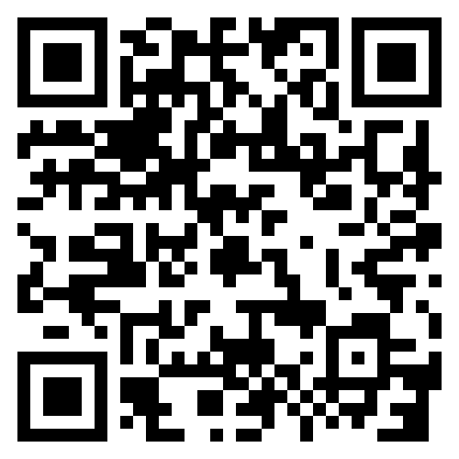
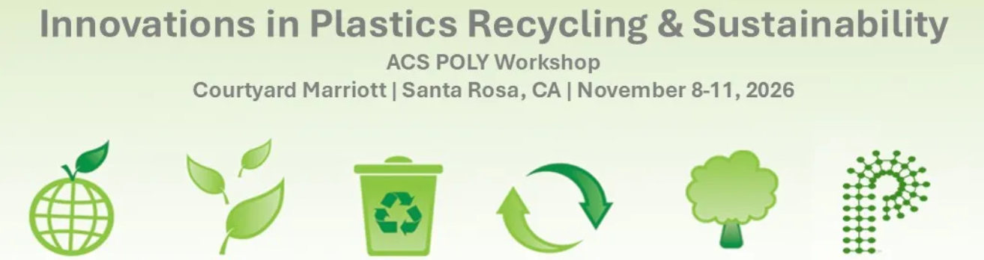
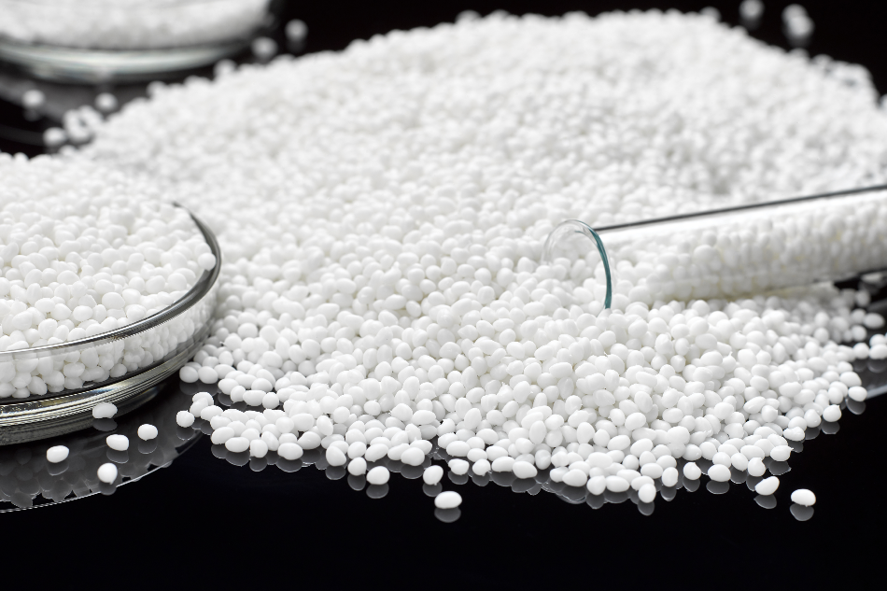
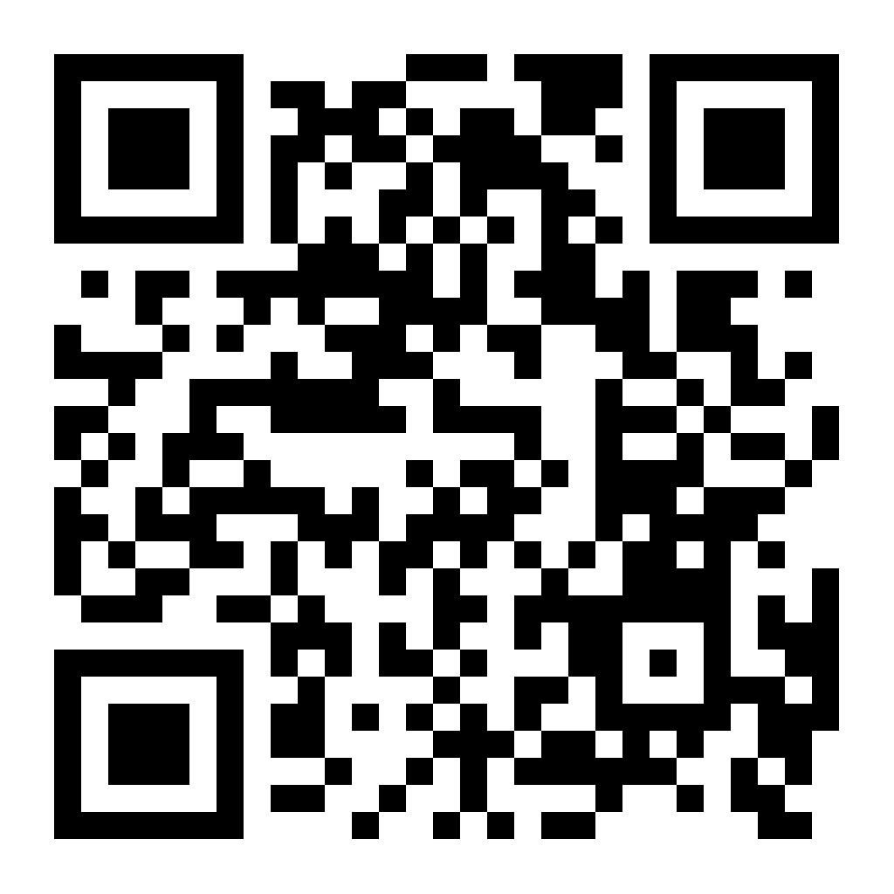

2026
Upcoming Workshops
2027
Advances
June 6-9, 2027
Doubletree by Hilton
Rohnert Park, CA
In PolyOlefins (APO)
Organizers:
Jaime Grunlan, Alex Morgan
Organizers:
J. Klosin, R. Register, K. Ragaert, K. B. Wagener, J. B. P Soars
-Proposal Submitted-
Controlled Radical Polymerization (CRP)
Lead Organizer: Brent Sumerlin
Fall 2027 Workshop
POLY 2023 – International 2025
Returning to POLY 2027
Vote On-Site at Winter Mtg
Organizing Team:
Brett Helms, LaShanda Korley
Megan Robertson, Katrina Knauer

Slide 5
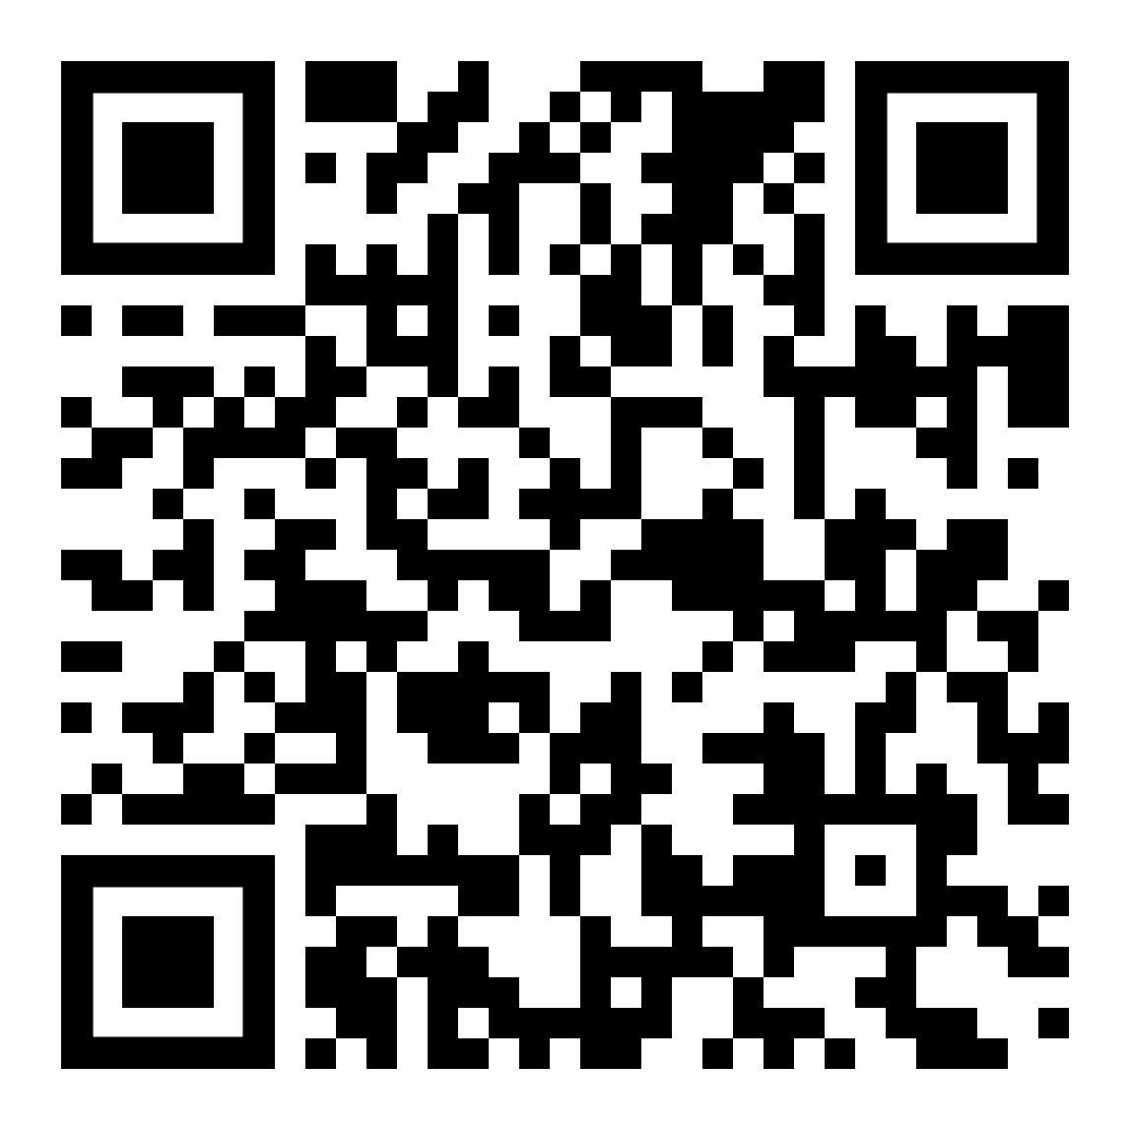
POLY NGRPC
National Graduate Research Polymer Conference
Arizona State University
March 18-21, 2025
Lead Organizers: S. Eileen Seo, Timothy E. Long
Highlights: 145 Attendees, 46 Speakers, 58 Posters, 17 Sponsors
Previous Graduate Conferences
Penn State, 1994
Virginia Tech, 1996
University of Akron, 1998
Southern Mississippi Univ., 2000
Lehigh University, 2003
UMass Amherst, 2005
UT Knoxville, 2007
Univ. of NC at Chapel Hill, 2010
Case Western Reserve Univ., 2012
Louisiana State Univ., 2014
University of Akron, 2016
University of Minnesota, 2018
Virginia Tech (virtual), 2021
University of Michigan, 2023
Arizona State University, 2025
University of Florida, 2027
POLY 2027 NGRPC Winner
University of Florida, May 3-5, 2027
Organizers: Austin Evans, Ariana Tamura, and
Brent Sumerlin (faculty); Annabelle Palmer,
Pouriya Nayebpashaei, Madeline Howell, Eva Vasquez,
and Andrei Potapenko (students)
REQUEST:
Can POLY assist with collecting sponsor support (with a 5% collection fee)?
Next Application Due Date: Fall 2027 (for 2029 event):
Notes:
Hayley, you can skip this slide if you’d like since NGRPC is on the next one as well, but I thought it would be good to list the student team and show the QR code (and past locations) too.

Slide 6
Looking Ahead
Workshop Committee Goal:
Seek and review potential 2028 Workshop proposals during Spring 2026, and submitted recommendation to ExComm, August 2026 for Spring 2028.
Add younger members to the Committee.
REMINDER:
POLY holds 2 Topical Workshops Annually SPRING (May/June) and FALL (Oct/Nov)
+Plus ONE National Graduate Focused Meeting, Odd-Years
Workshops application should be submitted 2 yrs pre-event date, reviewed by workshop committee and approved by ExComm 18 months out.
Submit Application Online
Invite To Apply for 2028:
Fire and Polymers
Fuel Cells
Fluoropolymers
PoWer Polymer Women Empowerment Research
New Topics? Suggestions?
Notes:
FYI Fluoropolymer will merge with Fluorine Conference January 2027 workshop

Slide 7
Workshop Progress
NEW WORKSHOPS: 2024 Fire and Polymers (very successful-repeating 2026) and 2027 Upcycling & Sustainable Polymers Planned
8 RETIRED WORKSHOP OVER 10 YEARS: Polymer in Med, Polymer Colloids, Next Generation Smart Materials, Layered Polymeric Systems, Poly and Nanotechnology, Silicone-Containing Polymers Composites, Advanced Polymer Materials, & Advances in Water Purifications
HISTORICAL WORKSHOPS ARE IMPORTANT: APO, Fluoropolymers, & Fuel Cells.
ORGANIZER ROTATION: Long-time workshops are encouraged to bring on new organizers
SCHEDULE ADJUSTMENTS: Repeats are encouraged to go to 2.5–4 years (verses every 2 yrs.)
FUTURE TOPICS: A “Call for Potential Workshops” circulated fall 2026, is continuously open, and will be circulate again in February.
CHANGE TAKES TIME: Workshop changes take 2-3 years to implement
SUMMARY:
New workshops ARE included; things ARE continuously changing, & new organizers ARE engaged. All accomplished while reducing from 4 workshops to 2 per year.

Slide 8
Thank you for your support and advice moving forward!

