Slide 1

ACS DIVISION OF POLYMER CHEMISTRY Treasurer Report POLY Business Meeting March 2025
Presented by John Matson (Treasurer)
Support from Kathy Mitchem and Carlee Black

Slide 2

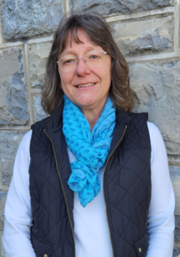
POLY Business Office
Oversite:
*POLY Supervisor: John Matson (Treasurer)
*VT Representative: Bob Moore
Location: Blacksburg, VA (new offices!)
Carlee Black
Administrative Assistant Salary 32hrs Week
Membership Support
Workshop/Meeting Prep, Website, etc.
Awards Oversite
POLY Newsletter & Publicity Posts:
Facebook, E-news, ListServe
General Websites Updates
Graphical Abstracts/Preprint
Office Supplies/Orders
Kathy Mitchem
Business Manager
Full Time
Budget Support-Bookkeeping
ExComm Officer Support
Workshops & Event Planning
ACS Meetings Support
Industrial Advisory Board
- & Other Committee Assistance
Election Oversite
VT/Staff/Office Oversite

Slide 3
Reminder: 2025 Year-End Positives and Negatives
Positives
Income
Sponsor income is up, largely due to JAI ($9K versus $3K budgeted).
Investments had a good year (up 20%, $108K with $115K withdrawn; +$223K in total).
We withdrew $115K from investments in 2025 ($151K was projected).
Some of this apparent positive is masked—we were not actually $36K better than our budget.
No other significant income positives.
Expenses
We saved money in a few areas, notably:
ACS Expenses $3K better than projected
Awards $3K better than projected
Red Herrings (things that are misleading)
Natural Polymers CCC spent $11K less than budgeted; these funds will go out in 2026.
Our checking balance is lower at the end of this year than it was at the end of 2024 (keeping $ in market).
Negatives
Income
POLY membership dues generated $45K, continuing the downward trend ($5K below budget). See later slides.
ACS allocation was $50K ($58K in 2024), $8K less than budgeted.
Expenses
IAB appears to be $2K in the red but an early Jan 2026 payment for 2025 alleviates it.
Workshops
Workshop delta baseline is $40K for two workshops, but delta in 2025 was $31.7K. Fuel Cells fell well short of budget.
Summary
Overall, income is declining and expenses are increasing.
A strong market year made the budget look better than it actually was.

Slide 4
2026 Approved Budget

Slide 5
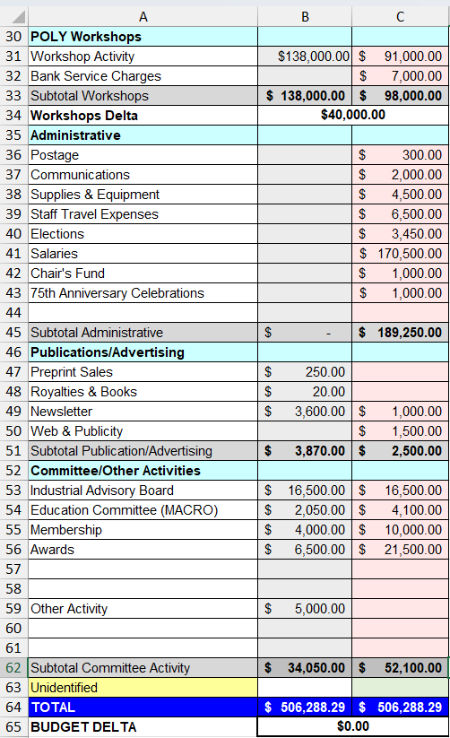
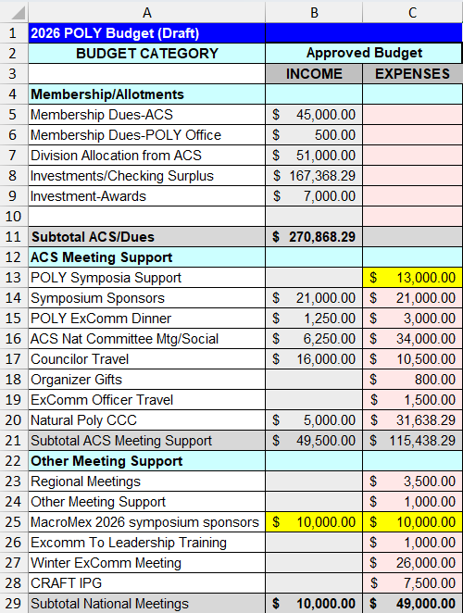
2026 Final Approved Budget
Important points
Investment: We anticipate cashing out $167K from investments in 2025. Trimming below this value became quite difficult.
ACS Expenses: We continue to reduce our spending at ACS meetings. There will be no spring business meeting but rather a virtual town hall in April.
Other: The budget reflects decreasing membership dues (line 5). Changes to symposium support ($500 per POLY-sponsored symposium regardless of number of POLY sessions) reduced projected expenses (line 13).

Slide 6
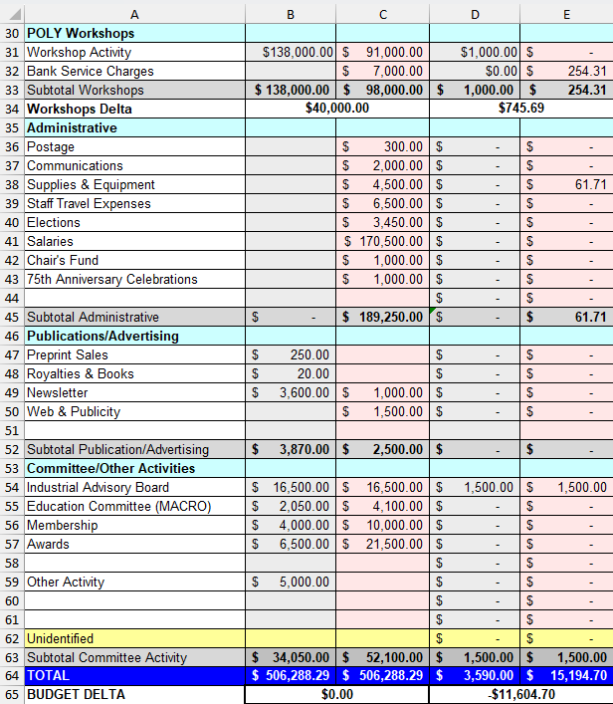
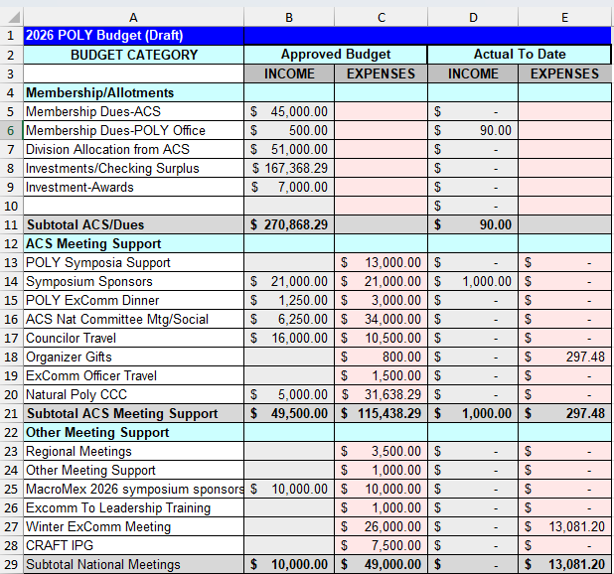
2026 Budget Updates (from Feb 28)
Important points
Membership dues (line 5): Not included in this sheet yet, the spring dues payment (Mar. 11) was$23.4K, which is down significantly from 2025 ($27.6K) and 2024 ($27.2K).
Winter Excomm (line 27): We kept Winter Excomm meeting expenses quite low
Investments: John ran into issues with both Fidelity (linked bank account was no longer linked) and Vanguard (a system upgrade required verifications that are still underway). Both should be resolved by the end of March.
Sponsor support (line 57): Sponsors have not come through at expected levels so far.

Slide 7
2026 Sponsorship Support

Slide 8
Sponsorship Support
Newsletter Advertising | 1/8 pg $20 up to Full pg $2,000 | Semi-Annually
E-news with Web Link | $500 | Annually
Mark Scholar Awards (3 awards) | $4,500 | Bi-Annually
Plenary Speaker | $1,500 | Annually ($600x2 annually)
Major Awards: Each: Marvel, Flory, Mark, IPS | $3,500 each (prize & travel) | Bi-Annually
Student Social | $1,000-$3,000 | Semi-Annually
Cookie/Snack Break Sponsor | $1,500 per ACS Mtg | Semi-Annually
General Division Sponsorship
General Papers | $400-600 per ACS meeting | Per ACS Meeting
In Place for 2026
Coffee Break Sponsor | $3,250 per ACS meeting (?) | TOSOH
Poster Awards | $600 $1,200 per ACS meeting | SpringerNature
Poster Session Food and Beverage | $3,000 per ACS meeting | JAI
General Papers | $400-600 per ACS meeting | Allan/ZCMI: Looking for Sponsor
Important points
Mark awards have been discontinued after this year
Poster award contributions have changed.

