Slide 1
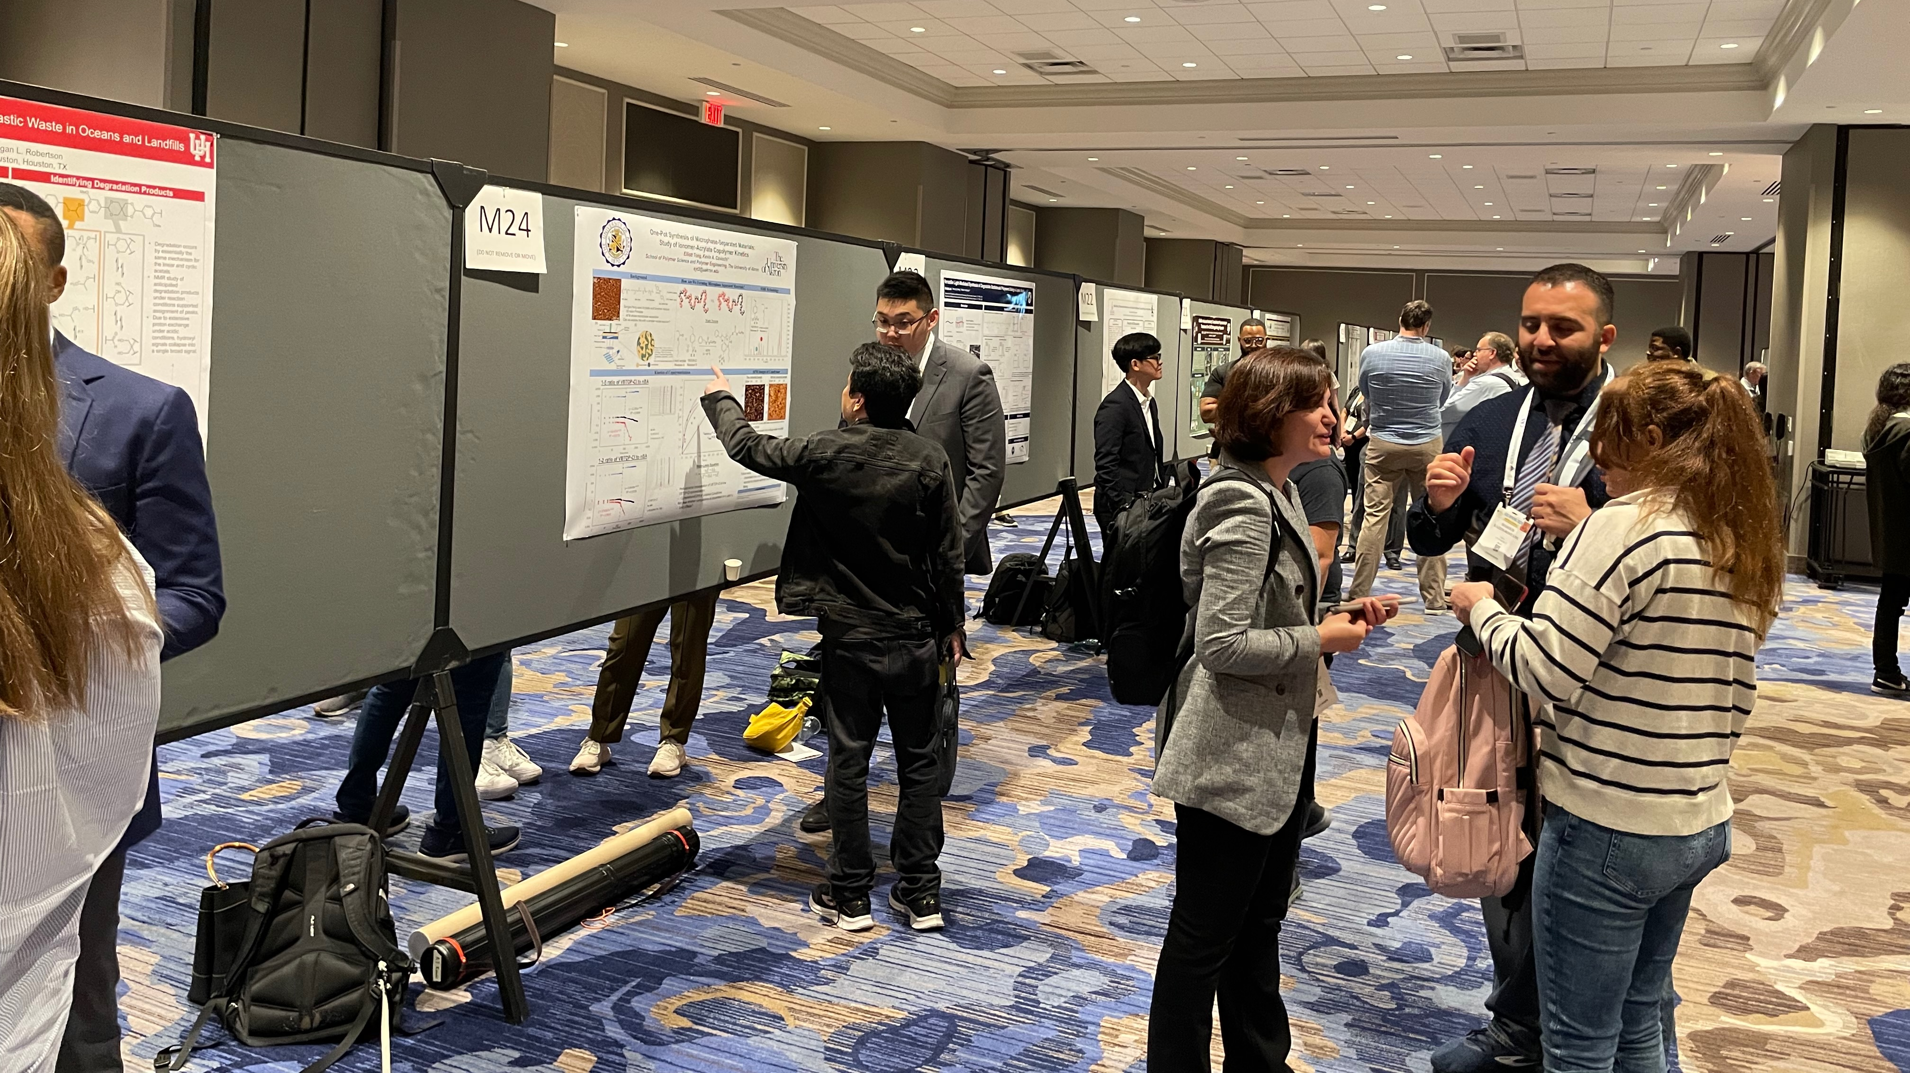
POLY Programming Team
ACS Spring 2026
Spring 2024 ACS (photo credit: Megan Robertson)
Julia Kalow, Graham Collier, Alice Savage, Michael Petr
Kathy Mitchem (POLY Business Liaison),
and Hayley Brown (2026 ExComm. Liaison)

Slide 2
Overview
POLY at the ACS National Meeting Review
  Review of POLY at recent ACS National Meeting, including San Diego and DC
Upcoming National Meetings
  Spring 2026 (Atlanta) – Alice Savage
  Fall 2026 (Chicago) – Julia Kalow
  Spring 2027 (New Orleans) – Michael Petr
  Fall 2027 (San Diego) – Graham Collier
Future of POLY Programming
  2026 programming goals
  HDS allocation formula
  Team composition and rotation

Slide 3
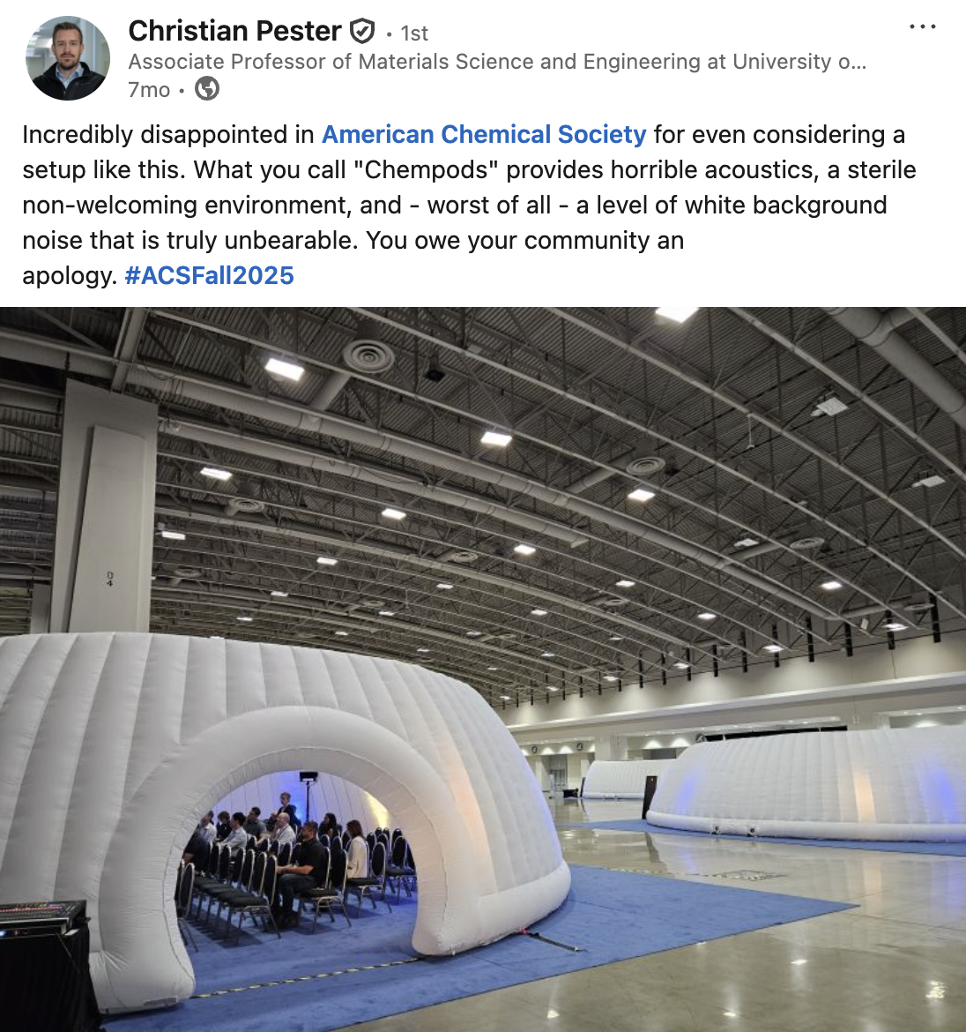
Review and Report Summary
  Innovative Sessions (live polling, panels, interactive digital posters, industry and policy focus)
    CME-NASA: Elevating Polymer Chemistry to New Heights-Polymers for Future Space Missions
  The “ChemPods”
    Not popular
Year | Total ACS | % POLY
Fall 2026 | 11786 | TBD
Spring 2025 | 15289 | 5.1
Fall 2024 | 11552 | 4.6
Spring 2024 | 11779 | 4.7
Fall 2023 | 10801 | 4.6

Slide 4
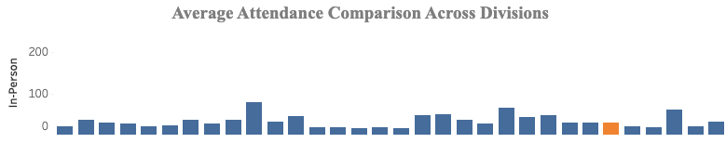
2025 Fall Review and Report Summary
Overview of Fall POLY meeting presentations in San Diego
  ~640 abstracts presented at POLY and joint sessions (~7% of total ACS)
    443 POLY in-person oral (244 POLY only, 182 joint)
    155 POLY posters
    43 POLY virtual oral
    86% acceptance rate (oral in-person only)
  Average in-person session attendance
    26.19 for sole POLY in-person sessions
    50.50 for POLY virtual sessions
    28.38 for joint in-person sessions
    Top sessions: Herman Mark Award in honor of Craig Hawker, Green Polymer Chemistry & Sustainability, Innovations in Natural Polymer Science for Sustainable Agriculture and Food Security, Conjugated Polymers: Past, Present, and Future, CME-NASA: Elevating Polymer Chemistry to New Heights

Slide 5
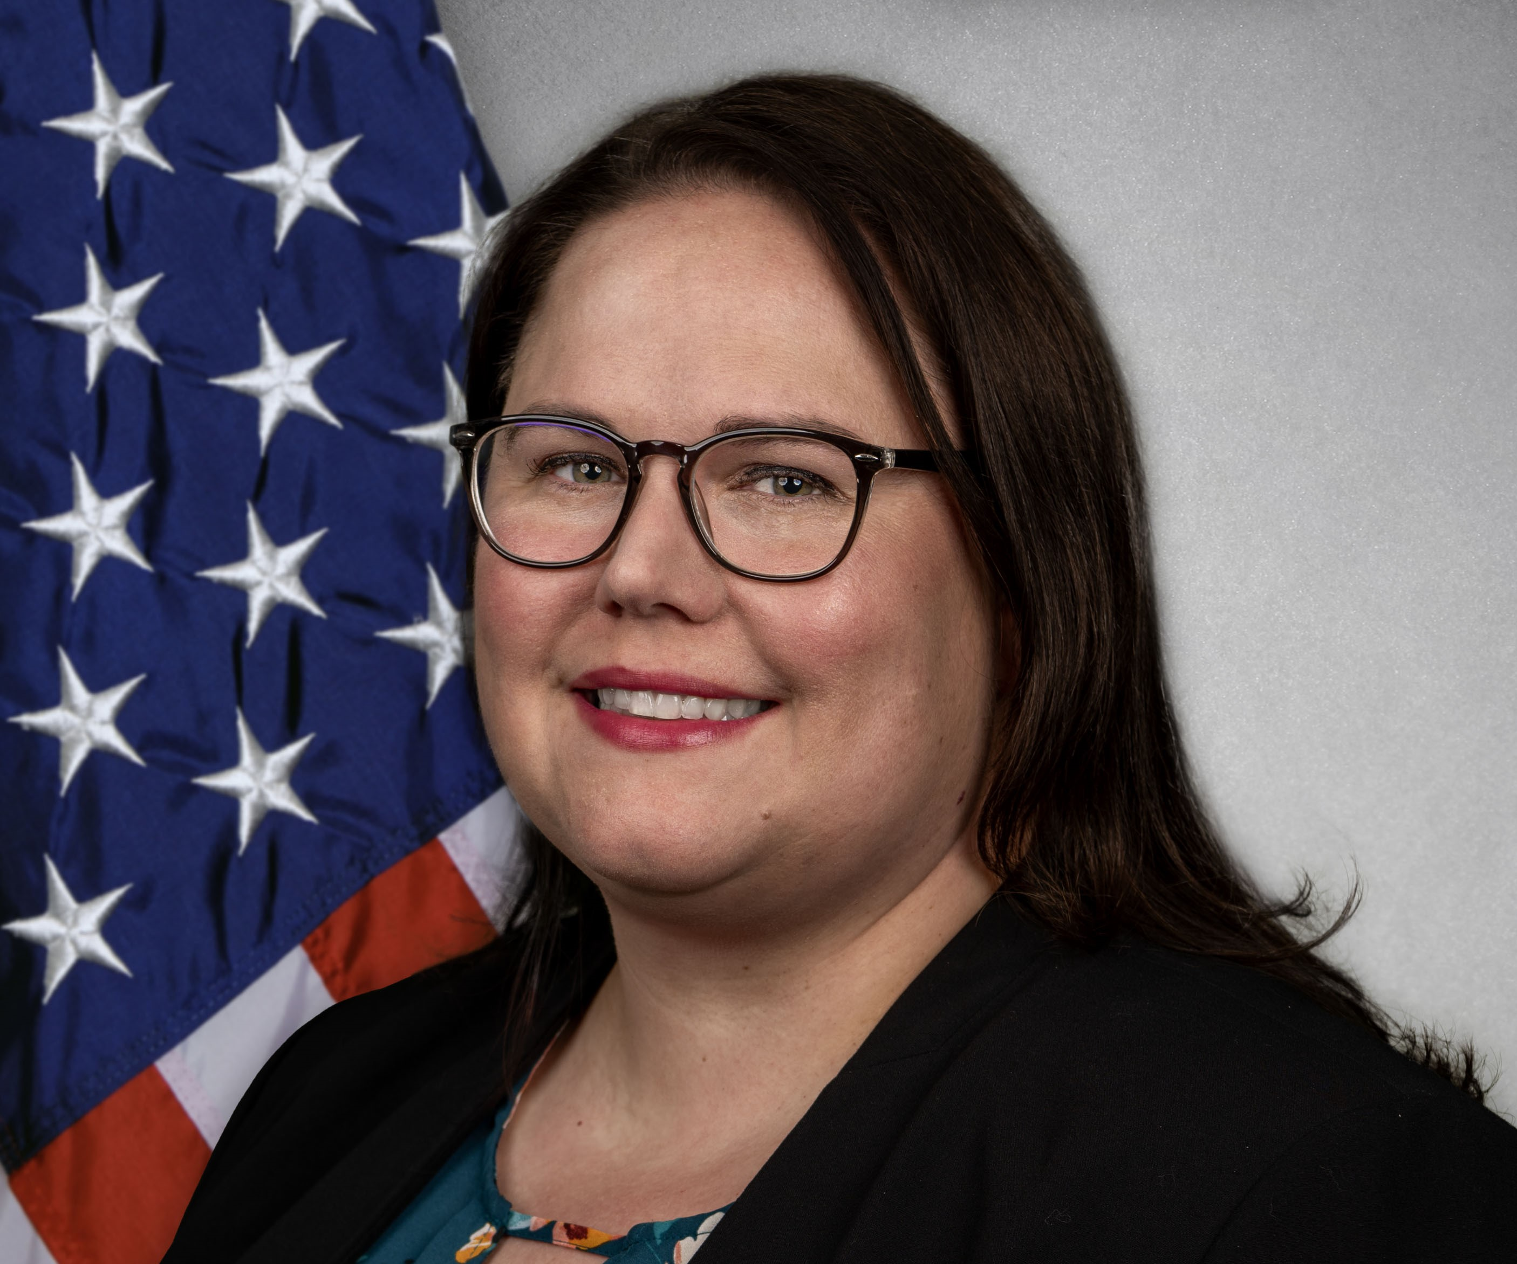
Atlanta – Spring 2026
Alice Savage
Alice.m.savage3@gmail.com
Spring 2026 POLY Symposia
Symposium Title | Symposium Organizer | HDS
Excellence in Polymer Graduate Research | R. Behling, C. Coltrain, C. Ellison, K. Heifferonm, J. Self | 3
Undergraduate Research in Polymer Science | H. Broadhead, S. Morgan, S. Nazarenko | 2
ACS Award in Polymer Chemistry for Geoff Coates | B. Fors | 2
POLY/ PMSE Award and Plenary (Wed, Mar 25th, 5:30-8:00 PM) | J. Kalow, G. Collier, A. Savage, K. Mitchem | 0
Paul J. Flory Education Award for Dr. Richard Spontak | B. Summerlin, T. Nelson | 1
General Topics: New Synthesis and Characterization | J. Kalow, A. Savage, G. Collier | 4
Industrial Innovations in Polymer Science | J. Ting, M. Sims | 2
Virtual Graduate Students Symposium in Asia-Pacific Region on Polymer Chemistry | Chiungwei Huang | 0
*Capturing the Power of Data for Materials and Chemical Scientists in Industry | A. Schmidt, M. Heiber, R. Shaffer, C. Szczepanski | 3
*Academic Entrepreneurship and Tech Transfer: Turning Research into Revenue | S. Dishari, C. Szczepanski , C. Wirth | 3
Green Chemistry and Beyond: Modern Mechanochemistry as a Frontier in Synthetic Innovation | M. Zagho, S. Nazarenko | 2
Functional Hydrogels for Energy and Soft Machines | A. Toor, S. Li, T. Schroeder | 2
Molecular Engineering of Stimuli-Responsive Polymers | T. Hebner, T. White, E. Runnerstrom | 3
Excellence in Polymer Research at HBCU/MS Institutions | R. Lambeth, D. Poree | 1
Specialized Fluoropolymer Applications: Current Limitations in Material Substitution | Jena McCollum | 1
 | Total POLY HDS: | 29
* Symposium overflow from Fall 2025
Recurring Symposia

Slide 6
Atlanta – Spring 2026
Alice Savage
Alice.m.savage3@gmail.com
Spring 2026 Joint Symposia
Symposium Title | Symposium Organizer | HDS
Polymers and Boron Nitride | J. Cash, C. Homenick | 1
Advanced Manufacturing and Concepts for Functional Coatings, Thin Films, and Interphases | J. Werner, L. Sun | 1
Circular Economy of Synthetic and Bio-Based Polymers: Advances in Feedstocks, (Bio)Degradation, Recycling, and Chemistry | M. Karayilan, Y.q. Rao, M. Webber, A. Sheldon Knight | 1
Soft Polymer Networks: Linking Chemistry, and Mechanics | S. Danielsen, G. Sanoja, C. Ellison, H. Kim | 2
Advances in Polymer Electrolytes | T. Saito, J. Lutkenhaus | 2
Microplastics | Y. Q. Rao , M. Blenner, R. M. Espinosa Marzal , A. Nason, K. Goodall, G. Miller | 1
Polymers at Bio-interfaces | R. Advincula, Z. Yang, C. Maladeniya, S. Zauscher | 2
Polymer dynamics at the nano- to meso-scale revealed by Neutrons and X-ray spectroscopy | LR Stingaciu, N. Osti, R. Advincula, H. Zhang | 1
Emerging Properties of Pi-Conjugated Polymers & Macromolecules Symposium | J. Azoulay, Z. Bao, T.-Q. Nguyen, J. Reynolds, A. Facchetti | 2
Innovations in Thermal Management & Fire Safety | T. Emrick, S. Nuguri, G. Wan | 2
Automation & AI in Polymer Science: Accelerating Discovery of functional polymers | E. Papanou, A. Afzal, M. Karayilan, N. Sinha, W. Xia | 2
Transformative Natural Polymers for 21st Century Materials (CCC) | Wei Gao | 1
 | Poly HDS | 18
Allotted: Joint 6 and POLY 41; Total: 47
Scheduled: POLY 29, Joint 18; Total: 47

Slide 7
Atlanta – Spring 2026
Alice Savage
Alice.m.savage3@gmail.com
POLY Only Symposia
SUNDAY (Mar 22) | MONDAY(Mar 23) | TUESDAY(Mar 24) |  | WEDNESDAY(Mar 25)
Academic Entrepreneurship and Tech Transfer SUN AM/PM & MON AM (Rm: Int. 1) |  | Capturing the Power of Data for Mat. & Chem. Sci in Industry: TUES PM & WED AM/PM (Rm: Int. 3)
General Topics: New Synthesis & Characterization SUN AM (Rm: Int. 10) | Industrial Innovations in Polymer Science MON AM/PM (Rm: Int. 10) | General Topics: New Synthesis & Characterization TUES AM (Rm : Int. 1) & WED PM (Rm : Int. 5)
General Topics: NSC SUN AM (Rm: Int. 3) | Excellence in Polymer Graduate Research MON AM/PM & TUES AM (Rm: Int. 3) |  |  | Green Chemistry & Beyond WED AM/PM (Rm: Int. 2)
Functional Hydrogels for Energy and Soft Machines SUN AM/PM (Rm: Int. 2) | Specialized Fluoropolymer Applications: CLMS MON PM (Rm: Int. 1) | Undergraduate Research in Polymer Science TUES AM/PM (Rm: Int.2) | Undergraduate Research in Polymer Science TUES AM/PM (Rm: Int.2) | Excellence in Polymer Research at HBCU/MS Inst. WED AM (Rm: Int. 5)
Paul J. Flory Education Award: Dr. Richard Spontak SUN PM (Rm: Int. 10) | ACS Award in Polymer Chemistry for Geoff Coates MON AM/PM (Rm: Int. 2) | Molecular Engineering of Stimuli-Responsive Polymers TUES PM (Rm: Int. 1) & WED AM/PM (Rm: Int. 1) | Molecular Engineering of Stimuli-Responsive Polymers TUES PM (Rm: Int. 1) & WED AM/PM (Rm: Int. 1)
 |  | Virtual Graduate Students Symposium in Asia-Pacific Region on Polymer Chemistry: TUES PM & WED PM | Virtual Graduate Students Symposium in Asia-Pacific Region on Polymer Chemistry: TUES PM & WED PM
Marriott Marquis Rooms:
International 1 | International 2 | International 3 | International 5 | International 10

Slide 8
Atlanta – Spring 2026
Alice Savage
Alice.m.savage3@gmail.com
Joint Symposia
SUNDAY (Mar 22) | MONDAY(Mar 23) |  | TUESDAY(Mar 24) | WEDNESDAY(Mar 25)
Adv. Manufactur. & Concepts for Functional Coatings, Thin Films, & Interphases: SUN AM/PM & MON AM/PM (Rm: Int. 7) |  |  | Automation & AI In Poly Sci: Accelerating Discovery of Functional Polymers: TUES AM/PM & WED AM/PM (Rm: Int. 8)
 | Advances in Polymer Electrolytes MON AM/PM (Rm: Int. 5) TUES AM/PM (Rm: Int. 10) WED PM (Rm: C206 Con. Ctr.)
Circular Economy of Synthetic and Bio-Based Polymers: Advances in Feedstocks, (Bio) Degradation, Recycling, and Chem SUN AM/PM (Rm: M304) MON PM (Rm: Int. 8) TUES AM/PM (Rm: Int. 5) WED PM (Rm: A401 Con. Ctr.)
Emerging Prop. of Pi-Conjugated Poly & Macromolecules SUN AM/PM & MON AM/PM (Rm: Int. 9) |  |  | Innovations in Heat Resistant Materials and Fire Safety TUES PM & WED AM/PM (Rm: Int. 9)
Polymers and Boron Nitride SUN AM /PM & MON AM (Rm: Int. 8) |  |  | Polymer Dynamics & Structure By Neutrons and X-Ray Spectroscopy: TUES AM/PM (Rm: Int. 7) WED AM (Rm: Int. C)
Microplastics SUN AM/PM (Rm: Int. 6) MON AM/PM (Rm: B314 Con. Ctr.) TUES AM (Rm: B405 Con. Ctr.)
Polymers at Bio-Interfaces SUN AM/PM (Rm: Int. B) MON AM/PM (Rm: Int. B) TUES AM (Rm: Int. 9)
 |  |  | Transformative Natural Polym 21st Century Materials (CCC) TUES PM (Rm: C205 Con. Ctr.) WED AM (Rm: Int. 10)
 | Soft Polymer Networks: Linking Chemistry, and Mechanics MON PM (Rm: Int. A) TUES AM/PM & WED AM/PM (Rm: Int. B)
 | POLY Posters 1-3 PM International Foyer | Sci-Mix: 8-10 PM B/C – Exhibit Hall Convention Center | POLY Posters 1-3 PM International Foyer | PMSE POLY Plenary 5:15-8 PM Imperial Ballroom Salon B
Marriott Marquis Rooms:
International 1 | International 2 | International 3 | International 5 | International 6 | International 7 | International 8 | International 9 | International 10 | International A | International B | M304 | Imp. BR Salon B

Slide 9
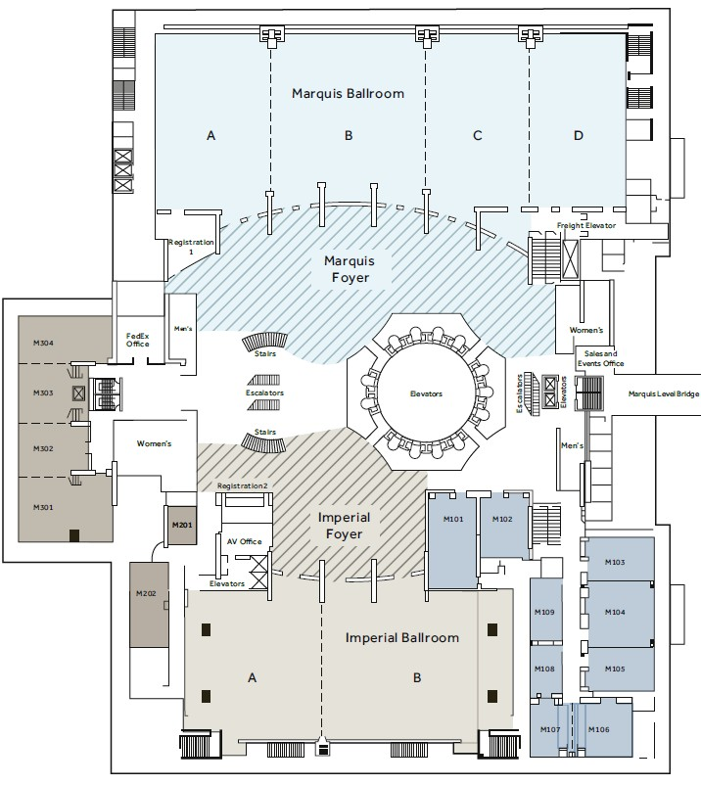
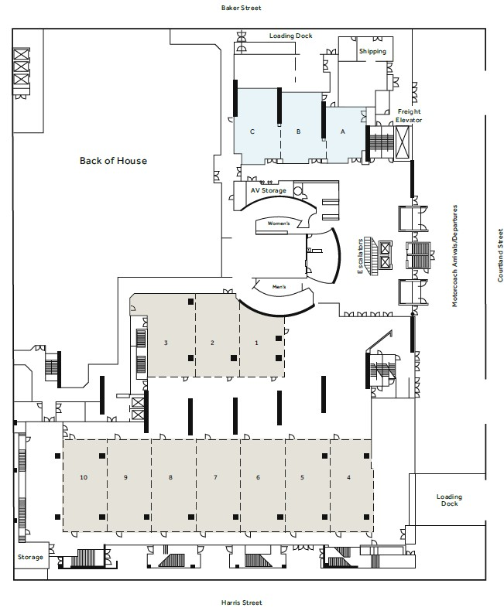
Atlanta – Spring 2026 floor plan
Marquis Level
International Level
Marriott Marquis
Atlanta GA
POLY/PMSE Poster Session and Membership Desk is on International Level

Slide 10
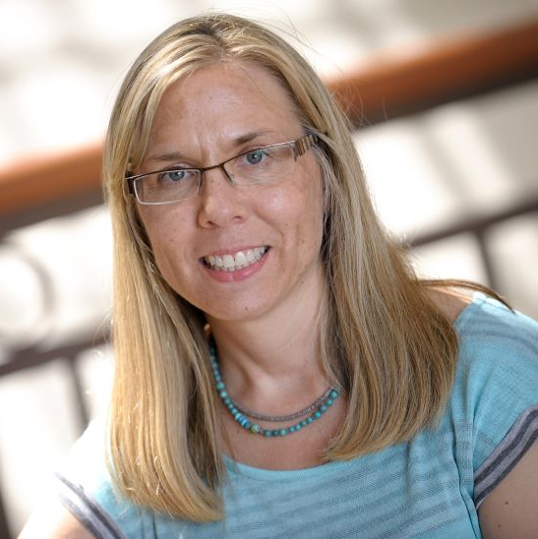
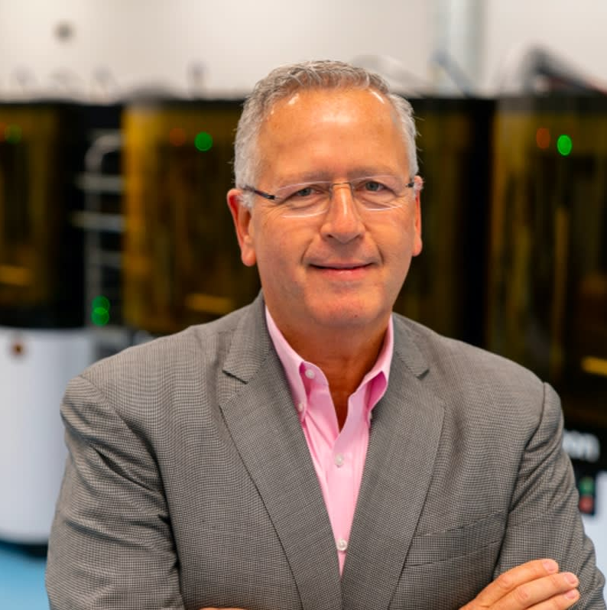
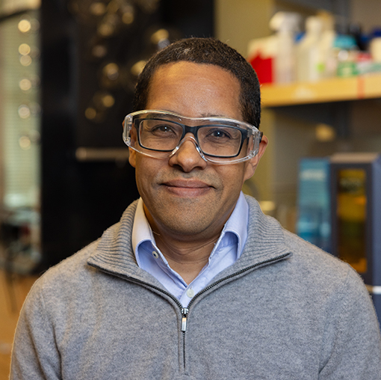
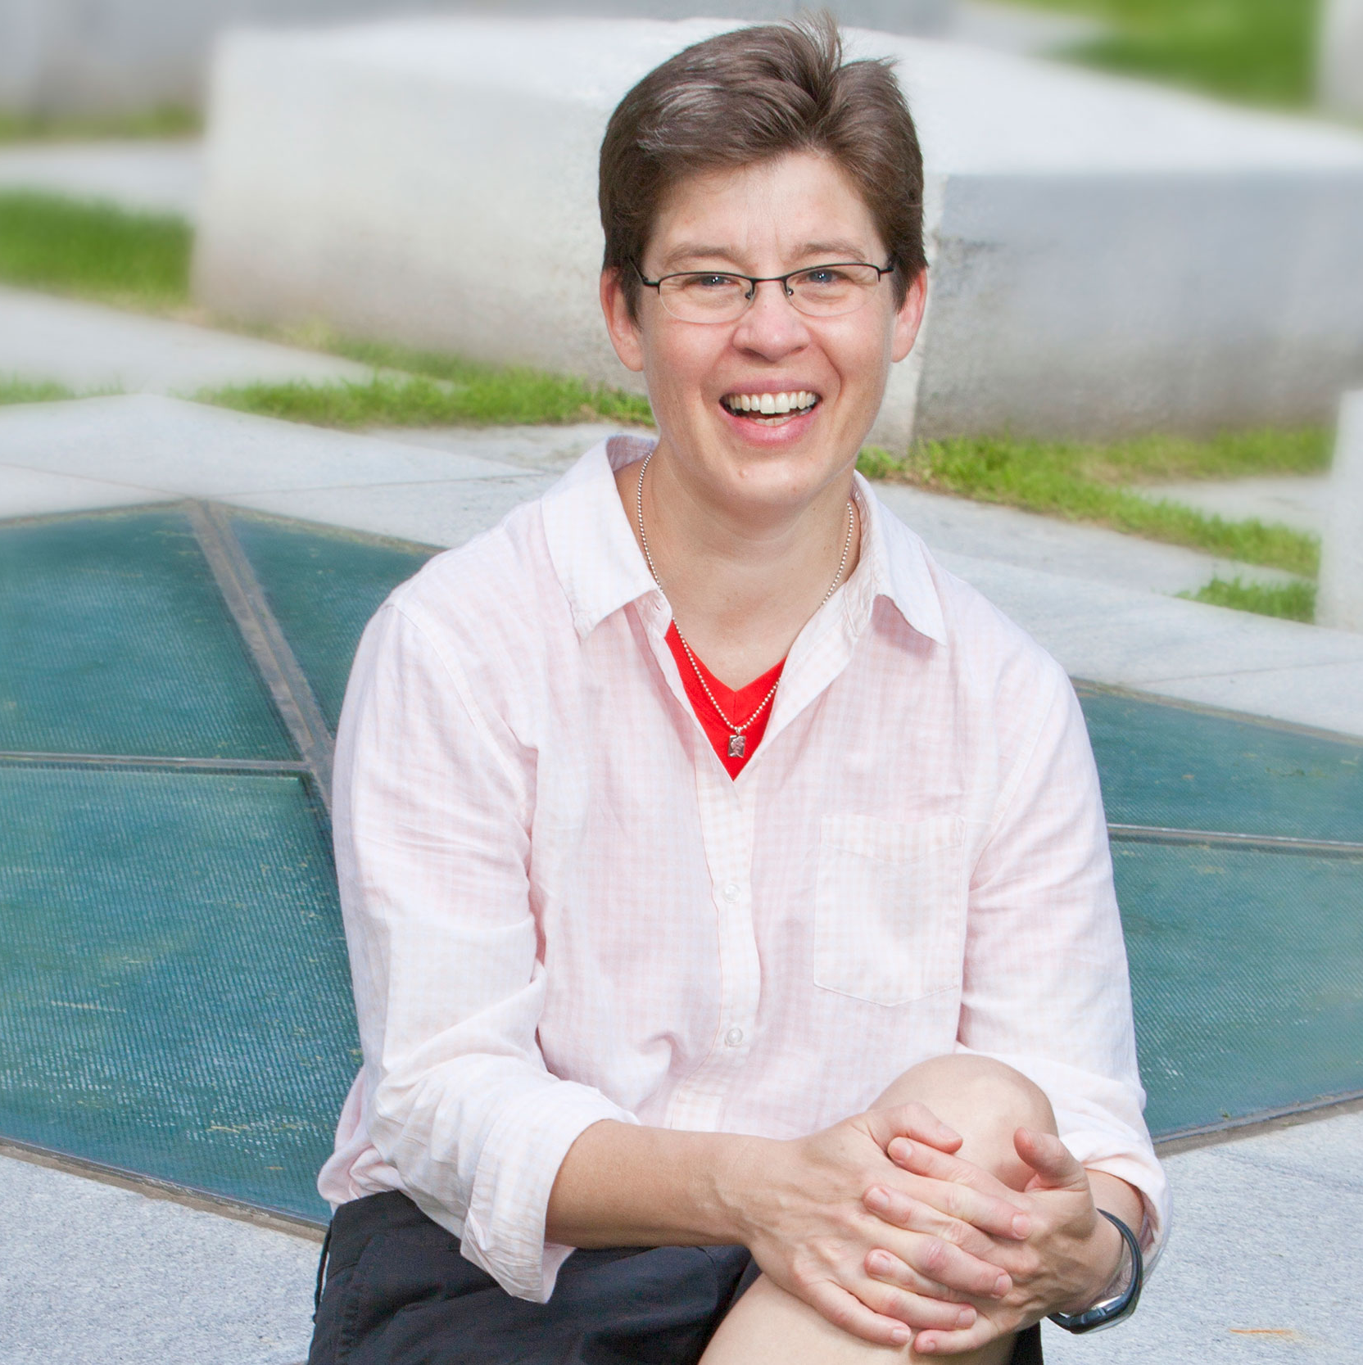
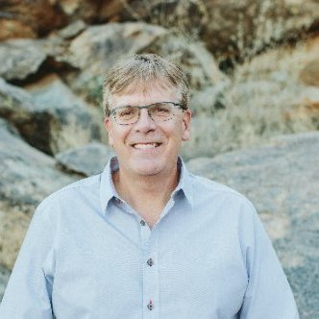
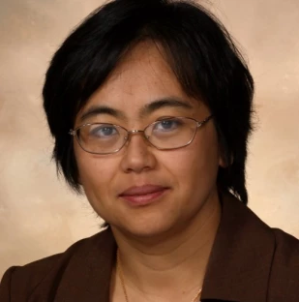
Additional Collaboration for Spring 2026
  Innovative Sessions involving POLY
    Sunday AM: 3D to 4D Printing Towards Dynamic Soft Materials (with POLY, PMSE, CELL)
    Tuesday PM, Wednesday AM: Transformative Natural Polymers for 21st Century Materials (CCC) (with POLY, CARB)

Slide 11
Additional Collaboration for Spring 2026

Slide 12
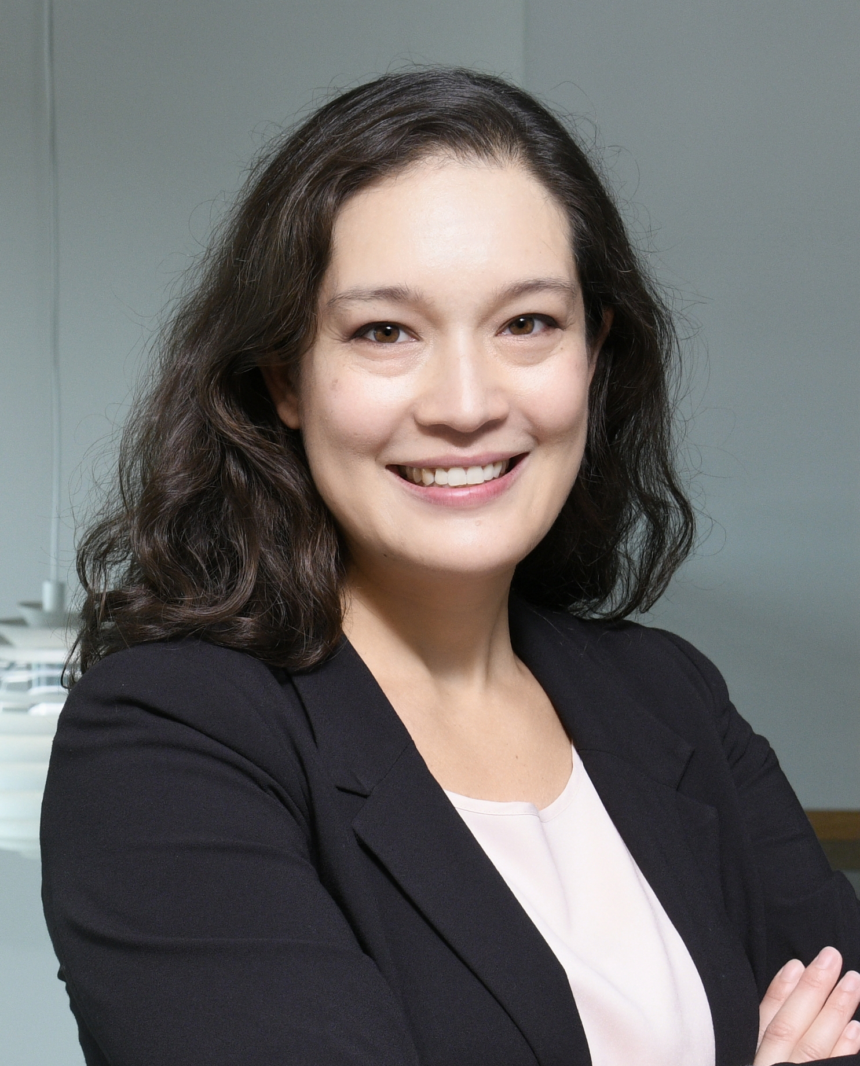
Chicago – Fall 2026
Symposium Title (Co-Organizing Divisions) | Symposium Organizers | Total HDS
Industrial Innovations in Polymer Science | Sayala, Blankenship, Abdilla, Murphy | 2
Industrial Polymer Scientist Award | Bates | 1
ACS Macro Letters/Biomacromolecules/Macromolecules Early Career Award | Smeddle, Hillmyer, Lecommandoux, Rowan | 1
Mark Scholar Awards | Nelson (placeholder) | 3
General Topics | Program Chairs | 3/TBD
POLY-PMSE Student Chapter Organized Symposium | Gross, Emrick | 1
Stimuli-Responsive Polymers for Reconfigurable Materials and Devices | Jiang, Xu, Li, Liu | 2
CME NASA Symposium (BIOT, COMSCI) | Meador, Rodriguez, Takhistova | 4
Polyzwitterions: Innovative Materials for Advanced Functional Systems (ENFL) | Imel, Dadmun | 3
Data Analytics and AI: Polymers, Chemistry, and Manufacturing (I&EC) | Advincula, Molitor, Chen | 3
Celebrating 150 Years of Industry-Academia Collaborations in Polymeric and Inorganic Materials for Societal Needs (PMSE) | Ting, Letteri, Radu | 2
Structure to Function in Supramolecular Biomaterials (PMSE) | Matson, Besenius, Kieltyka | 3
ACS Polymers Au: Innovations in Polymer Science (PMSE) | Perrier, Smeddle | 2
Transformative Natural Polymers of 21st Century ACS Series Symposia IV (CARB, CELL, AGFD) | Gao, Wang, Chen, Jiang, Fehl | 5

Slide 13
Chicago – Fall 2026
Symposium Title (Co-Organizing/Lead* Divisions) | Symposium Organizers | Total HDS
US-German Joint Symposium - Polymeric Materials: From Synthesis to Application (PMSE*) | Pester, Hickey, Peterson, Brendel, Weber | 4
Porous Polymers (PMSE*, COLL) | Silverstein, Cameron, Guo, Wiesner | 4
Synthesis, Properties, and Applications of Vinyl-Addition Cyclic Olefin Polymers (PMSE*) | Long, Rhodes | 2
J. Fraser Stoddart Award Symposium (ORGN*, INORG) | Cantrill, Flood, Dichtel | 3
Polymers in Fuel Cells and Electrolyzers: From Molecular Design to System Integration (ENFL*, PMSE) | Dishari, Zhu, Wang, Park | 3
Heroes of Polymer Science | Kalow, Collier, Konkolewicz, Nepal | 0 (poster)

Slide 14
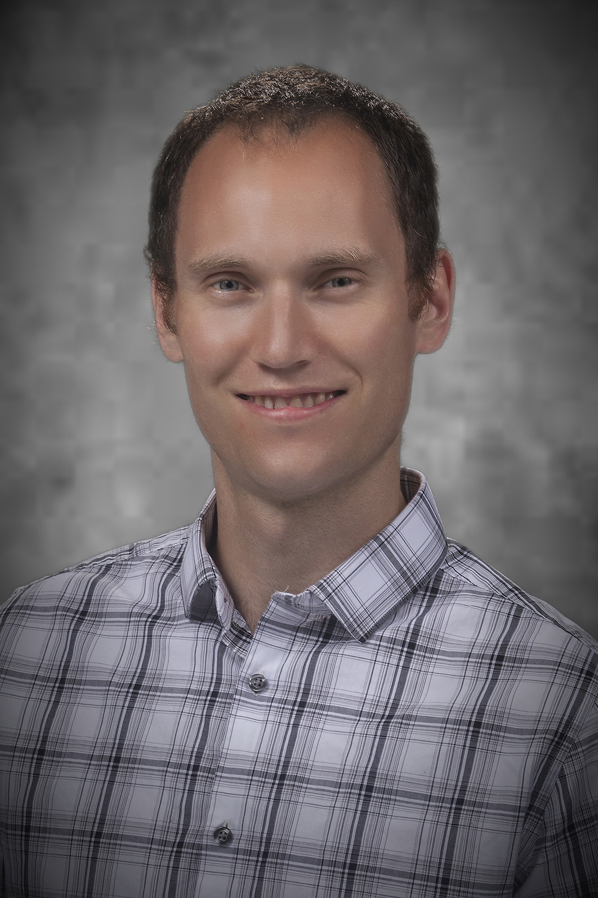
New Orleans – Spring 2027
Recruiting Symposia & Organizers!
Symposium Title (Co-Organizing Divisions) | Symposium Organizers | POLY HDS
Industrial Innovations in Polymer Science | Sims, Sayala (placeholders) | 2
Carl S. Marvel Creative Polymer Chemistry |  | 1
ACS Award in Polymer Chemistry |  | 1
General Topics | Program Chairs | TBD
POLY-PMSE Student Chapter Organized Symposium | TBD | 1
Undergraduate Research in Polymer Science | Broadhead, Morgan, Nazarenko | 2
Excellence in Polymer Graduate Research Symposium |  | 4
Undergraduate Research in Polymer Science Symposium |  | 2
*Functional Macromolecular Architectures from Renewable Feedstocks | Voronov, Vacche, Caillol, Caldona | 4
*Targeted Microstructure in Polymers: Synthesis, Characterization, and Function | Dishner, Szweda, Meyer | 4
*Synthetic and Natural Polymers for Healthcare and Biotechnology | Sayala, Narayanan | 3
*Proposed symposia; will be evaluated based on symposium selection rubric
*overflow from 2025

Slide 15
New Orleans – Spring 2027
Symposium Title (Co-Organizing Divisions) | Collaborating divisions | Symposium Organizers
Polymers for Drug Delivery
Characterization of Soft Materials and Water Soluble Polymers
Advances in Process Analytical Measurement Science
Protecting Inventions and Investors in Polymer Science
Advances in Renewable Materials
Recruiting Organizers!
  Joint symposia proposed during the ACS Leadership Institute
  Seeking POLY co-organizers who can collaborate with other divisions
Notes:
Make a 1-pager advertisement for Carlee/Tayler/Nick to post

Slide 16
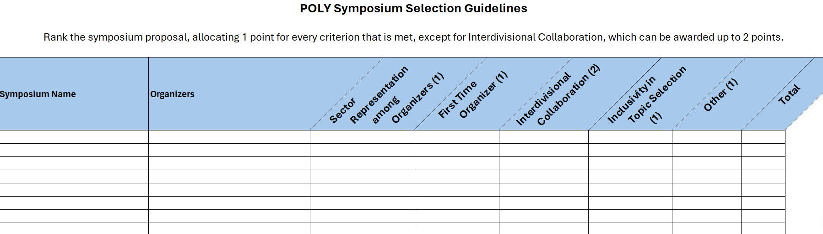
POLY Symposium Selection Guidelines
Used in Fall 2026; no single symposium got more than 2 POLY HDS
Overlapping symposia were asked to choose between moving to future meeting, combining, or differentiating

Slide 17
2026 Programming Goals
Intentionally plan joint programming
  Maximize POLY impact within smaller ACS footprint
  Develop ideas with other divisions and recruit experienced organizers
  Suggest/contribute to Innovative Programming
Organizer recruiting, outreach, and training
  Develop policies around HDS utilization
  Best practices for abstract rejection/conversion to poster
Elevate poster sessions
  Continue collocated poster sessions with PMSE
  Pilot an invited poster session at Fall 2026 (“Heroes of Polymer Science” with PMSE)
Develop new virtual programming
  Recruit a virtual programming chair
  Use lessons from the pandemic to create engaging virtual programming
  Collaborate with Global Engagement committee

Slide 18
HDS Allocations
Spring allocation is decreasing in 2027, but fall allocation is increasing relative to 2026
New formula for determining allocations
  Start with 2 base HDS/division
  Net change by season capped at 20%
  Factors weighted by 25% each, based on average of past 2 years of data:
    Demand (division attendance)
    Utilization (session attendance)
    Quality (oral session rejection rate)
    Collaboration (use of joint session allocation)
Meeting | Total | Joint
Spring 2025 | 53 | 4
Fall 2025 | 36 | 4
Spring 2026 | 41 | 6
Fall 2026 | 31 | 6
Spring 2027 | 38 | 6
Fall 2027 | 35 | 7

Slide 19
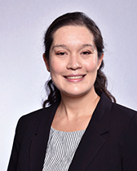
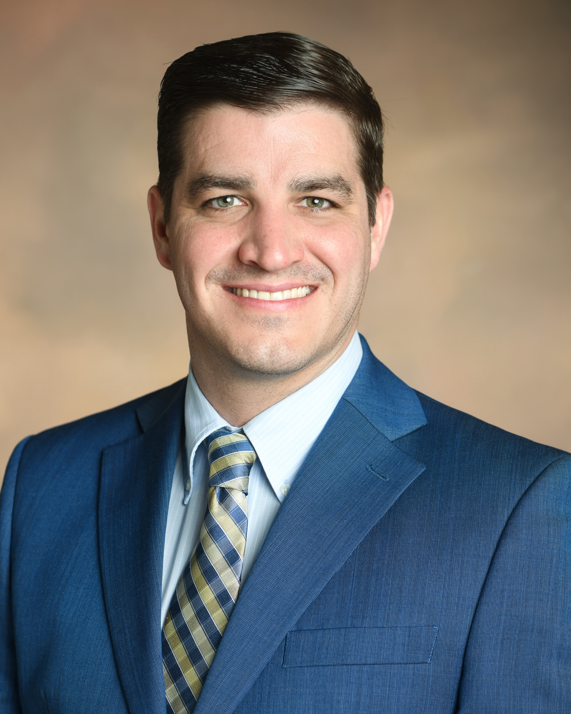
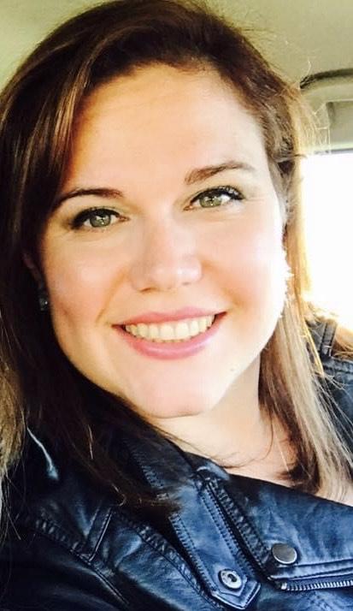
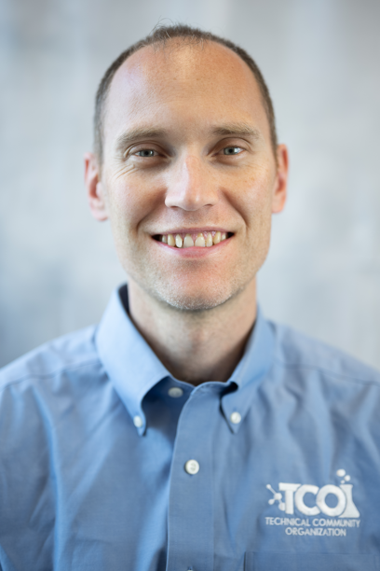
POLY Programming Team Rotation
Date (Location) | Julia Kalow Northwestern | Graham Collier Southern Miss | Alice Savage ARL | Michael Petr Dow | TBN Academia?
Spring 2025 (San Diego) | LEAD | SUPPORT | SHADOW
Fall 2025 (DC) | SUPPORT | LEAD | SUPPORT
Spring 2026 (Atlanta) | SUPPORT/CHAIR | SUPPORT | LEAD | SHADOW
Fall 2026 (Chicago) | LEAD/CHAIR | SUPPORT | SUPPORT | SUPPORT
Spring 2027 (New Orleans) | SUPPORT | SUPPORT/CHAIR | SUPPORT | LEAD | SHADOW
Fall 2027 (San Diego) | SUPPORT | LEAD/CHAIR | SUPPORT | SUPPORT | SUPPORT
Spring 2028 (Houston) | CONSULT | SUPPORT | LEAD/CHAIR | SUPPORT | SUPPORT
Fall 2028 (TBN) |  | CONSULT | SUPPORT/CHAIR | SUPPORT | LEAD

Slide 20
Team Composition
Balance of industry/academia/government
  Julia will complete her term at the end of 2027
  New programming chair named by Derek
  POLY Program Committee Chair Rotation:
    2026 – Julia
    2027 – Graham
    2028 – Alice
    2029 - Michael

Slide 21
Thank you!
Any questions?
Notes:
PMSE same as us; Org up to $4K and works out to the same; Coll - Info from Allan

Slide 22
Back Up Slides

Slide 23
New/Continuing Initiatives
Knowledge continuity in business office/ program chair liaison (Thanks Kathy!) & with ExComm (2026, Hayley Brown)
Continuing – Programming event to thank current organizers, reporting out on Programming, and recruiting new organizers
  Recognition paths
  Reporting paths
  Recruitment paths
Continuing – Revising Programming Best Practices (In progress)
Continuing – Discussions & initiatives regarding DEIR in POLY Programming
Continuing – Symposia Selection Guidelines Implementation with amendments as needed (2025 Focus)
New! – Virtual Programming Chair & Program Development (2026 Focus)

Slide 24
Historical Contributions
Philadelphia 2020- cancelled, Spring 2021 Virtual meeting did not collect division-level stats.

Slide 25
POLY Programming Workshop
Discussion Phase: gather best practices of several past program chairs (PC)
Questions discussed at workshop:
  What works well in POLY programming?
  What can be improved? What’s not working?
  What are some ideas you have that would help POLY innovate with regards to programming?
  What would have been helpful for you to know as a new program chair that you’d want to share with future program chairs?
  What were some of the best technical symposia that you programmed? Why were they successful?
  What have you observed makes the community eager to present in POLY? What helps motivate you to present? What helps students and early career chemists present?
  Special topic on innovation within general topics symposia
Findings and best practices will be summarized in growing POLY Program Chair Guidebook - an ongoing document summarizing findings of workshop and addition input by champions

Slide 26
Voting Items & Items for Evaluation
  (Voting) Organizer recognition/retention proposals:
    Continuing Resolution on proposal to continue to produce and distribute “POLY National Meeting Symposium Organizer” recognition pins and organizational “care packages” to organizers as a method of recognition and retention
  (Consideration) Programming Recruitment Funding: With a reduced meeting footprint, what is the appropriate level of financial support?
      For pins, bags/supplies, and postage
      Coffee/happy hour programming meetings to recruit organizers
        ACS foresees virtual component to meetings long-term
Notes:
$12k penciled into Christine’s budget
(no postage if in person, )

