Slide 1
POLY Webinar Update
Bob Lambeth, Tomonori Saito, Brent Sumerlin, Rebecca Olson Short,
April 9, 2026

Slide 2


POLY Webinars: 2025
Flow Chemistry In Polymer Science 4/2/2025
Two-Dimensional Polymers
7/10/2025
Carbohydrate Polymers 10/29/2025
Frank Leibfarth
Royce Murray Distinguished Term Professor of Chemistry, The University of North Carolina, Chapel Hill
Damien Guironnet
James W Westwater Professorial Scholar, Department of Chemical and Biomolecular Engineering, University of Illinois Urbana-Champaign
Luke Baldwin (moderator)
Research Chemist, Polymers & Responsive Materials,
Air Force Research Laboratory
Dana D. Medina
Habilitand, Department of Chemistry, Ludwig Maximilian University of Munich
Austin M. Evans
Assistant Professor, Department of Chemistry, University of Florida
Ronald A. Smaldone (moderator)
Associate Professor, Department of Chemistry and Biochemistry, University of Texas, Dallas
Kevin Edgar
Associate Dean, Professor of Biomaterials
Virginia Tech
Kamil Godula
Associate Professor,
Department of Chemistry and Biochemistry
UC San Diego
Cassandra Callman (moderator)
Assistant Professor
Department of Chemistry
The University of Texas at Austin

Slide 3
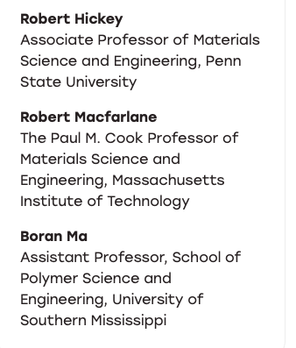

POLY Webinars: 2026
Polymer Nanocomposites
3/4/2026
6/26/2026
9/24/2026

Slide 4
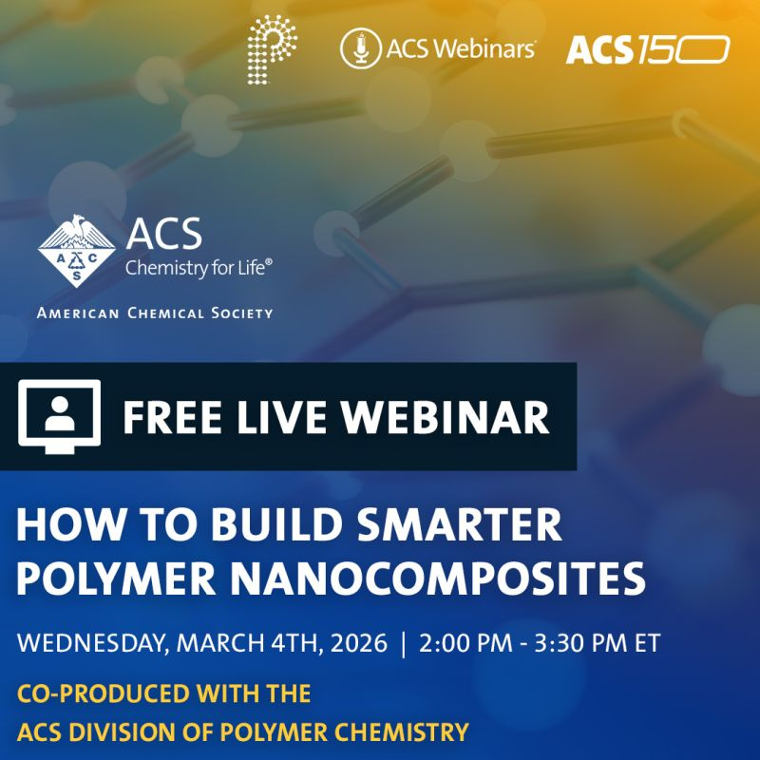
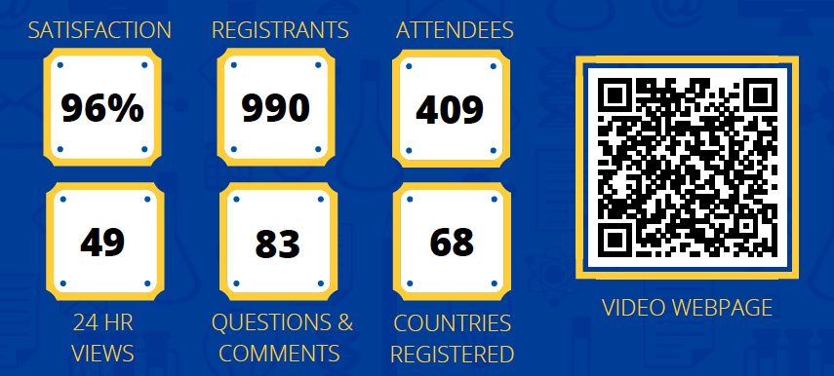
First POLY/ACS Webinar in 2026
Speakers
Robert Hickey
Associate Professor of Materials Science and Engineering, Penn State University
Robert Macfarlane
Paul M. Cook Professor of Materials Science and Engineering, Massachusetts Institute of Technology
Moderator
Boran Ma
Assistant Professor, School of Polymer Science and Engineering, University of Southern Mississippi
POLY Leads
277

Slide 5
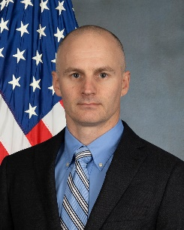
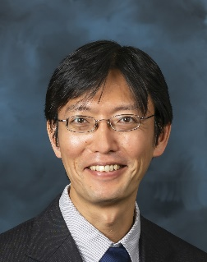

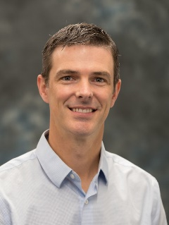
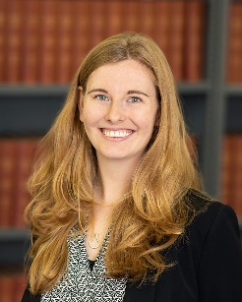
POLY Webinar Committee
Future Webinar
Please send your ideas and feedback to any of us.
Bob Lambeth (chair), Army Research Laboratory robert.h.lambeth2.civ@army.mil
Tomonori Saito, Oak Ridge National Laboratory saitot@ornl.gov
Brent Sumerlin, University of Florida sumerlin@chem.ufl.edu
Rebecca Olson Short, PPG RAShort@PPG.com

