Slide 1

ACS
DIVISION OF POLYMER CHEMISTRY
Treasurer Report
POLY Business Meeting August 2026
Presented by John Matson (Treasurer)
Support from Kathy Mitchem and Carlee Black

Slide 2
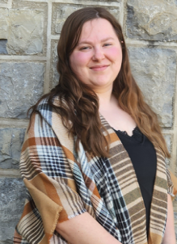
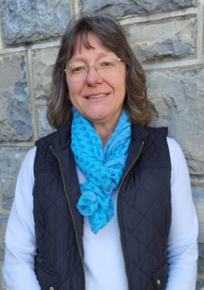
POLY Business Office
  Oversite:
  *POLY Supervisor– John Matson (Treasurer)
  *VT Representative – Bob Moore
  Location: New offices at Fralin Hall; staff work a mix of remotely and on-site.
  Carlee Black
  Administrative Assistant
  Salary 32hrs Week
  Membership Support
  Workshop/Meeting Prep, Website, etc.
  Awards Oversite
  POLY Newsletter & Publicity Posts:
  Facebook, E-news, ListServe
  General Websites Updates
  Graphical Abstracts/Preprint
  Office Supplies/Orders
Kathy Mitchem
Business Manager
  Full Time
  Budget Support-Bookkeeping
  ExComm Officer Support
  Workshops & Event Planning
  ACS Meetings Support
  Industrial Advisory Board
  - & Other Committee Assistance
  Election Oversite
  VT/Staff/Office Oversite

Slide 3
2026 Approved Budget

Slide 4
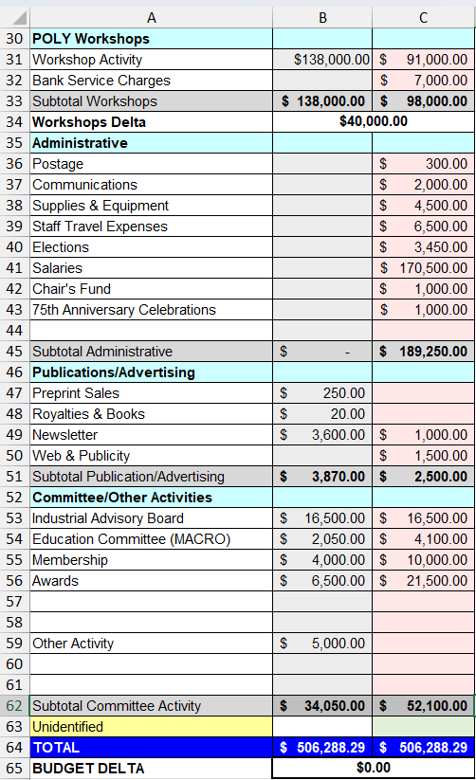
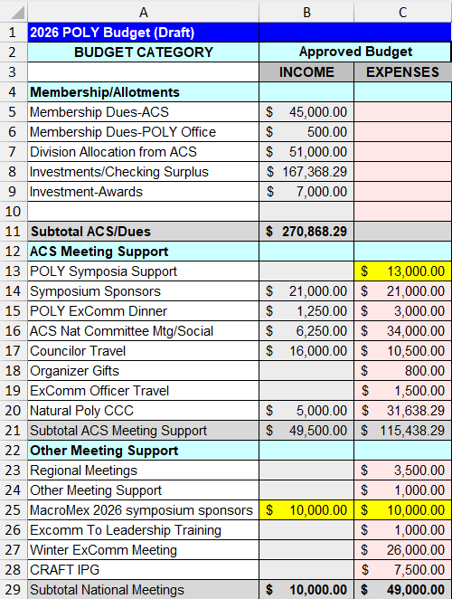
2026 Final Approved Budget
Important points
Investment: We anticipate cashing out $167K from investments in 2026. Trimming below this value became quite difficult.
ACS Expenses: We continue to reduce our spending at ACS meetings. There was no spring business meeting but rather a virtual town hall in April.
Other: The budget reflected decreasing membership dues (line 5). Changes to symposium support ($500 per POLY-sponsored symposium regardless of number of POLY sessions) reduced projected expenses (line 13).

Slide 5
2026 Budget / Actuals
(as of July 30, 2026)

Slide 6
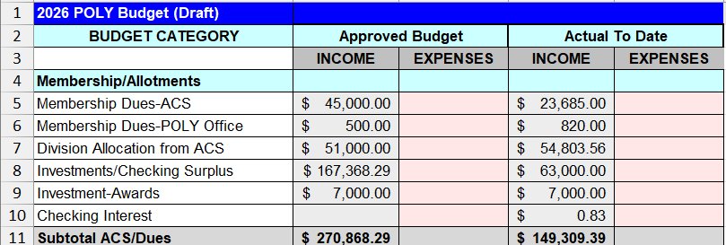
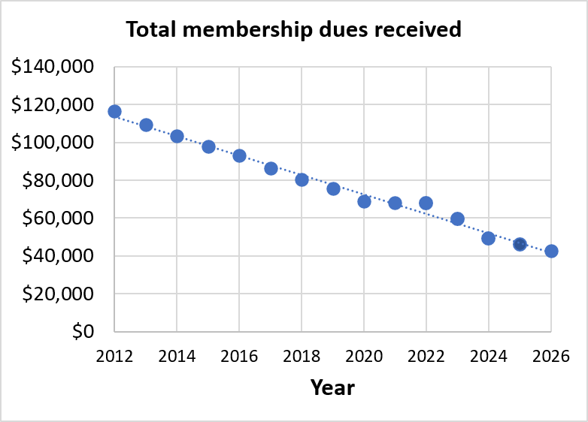
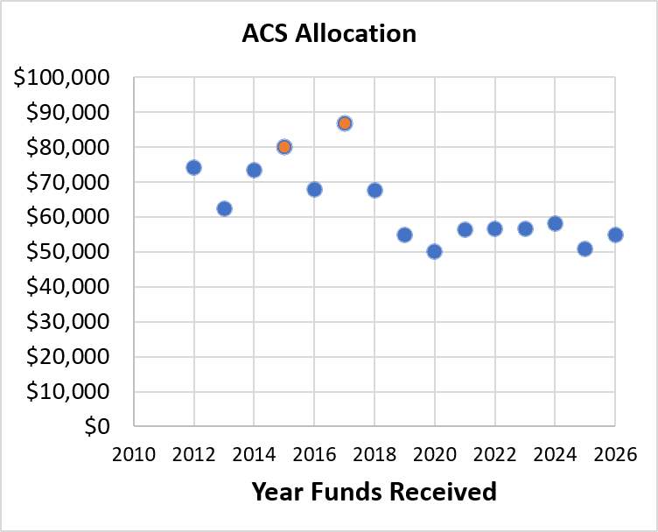
2026 Approved Budget & Activity 1:
Income from dues & ACS
Important points
Membership dues (5): Both dues payments have now come in (the second one was not yet reflected as of July 31). We will finish the year at $41,815, $3K below budget.
ACS allocation (7): ACS allocation is $3K above budget.
Summary
ACS dues will be down $3K, but this is offset by a higher than budgeted division allocation.

Slide 7
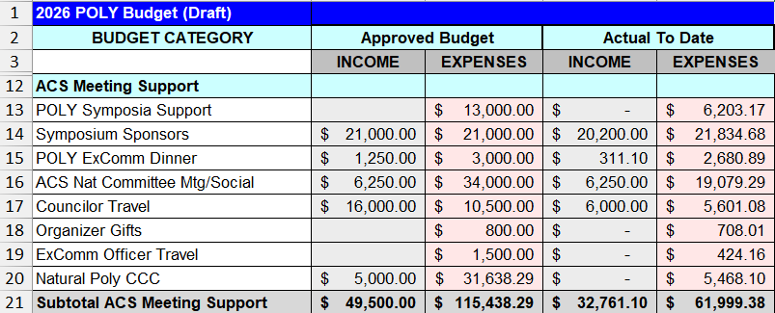
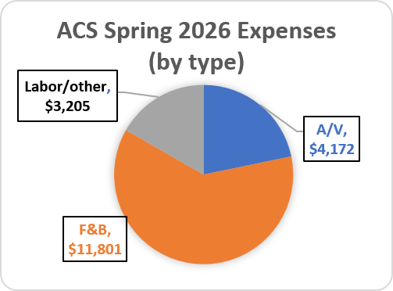
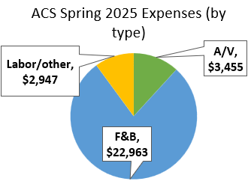
Important points
Symposia support (13): We are on track to be close to our $13K budget.
ACS meeting (16): We are on track to be on budget. Major reductions in F&B due to lack of programming lunch and board meeting.
Councilor Travel (17): ACS pays $2000 per councilor who travels. Decreased income matches decreased expenses.
Natural Polymer CCC (20): Wei anticipates using this funding in 2027 instead of 2026, so expenses will be much lower than expected this year.
Summary
We are keeping ACS costs down through several recent changes.
2026 Approved Budget & Activity 2:
ACS meeting-related expenses
Notes:
From 2026-08: Half of our F&B expenses at ACS Spring 2026 were the plenary. Most of the rest was morning coffee (which is sponsored in part by TOSOH) and the poster session food.

Slide 8
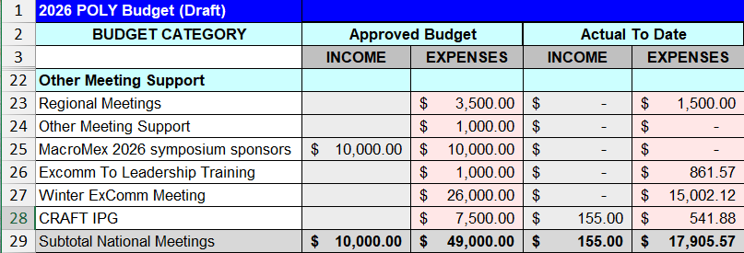
2026 Approved Budget & Activity 3:
Other meetings
Important points
Winter ExComm meeting (27): Our Winter ExComm 2027 deposit is only $700, so we ended up $10K below budget here. Nice work!
Summary
No major unexpected outcomes so far here.
Nice job, everyone, in keeping Winter ExComm expenses low.

Slide 9
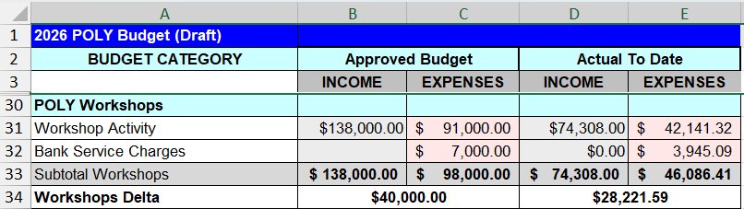
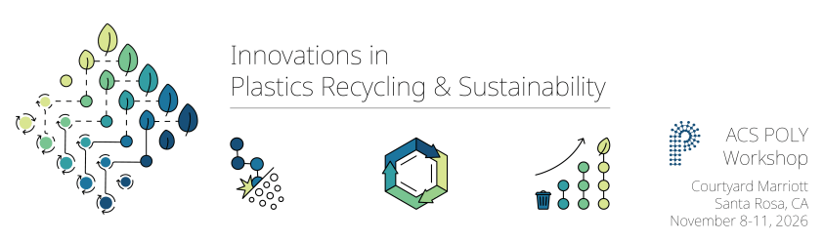
2026 Approved Budget & Activity 4:
Income from workshops
Important points
Fire & Polymers (May 2026, San Diego, CA) was a scientific success and financially viable. It had 67 total attendees and netted $2,975 to POLY. Excellent fundraising made up for a lower than projected number of attendees. Incredible work!
Innovations in Plastics Recycling and Sustain-ability is coming up (Nov 2026, Santa Rosa, CA) is up next. Registration deadline Sep 1.
Summary
The workshop delta stands at $28K now; we hope to hit our budget projection of $40K.

Slide 10
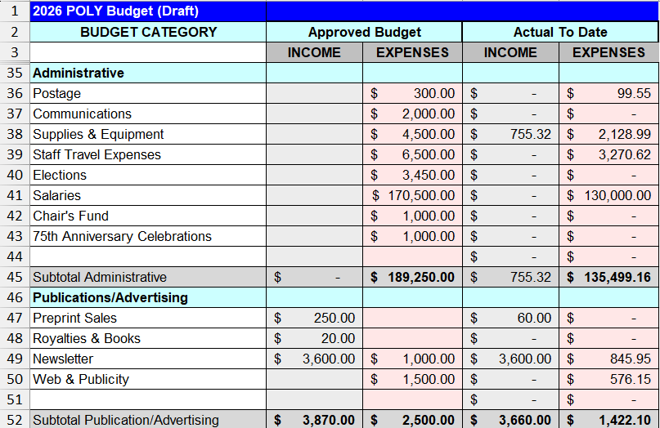
2026 Approved Budget & Activity 5:
Administrative
Important points
Nothing critical
Summary
No major unexpected outcomes so far here.

Slide 11
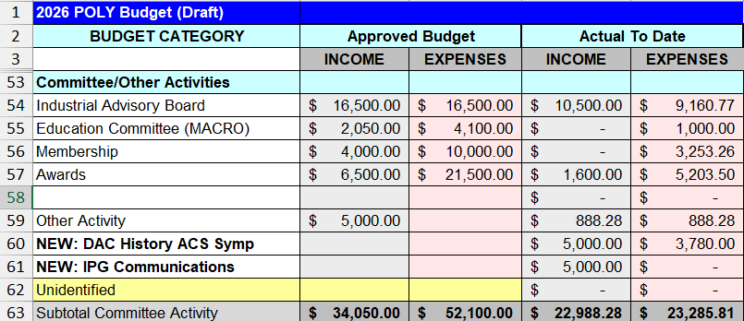
2026 Approved Budget & Activity 6:
Committee Activities
Important points
Awards (57): The majority of awards activity occurs in the fall.
Summary
It would help to have more award sponsors, as always.

Slide 12
2026 Investments Activity

Slide 13
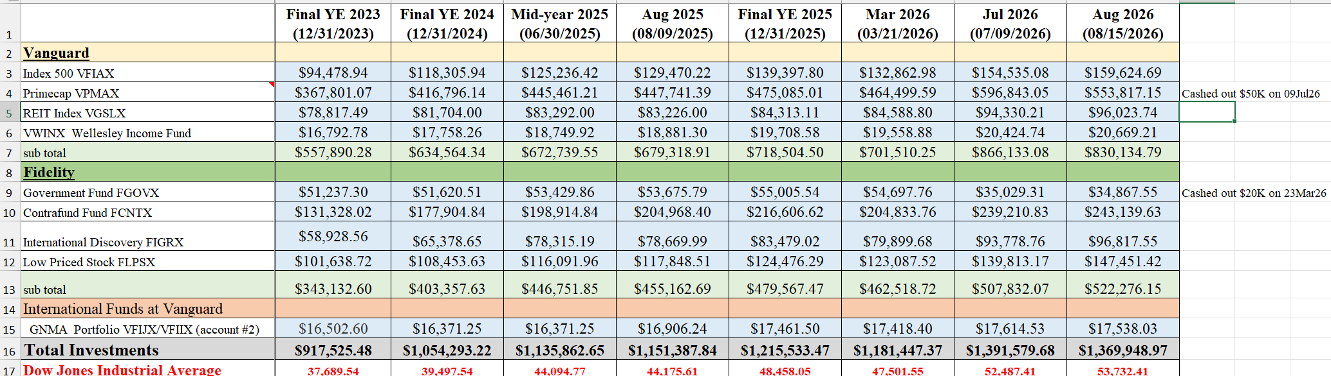
POLY Investment Fund Details
Summary of investments through Aug 15, 2026
As of Aug 15, investments have netted $224K (18%) since Jan. 1, 2026. The market has been excellent for POLY so far again this year. Actual increase is $154K due to withdrawals.
Keep in mind that we invest aggressively. These gains can decrease with a market disruption.
We withdrew $20K on March 23, 2026 (Fidelity) and $50K on July 9, 2026 (Vanguard).
The budget allows for a withdrawal of up to $167K in 2026. I anticipate a total of around only $130K due to CCC Natural Polymer spending being deferred to 2027 and winter ExComm savings.

Slide 14
2026 Sponsorship Support

Slide 15
Sponsorship Support
Newsletter Advertising | 1/8 pg $20 up to Full pg $2,000 | Semi-Annually
E-news with Web Link | $500 | Annually
Plenary Speaker | $1,500 | Annually ($600x2 annually)
Major Awards: Each: Marvel, Flory, Mark, IPS | $3,500 each (prize & travel) | Bi-Annually
Student Social | $1,000-$3,000 | Semi-Annually
Cookie/Snack Break Sponsor | $1,500 per ACS Mtg | Semi-Annually
General Division Sponsorship
General Papers | $600 per ACS meeting | Need new sponsor
In Place for 2026
Coffee Break Sponsor | $3,250 per ACS meeting | TOSOH
Poster Awards | $1,200 per ACS meeting | SpringerNature
Poster Session Food and Beverage | $3,000 per ACS meeting | JAI
General Papers | $400-600 per ACS meeting | Allan/ZCMI: Looking for Sponsor
Important points
Mark awards have been discontinued after this year
Allan/ZCMI is sponsoring general papers award currently; new sponsor needed.

