Slide 1
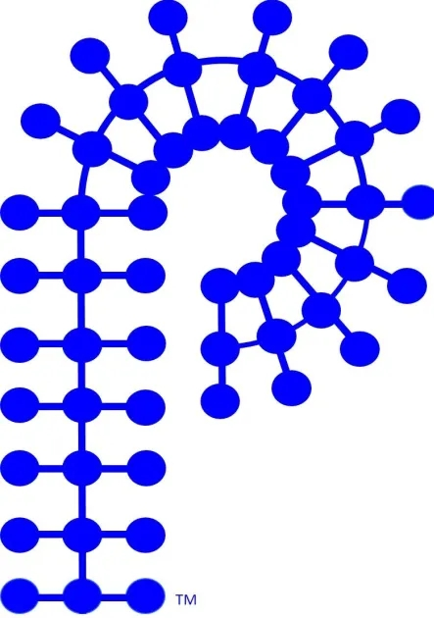

International Committee Update
ACS Polymer Chemistry Division
Gobet Advincula, Kris Matyjaszewski, Tim Lodge
Peter Zarras, Allan Guymon

Slide 2


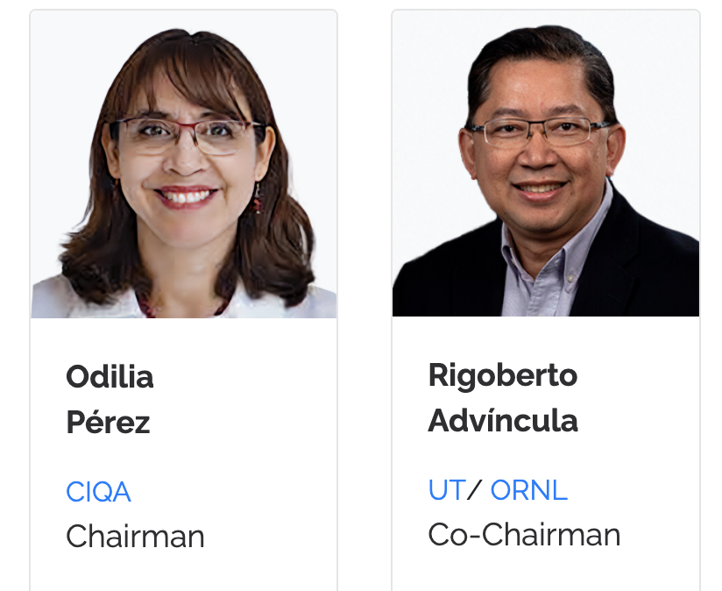

https://macromex2026.com.mx/
Great lineup of Speakers and Session
Cancun, Riviera Maya, Mexico
Co-Organizers
August 31, 2026: Abstract Deadline

Slide 3
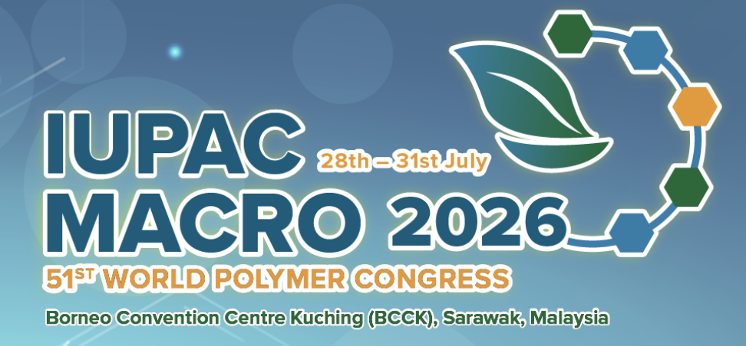



Recent Conferences held:
June 2026 In Sarawak, Malaysia
Bordeaux Polymer Conference (BPC)
Pacific Polymer Conference (PPC20)
Next year, November 2027
The 20th Pacific Polymer Conference (PPC20) is scheduled for November 2027 in Busan, South Korea, and will be hosted by the Polymer Society of Korea and the Pacific Polymer Federation (PPF). ACS Polymer Chemistry Division is a founding member of the PPF.
Conference Details
Event: 20th Pacific Polymer Conference (PPC20)
Location: Busan, South Korea
Date: November 2027 (Exact dates to be announced)
Conference Chair: Prof. Dong June Ahn (Korea University, also serving as PPF President)
Secretary-Treasurer: Prof. Pil J. Yoo (Sungkyunkwan University)
Future Conference:
European Polymer Federation (EPF 2027)
Riga, Latvia
https://epf2027.org/

