Slide 1
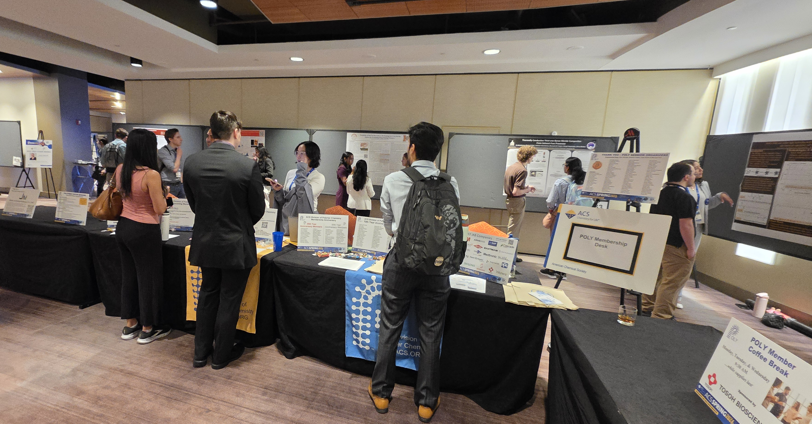
POLY Programming Team
ACS Fall 2026
Spring 2026 ACS
Julia Kalow, Graham Collier, Alice Savage, Michael Petr
Kathy Mitchem (POLY Business Liaison),
and Hayley Brown (2026 ExComm. Liaison)

Slide 2
Overview
POLY at the ACS National Meeting Review
  Review of POLY at recent ACS National Meetings
Upcoming National Meetings
  Fall 2026 (Chicago) – Julia Kalow
  Spring 2027 (New Orleans) – Michael Petr
  Fall 2027 (San Diego) – Alice Savage
  Spring 2028 (Houston) – Graham Collier
Future of POLY Programming
  Ongoing challenges and 2026 programming goals
  HDS allocation formula
  Team composition and rotation

Slide 3
Review and Report Summary
  Spring 2026: POLY/PMSE at the Marriott
    Overall successful, distance required shuttles between hotel and conference center (joint sessions and innovative programming)
    Joint colocated poster session was well-attended but loud
    Programming meeting was not well attended; will try a new format in Chicago
Year | Total ACS | % POLY
Spring 2026 | 11,883 | TBD
Fall 2025 | 11,786 | TBD
Spring 2025 | 15,294 | 5.1
Fall 2024 | 10,591 | 4.6
Spring 2024 | 14,484 | 4.7
Fall 2023 | 15,241 | 4.6
Meeting | Total ACS Registered | % POLY | # POLY Registered
Spring 2026 | 13522 | 3.2 | 438
Fall 2025 | 11664 | 3.2 | 370
Spring 2025 | 15230 | 2.8 | 433
Fall 2024 | 11897 | 3.4 | 400
Spring 2024 | 14391 | 3.2 | 466
Fall 2023 | 15242 | 2.7 | 415
Notes:
Josh Blair J_Blair@acs.org got all these data!

Slide 4
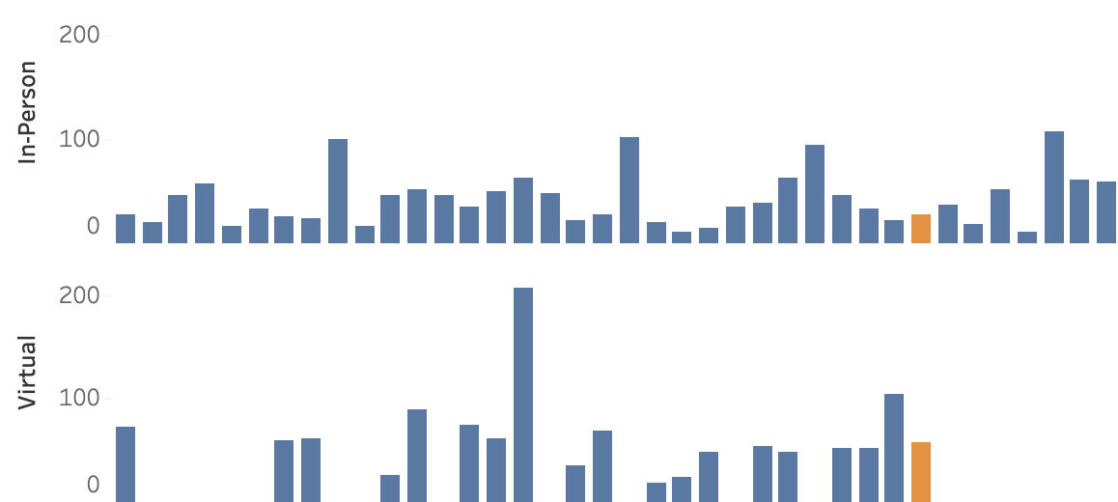
2026 Spring Review and Report Summary
Overview of Spring POLY meeting presentations in Atlanta
  766 abstracts presented at POLY and joint sessions (~7% of total ACS)
    616 in-person oral
    115 posters
    35 virtual oral
    96% acceptance rate (oral in-person only)
  Average in-person session attendance
    27.32 for sole POLY in-person sessions
    58.00 for POLY virtual sessions
    28.86 for joint in-person sessions
    Top sessions by attendance: ACS Award in Polymer Chemistry for Geoff Coates, Molecular Engineering of Stimuli-Responsive Polymers, Excellence in Polymer Graduate Research, Soft Polymer Networks, Polymers and Boron Nitride
Notes:
POLY Presentations Fall 2025
Oral - Digital: 38
Oral - In-Person: 355
Poster: 113
Total Unique Abstracts: 506
(note the above are not additive due to abstracts appearing in more than one format)
POLY Presentations Spring 2026
Oral - Digital: 35
Oral - In-Person: 616
Poster: 115
Total Unique Abstracts: 766
(note the above are not additive due to abstracts appearing in more than one format)

Slide 5
Chicago – Fall 2026
Joint Symposia
MONDAY (Aug 24) | TUESDAY (Aug 25) | WEDNSEDAY (Aug 26) | THURSDAY (Aug 27)
CME/NASA Symposium (POLY, COMSCI, BIOT): MON AM/PM & TUES AM/PM, W194b |  | Polyzwitterions (POLY, ENFL): WED PM & THURS AM, W185d
Transformative Natural Polymers of the 21st Century (ACS Series) (POLY, CELL, CARB, AGFD): MON PM & TUES AM/PM (W187a), WED AM/PM (W186c)
Porous Polymers (PMSE, POLY): MON AM/PM & TUES AM/PM, W185d |  | ACS Polymers Au (POLY, PMSE): WED AM & PM, W194b
US-German Joint Symposium (PMSE, POLY): MON AM/PM & TUES AM/PM, W187b
Data Analytics and AI (POLY, I&EC): MON AM/PM (W184bc), TUES AM (W184a), TUES PM (virtual)
 | Celebrating 150 Years of Industry-Academia Collaboration (POLY, MSE, INOR): TUES AM/PM, W194a
 | Vinyl-Addition Cyclic Olefin Polymers (PMSE, POLY): TUES AM/PM, W193a
Structure to Function in Supramolecular Biomaterials (POLY, PMSE): MON PM (S401d), TUES AM/PM & WED AM (W193b)
 | Fraser Stoddart Memorial Symposium (ORGN, POLY, PMSE, INORG): TUES AM/PM (W196c), WED AM/PM (W195)
Sci-Mix: 8-10 PM | Posters 12-2 PM: Data Analytics and AI | Posters 12-2 PM: ACS Polymers Au, Celebrating 150 Years Posters 6-8 PM: Transformative Natural Polymer, Polyzwitterions
All posters are in McCormick Place Hall F2 (West Building)

Slide 6
Chicago – Fall 2026
POLY Symposia
MONDAY (Aug 24) | TUESDAY (Aug 25) | WEDNSEDAY (Aug 26) | THURSDAY (Aug 27)
Industrial Innovations in Polymer Science: AM, S401bc | ACS Macro Letters/Biomacro/Macro Early Career Award: AM, S401bc | General Topics B: Bio-inspired and Bio-Active: AM, S401a | General Topics Virtual Session: 10AM, virtual
General Topics D: Contemporary Synthetic Approaches: AM, S401a | Mark Young Scholar Award in honor of Zhe Qiang: AM, S401a | General Topics C: Branched, Porous, Composite: AM, S401bc
General Topics A: Polymer Networks: AM, S401d | Stimuli-Responsive Polymers for Reconfigurable Materials and Devices: TUES AM/PM & WED AM/PM, S401d
Mark Scholar Award in honor of Will Dichtel: PM, S401a | POLY-PMSE Student Chapter Symposium: PM, S401bc | Mark Senior Scholar Award in honor of Tim Long: PM, S401bc
Industrial Polymer Scientist Award in honor of Kim Chaffin: PM, S401bc | General Topics F: Polymer Physics, Characterization, Structure-Property: PM, S401a | General Topics G: Sustainable Polymer Synthesis & End-of-life: PM, S401a
 | Virtual Graduate Students Symposium in Asia-Pacific Region: TUES & WED 8 PM, virtual
Posters 12-2 PM: General Topics, POLY-PMSE Student Chapter | Posters 12-2 PM: General Topics, Stimuli-Responsive Polymers Check out the programming table!
Sci-Mix: 8-10 PM | PMSE POLY Plenary, S100a 5:30-6:30 PM: Reception & Heroes of Polymer Science 6:30-8 PM: Plenary & Awards
All posters are in McCormick Place Hall F2 (West Building)
Notes:
POLY posters TBD

Slide 7
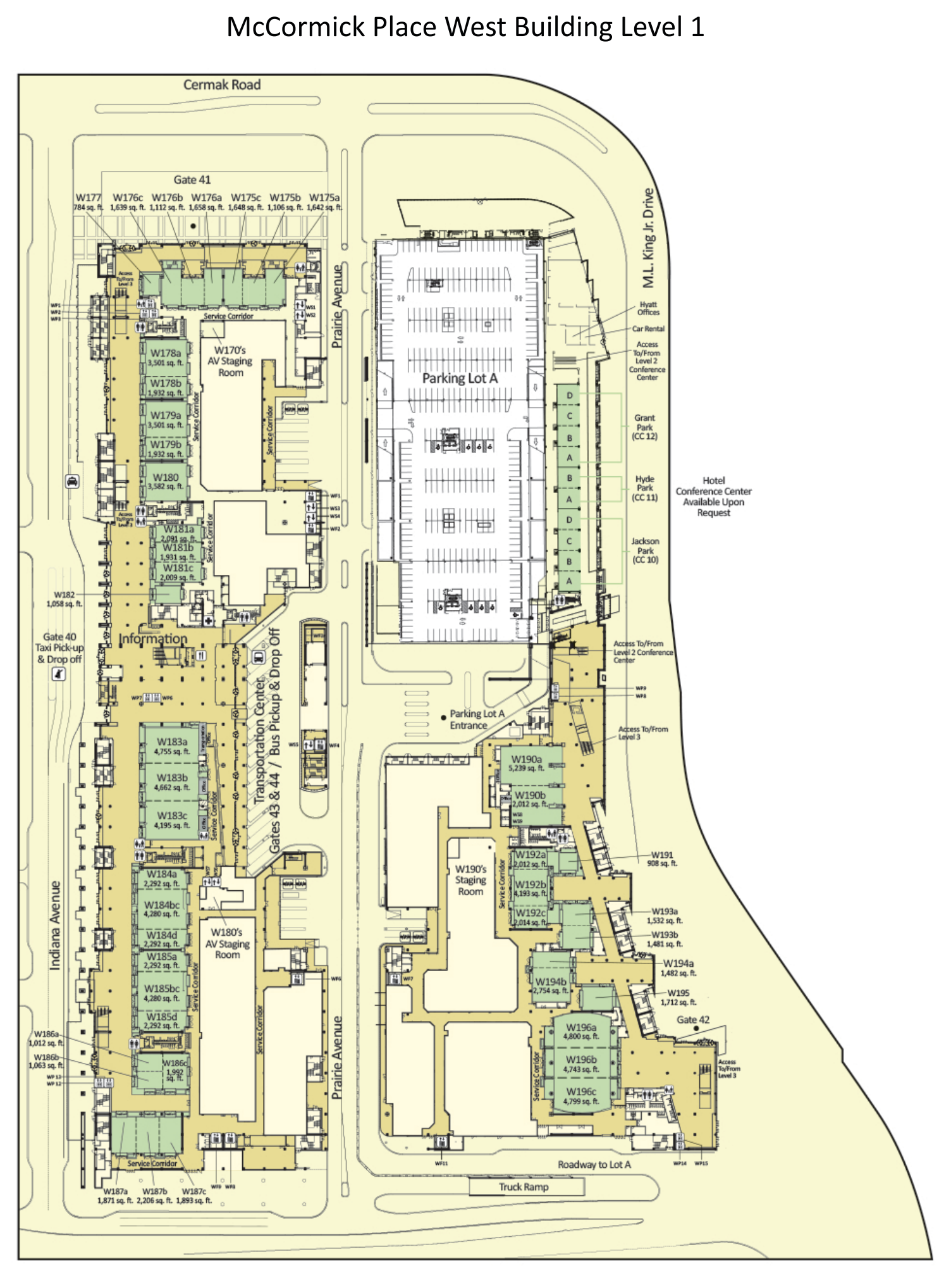
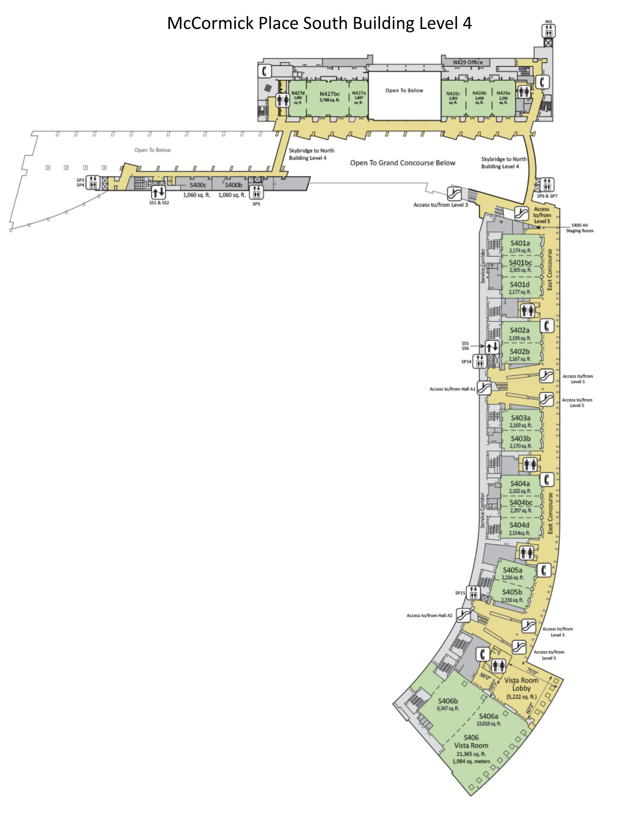
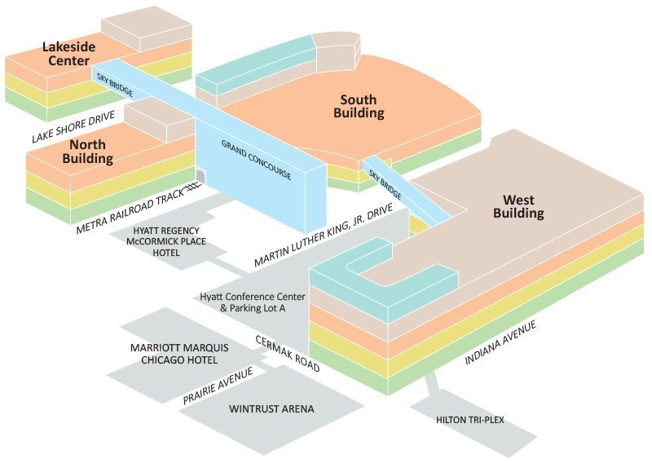

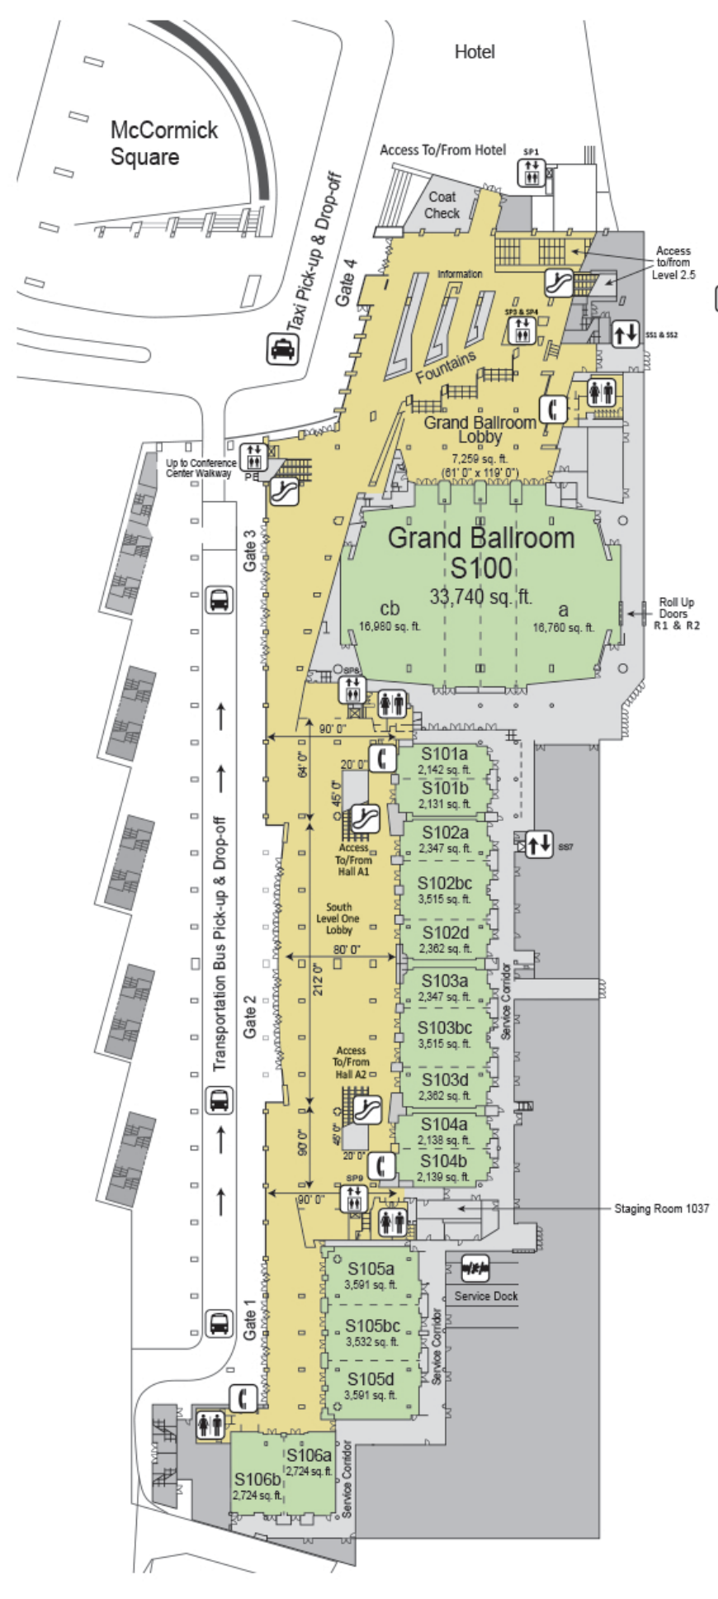
Chicago – Fall 2026 floor plan
South
POLY sessions (4th floor)
Plenary (1st floor)
Membership desk
West
Joint sessions (1st floor)
Poster sessions (3rd floor)

Slide 8
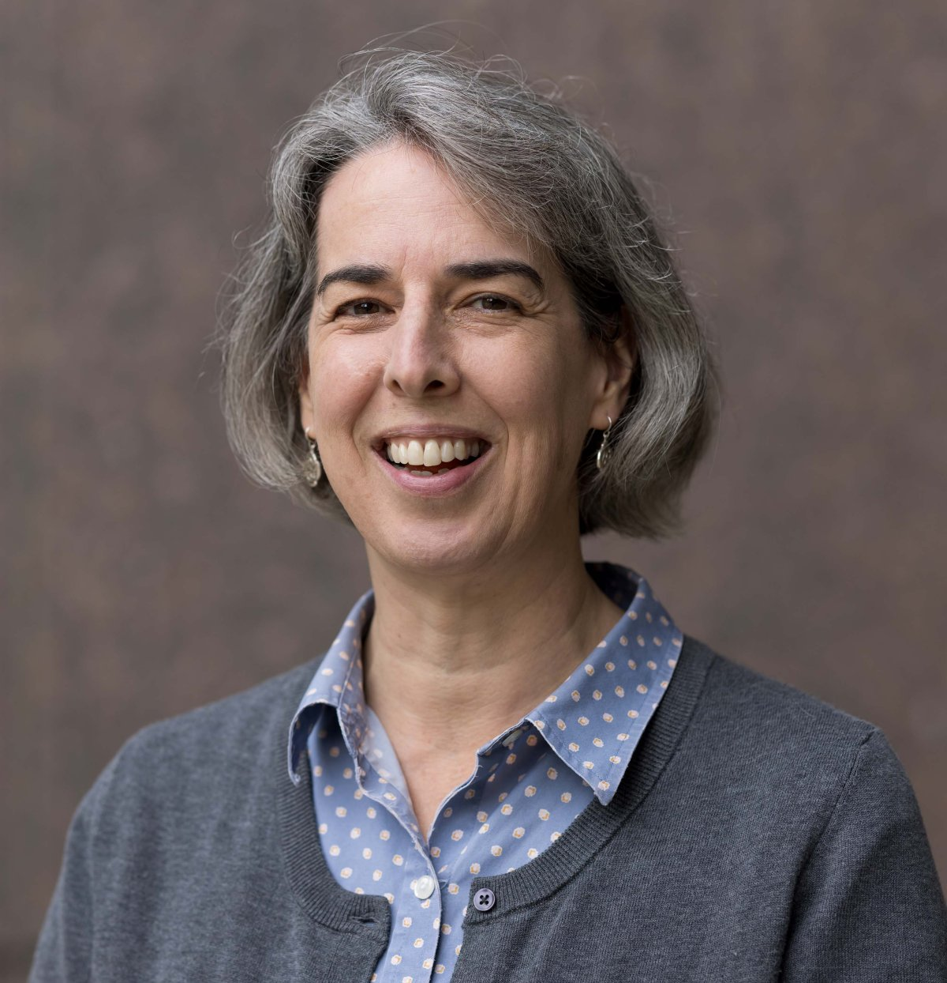
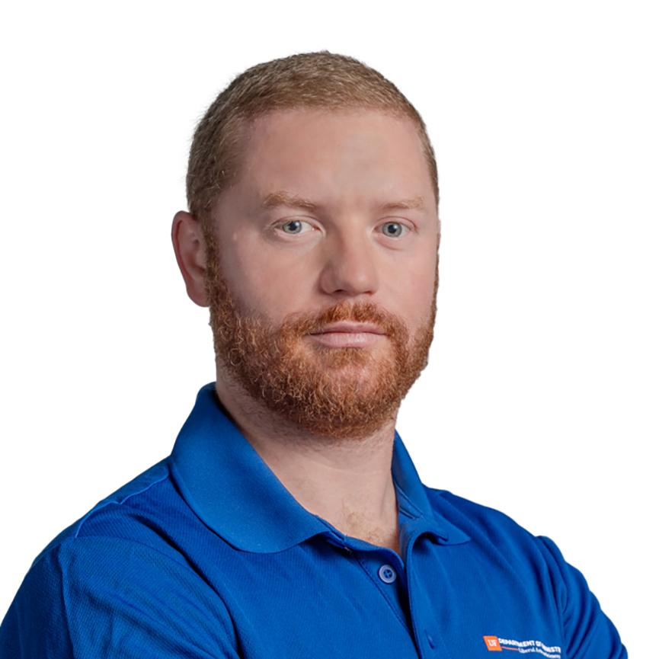
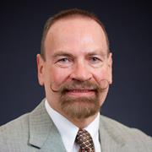
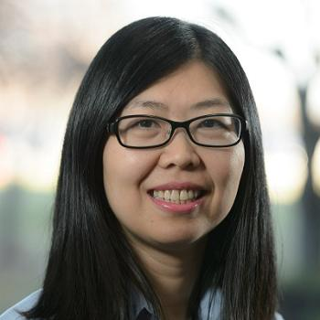

Additional Collaboration for Fall 2026
  Innovative and Featured Sessions involving POLY
    Monday PM: Good Science in Water-Soluble Polymers (W192b)
    Tuesday AM: CME/NASA Symposium (W194b)
    Tuesday AM: In Celebration of 150 Years: Brief Histories of ACS Divisions (W192c)
    Tuesday AM/PM: Advancing a Circular Water Economy (W192b)
    Wednesday AM: Heroes of Chemistry, Evelyn Auyeung, Dow, “Advanced Materials through Catalysis: Polyolefins R&D as an Industrial Chemist”

Slide 10

Relevant Featured Programming
W190b

Slide 11
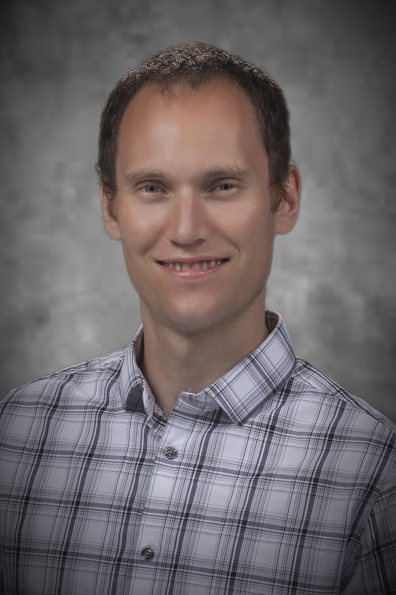
New Orleans – Spring 2027
Joint Symposia
Symposium Title (Co-Organizing Divisions) | Collaborating divisions
POLY-PMSE Student Chapter Organized Symposium | POLY (1), PMSE (1)
Advances in Renewable Materials: Functional Macromolecular Architectures from Sustainable Feedstocks | CELL (3), POLY (4)
Precise Polymers for Targeted Microstructures: Synthesis, Structure, and Application | POLY (3), PMSE (1)
Plastics Recycling and Upcycling | POLY (3), PMSE (2)
Physics of Polymers and Charged Macromolecules: A Symposium in Honor of Professor M. Muthukumar (on his 75th birthday). | POLY (1), PMSE (1)
Modern Organic Methods in Polymer Chemistry | POLY (2) ORGN (1)
Advances in Branched Polymers: From Precision Synthesis and Characterization to Emerging Applications | PMSE (3), POLY (1)
Molecularly Engineered Polymers: Tailored Architectures for Delivery, Therapy, and Imaging | POLY (2), PMSE (2)
Polymers in the Spotlight: Photochemical Tools from Molecular Mechanisms to Manufacturing | POLY (2), PMSE (1)
AI/ML in Chemistry and Polymers: Data, Circularity, and Agentic Systems | POLY (3), I&EC (2), CELL (1)
Incorporating Polymer Science in the Classroom | POLY (1), CHEMED (1)
Microplastics and Nanoplastics in the Environment: Methods, Modeling, Fate, and Toxicity Studies for an Emerging Contaminant | ENVR (2), POLY (1), PMSE (1), TOXI (1)
Addressing Societal Needs through Community-Informed Design of Responsible Chemical Systems | POLY (1), CELL (1), ENVR (1), PMSE (1)
Women Transforming Polymer Science and Engineering: Leadership, Innovation, and Impact (Invited) | PMSE (1), POLY (1)
Notes:
Issue with student chapter symposium—confusion over who the winner is

Slide 12
New Orleans – Spring 2027
POLY Symposia
Symposium Title (Co-Organizing Divisions) | POLY HDS
General Topics | 4
Industrial Innovations in Polymer Science | 2
Undergraduate Research in Polymer Science | 3
Carl S. Marvel Award for Creative Polymer Chemistry Award | 1
Excellence in Polymer Graduate Research | 3
Synthetic and Natural Polymer Biomaterials | 3
Allotted: 44 (6 Joint); Scheduled: POLY 16, Joint 26 (hold 2 for National Awards)

Slide 13
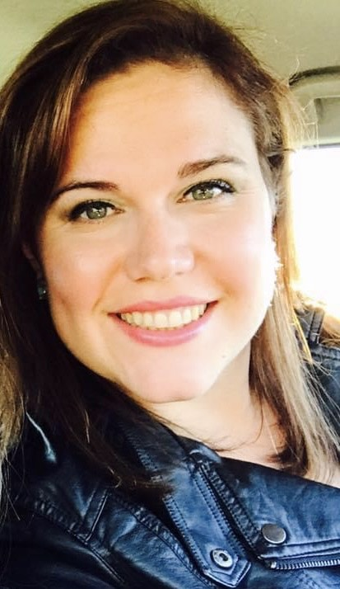
San Diego – Fall 2027
Recruiting Symposia & Organizers!
Symposium Title (Co-Organizing Divisions) | Symposium Organizers | POLY HDS
Industrial Innovations in Polymer Science |  | 1
The Herman Mark Award |  | 1
Overberger International Prize |  | 1
The Young Industrial Polymer Scientist Award |  | 1
Henkel Award for Outstanding Graduate Research in Polymer Science & Engineering |  | 1
ACS Macro Letters/Biomacromolecules/Macromolecules Young Investigator Award |  | 1
General Topics: New Synthesis and Characterization of Polymers |  | TBD
CME/NASA Symposium |  | TBD

Slide 14
San Diego – Fall 2027
Joint Symposia
Symposium Title (Co-Organizing Divisions) | Collaborating divisions | Symposium Organizers
Food packaging (AGFD) | CELL, ENVR, PMSE, POLY, RUBB
Chemistry and Physics of Foams (COLL) | PMSE, POLY
Additives for PFAS Remediation (COLL) | ANYL, CELL, ENVR, I&EC, PMSE, POLY, TOXI
Colloidal Suspensions of Renewable Polymers* | CELL, ENVR, PMSE, POLY
Recruiting Organizers!
Proposed symposia; will be evaluated based on symposium selection rubric
*Carryover from Spring 2027
  Joint symposia proposed during the ACS Leadership Institute
  Seeking POLY co-organizers who can collaborate with other divisions
Notes:
Make a 1-pager advertisement for Carlee/Tayler/Nick to post

Slide 15
Ongoing challenges
  Joint POLY/PMSE poster sessions
    Despite our best efforts, ACS would not do a collocated poster session for POLY/PMSE at the Fall meeting
    We will continue to campaign for collocated poster sessions, but it will depend on the venue and ACS priorities
  General Topics judging
    Challenging to recruit judges and get their scores on time
    We’d like to announce the winners at the Awards & Plenary, but Monday/Tuesday are popular and General Topics sessions get pushed to end of the conference
    Is continuous funding feasible? Or keep the award without money?
    Move responsibility to Awards committee?
  Naming POLY/PMSE chapter awardee before the symposium selection
  Early registration deadline: difficult for many industry/government/international speakers; ACS eventually walked it back
  Future ACS requirement: being a member of a division to present in that division?

Slide 16
2026 Programming Goals
Intentionally plan joint programming
  Maximize POLY impact within smaller ACS footprint
  Develop ideas with other divisions and recruit experienced organizers
  Suggest/contribute to Innovative Programming
Organizer recruiting, outreach, and training
  Develop policies around HDS utilization
  Best practices for abstract rejection/conversion to poster
Elevate poster sessions
  Continue advocating for collocated poster sessions with PMSE
  Fall 2026: Piloting an invited poster session (“POLY/PMSE Heroes of Polymer Science”)
Develop new virtual programming
  Recruit a virtual programming chair
  Use lessons from the pandemic to create engaging virtual programming
  Collaborate with Global Engagement committee
  Fall 2026: Piloting a panel on graduate admissions aimed at international audience, and a Thursday morning session for speakers with last-minute travel cancellations

Slide 17
HDS Allocations
2027 allocations are higher than the previous 2 years!
New ACS formula for determining allocations
  Start with 2 base HDS/division
  Net change by season capped at 20%
  Factors weighted by 25% each, based on average of past 2 years of data:
    Demand (division attendance)
    Utilization (session attendance)
    Quality (oral session rejection rate)
    Collaboration (use of joint session allocation)
Meeting | Total | Joint
Spring 2025 | 53 | 4
Fall 2025 | 36 | 4
Spring 2026 | 41 | 6
Fall 2026 | 37 | 6
Spring 2027 | 44 | 6
Fall 2027 | 42 | 7

Slide 18
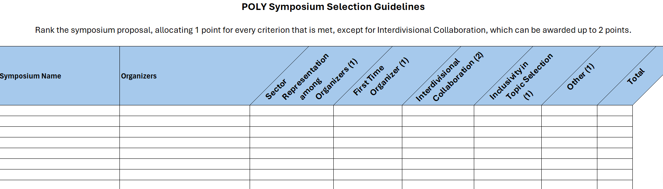
POLY Symposium Selection Guidelines
Used for Fall 2026 and Spring 2027
Overlapping symposia were asked to choose between moving to future meeting, combining, or differentiating

Slide 19
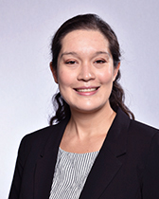
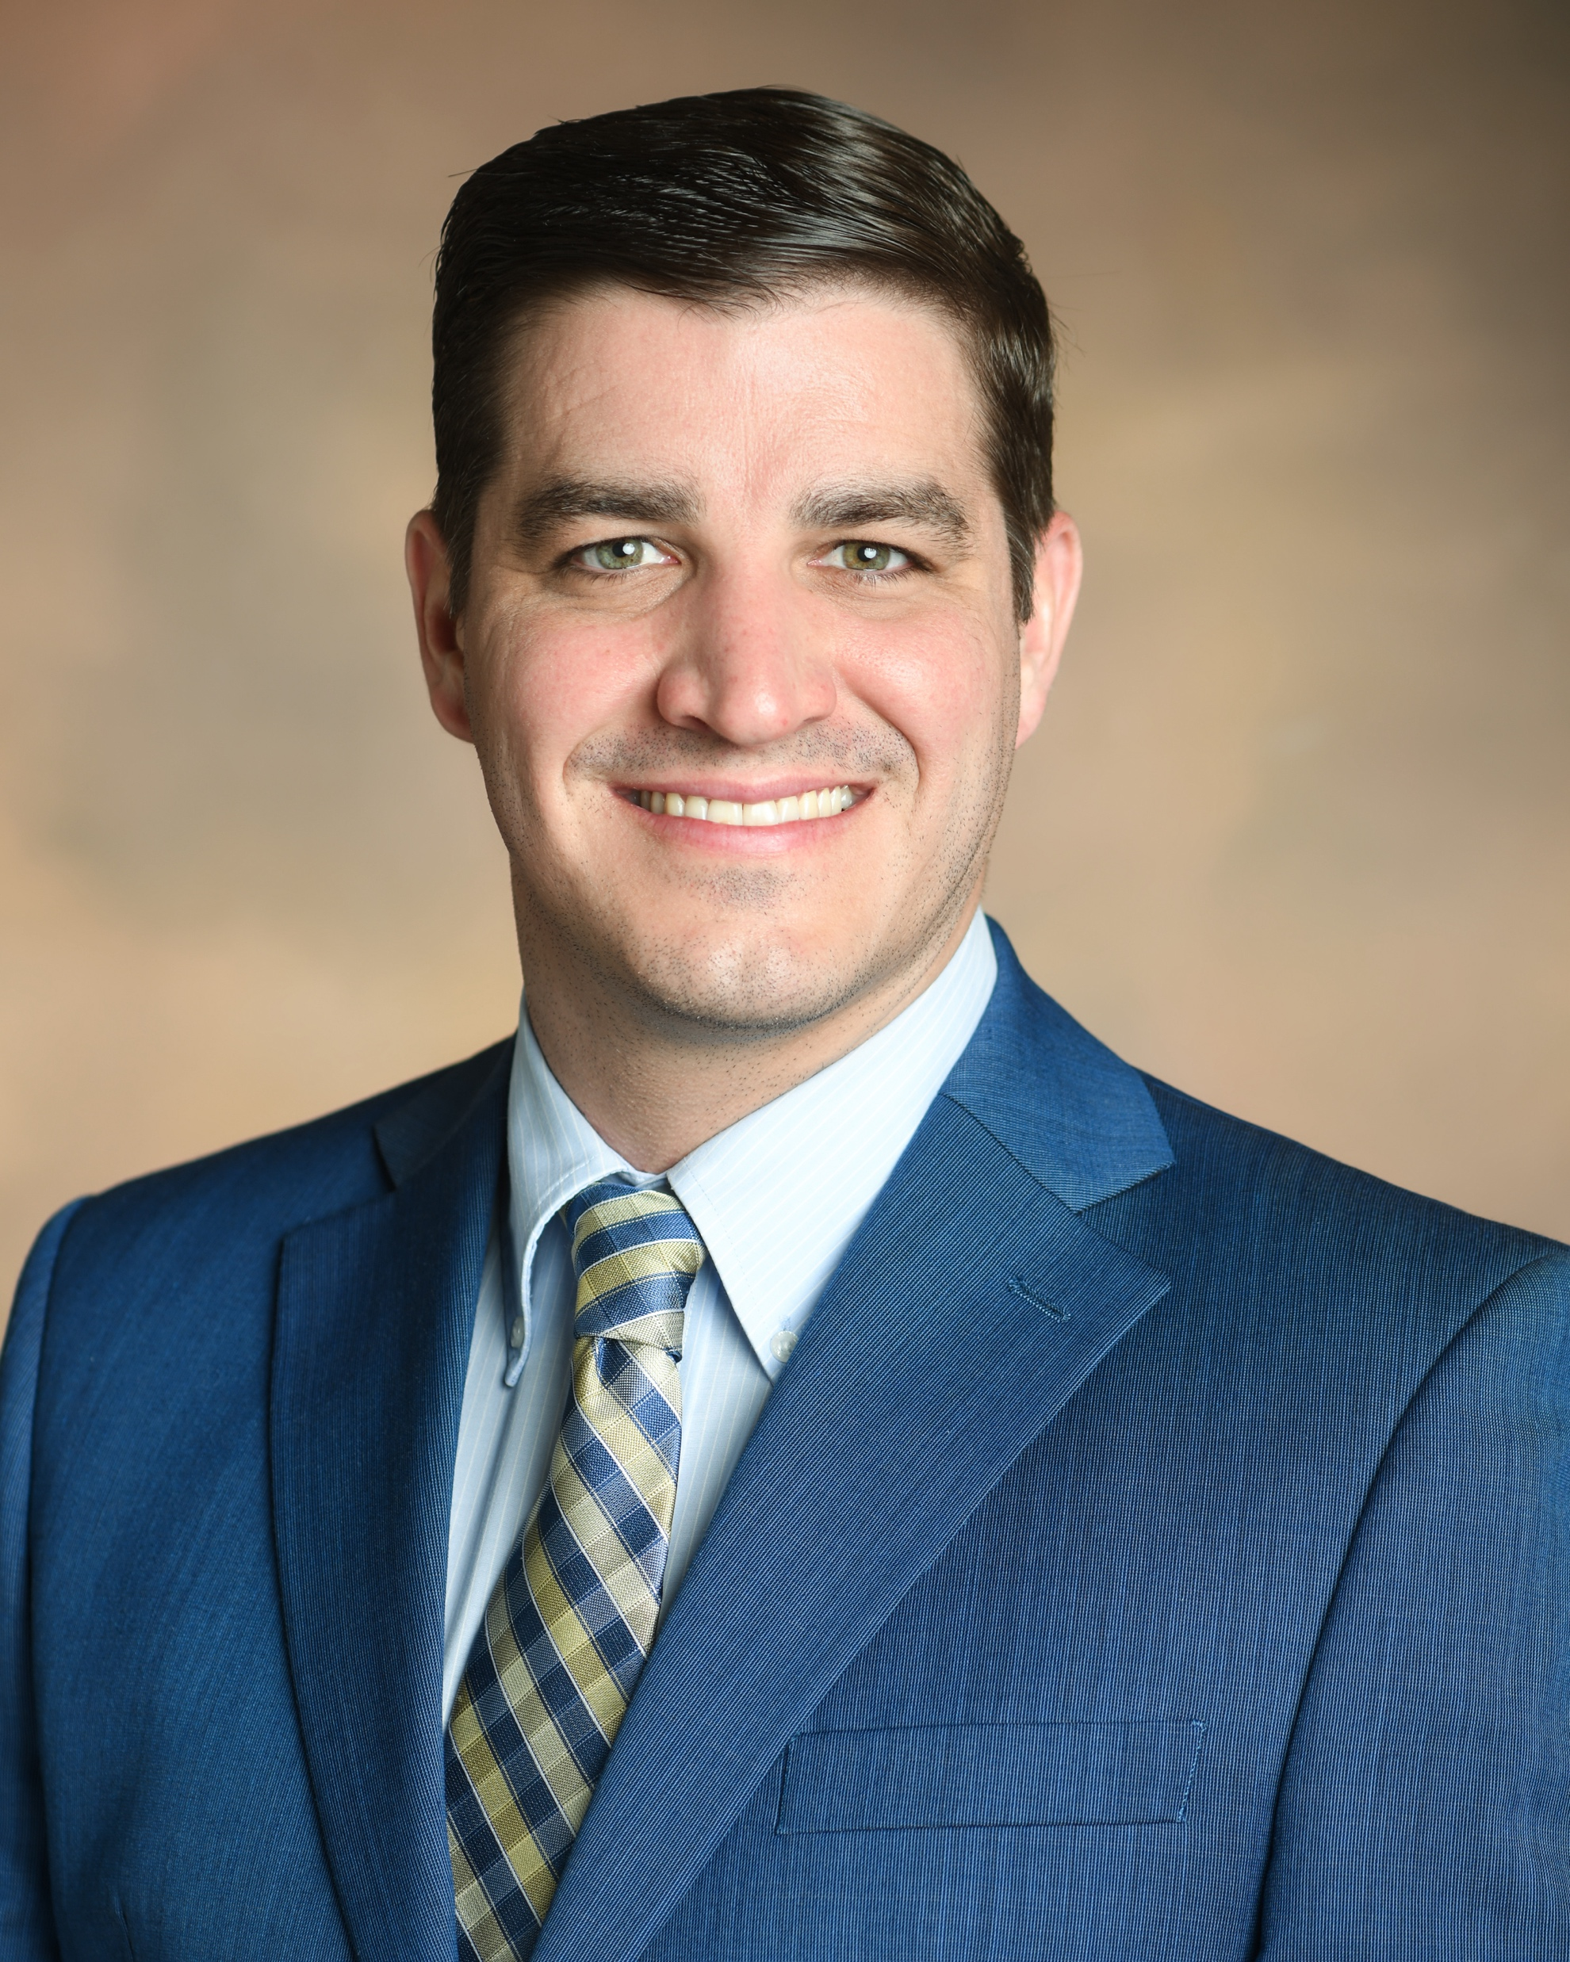
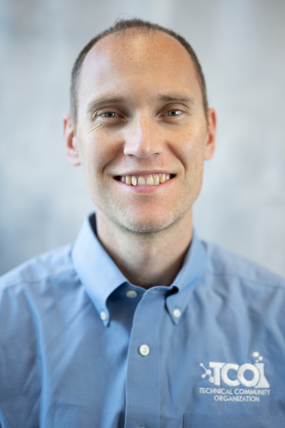
POLY Programming Team Rotation
Date (Location) | Julia Kalow Northwestern | Graham Collier Southern Miss | Alice Savage Aerospace | Michael Petr Dow | TBN Government?
Spring 2025 (San Diego) | LEAD | SUPPORT | SHADOW
Fall 2025 (DC) | SUPPORT | LEAD | SUPPORT
Spring 2026 (Atlanta) | SUPPORT/CHAIR | SUPPORT | LEAD | SHADOW
Fall 2026 (Chicago) | LEAD/CHAIR | SUPPORT | SUPPORT | SUPPORT
Spring 2027 (New Orleans) | SUPPORT | SUPPORT/CHAIR | SUPPORT | LEAD | SHADOW
Fall 2027 (San Diego) | SUPPORT | CHAIR | LEAD | SUPPORT | SUPPORT
Spring 2028 (Houston) | CONSULT | LEAD | CHAIR | SUPPORT | SUPPORT
Fall 2028 (TBN) |  | CONSULT | SUPPORT/CHAIR | SUPPORT | LEAD

Slide 20
Team Composition
Balance of industry/academia/government
  Julia will complete her term at the end of 2027
  New programming chair named by Derek
  POLY Program Committee Chair Rotation:
    2026 – Julia
    2027 – Graham
    2028 – Alice
    2029 - Michael

Slide 21
Thank you!
Any questions?
Notes:
PMSE same as us; Org up to $4K and works out to the same; Coll - Info from Allan

Slide 22
Back Up Slides

Slide 23
New/Continuing Initiatives
Knowledge continuity in business office/ program chair liaison (Thanks Kathy!) & with ExComm (2026, Hayley Brown)
Continuing – Programming event to thank current organizers, reporting out on Programming, and recruiting new organizers
  Recognition paths
  Reporting paths
  Recruitment paths
Continuing – Revising Programming Best Practices (In progress)
Continuing – Discussions & initiatives regarding DEIR in POLY Programming
Continuing – Symposia Selection Guidelines Implementation with amendments as needed (2025 Focus)
New! – Virtual Programming Chair & Program Development (2026 Focus)

Slide 24
Historical Contributions
Philadelphia 2020- cancelled, Spring 2021 Virtual meeting did not collect division-level stats.

Slide 25
POLY Programming Workshop
Discussion Phase: gather best practices of several past program chairs (PC)
Questions discussed at workshop:
  What works well in POLY programming?
  What can be improved? What’s not working?
  What are some ideas you have that would help POLY innovate with regards to programming?
  What would have been helpful for you to know as a new program chair that you’d want to share with future program chairs?
  What were some of the best technical symposia that you programmed? Why were they successful?
  What have you observed makes the community eager to present in POLY? What helps motivate you to present? What helps students and early career chemists present?
  Special topic on innovation within general topics symposia
Findings and best practices will be summarized in growing POLY Program Chair Guidebook - an ongoing document summarizing findings of workshop and addition input by champions

Slide 26
Voting Items & Items for Evaluation
  (Voting) Organizer recognition/retention proposals:
    Continuing Resolution on proposal to continue to produce and distribute “POLY National Meeting Symposium Organizer” recognition pins and organizational “care packages” to organizers as a method of recognition and retention
  (Consideration) Programming Recruitment Funding: With a reduced meeting footprint, what is the appropriate level of financial support?
      For pins, bags/supplies, and postage
      Coffee/happy hour programming meetings to recruit organizers
        ACS foresees virtual component to meetings long-term
Notes:
$12k penciled into Christine’s budget
(no postage if in person, )

