Slide 1
POLY Webinar Update
Bob Lambeth, Tomonori Saito, Brent Sumerlin, Rebecca Olson Short,
August 23, 2026

Slide 2
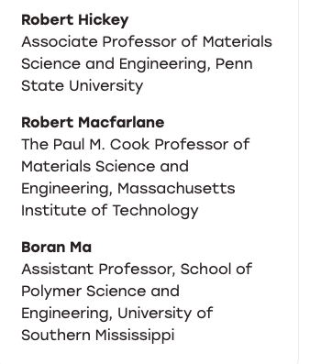
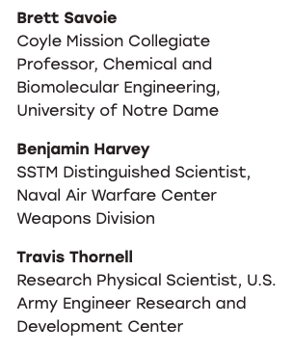


POLY Webinars: 2026
Polymer Nanocomposites
3/4/2026
High Performance Polymer Design: AI Meets Sustainable Materials 6/26/2026
Inverse Vulcanization and Functional Organopolysulfides 9/24/2026
Jeffrey Pyun
University of Arizona
Justin Chalker
Flinders University
Neil Dolinski
Columbia

Slide 3
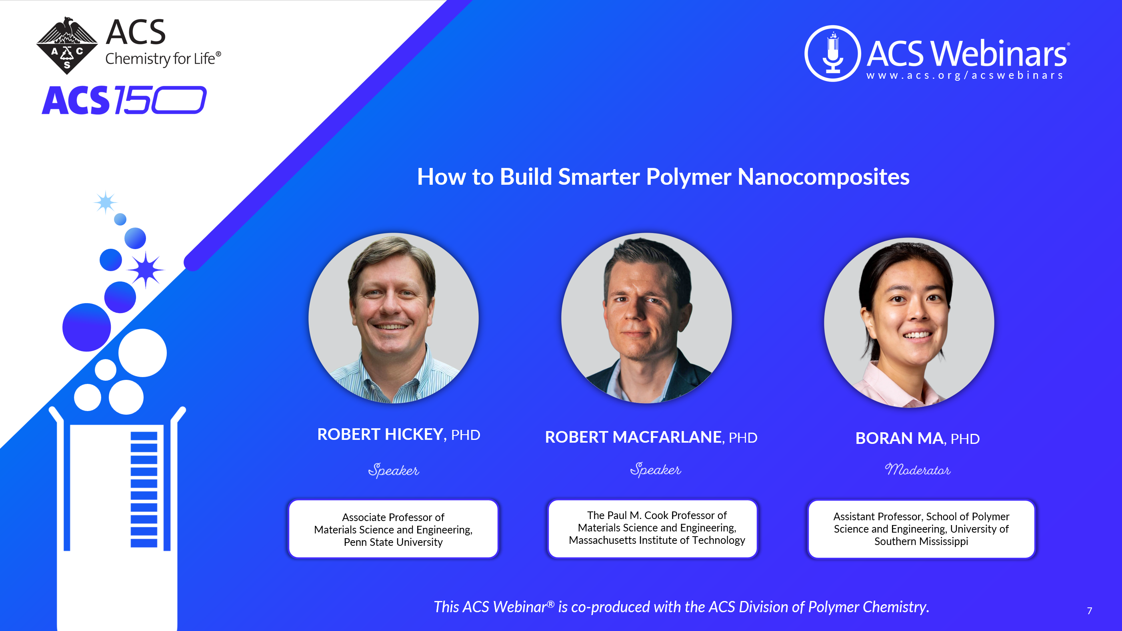
3/4/2026

Slide 4
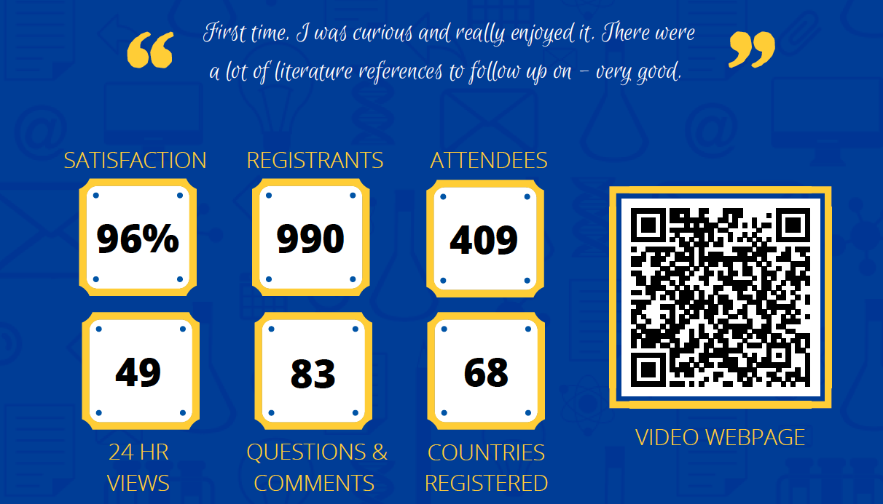
Statistics
POLY Leads
223

Slide 5
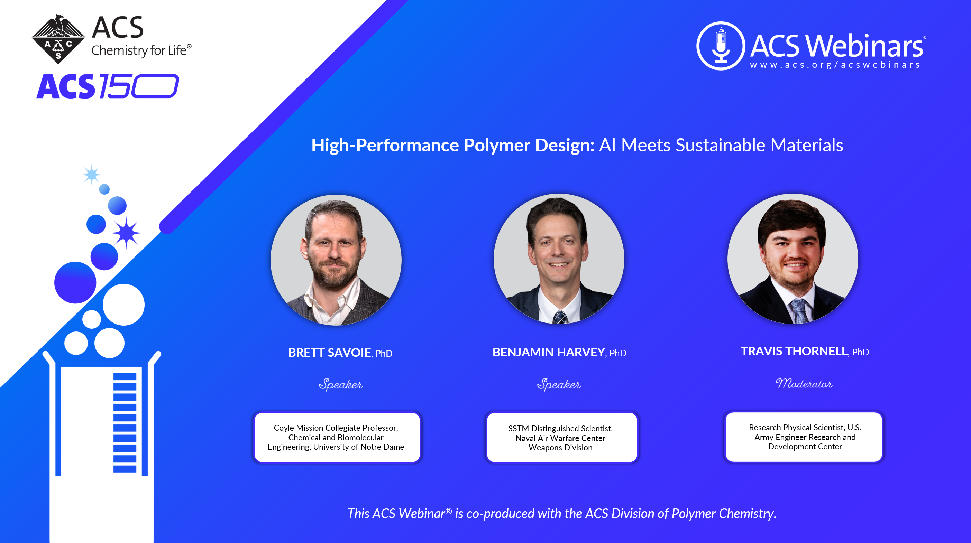
6/26/2026

Slide 6
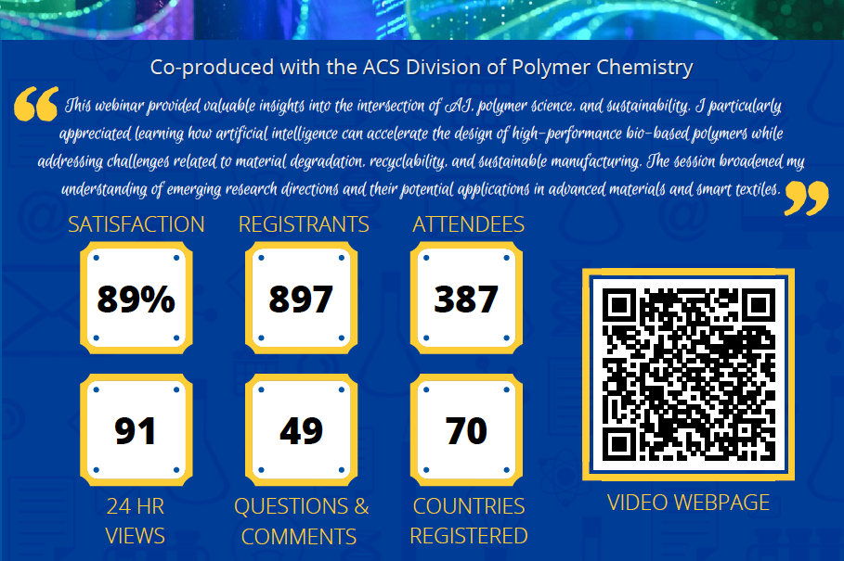
Statistics
POLY Leads
277

Slide 7
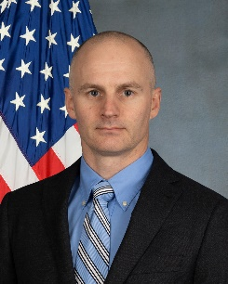
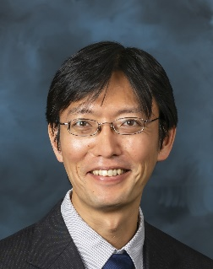

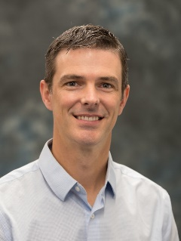
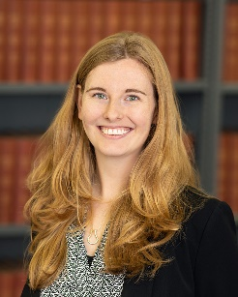
POLY Webinar Committee
Future Webinars
Please send your ideas and feedback to any of us.
Bob Lambeth (chair), DEVCOM Army Research Office robert.h.lambeth2.civ@army.mil
Tomonori Saito, Oak Ridge National Laboratory saitot@ornl.gov
Brent Sumerlin, University of Florida sumerlin@chem.ufl.edu
Rebecca Olson Short, PPG RAShort@PPG.com

