Slide 1
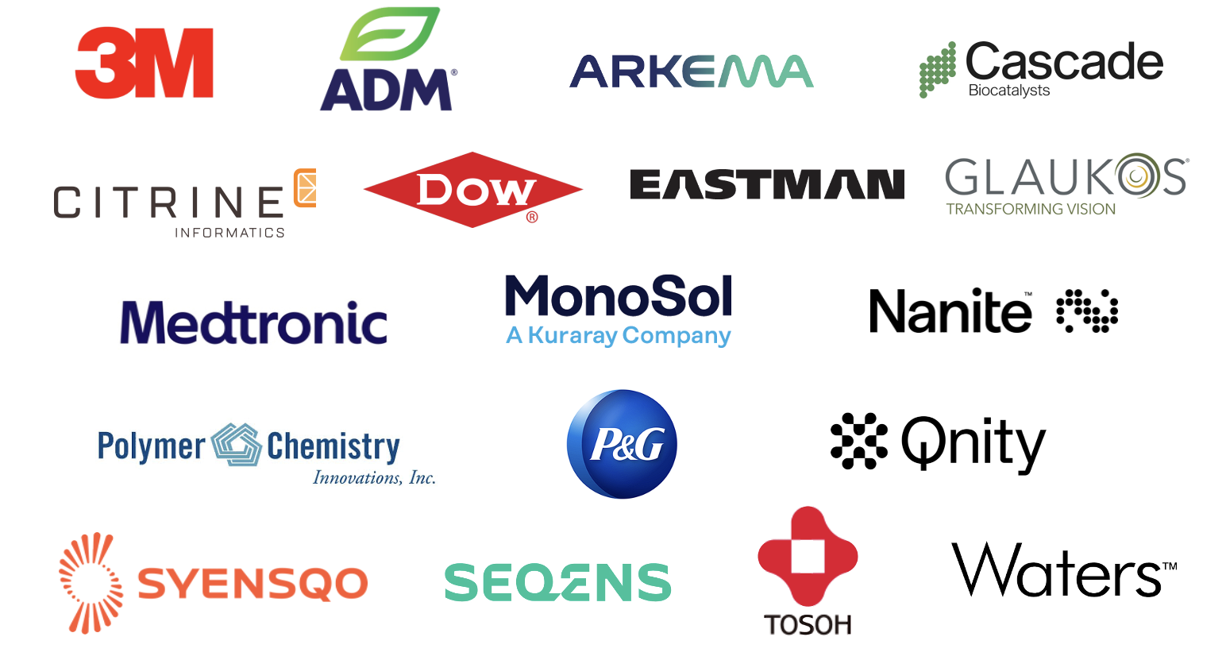

Annual dues: $1,500
Small company dues: $500
Chair: Mike Sims
Co-Chair: Kapil Dev Sayala (SEQENS)
“Enhance and foster industrial engagement and support to develop programming, education, recognition & awards within the ACS Division of Polymer Chemistry.”

Slide 2
IAB Focuses for 2026
Maintain programming & awards support
Deliver on member company initiatives
  IAB Networking Sessions
  IAB Meetings
Integrate smaller company members
Support local events
Create opportunities for IAB membership value

Slide 3
Fall 2026 IAB programming at-a-glance
Monday AM
Industrial Innovations in Polymer Science symposium, S401bc
Monday PM
Industrial Polymer Scientist Award in honor of Kim Chaffin, S401bc
Tuesday AM
IAB Business Meeting, Brûlée, 8 am
Celebrating 150 Years of Industry-Academia Collaboration symposium, W193a
Tuesday PM
Celebrating 150 Years of Industry-Academia Collaboration symposium, W193a
IAB Networking Reception (co-hosted with the 150 Years symposium), VU Rooftop, 5:30 pm – 7:30 pm

Slide 4
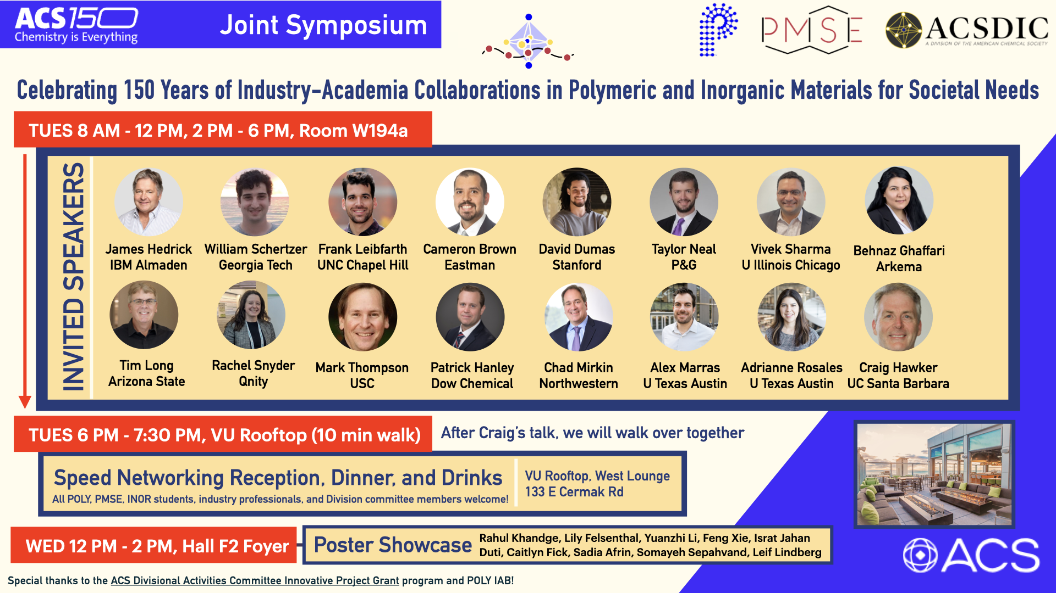
Fall 2026 Programming Highlights

Slide 5
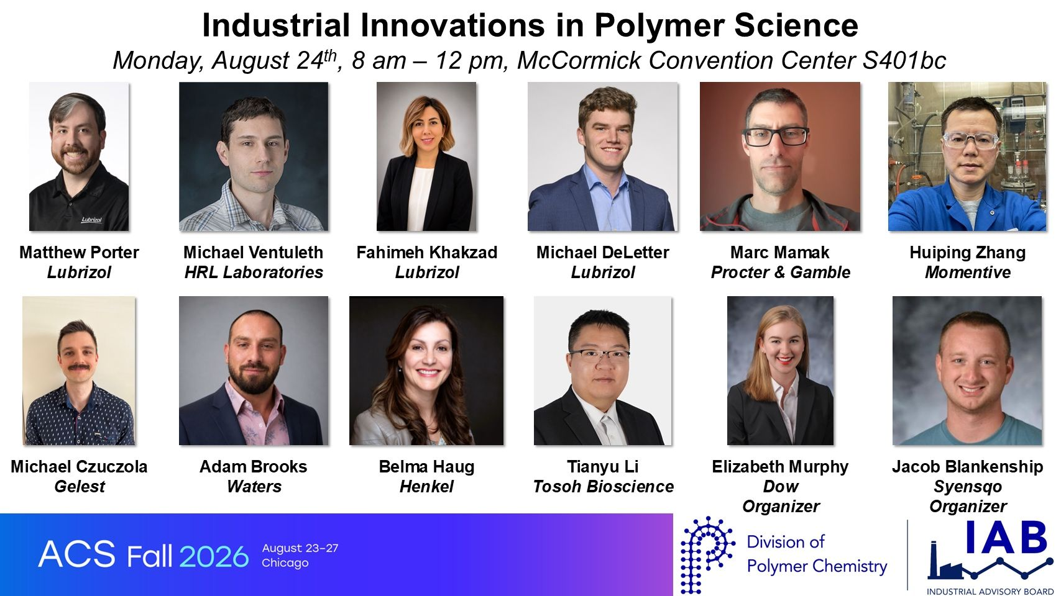
Fall 2026 Programming Highlights

Slide 6
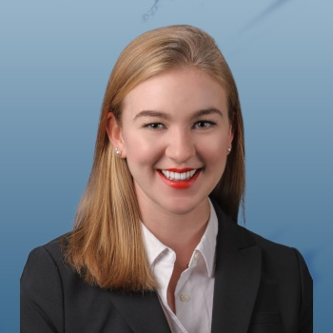

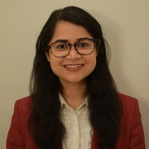
New structure for IIPS organizing
Goal: permanently solve prior challenges with IIPS organizing, and create new opportunities for IAB member involvement
New system: Yearly rotation of 3 IIPS organizers – One former organizer, IAB co-chair, one new organizer
2027 IIPS Organizers
Elizabeth Murphy
Dow
Joe Hassler
Medtronic
Mayuri Porwal
Qnity

Slide 7
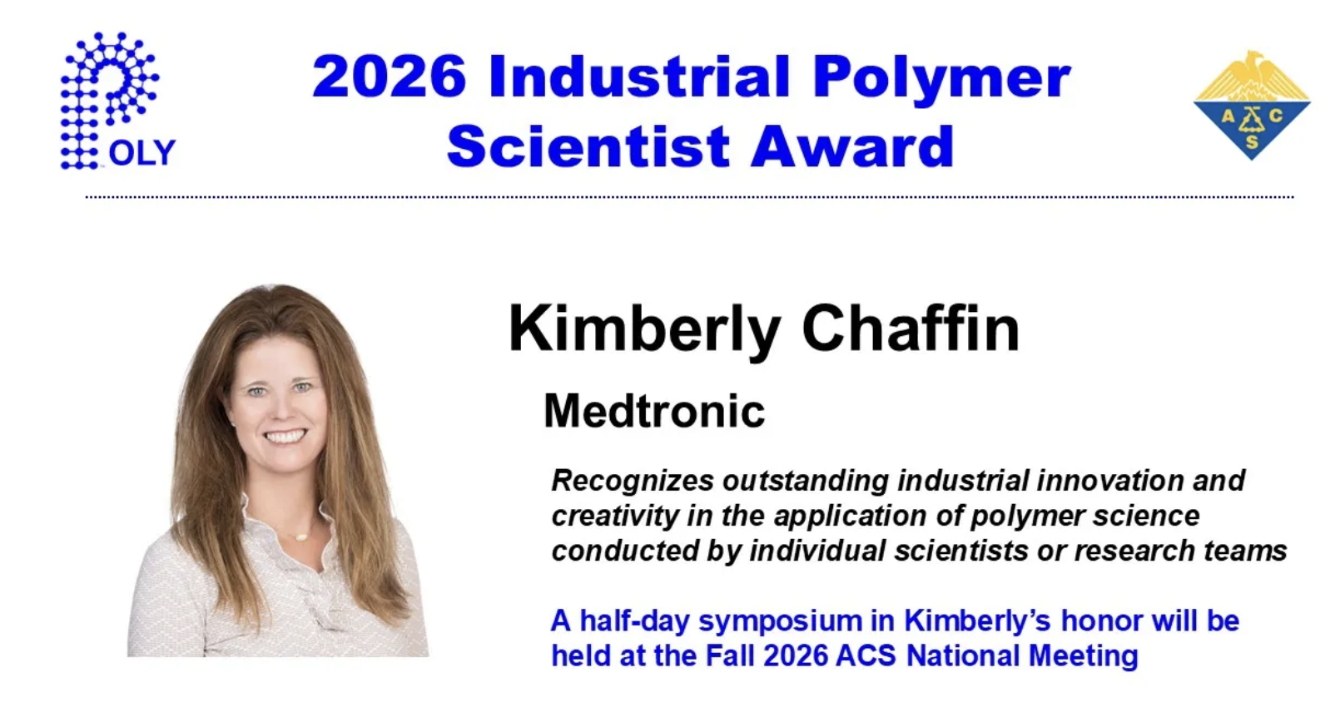
Award Spotlight

Slide 8
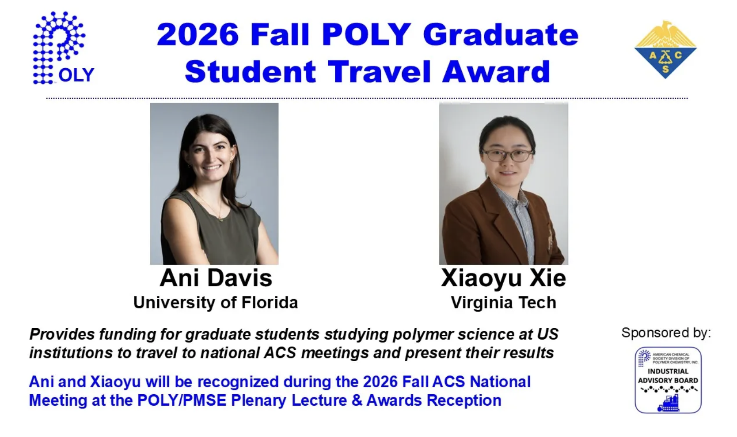
Award Spotlight

Slide 9
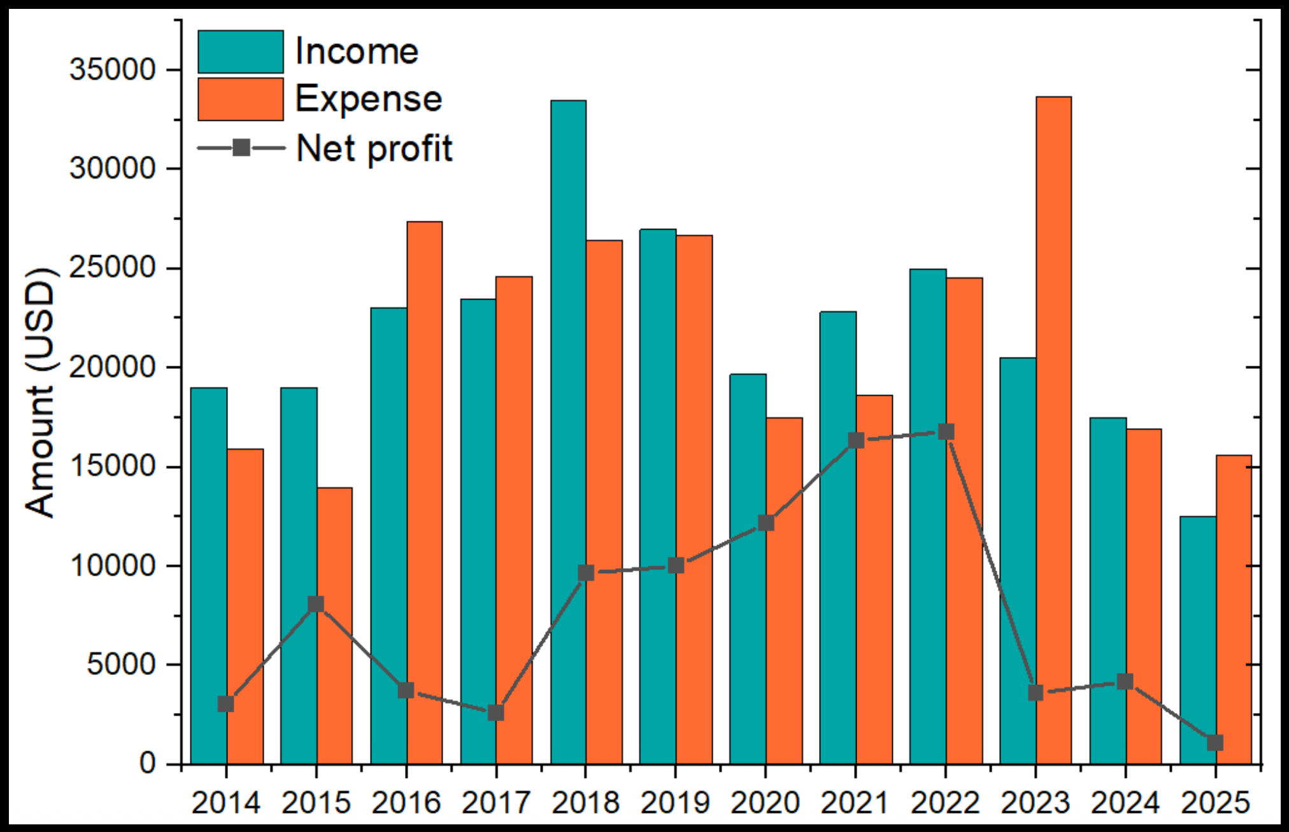
IAB Budget Overview

Slide 10

IAB sponsored activity: NESACS meeting

Slide 11
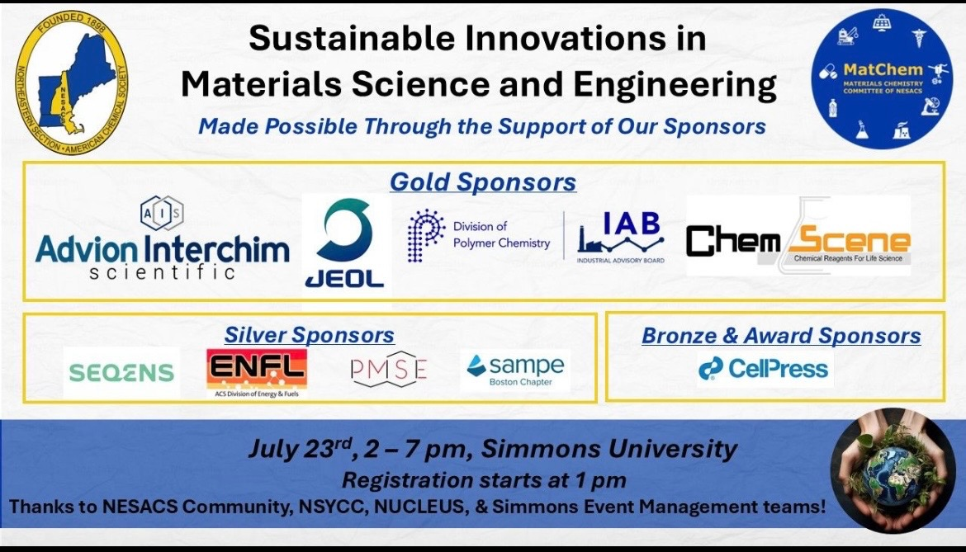
IAB sponsored activity: NESACS meeting

Slide 12
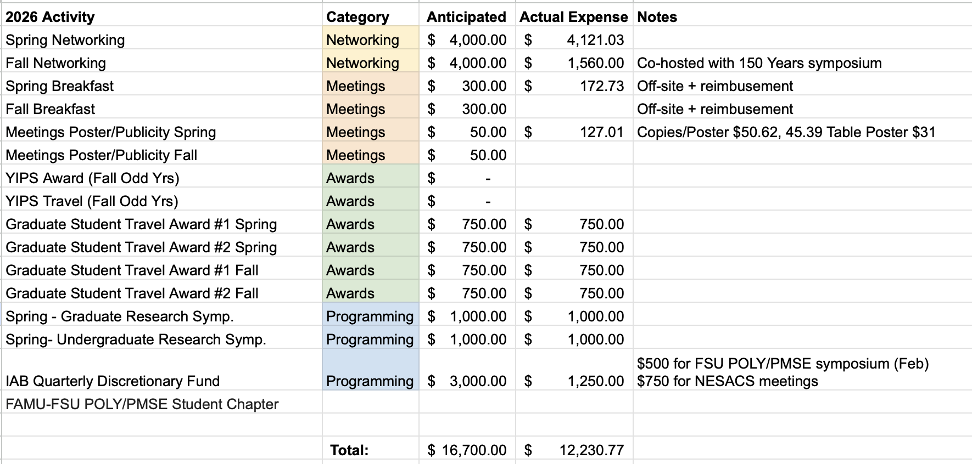
2026 IAB Budget Summary
vs $12,000 received in 2026 (with some outstanding)

Slide 13
Thank you
Industrial Advisory Board

